Slide 1
Adversarial Deletion Attacks on
Approximate Graph Unlearning
Thesis
Deletion interfaces in approximate graph unlearning can be exploited to amplify approximation error, and fragility differs sharply across method families.
The inheritance of safety behavior within graph unlearning families
EE5003 MSc Project Report
National University of Singapore
Problem
Method
Liu Chengyu
Examiner: Prof. Wu and Wang
April 2026
Results
Takeaway
Notes:
Key Lines:
- This project audits approximate graph unlearning under adversarial deletion requests.
- The question is whether a malicious requester can choose deletions that amplify approximation error.
- The answer depends strongly on the unlearning family.
Speaker Notes:
Good afternoon. I am Liu Chengyu, and this presentation summarizes my EE5003 MSc project on adversarial deletion attacks against approximate graph unlearning. The core question is whether a deletion interface can be exploited by choosing nodes whose removal causes much more damage than a normal request should. I study this problem across several graph unlearning families, build an evaluation workflow on top of OpenGU, and show that these methods do not inherit safety behavior equally.

Slide 2
Why Graph Unlearning Matters
02 / 15
Deletion requests are operationally plausible, and approximation turns them into a security question.
Real deletion requests
Approximate
unlearning
Attack surface
User-level or node-level removal is realistic in citation, social, and recommendation graphs.
Exact retraining is expensive, so practical systems use approximation.
A malicious requester may exploit the deletion interface itself by choosing harmful targets.
Delete
Compliance tool and attack interface
EE5003 MSc Project | Liu Chengyu
Approximate Graph Unlearning Audit
Notes:
Key Lines:
- Graph models are used in settings where deletion requests are realistic.
- Approximate unlearning is attractive because exact retraining is expensive.
- That same approximation creates a security surface.
Speaker Notes:
Graph unlearning matters because graph neural networks are used in citation, recommendation, and social systems where node-level removal is a realistic requirement. In practice, exact retraining after every deletion request is often too expensive, so approximate unlearning methods are attractive. But approximation also creates risk. If the retained model only approximates the effect of deletion, then a malicious requester may exploit the deletion interface itself by choosing nodes that maximize retained-model damage. So the deletion API is not only a compliance mechanism; it can also become an attack interface.

Slide 3
Research Question And Objectives
03 / 15
Research question
Can malicious deletion requests amplify approximation error and degrade retained-model utility beyond ordinary deletion at the same budget?
Objective 1
Objective 2
Build an attack pipeline with multiple deletion strategies.
Compare vulnerability across method families, not just one algorithm.
Objective 3
Objective 4
Add attribution metrics for collateral and retrain gap.
Measure whether adversarial node selection is practically efficient.
EE5003 MSc Project | Liu Chengyu
Approximate Graph Unlearning Audit
Notes:
Key Lines:
- Can malicious deletion requests degrade utility beyond ordinary deletion at the same budget?
- Compare method families, not just one algorithm.
- Add attribution metrics and practicality analysis.
Speaker Notes:
The main research question is whether malicious deletion requests can amplify approximation error and degrade retained-model utility beyond what ordinary deletion would cause at the same budget. I organized the project around four objectives. First, build an attack pipeline with multiple deletion strategies. Second, compare vulnerability across different graph unlearning families. Third, introduce attribution metrics that separate true deletion impact from approximation-induced spillover. And fourth, test whether adversarial node selection is efficient enough to be practically relevant rather than only conceptually possible.

Slide 4
Method Families And Threat Model
04 / 15
Families under test
Learning-based
Threat model
Learn a direct unlearning correction; GNNDelete is the fragile representative here.
Attacker capability: choose which nodes to delete through the normal interface.
Out of scope: poisoning labels, features, or hidden training code.
Target: maximize post-unlearning utility loss beyond random deletion.
IF-based
Approximate deletion through local influence-style updates; GIF stays comparatively stable.
Shard-based
ΔF1
Gap
26.2%
Partition the graph and retrain affected shards; GraphEraser behaves differently in the tested settings.
attack-over-random
vs exact retrain
non-target changes
EE5003 MSc Project | Liu Chengyu
Approximate Graph Unlearning Audit
Notes:
Key Lines:
- The study covers learning-based, IF-based, and shard-based unlearning.
- These families differ in mechanism, so family-level robustness may differ too.
- The attacker controls only the deletion request.
Speaker Notes:
The evaluation spans several unlearning families. Learning-based unlearning is represented by GNNDelete, which learns a direct unlearning correction. Influence-function-based unlearning is represented by GIF, which approximates deletion through local influence-style updates. The broader benchmark also includes IDEA, MEGU, and the shard-based GraphEraser, which partitions the graph and retrains affected shards. I make this distinction early because the mechanisms are genuinely different, so it would be surprising if they all inherited the same robustness behavior. The threat model is deliberately practical. The attacker can choose which nodes to delete through the normal interface, but does not modify labels, features, optimizer settings, or hidden training code. This is not a poisoning attack. I also track collateral damage on retained nodes.

Slide 5
Attack Pipeline And Experimental Matrix
05 / 15
The workflow compares approximate unlearning against an exact-retrain control on the same deletion set.
1
Select nodes
Experimental matrix
Use random or structured attack targets.
Methods: 5
Datasets: 2 citation graphs
Backbones: 3 GNN architectures
Strategies: 6 node-selection methods
Runs: 950 experiment executions
Outputs: relative_f1_drop, retrain_gap, collateral damage, and efficiency.
2
Apply unlearning
Run the selected graph unlearning method.
3
Exact retrain control
Retrain on the same deletions for the gold-standard reference.
4
Compare outcomes
Read utility loss, retrain gap, and collateral damage.
EE5003 MSc Project | Liu Chengyu
Approximate Graph Unlearning Audit
Notes:
Key Lines:
- The pipeline is select nodes, unlearn, exact retrain, and compare.
- Structured attacks include TracIn, IM, and Hybrid.
- The final matrix covers 5 methods, 2 datasets, 3 backbones, 6 strategies, and 950 runs.
Speaker Notes:
The workflow has four steps. First, select deletion targets, either randomly or with a structured strategy such as TracIn, IM, or Hybrid. Second, apply the chosen graph unlearning method. Third, run an exact retrain control on the same deletion set. This shows what the post-deletion model should ideally look like without approximation error. Fourth, compare the main outputs: relative F1 drop, retrain gap, collateral effects, and efficiency. Up to now, The completed evaluation covers five unlearning methods, two citation-graph datasets, three GNN backbones, six node-selection strategies, and 950 total runs.

Slide 6
Attack Selection Logic
06 / 15
The attack is not only about how many nodes are deleted, but about what logic is used to choose them.
TracIn / IF-style
IM
Hybrid
Model-aware logic.
Pick nodes with high training influence on the learned model.
Shorthand: score(v) ≈ I_train(v)
Graph-structural logic.
Pick nodes that maximize spread or disruption in the graph.
Shorthand: score(S) = spread(S)
Combine model-side influence with topology-side spread to search for stronger targets.
Shorthand: score(v) = α·z_IF(v) + (1-α)·z_IM(v)
Reading rule
Read these formulas only as intuition. The benchmark compares attacker logics: model-aware selection, graph-structural selection, and a hybrid of the two.
EE5003 MSc Project | Liu Chengyu
Approximate Graph Unlearning Audit
Notes:
Key Lines:
- TracIn or IF-style selection is model-aware.
- IM is graph-structural and aims at spread or disruption.
- Hybrid combines model-side influence with topology-side spread.
- The later comparison is mainly among these informed selectors, not against random.
Speaker Notes:
Before defining the metrics, I want to clarify what the attack strategies are actually doing. These are not just arbitrary labels. TracIn, or more broadly IF-style logic, is model-aware: it tries to pick nodes with high training influence on the learned model. IM is graph-structural: it tries to pick nodes that maximize spread or disruption in the graph itself. Hybrid combines both signals. I put a small formula on the slide, but it is only there as shorthand intuition, not something I need the audience to parse line by line. This matters because the more interesting strategy comparison later is mainly among these informed selectors themselves: IF-style selection, IM, and Hybrid, rather than simply asking whether any one of them beats a naive baseline.

Slide 7
Metrics Framework
07 / 15
Three metrics answer three different questions: how much extra damage appears beyond a k=5 baseline, where it comes from, and how far it spreads.
Utility
Fidelity
Collateral
relative_f1_drop = F1_after(k=5, random) - F1_after(attack)
Use a tiny random-trigger baseline because raw drop can mislead on shard-based methods.
retrain_gap = F1_retrain - F1_unlearn
total_drop = drop_retrain + retrain_gap
fraction_flipped
mean_pred_shift
These show how strongly retained nodes are disturbed.
Reading rule
First trigger each method with a tiny random deletion, k=5, and use that post-unlearning F1 as the reference point. Then compare stronger attacks against that baseline; retrain_gap and collateral metrics explain why the utility changes appear.
EE5003 MSc Project | Liu Chengyu
Approximate Graph Unlearning Audit
Notes:
Key Lines:
- `relative_f1_drop = F1_after(k=5, random) - F1_after(attack)`.
- Use a tiny random-trigger baseline because raw utility drop can be misleading for shard-based methods.
- `retrain_gap` and collateral metrics explain where the degradation comes from.
Speaker Notes:
Before showing the main results, I want to define the metrics clearly. The main utility metric is relative F1 drop, but the important design choice is the reference point. Instead of relying only on raw F1 before minus F1 after, I first trigger each method with a very small random deletion, k equals 5, and use that post-unlearning F1 as the baseline. This matters because shard-based methods such as GraphEraser can show method-induced score shifts after deletion, so raw drop alone can be misleading. Relative F1 drop therefore measures extra damage beyond that small-trigger baseline. To explain why a method degrades, I then use retrain gap and collateral metrics. Retrain gap compares approximate unlearning against exact retraining on the same deletion set, and collateral metrics track how much the retained nodes are disturbed.

Slide 8
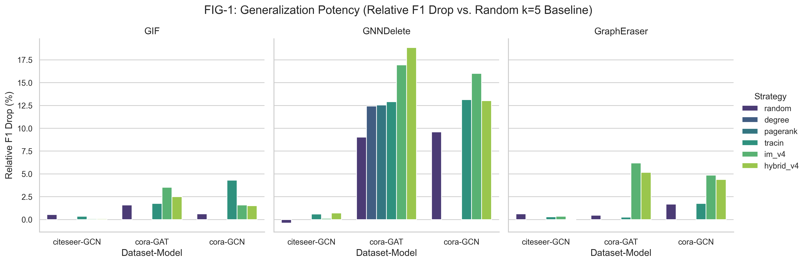
Main Finding: Family Spectrum
08 / 15
Core read
Relative_f1_drop reveals a family-level vulnerability spectrum rather than one shared failure pattern.
Family readout
GNNDelete highest.
GIF comparatively stable.
GraphEraser shows shard protection.
Figure 1. Family-level spectrum using relative F1 drop at ratio = 0.05.
EE5003 MSc Project | Liu Chengyu
Approximate Graph Unlearning Audit
Notes:
Key Lines:
- Relative F1 drop reveals a clear family-level vulnerability spectrum.
- GNNDelete is the most fragile representative in the tested settings.
- GIF stays comparatively stable, while GraphEraser shows shard protection.
Speaker Notes:
This is the main result of the project. When I compare relative F1 drop across datasets and backbones at the same deletion ratio, I do not see one shared failure pattern. Instead, I see a clear vulnerability spectrum across graph unlearning families. GNNDelete is consistently the most fragile representative. GIF remains comparatively stable, with much smaller extra drops beyond the k equals 5 baseline. GraphEraser behaves qualitatively differently again: because raw utility change can be negative, the relative metric is the cleaner way to compare it against the other families. In the tested settings, GraphEraser shows a shard protection pattern rather than the expected collapse. So the broader takeaway from this page is that robustness is mechanism-dependent, and the metric definition matters for reading that spectrum correctly. I then use the next page to ask a different question, which is how the informed selection methods compare with each other.

Slide 9
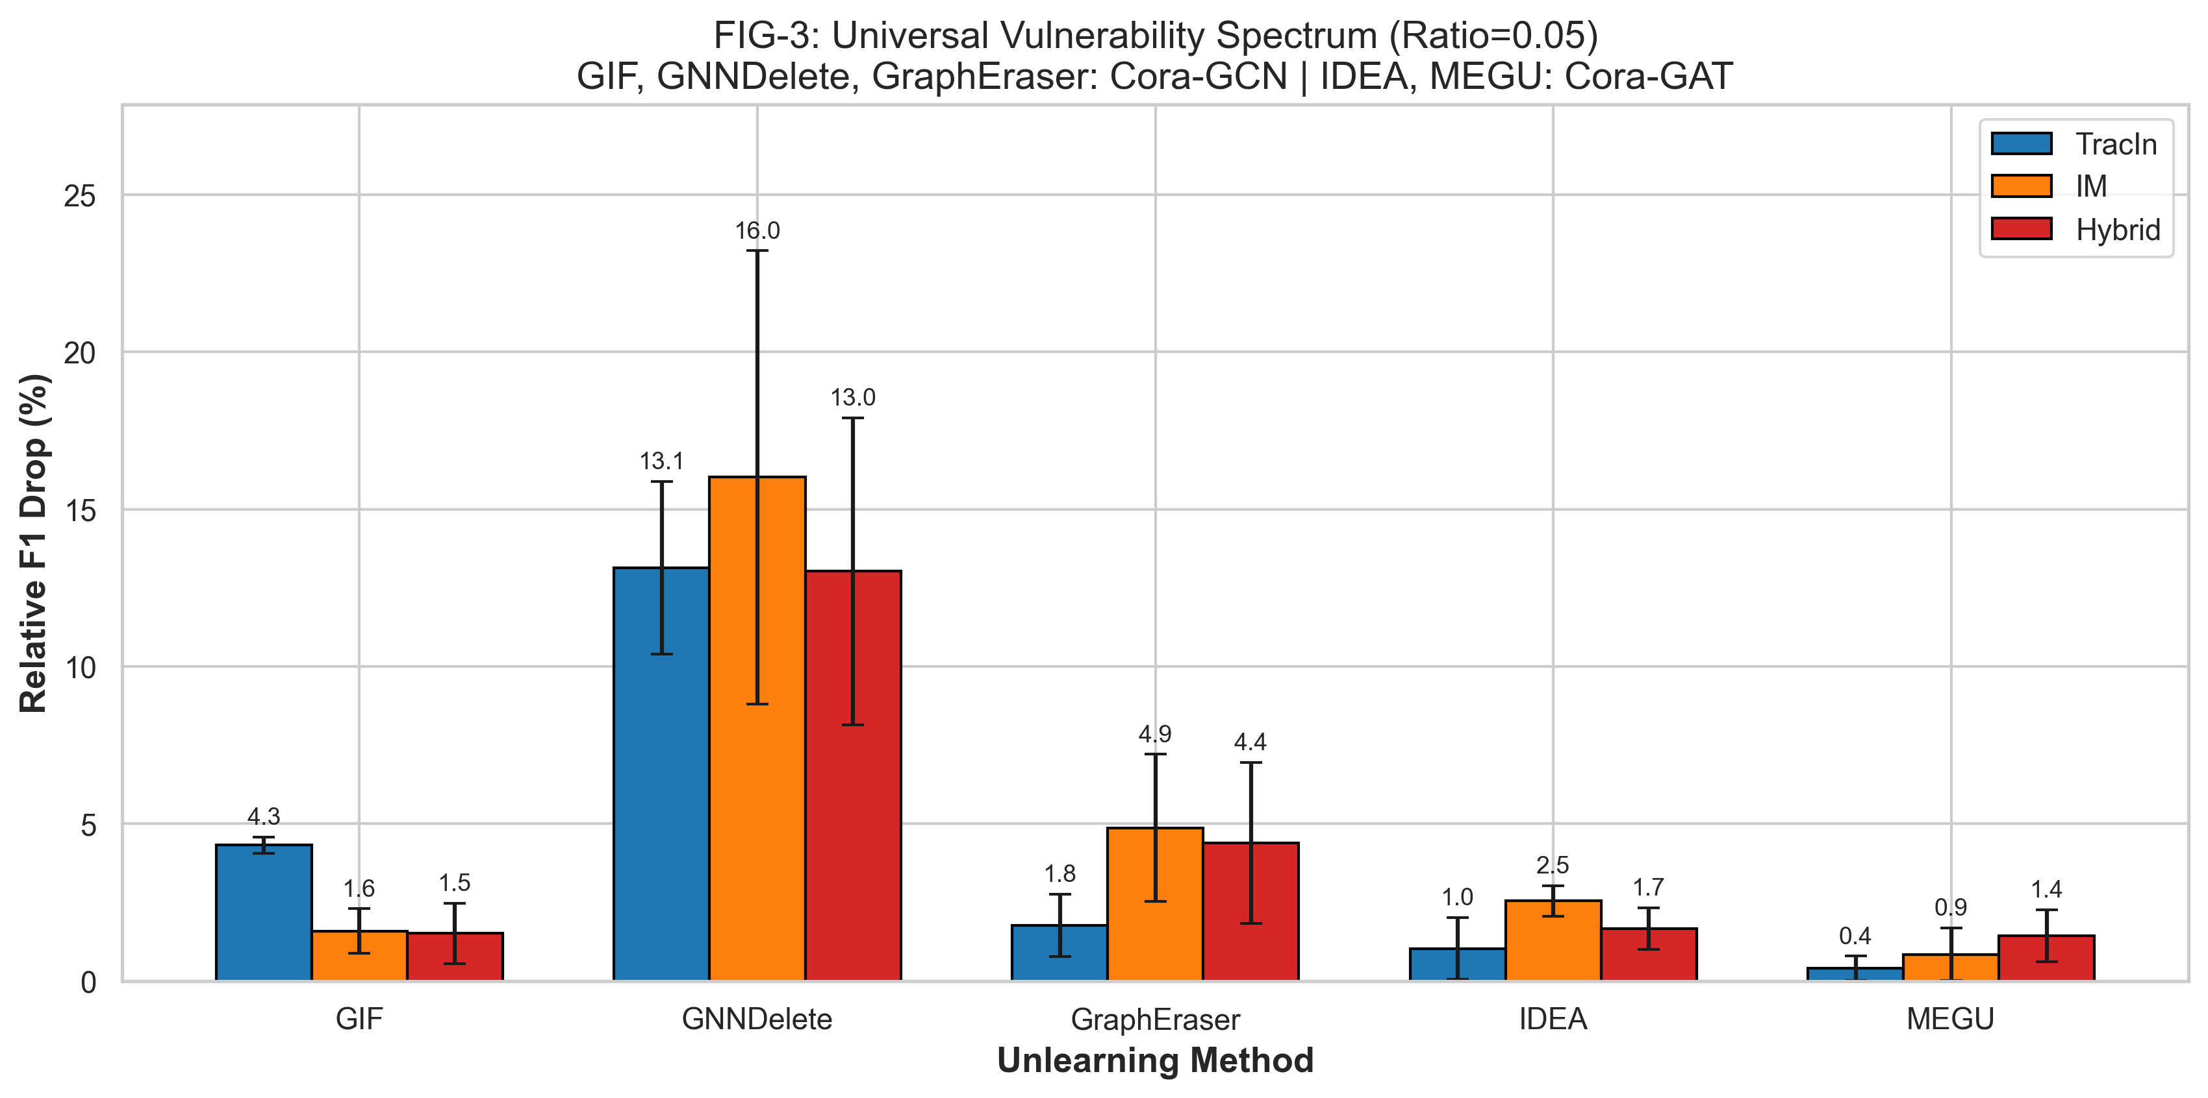
Main Finding: Strategy Spectrum
09 / 15
Full Figure 3. Strategy comparison in relative_f1_drop at ratio = 0.05 using the k=5 baseline.
EE5003 MSc Project | Liu Chengyu
Approximate Graph Unlearning Audit
Notes:
Key Lines:
- This page is not mainly about random versus informed selection.
- The useful comparison here is IF-style selection versus IM versus Hybrid.
- There is no universally dominant informed selector; effectiveness depends on the target method.
Speaker Notes:
This page answers a different question from the previous one. I am not mainly using it to argue that informed selection beats random. The more useful comparison here is within the informed selectors themselves: IF-style selection such as TracIn, graph-structural selection through IM, and the fused Hybrid strategy. The key result is that there is no universally dominant selector across all graph unlearning methods. In some settings, especially on GNNDelete, IM is often the strongest or one of the strongest choices because structural disruption directly targets its weak point. In other settings, Hybrid or TracIn is competitive, and the gap is usually moderate rather than dramatic. So the strategy-level conclusion is not a single global ranking. It is that selector effectiveness is also mechanism-dependent, and these informed selectors should be read as different attack logics with different targets of strength.

Slide 10
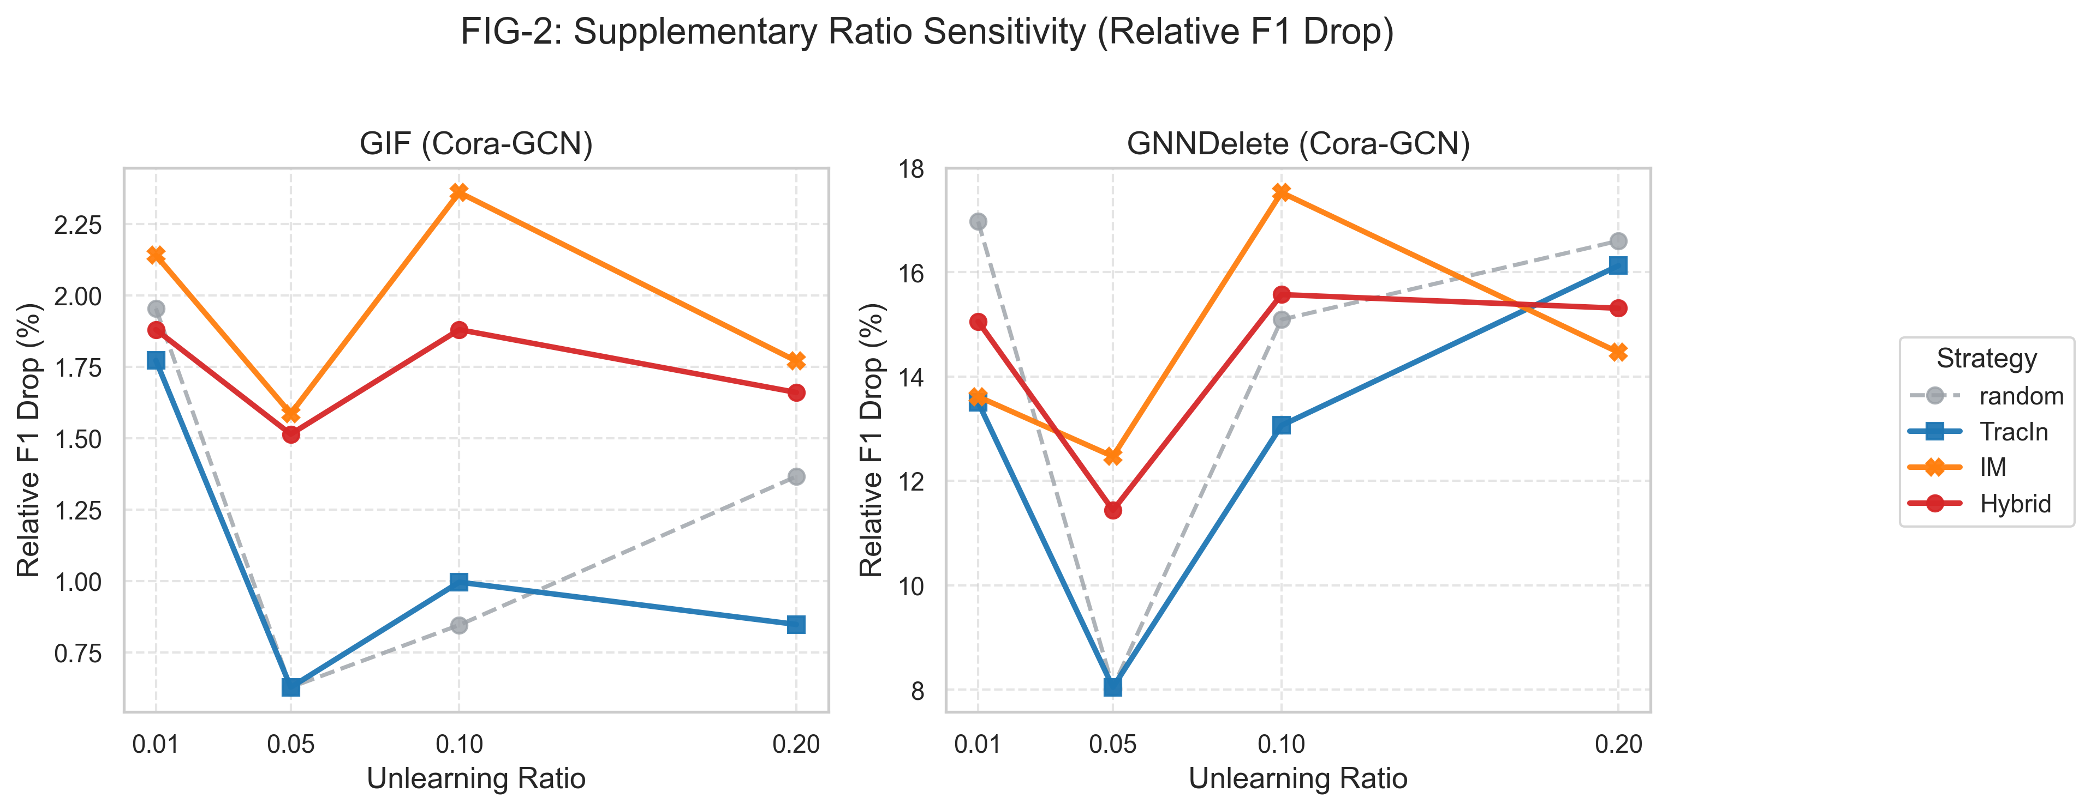
Ratio Sensitivity And Ablation
10 / 15
Ablation read
This page asks how attack strength changes as the deletion ratio increases, not only who wins at one fixed point.
Observed pattern
GNNDelete stays sensitive even at small ratios, while GIF remains much flatter across the same range.
Takeaway
The family difference is structural rather than a one-point artifact of the chosen ratio.
Figure 2. Ratio-sensitivity view for GIF and GNNDelete on Cora/GCN.
EE5003 MSc Project | Liu Chengyu
Approximate Graph Unlearning Audit
Notes:
Key Lines:
- The ratio figure works like an ablation on deletion budget.
- GNNDelete stays sensitive even at very small ratios.
- GIF remains comparatively flat, showing much weaker amplification.
Speaker Notes:
To make the spectrum more concrete, I next use the ratio-sensitivity figure as an ablation-style view. The question here is not only which method is worse at one fixed budget, but how attack strength changes as the deletion ratio increases. GNNDelete already shows strong amplification even at a very small ratio, which means the vulnerability appears early rather than only under large deletion budgets. GIF remains much flatter across the same range. So this page supports the interpretation that the family difference is structural rather than a one-point artifact of the ratio chosen for the main comparison.

Slide 11
Attribution And Collateral Damage
11 / 15
relative_f1_drop says the attack beats the k=5 method baseline; retrain_gap and collateral metrics explain where the extra damage comes from.
Attack success
Attribution
Spillover
relative_f1_drop tells us whether a structured attack causes more loss than the small random-trigger baseline.
retrain_gap isolates the additional approximation error by comparing approximate unlearning with exact retraining on the same deletion set.
fraction_flipped and mean_pred_shift show how strongly retained non-target nodes are disturbed.
Method | Avg Gap | Pred Shift / Flip
GNNDelete | 9.74% | 0.245 / 26.2%
Bottom line
GraphEraser | 0.13% | 0.265 / 18.4%
GIF | -0.34% | 0.024 / 3.1%
If total_drop = drop_retrain + retrain_gap, then large retrain gaps and large retained-node shifts indicate mechanism-induced spillover rather than only intrinsic node importance.
EE5003 MSc Project | Liu Chengyu
Approximate Graph Unlearning Audit
Notes:
Key Lines:
- Relative F1 drop says the attack beat the k=5 baseline.
- Retrain gap says how much extra error comes from approximation.
- Collateral metrics show how strongly retained nodes are disturbed.
- The small evidence table anchors this logic with family-level collateral results.
Speaker Notes:
This slide summarizes the attribution logic. Relative F1 drop tells us whether a structured attack beats the k equals 5 method baseline, but it does not by itself explain why. That is why the exact retrain control is essential. It tells us what should happen on the same deletion set if approximation error were absent. The gap between approximate unlearning and exact retraining is the retrain gap, and that is the part we should attribute to the mechanism. I then use collateral metrics, such as prediction flips and mean prediction shift on retained nodes, to show how far the disturbance propagates beyond the requested deletions. So the three metrics answer three different questions: did the attack work, where did the error come from, and how far did it spread. The small evidence table at the bottom makes clear that this is not only conceptual. In the report-level collateral summary, GNNDelete also has the largest retrain gap and the strongest retained-node disturbance.

Slide 12
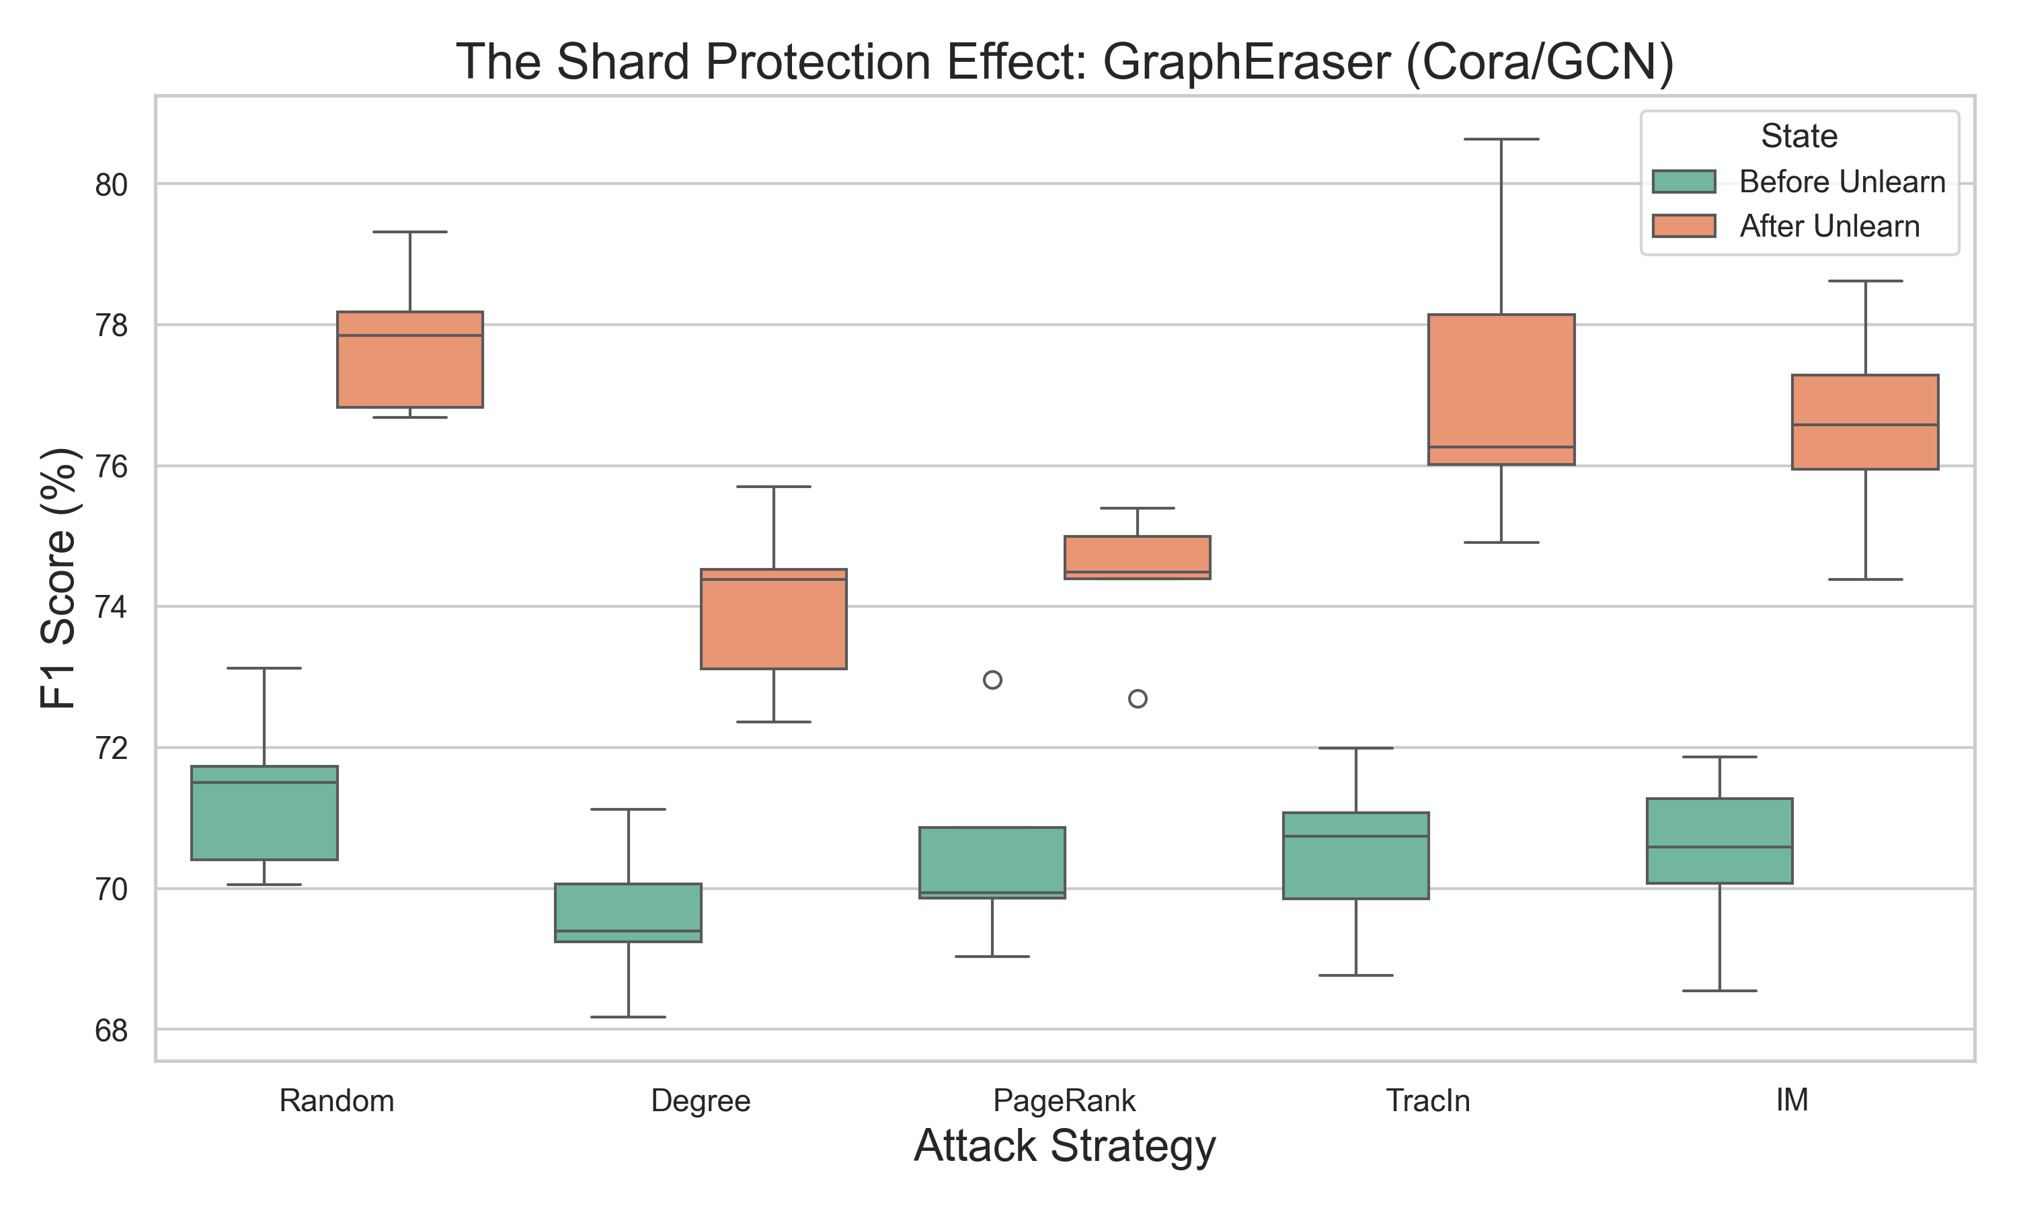
GraphEraser And Shard Protection
12 / 15
Observed pattern
After-unlearning scores shift upward across the tested strategies, which is evidence for a shard protection effect in these settings.
Why it matters
This is why raw utility drop alone is not the right cross-family metric here; the k=5 relative baseline is the cleaner comparison lens.
Caution
This remains setting-specific evidence, not a claim of universal robustness.
Observed shard-level score shift for GraphEraser on Cora/GCN.
EE5003 MSc Project | Liu Chengyu
Approximate Graph Unlearning Audit
Notes:
Key Lines:
- The observed GraphEraser score distribution shifts upward after unlearning.
- That is why raw utility drop alone is not the right cross-family metric here.
- This is setting-specific evidence for a shard protection effect, not universal robustness.
Speaker Notes:
GraphEraser behaves differently enough that it deserves its own evidence slide. Here I show the observed score shift for GraphEraser on Cora with a GCN backbone. The after-unlearning distribution moves upward across the tested attack strategies, which is why I said earlier that raw utility drop alone can be misleading for shard-based methods. A plausible explanation is that removing bridge or hub nodes changes the partition structure in a way that makes shard-local classification easier and reduces cross-shard interference. This is still a narrow claim. I am not saying GraphEraser is universally robust. I am saying that under the tested settings, the evidence is more consistent with a shard protection effect than with the collapse pattern seen in GNNDelete.

Slide 13
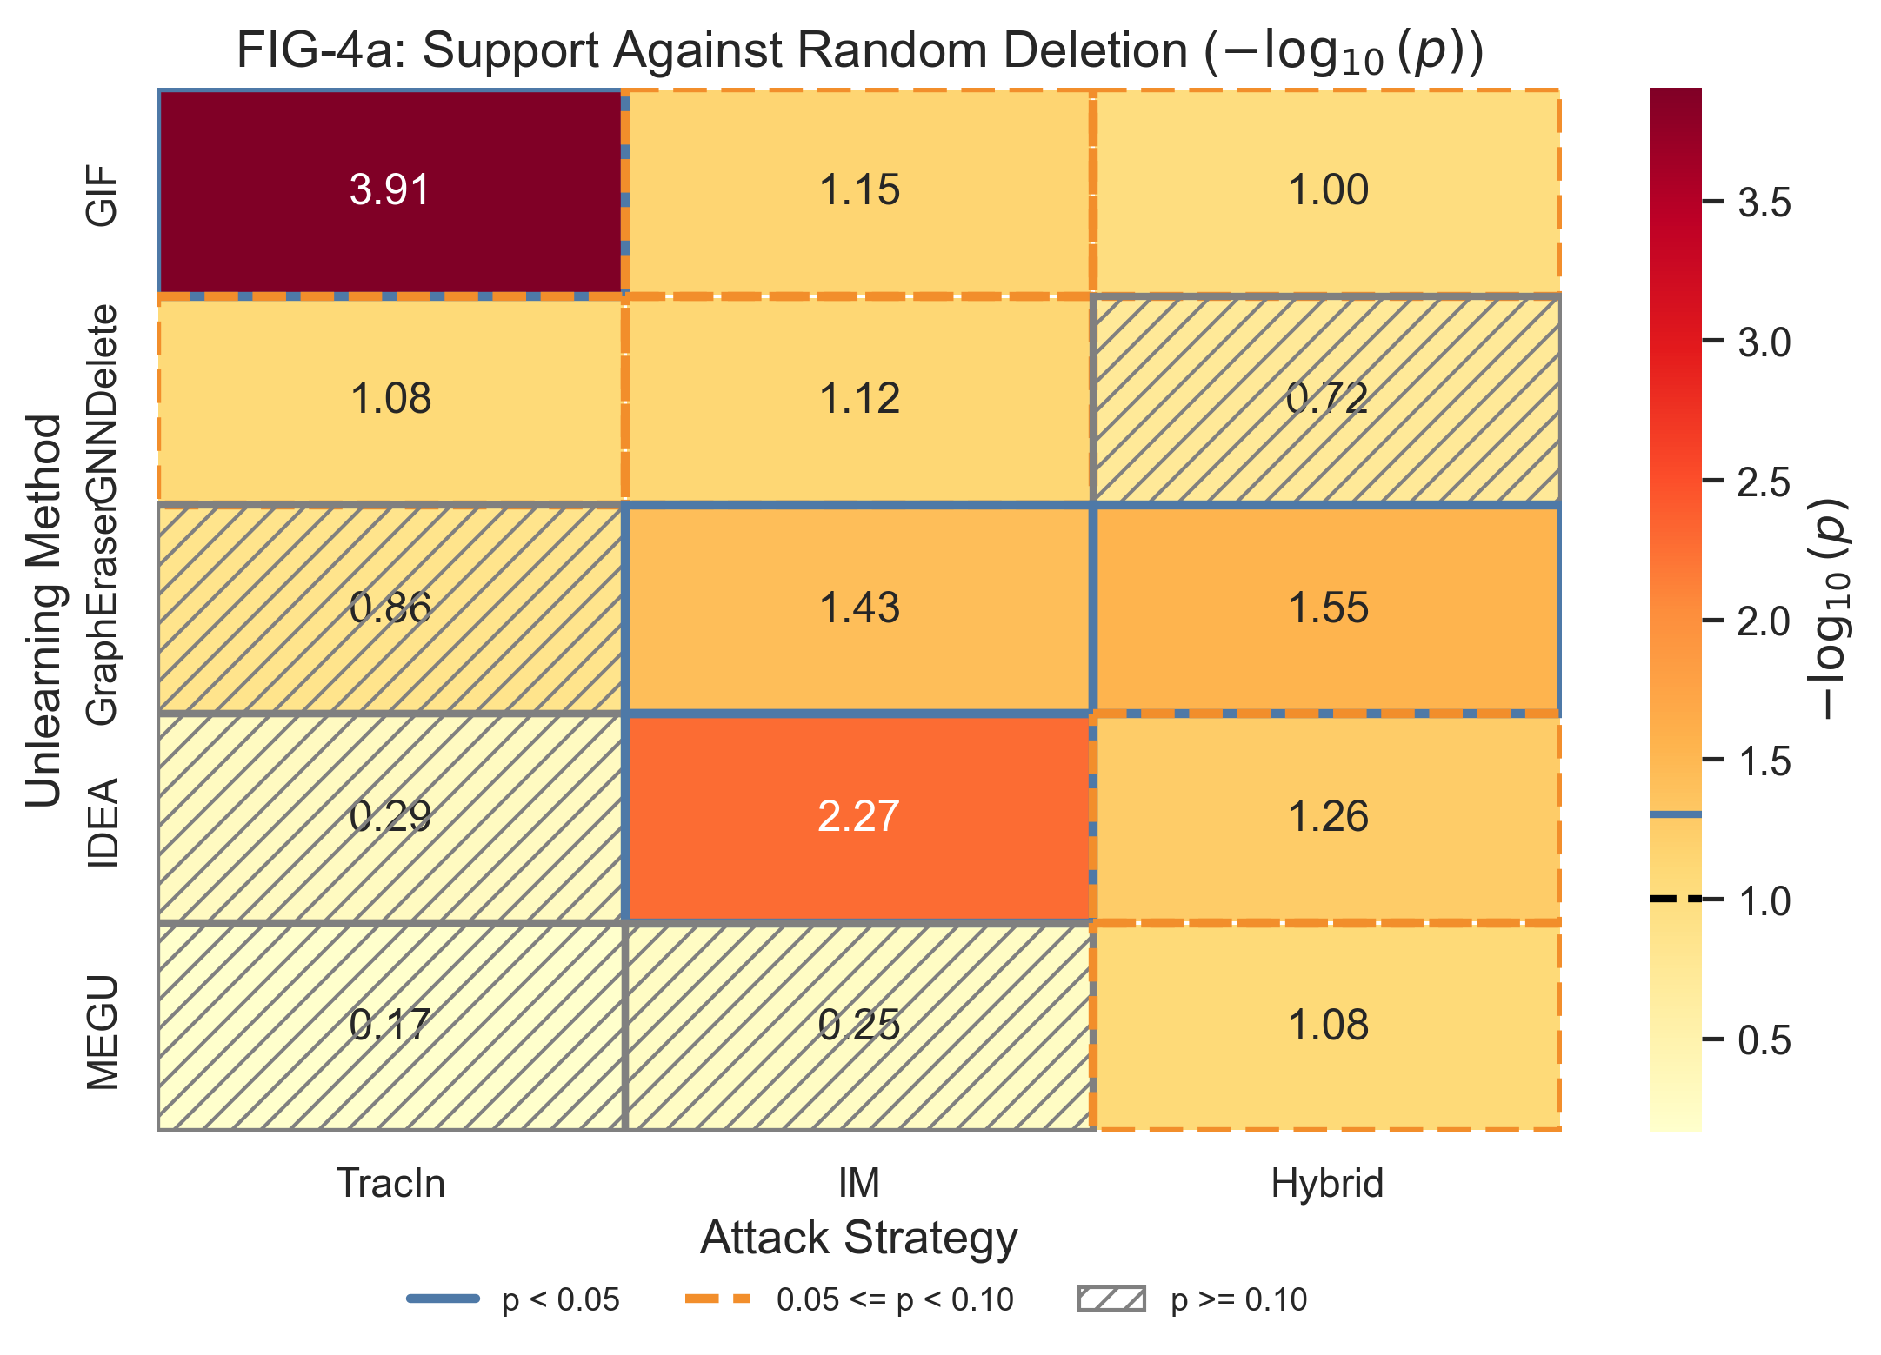
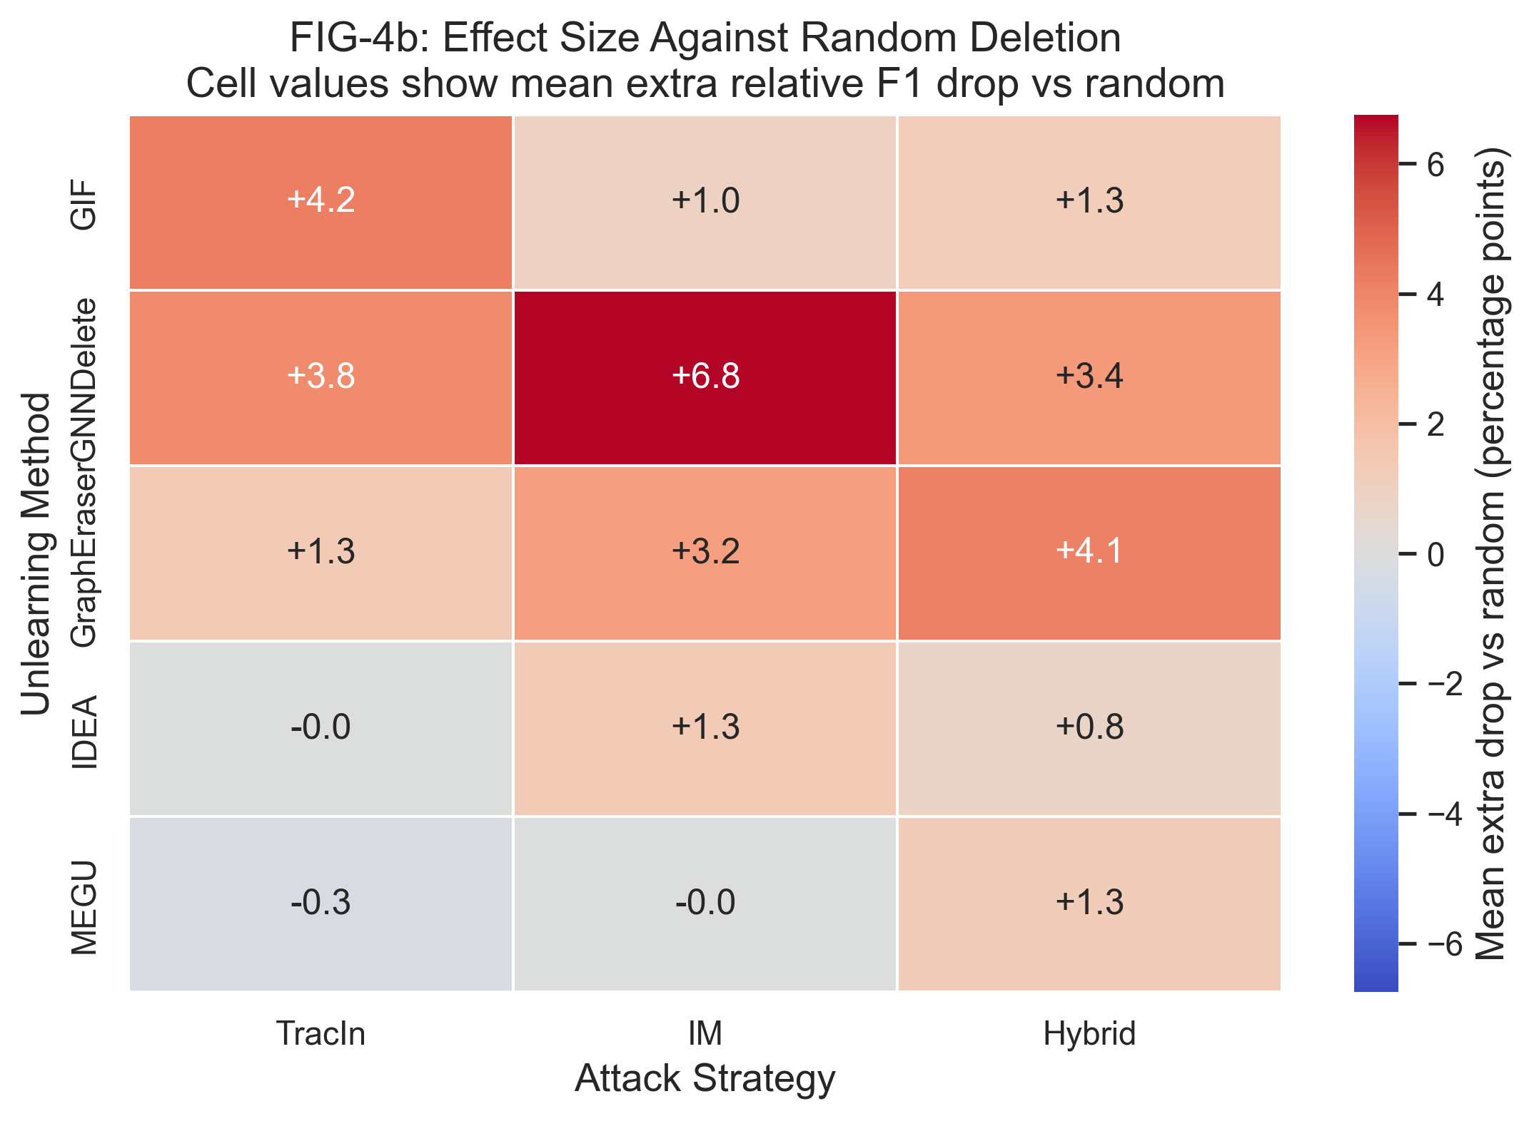
Statistical Support And Effect Size
13 / 15
Figure 4a. Statistical support against random deletion.
Figure 4b. Effect size beyond random deletion.
Support
Effect
Figure 4a asks how strongly the attack-over-random difference is supported.
Figure 4b asks how large that extra damage is once support is established.
EE5003 MSc Project | Liu Chengyu
Approximate Graph Unlearning Audit
Notes:
Key Lines:
- Figure 4a asks how strongly the attack-over-random gap is supported.
- Figure 4b asks how large that extra damage is.
- GNNDelete is strong on both support and effect size.
Speaker Notes:
I then strengthen the main result with statistical-support and effect-size evidence. Figure 4a asks how strongly the attack-over-random difference is supported, while Figure 4b asks how large that difference is once support is established. This matters because a visible pattern alone can still look thin if we do not show whether it is consistent. The key read is that GNNDelete is strong on both axes: it shows both clear support and large extra damage. The other families are more moderate, which is consistent with the main spectrum rather than a contradiction to it.

Slide 14
Limitations And Future Work
14 / 15
The project is complete; these scope limits and follow-up directions define what this report does and does not claim.
Limitation 1
Future work 1
Evidence is concentrated on the tested citation benchmarks and backbones.
Validate the same pattern on larger graph benchmarks such as PubMed.
Project status
Completed MSc project
Final course submission with a reusable audit workflow.
Limitation 2
Future work 2
The mechanism-level explanation for GNNDelete fragility is still incomplete.
Add targeted ablations that explain when and why GNNDelete fails.
EE5003 MSc Project | Liu Chengyu
Approximate Graph Unlearning Audit
Notes:
Key Lines:
- This is a completed MSc project with clearly bounded claims.
- The main limits are benchmark scope and the lack of deeper GNNDelete mechanism analysis.
- The most credible future work is larger-benchmark validation plus targeted GNNDelete ablations.
Speaker Notes:
This project has clear limitations, and I want to state them directly. The evidence is strong within the tested citation benchmarks and backbones, but it should not be treated as universal across all graph domains. The second limit is explanatory depth: GNNDelete is clearly fragile in these experiments, but the mechanism-level reason still needs more targeted ablation. At the same time, this is a completed MSc project, not a midstream progress report. The most credible future work is to validate the same pattern on larger graph benchmarks such as PubMed and to run more targeted ablations that explain when and why GNNDelete fails.

Slide 15
Conclusion
1. Auditability matters
2. Family behavior differs
3. Workflow contribution
Approximate graph unlearning should be evaluated not only for accuracy but also for adversarial deletion robustness.
In the tested settings, GNNDelete is most fragile, GIF is comparatively stable, and GraphEraser exhibits shard protection.
The project contributes a reusable OpenGU-based audit pipeline alongside the findings themselves.
Thank you. Q&A
EE5003 MSc Project | Liu Chengyu
Notes:
Key Lines:
- Approximate graph unlearning can and should be stress-tested through adversarial deletion requests.
- Robustness differs substantially across method families.
- The best informed selection method also depends on the target mechanism.
- The project contributes both findings and a reusable workflow.
Speaker Notes:
To conclude, this project shows that approximate graph unlearning can and should be stress-tested through adversarial deletion requests. The first main result is a clear family-level vulnerability spectrum defined through relative F1 drop: GNNDelete is the most fragile case in the tested settings, GIF is comparatively stable, and GraphEraser exhibits a shard protection effect rather than collapse. The second main result is about attack selection: among informed selectors such as IF-style selection, IM, and Hybrid, there is no single universally best choice, because effectiveness also depends on the target mechanism. Just as importantly, the project leaves behind a practical OpenGU-based audit workflow that can support future work from a completed course submission. Thank you, and I welcome your questions.

