Slide 1
Adversarial Deletion Attacks on
Approximate Graph Unlearning
Thesis
Deletion interfaces in approximate graph unlearning can be exploited to amplify approximation error, and fragility differs sharply across method families.
The inheritance of safety behavior within graph unlearning families
EE5003 MSc Project Report
National University of Singapore
Problem
Method
Liu Chengyu
April 2026
Results
Takeaway

Slide 2
Why Graph Unlearning Matters
02 / 15
Deletion requests are operationally plausible, and approximation turns them into a security question.
Real deletion requests
Approximate
unlearning
Attack surface
User-level or node-level removal is realistic in citation, social, and recommendation graphs.
Exact retraining is expensive, so practical systems use approximation.
A malicious requester may exploit the deletion interface itself by choosing harmful targets.
Delete
Compliance tool and attack interface
EE5003 MSc Project | Liu Chengyu
Approximate Graph Unlearning Audit

Slide 3
Research Question And Objectives
03 / 15
Research question
Can malicious deletion requests amplify approximation error and degrade retained-model utility beyond ordinary deletion at the same budget?
Objective 1
Objective 2
Build an attack pipeline with multiple deletion strategies.
Compare vulnerability across method families, not just one algorithm.
Objective 3
Objective 4
Add attribution metrics for collateral and retrain gap.
Measure whether adversarial node selection is practically efficient.
EE5003 MSc Project | Liu Chengyu
Approximate Graph Unlearning Audit

Slide 4
Method Families And Threat Model
04 / 15
Families under test
Learning-based
Threat model
Learn a direct unlearning correction; GNNDelete is the fragile representative here.
Attacker capability: choose which nodes to delete through the normal interface.
Out of scope: poisoning labels, features, or hidden training code.
Target: maximize post-unlearning utility loss beyond random deletion.
IF-based
Approximate deletion through local influence-style updates; GIF stays comparatively stable.
Shard-based
ΔF1
Gap
26.2%
Partition the graph and retrain affected shards; GraphEraser behaves differently in the tested settings.
attack-over-random
vs exact retrain
non-target changes
EE5003 MSc Project | Liu Chengyu
Approximate Graph Unlearning Audit

Slide 5
Attack Pipeline And Experimental Matrix
05 / 15
The workflow compares approximate unlearning against an exact-retrain control on the same deletion set.
1
Select nodes
Experimental matrix
Use random or structured attack targets.
Methods: 5
Datasets: 2 citation graphs
Backbones: 3 GNN architectures
Strategies: 6 node-selection methods
Runs: 950 experiment executions
Outputs: relative_f1_drop, retrain_gap, collateral damage, and efficiency.
2
Apply unlearning
Run the selected graph unlearning method.
3
Exact retrain control
Retrain on the same deletions for the gold-standard reference.
4
Compare outcomes
Read utility loss, retrain gap, and collateral damage.
EE5003 MSc Project | Liu Chengyu
Approximate Graph Unlearning Audit

Slide 6
Attack Selection Logic
06 / 15
The attack is not only about how many nodes are deleted, but about what logic is used to choose them.
TracIn / IF-style
IM
Hybrid
Model-aware logic.
Pick nodes with high training influence on the learned model.
Shorthand: score(v) ≈ I_train(v)
Graph-structural logic.
Pick nodes that maximize spread or disruption in the graph.
Shorthand: score(S) = spread(S)
Combine model-side influence with topology-side spread to search for stronger targets.
Shorthand: score(v) = α·z_IF(v) + (1-α)·z_IM(v)
Reading rule
Read these formulas only as intuition. The benchmark compares attacker logics: model-aware selection, graph-structural selection, and a hybrid of the two.
EE5003 MSc Project | Liu Chengyu
Approximate Graph Unlearning Audit

Slide 7
Metrics Framework
07 / 15
Three metrics answer three different questions: how much extra damage appears beyond a k=5 baseline, where it comes from, and how far it spreads.
Utility
Fidelity
Collateral
relative_f1_drop = F1_after(k=5, random) - F1_after(attack)
Use a tiny random-trigger baseline because raw drop can mislead on shard-based methods.
retrain_gap = F1_retrain - F1_unlearn
total_drop = drop_retrain + retrain_gap
fraction_flipped
mean_pred_shift
These show how strongly retained nodes are disturbed.
Reading rule
First trigger each method with a tiny random deletion, k=5, and use that post-unlearning F1 as the reference point. Then compare stronger attacks against that baseline; retrain_gap and collateral metrics explain why the utility changes appear.
EE5003 MSc Project | Liu Chengyu
Approximate Graph Unlearning Audit

Slide 8
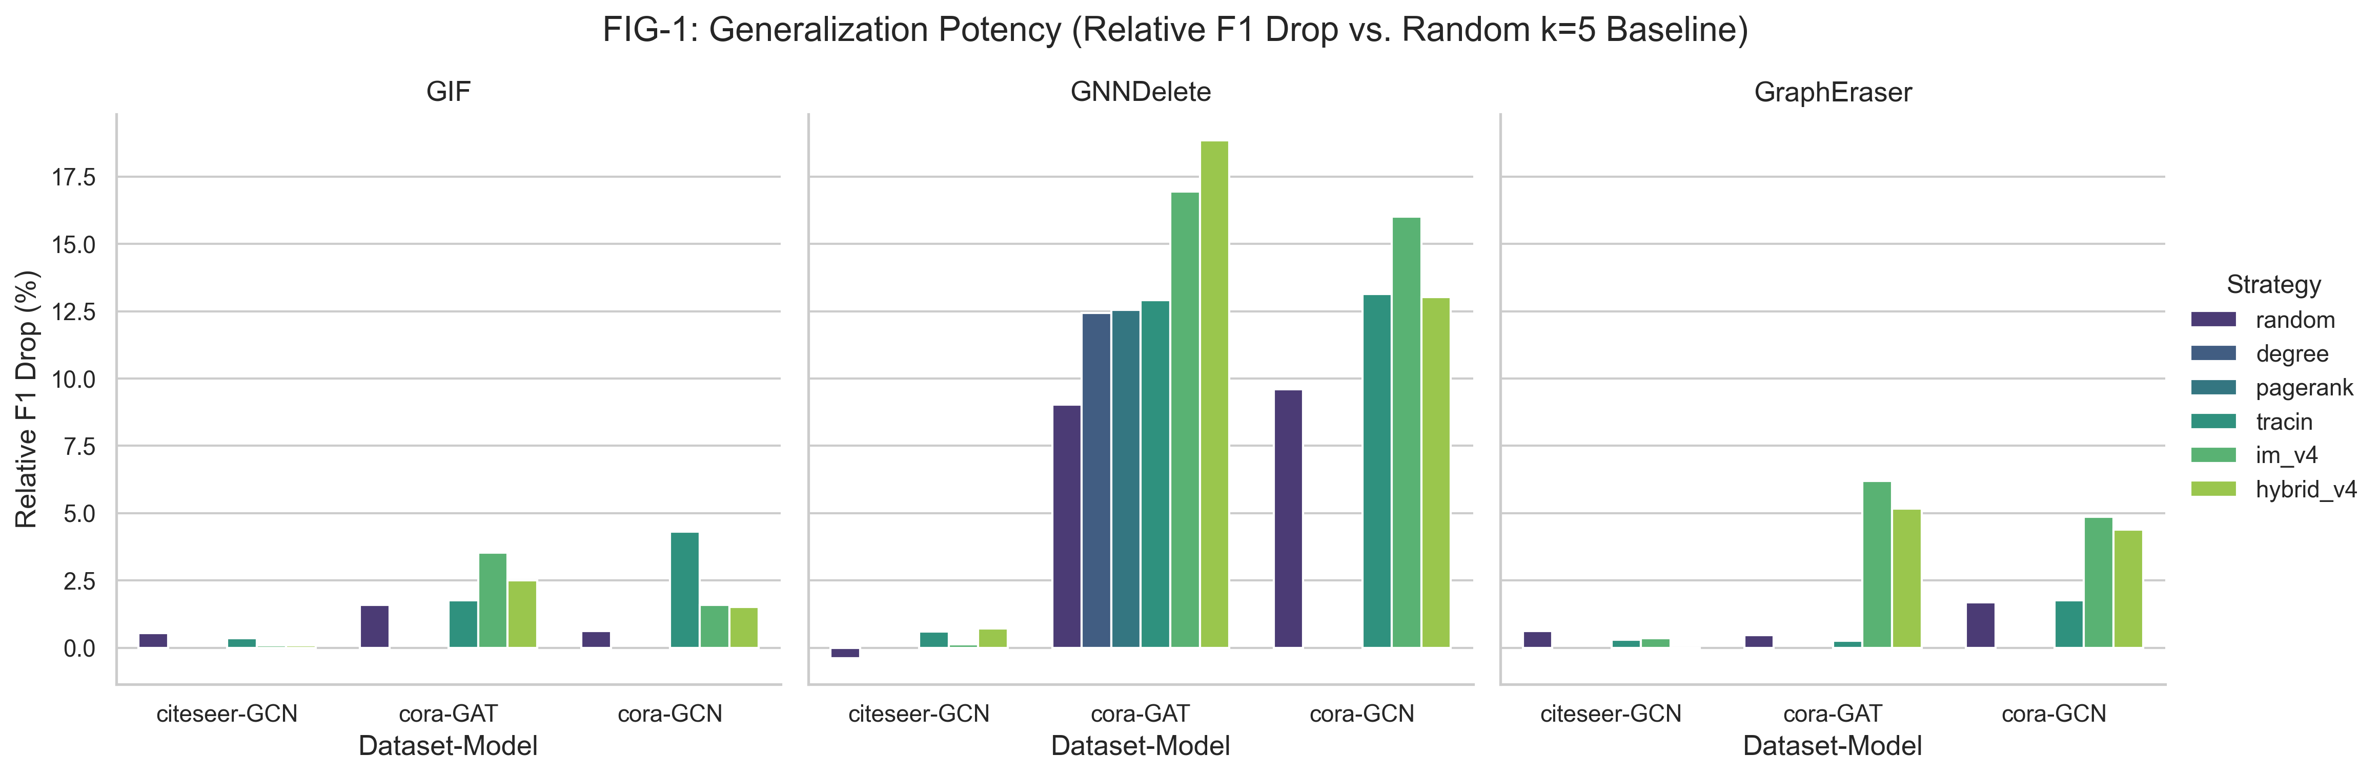
Main Finding: Family Spectrum
08 / 15
Core read
Relative_f1_drop reveals a family-level vulnerability spectrum rather than one shared failure pattern.
Family readout
GNNDelete highest.
GIF comparatively stable.
GraphEraser shows shard protection.
Strategy readout
Across the same figure family and the companion strategy view, the strongest extra damage still concentrates on GNNDelete rather than spreading evenly across methods.
Figure 1. Family-level spectrum using relative F1 drop at ratio = 0.05.
EE5003 MSc Project | Liu Chengyu
Approximate Graph Unlearning Audit

Slide 9
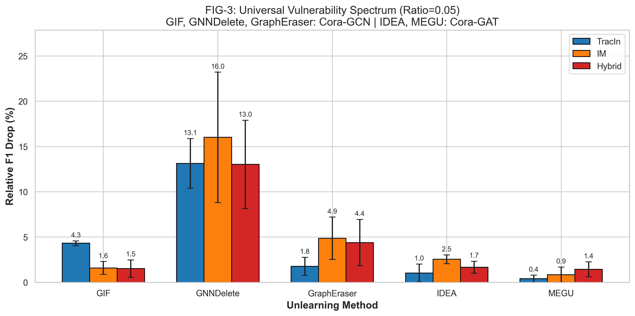
Main Finding: Strategy Spectrum
09 / 15
Full Figure 3. Strategy comparison in relative_f1_drop at ratio = 0.05 using the k=5 baseline.
EE5003 MSc Project | Liu Chengyu
Approximate Graph Unlearning Audit

Slide 10
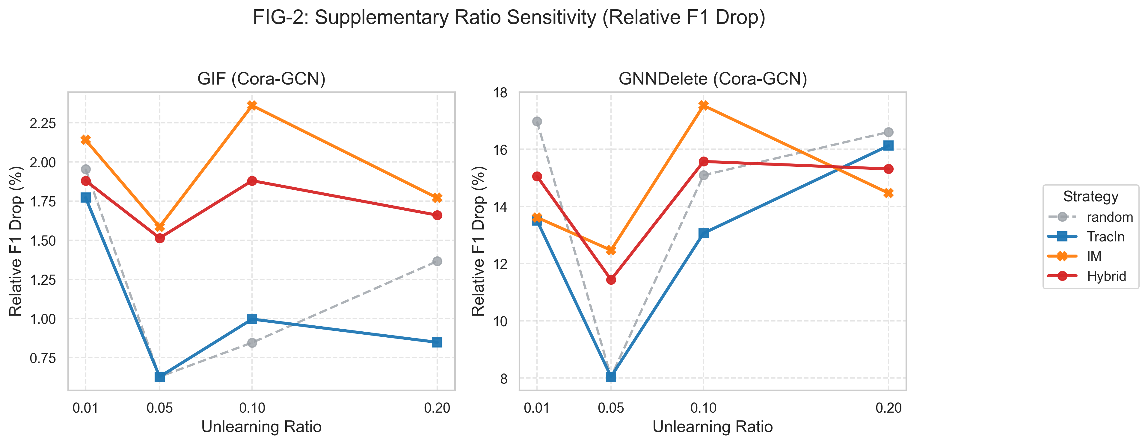
Ratio Sensitivity And Ablation
10 / 15
Ablation read
This page asks how attack strength changes as the deletion ratio increases, not only who wins at one fixed point.
Observed pattern
GNNDelete stays sensitive even at small ratios, while GIF remains much flatter across the same range.
Takeaway
The family difference is structural rather than a one-point artifact of the chosen ratio.
Figure 2. Ratio-sensitivity view for GIF and GNNDelete on Cora/GCN.
EE5003 MSc Project | Liu Chengyu
Approximate Graph Unlearning Audit

Slide 11
Attribution And Collateral Damage
11 / 15
relative_f1_drop says the attack beats the k=5 method baseline; retrain_gap and collateral metrics explain where the extra damage comes from.
Attack success
Attribution
Spillover
relative_f1_drop tells us whether a structured attack causes more loss than the small random-trigger baseline.
retrain_gap isolates the additional approximation error by comparing approximate unlearning with exact retraining on the same deletion set.
fraction_flipped and mean_pred_shift show how strongly retained non-target nodes are disturbed.
Collateral evidence
Method | Avg Gap | Pred Shift / Flip
GNNDelete | 9.74% | 0.245 / 26.2%
GraphEraser | 0.13% | 0.265 / 18.4%
GIF | -0.34% | 0.024 / 3.1%
Read this as a compact anchor from the report-level collateral table: GNNDelete combines the largest retrain gap with the strongest retained-node disturbance.
EE5003 MSc Project | Liu Chengyu
Approximate Graph Unlearning Audit

Slide 12
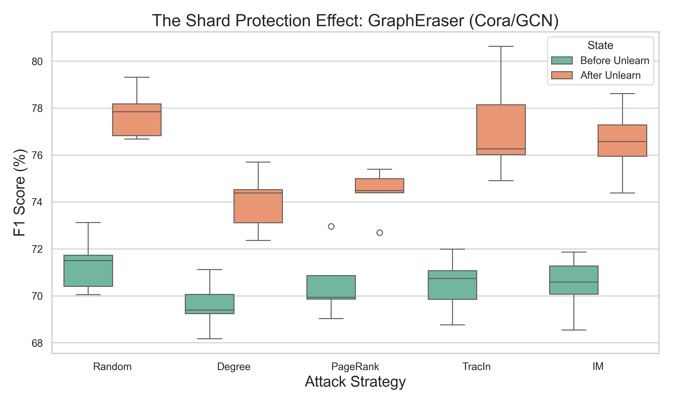
GraphEraser And Shard Protection
12 / 15
Observed pattern
After-unlearning scores shift upward across the tested strategies, which is evidence for a shard protection effect in these settings.
Why it matters
This is why raw utility drop alone is not the right cross-family metric here; the k=5 relative baseline is the cleaner comparison lens.
Caution
This remains setting-specific evidence, not a claim of universal robustness.
Observed shard-level score shift for GraphEraser on Cora/GCN.
EE5003 MSc Project | Liu Chengyu
Approximate Graph Unlearning Audit

Slide 13
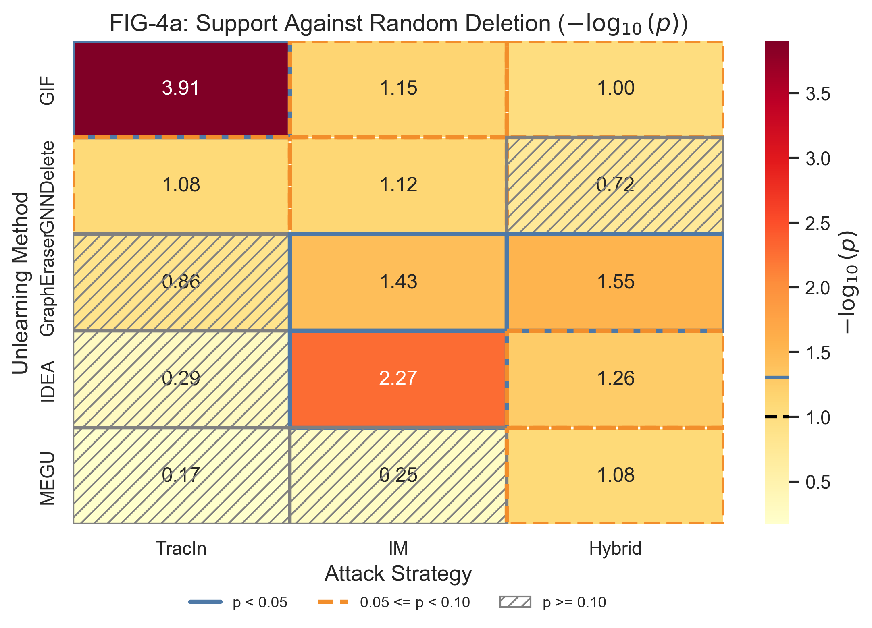
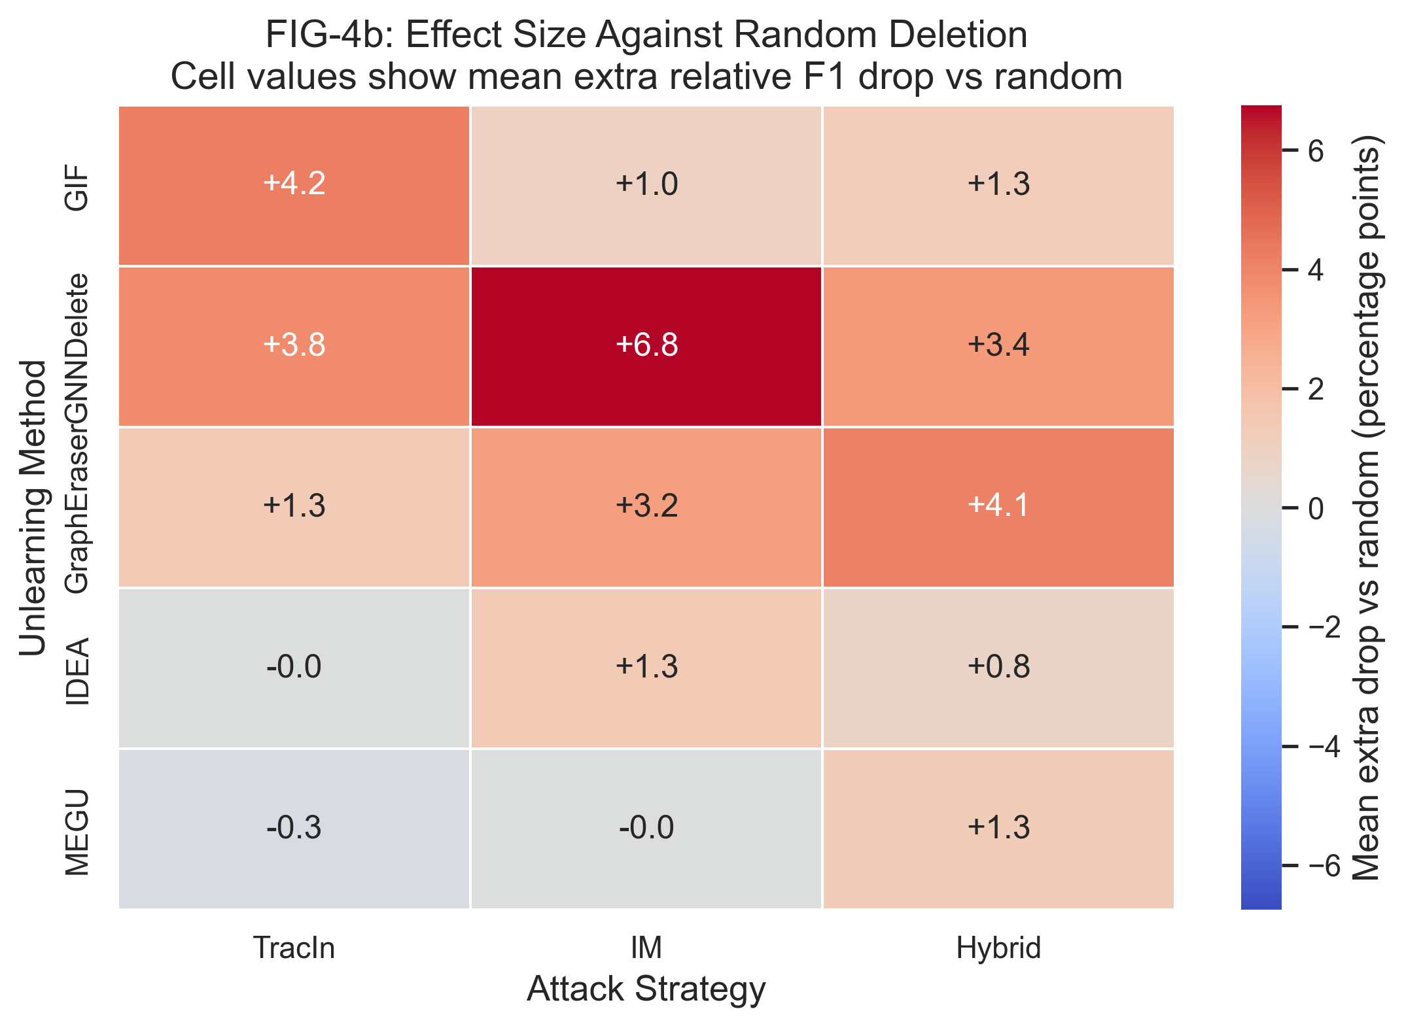
Statistical Support And Effect Size
13 / 15
Figure 4a. Statistical support against random deletion.
Figure 4b. Effect size beyond random deletion.
Support
Effect
Figure 4a asks how strongly the attack-over-random difference is supported.
Figure 4b asks how large that extra damage is once support is established.
EE5003 MSc Project | Liu Chengyu
Approximate Graph Unlearning Audit

Slide 14
Limitations And Future Work
14 / 15
The project is complete; these scope limits and follow-up directions define what this report does and does not claim.
Limitation 1
Future work 1
Evidence is concentrated on the tested citation benchmarks and backbones.
Validate the same pattern on larger graph benchmarks such as PubMed.
Project status
Completed MSc project
Final course submission with a reusable audit workflow.
Limitation 2
Future work 2
The mechanism-level explanation for GNNDelete fragility is still incomplete.
Add targeted ablations that explain when and why GNNDelete fails.
EE5003 MSc Project | Liu Chengyu
Approximate Graph Unlearning Audit

Slide 15
Takeaways
1. Auditability matters
2. Family behavior differs
3. Workflow contribution
Approximate graph unlearning should be evaluated not only for accuracy but also for adversarial deletion robustness.
In the tested settings, GNNDelete is most fragile, GIF is comparatively stable, and GraphEraser exhibits shard protection.
The project contributes a reusable OpenGU-based audit pipeline alongside the findings themselves.
Thank you. Q&A
EE5003 MSc Project | Liu Chengyu

