Slide 1
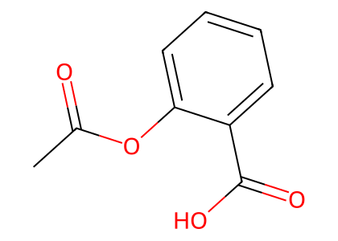
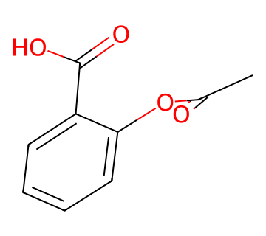
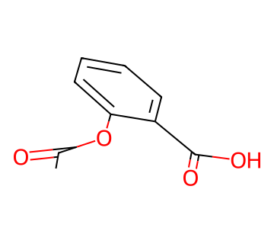
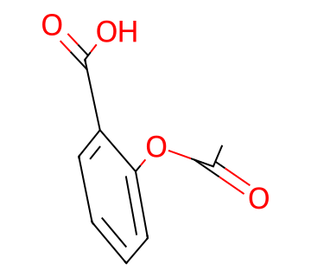
① 1D · Sequence
1D Semantic Tokens
BPE Tokenizer
(AutoTokenizer)
ChemBERTa-77M-MTR
(frozen)
Semantic tokens [ 354 × 128 ]
special tokens removed · adaptive-pooled
SMILES
② 2D · Graph
2D Molecular Graph
RDKit parse
atoms · bonds
Canonical atom/bond
featurizer → DGL graph
Molecular graph
nodes + edges
Node feats X
[290 × 75]
Edge feats E
[E × 12]
Adjacency A
[290 × 290]
CC(=O)Oc1ccccc1C(=O)O
③ 3D · Conformers
K Conformers + Energy
AddHs + ETKDGv3
embed K confs
UFF optimize
+ energy
...
atom feats [K×64×128]
coords [K×64×3] (x,y,z)
energy [K] UFF → z-score
conf_mask [K] valid confs
E₁
E₂
Eₖ
K conformers(sorted by energy)

Slide 2
X = 74 atom feats + 1 virtual-node bit
E = bond type · conjugation · ring · stereo A = self-loops on diagonal

