Slide 1
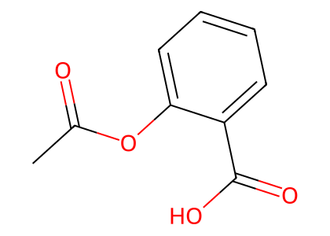
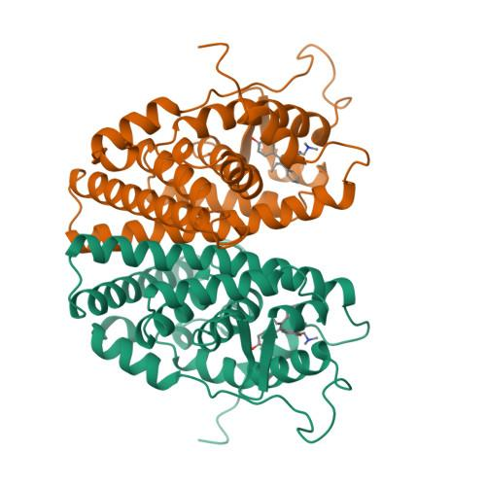
Drug Representation
Token-wise Fusion Gate
Protein-Mamba BiIntention Fusion
SMILES
ChemBERTa
Molecular Semantics
1D Semantics d_1d
...
...
P
Bidirectional
Mamba (SSM)
g
Refined Protein P'
2D/3D Geometry d_geo
...
2D Molecular
Graph
GCN
Topology Tokens
...
D
...
Conformer Summaries
Conformer representations
Gated Fusion
K Conformers
+ Energy
EGNN
BiIntention · Bidirectional Cross-Attention
...
...
DURG : Fused Drug D
Protein-guided Drug Intention
Drug-guided Protein Intention
...
Target-aware Conformer Weighting
α_k
Mean Pooling
Protein Seed Context
0.23
...
MLP
Target-aware
Geometry Tokens
Max Pooling
Max Pooling
...
0.47
×
Energy Embedding
...
Ligand Context d_g
...
0.08
...
Joint Representation f
Protein Representation
...
Ligand-conditioned
FiLM
Protein Tokens P
Protein Sequence
Protein Seed Context P_g
...
ProtBERT
...
Linear
Interaction Prediction Head
ACmix
Masked Mean Pooling
× 3
ŷ ∈ [0, 1]
Interaction
Probability
SiLU
×
MLP
σ
MAVSEQLKVEEL
LSKNYHLENEVAR
LKKLV ...
Protein Seed Tokens P0
Linear
Feed Forward
...

