Slide 1
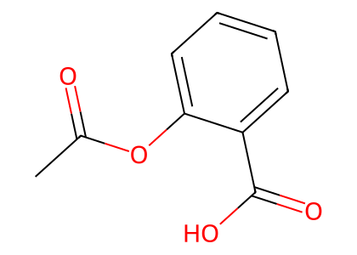
Drug Representation
Token-wise Fusion Gate
Protein-Mamba BiIntention Fusion
SMILES
ChemBERTa
Molecular Semantics
Bidirectional
Mamba (SSM)
1D Semantics d_1d
P
g
Refined Protein P'
...
...
...
D
2D Molecular
Graph
GCN
Topology Tokens
2D/3D Geometry d_geo
...
...
Gated Fusion
BiIntention · Bidirectional Cross-Attention
K Conformers
+ Energy
EGNN
Conformer Summaries
Conformer representations
Protein-guided Drug Intention
Drug-guided Protein Intention
...
...
DURG : Fused Drug D
...
Target-aware Conformer Weighting
Protein Seed Context p_g
α_k (softmax)
Mean Pooling
Max Pooling
Max Pooling
...
MLP
0.23
Target-aware
Geometry Tokens
...
0.47
×
Energy Embedding
u_k
...
Ligand Context d_g
...
0.08
...
Joint Representation f [bs, 256]
Protein Representation
...
Protein Seed Context P_g
ProteinACmix
× 3
Protein Sequence
Ligand-conditioned
FiLM
ProtBERT
...
ACmix
Linear
Protein Tokens P
Interaction Prediction Head
Masked Mean Pooling
...
MLP Decoder
(FC × 3 + ReLU+layernorm)
ŷ ∈ [0, 1]
Interaction
Probability
SiLU
×
MAVSEQLKVEEL
LSKNYHLENEVAR
LKKLV ...
Feed Forward
Protein Seed Tokens P0
Linear
...
Sigmoid

Slide 2
Drug Representation
Token-wise Fusion Gate
Protein-Mamba BiIntention Fusion
SMILES
ChemBERTa
Molecular Semantics
Bidirectional
Mamba (SSM)
1D Semantics d_1d
P
g
Refined Protein P'
...
...
...
D
2D Molecular
Graph
GCN
Topology Tokens
2D/3D Geometry d_geo
...
...
Gated Fusion
BiIntention · Bidirectional Cross-Attention
K Conformers
+ Energy
EGNN
Conformer Summaries
Conformer representations
Protein-guided Drug Intention
Drug-guided Protein Intention
...
...
DURG : Fused Drug D
...
Target-aware Conformer Weighting
Protein Seed Context p_g
α_k (softmax)
Mean Pooling
Max Pooling
Max Pooling
...
MLP
0.23
Target-aware
Geometry Tokens
...
0.47
×
Energy Embedding
u_k
...
Ligand Context d_g
...
0.08
...
Joint Representation f [bs, 256]
Protein Representation
...
Protein Seed Context P_g
ProteinACmix
× 3
Protein Sequence
Ligand-conditioned
FiLM
ProtBERT
...
ACmix
Linear
Protein Tokens P
Interaction Prediction Head
Masked Mean Pooling
...
MLP Decoder
(FC × 3 + ReLU+layernorm)
ŷ ∈ [0, 1]
Interaction
Probability
SiLU
×
MAVSEQLKVEEL
LSKNYHLENEVAR
LKKLV ...
Feed Forward
Protein Seed Tokens P0
Linear
...
Sigmoid

