Slide 1
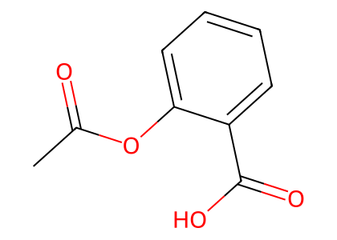



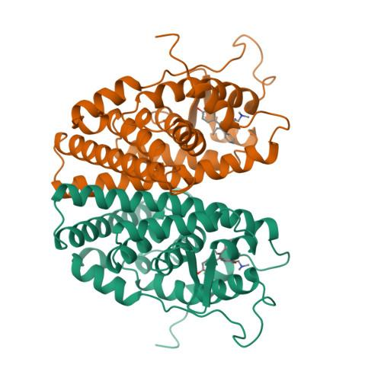
Drug Representation
Token-wise Fusion Gate
Protein-Mamba BiIntention Fusion
SMILES
ChemBERTa
Molecular Semantics
1D Semantics d_1d
...
...
P
Bidirectional
Mamba (SSM)
g
Refined Protein P'
2D/3D Geometry d_geo
D
...
2D Molecular
Graph
GCN
Topology Tokens
...
...
K Conformers
+ Energy
EGNN
Conformer Summaries
Conformer representations
Gated Fusion
Bidirectional Cross-Attention
...
...
DRUG : Fused Drug D
Protein-guided Drug Intention
Drug-guided Protein Intention
...
Target-aware Conformer
Conformer weights
Protein Seed Context
Mean Pooling
...
MLP
Target-aware
Geometry Tokens
Max Pooling
Max Pooling
...
x
Energy Embedding ε_k
...
Ligand Context d_g
...
...
Joint Representation f
Protein Representation
...
Protein Sequence
Protein Seed Context P_g
Linear
Protein Tokens P
...
...
ProtBERT
SiLU
ACmix
Interaction Prediction Head
Masked Mean Pooling
Linear
(γ,β)
× 3
MLP
ŷ = 0(p ≤ τ)
×
× 3
σ
MAVSEQLKVEEL
LSKNYHLENEVAR
LKKLV ...
Protein Seed Tokens P0
Ligand-conditioned
FiLM
ŷ = 1(p ≥ τ)
...
Feed Forward
Label ∈ {0, 1}

