Slide 1
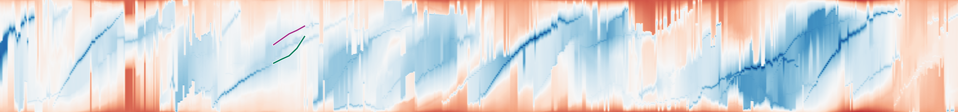

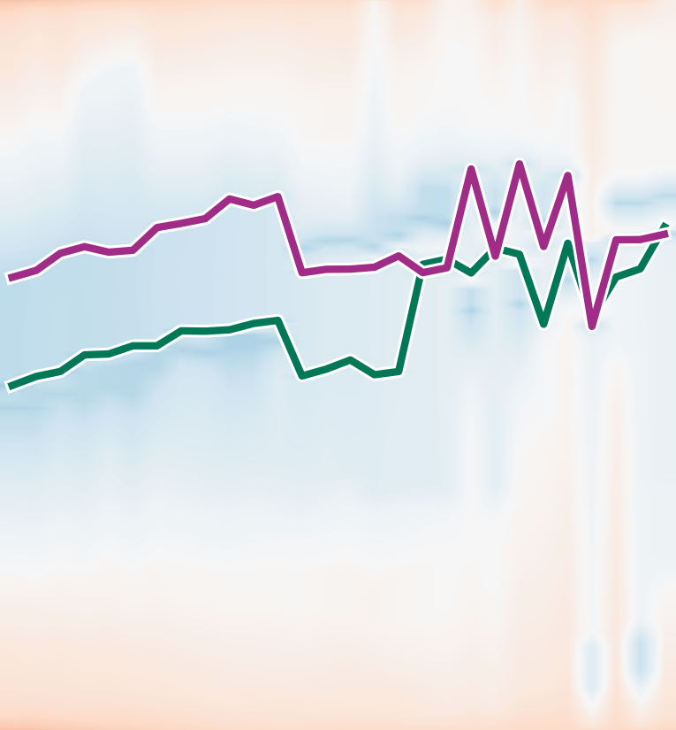


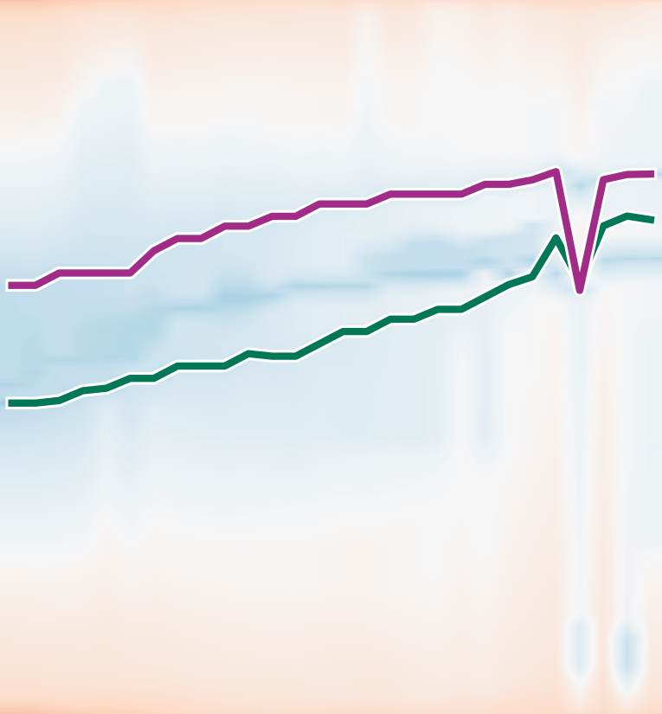

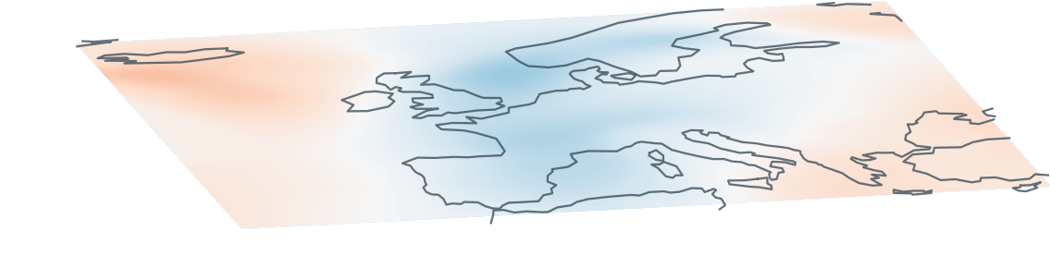

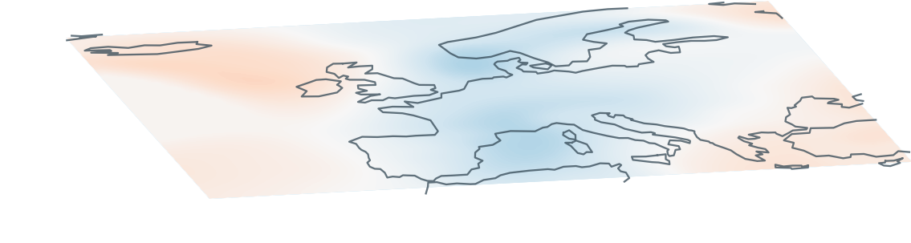

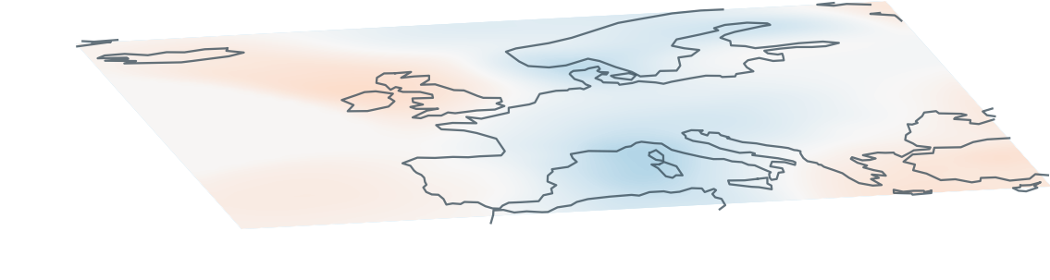

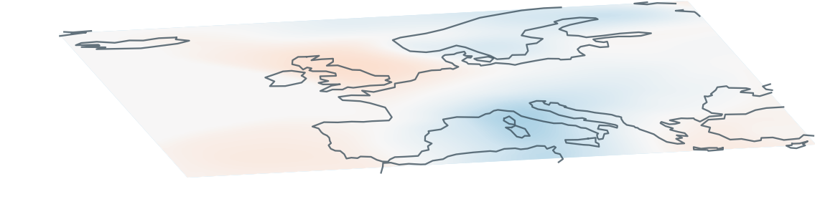

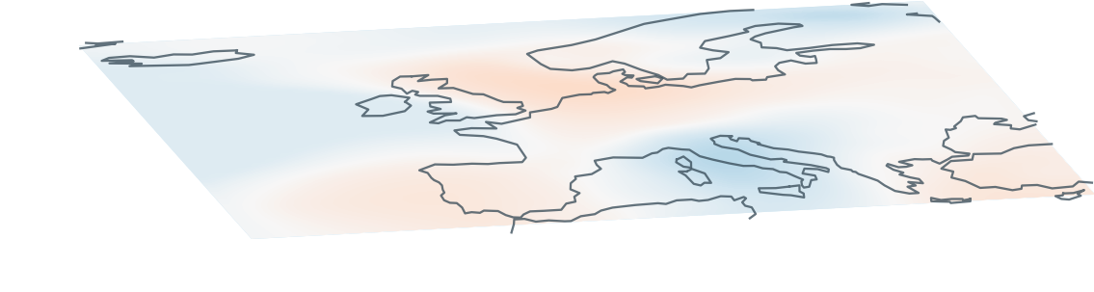
(a) Full sequence · ε = 5%
1.0
35
SLP anomaly [hPa]
Mapped position
0
0.5
Selected window
0.0
−35
0
150
300
450
600
743
(b) Spatial reference
(c) Leaf correspondence
Reference q
ε = 0%
ε = 0%
ε = 1%
ε = 2%
ε = 3%
ε = 5%
t = 212
0.75
1.0
A11
B11
B11
B12
B15
B23
B25
B33
B34
B35
B43
B44
B45
B53
B54
B55
0.60
B11
B13
B14
B21
B22
B24
B31
B32
B41
B42
B51
B52
q
0.45
A11
A14
A55
Mapped position
A35
A45
t = 218
0.75
B12
0.5
A12
A15
A23
A25
A34
A44
A54
A12
A11
A13
A21
A22
A24
A31
A32
A33
A41
A42
A43
A51
A52
A53
B12
0.60
q
0.45
A12
t = 224
0.0
212
224
236
212
224
236
212
224
236
212
224
236
212
224
236
A13
0.75
B13
B13
0.60
q
0.45
A13
(d) Progressive hierarchy relaxation · t = 236
t = 230
0.75
4 levels
4 levels
3 levels
3 levels
2 levels
A14
B14
B14
0.60
A14
0
q
0.45
t = 236
Levels below root
A15
0.75
2
A55
B55
B15
0.60
B15
B35
A35
B45
A45
A15
4
B15
A15
B25
A25
q
0.45
Notes:
Hybrid authoring: 16 scientific panels (heatmaps, snapshots with coastlines, scalar strips and scientific trajectory curves) were rendered from the audited code and inserted as PNG images. All 159 text items, axes/ticks, Aij/Bij instance labels, circular markers, reference diamonds, reference projection segments and right-angle marks, position-gap lines, selection frame, callout arrow and gradient colorbar are native editable PowerPoint objects. All 57 topology branches are native editable PowerPoint lines and exactly match the audited hierarchy. Parameters are 0%,1%,2%,3%,5%. Snapshots are t=212,218,224,230,236. c retains real hourly data through 239. Layout, data and topology are unchanged from the indexed scientific figure.
Root-aligned display: each complete tree and its A/B leaf labels are translated vertically so the root merge node has a shared top position. Branch connectivity, vertical inter-level spacing, leaf identity, scalar merge values and depth counts are unchanged. Vertical axis now reads Levels below root (0 at the common root).

