Slide 1

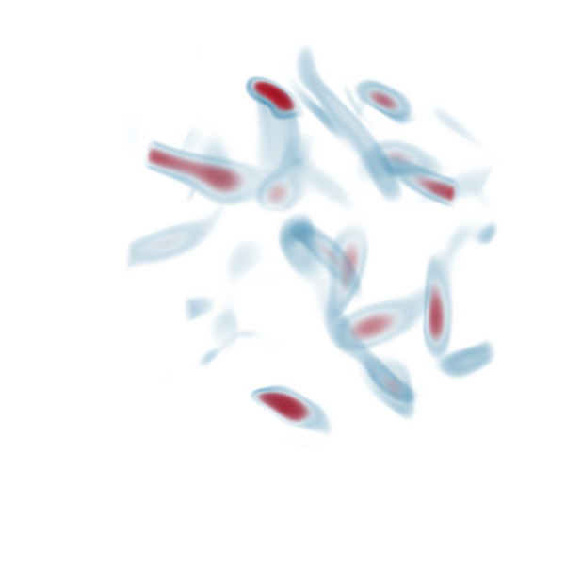
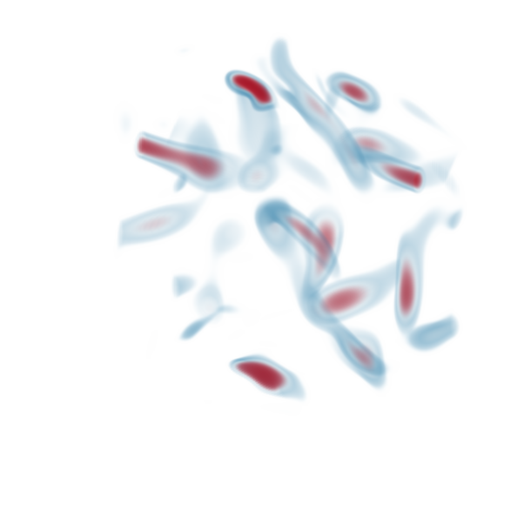
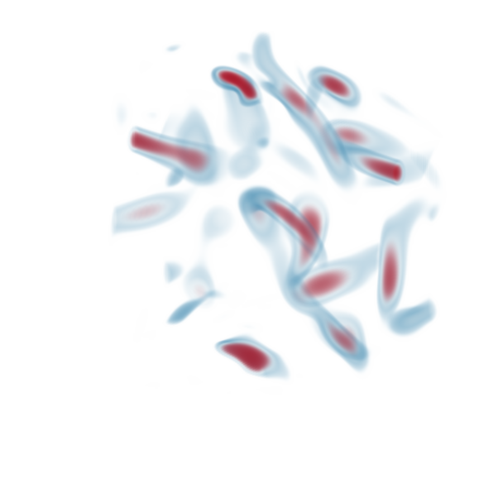


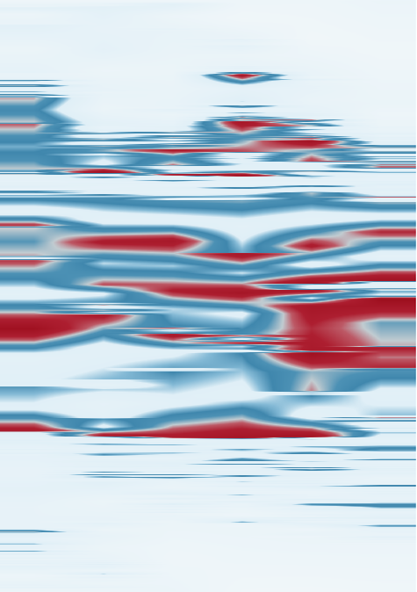

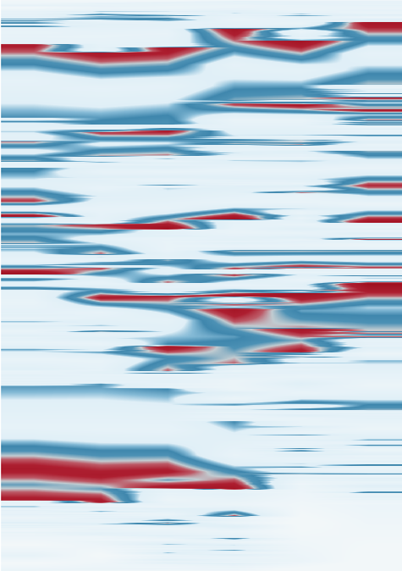

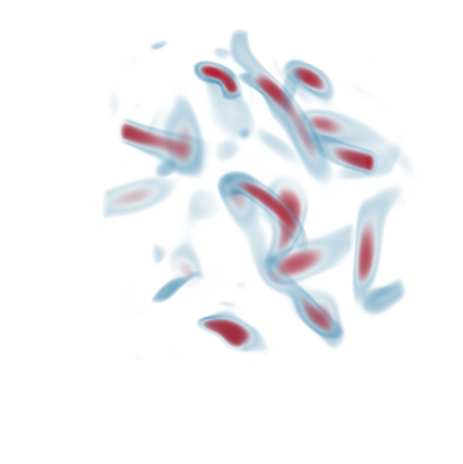
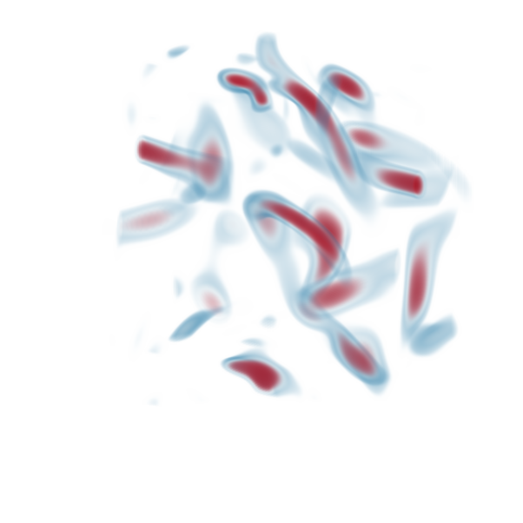
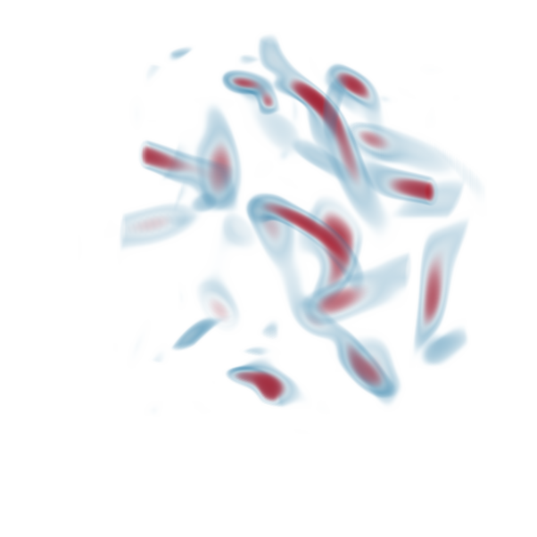
1.0
1
Mapped position
0
0.5
Normalized scalar
Selected window
−1
0.0
0
15
30
45
60
75
89
0%
0%
0%
1.0
ε = 0%
ε = 2%
ε = 5%
ε = 10%
t = 3
t = 4
t = 5
A11
A12
A13
A16
A22
A24
A26
A32
A34
A36
A42
A44
A45
A46
B11
A11
B12
B13
A15
A21
A23
A25
A31
A33
A35
A41
A43
A12
A13
A12
A14
A11
A13
Mapped position
0.5
B11
B12
B13
B32
B42
q
q
q
B12
B14
B22
B24
B25
B33
B43
B11
B13
B15
B16
B21
B23
B26
B31
B35
B41
B45
B34
B36
B44
B46
0.0
3
4
5
6
7
8
3
4
5
6
7
8
3
4
5
6
7
8
3
4
5
6
7
8
0%
0%
0%
t = 6
t = 7
t = 8
A14
A15
A15
A16
A16
74 levels
53 levels
48 levels
B14
A14
B15
B16
0
B15
B16
B14
20
q
q
q
Levels below root
40
B26
B36
A36
60
A26
80
B16
A16
Notes:
Vortex: 90 original 128-cubed normalized scalar volumes. Parameter budgets epsilon 0,2,5,10,20,30 percent; selected frames t=3..8. A/B identify voxel-overlap tracks 75/53. Source extrema project orthogonally in 3D to X-directed reference feet, q=X/127. Label first digit is parameter index 1..6, second digit is time index 1..6; b uses epsilon=0 identities A11..A16 and B11..B16. c retains all six time samples for each budget. d shows complete trees at t=8, with 142 leaves and depths 74,53,48,48,18,18. Diagram height is structural depth, not scalar. 3D volume rendering and 1D/2D scalar profiles share the blue/red scalar RGB transfer function. Source scalar transform display=-2*canonical join scalar. Original physical units and voxel spacing unavailable. Source 2 percent persistence simplification differs from epsilon. Epsilon=30 is solved on all 90 frames using the original frozen method and independently verified. Numerical profiles, position values, budget checks and data hashes: ../vortex_teaser_3d_v4_20261030/evidence.json, ../vortex_teaser_3d_v4_20261030/position_comparison.json, ../vortex_teaser_3d_v4_20261030/epsilon30/vorts/verification.json. Scientific input metadata: ../../../RG-MTM/code/results/volumes20261029/vorts/input_protocol.json.
Root-aligned display: each complete tree and its A/B leaf labels are translated vertically so the root merge node has a shared top position. Branch connectivity, vertical inter-level spacing, leaf identity, scalar merge values and depth counts are unchanged. Vertical axis now reads Levels below root (0 at the common root).
Layout revision: b is uniformly reduced to 82 percent and moved left, preserving volume aspect ratio and all point/projection alignment. Its axis label is q and the heading defines q=X/127, the normalized X voxel coordinate on a 128-sample axis. c/d each expand from width .072 to .08283333 of the slide, retaining all 6 parameter columns. Root-aligned topology, scalar values and labels retain their scientific identities.

