Slide 1
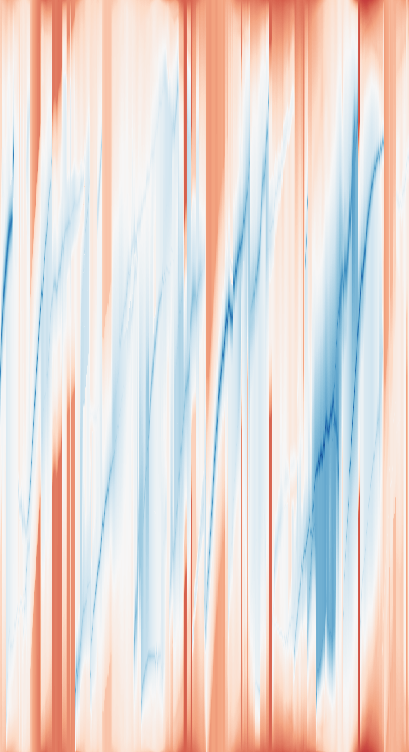
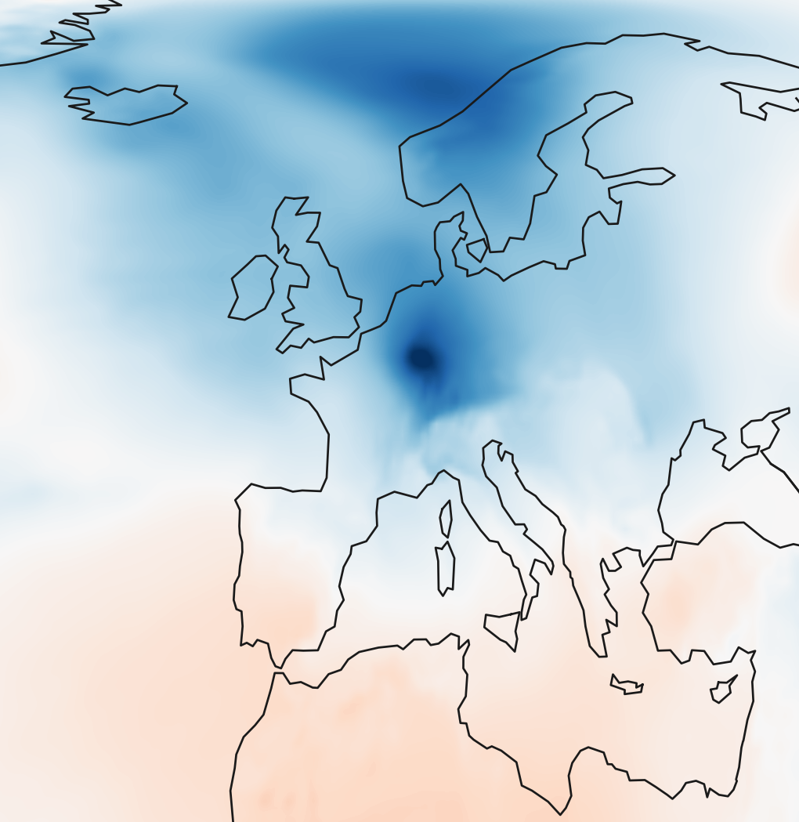
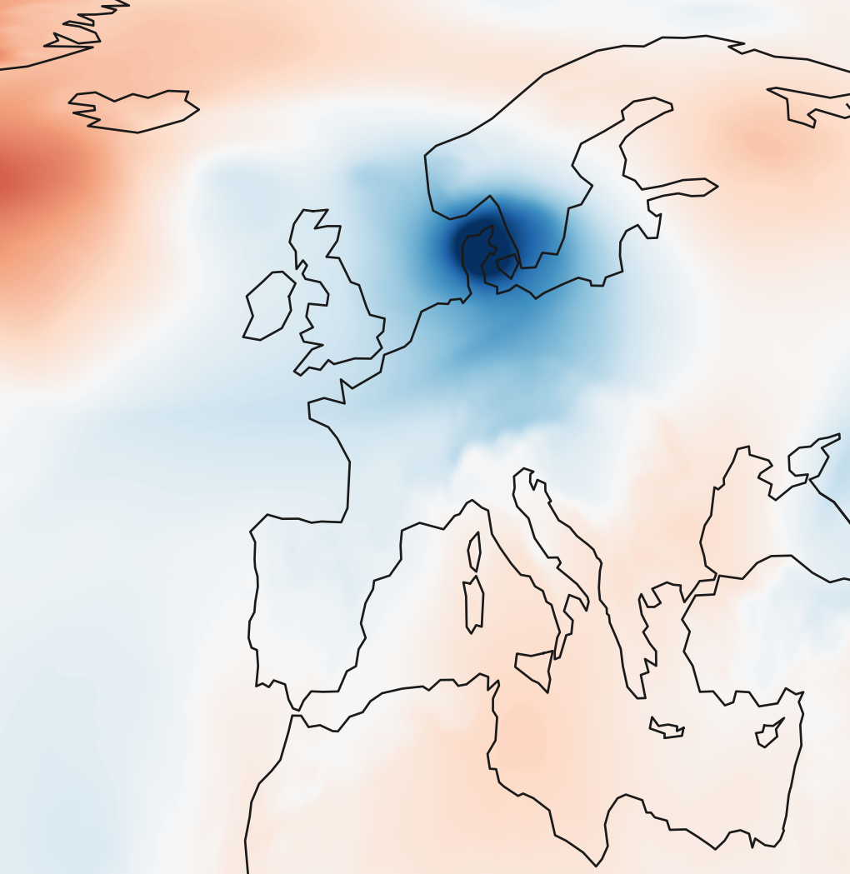
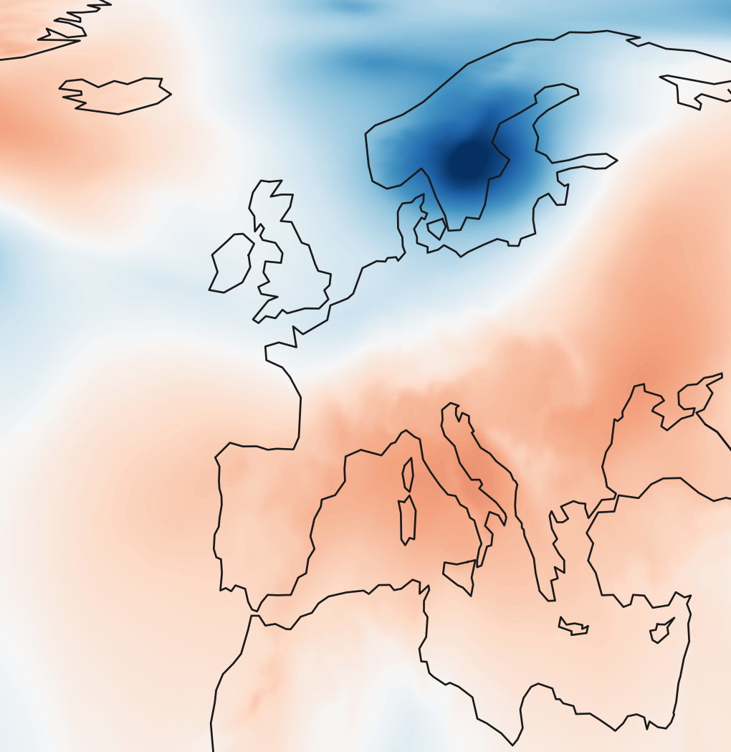
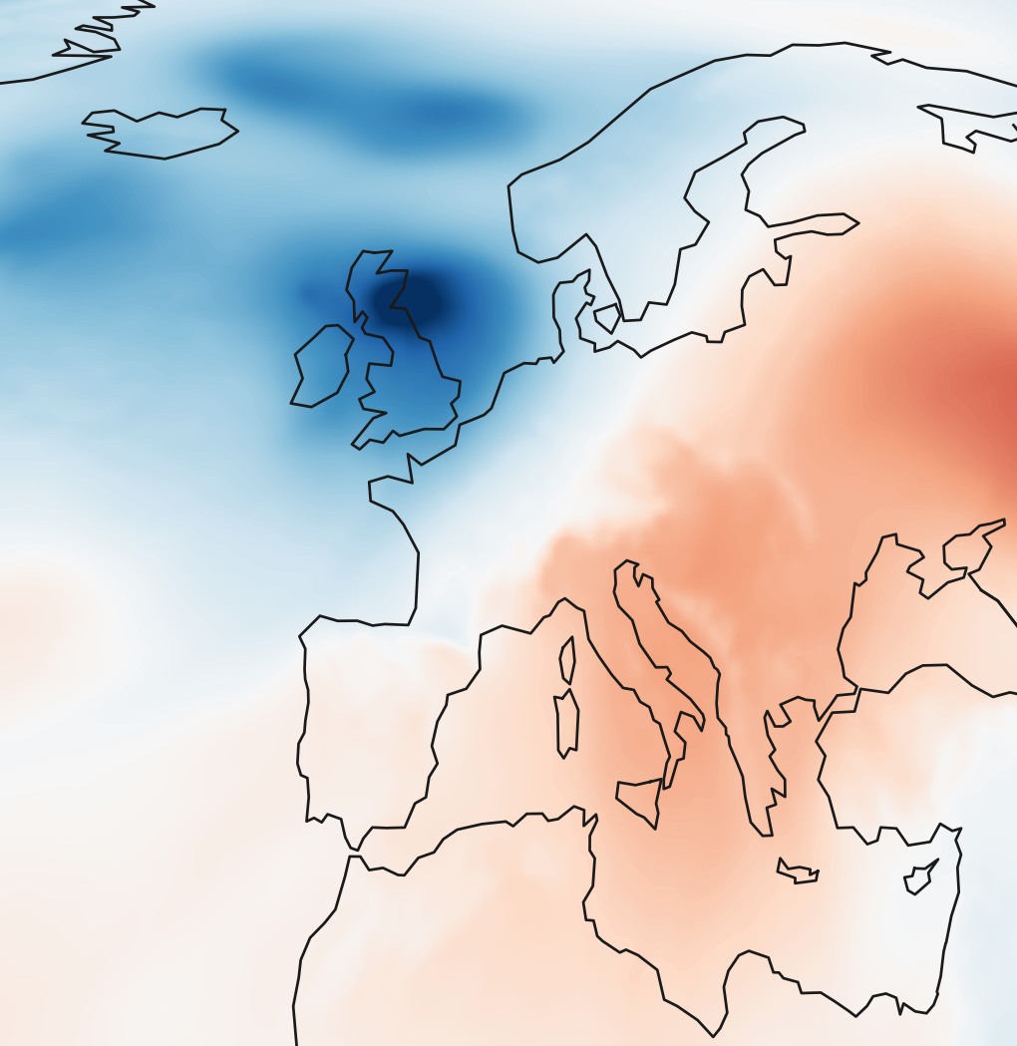
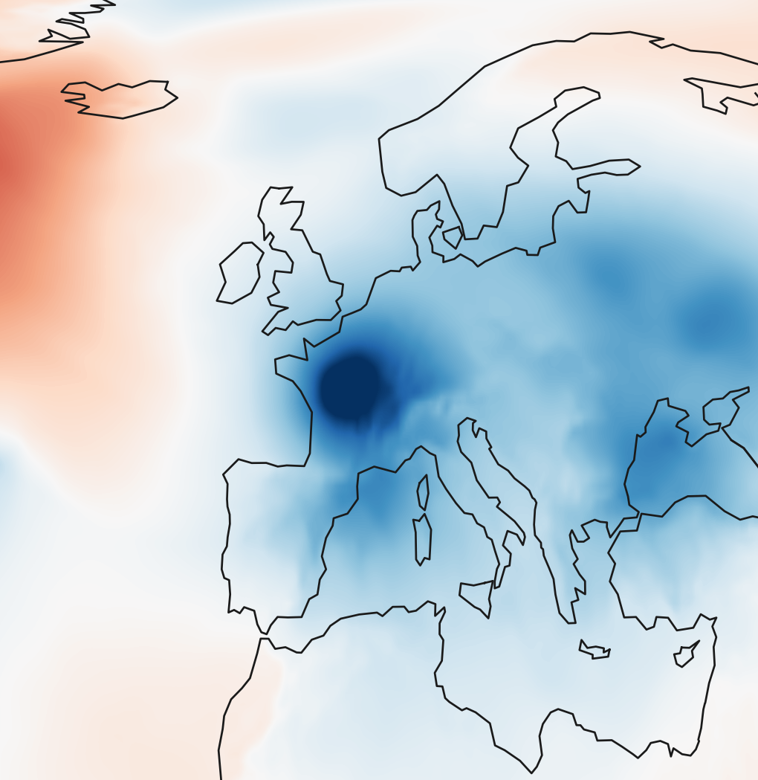
(a) RG-MTM-R20
d = (0.948, -0.319) · -18.6°
(b) Local event and tracks
26 Dec 1999 10:00 UTC
MSLP anomaly [hPa]
-35
0
35
Cyclone Martin
C
B
Strong storm over
Scandinavia
Reference position along d
A
Cyclone Lothar
d
Cyclone Anatol
Strong storm over the
British Isles and Norway
1 Dec
8 Dec
15 Dec
22 Dec
31 Dec
Local tracks · 00:00–23:00 UTC
Time
1.0
Output position
d
A
d
d
d
0.5
B
d
A
B
C
0.0
1999-12-03 18:00
1999-12-17 21:00
1999-12-24 23:00
1999-12-26 10:00
1999-12-27 21:00
00:00
10:00
23:00
Time (UTC, 26 Dec)
Notes:
New authorized experiment: ERA5 December 1 00:00–December31 23:00 1999, 744 actual hourly observations. d=[0.9478317491832081, -0.3187710388982978], angle=-18.588619 degrees in equal-area coordinates. RG-MTM-R20 recomputed with the existing solver and optimal scalar barriers. Analysis:49x49 grid,250km smoothing,192-hour centered pressure anomaly baseline. This differs from the reference papers spatial preprocessing. Five published event dates/names follow TMTM Fig1, https://www.csc.kth.se/~weinkauf/publications/documents/koepp22.pdf . Annotation targets are actual computed minima nearest the published event region; identities are not independently validated cyclone tracks. Maps are native 0.25degree ERA5 hourly anomaly fields. Intermediate display columns use conservative anchor alignment; original744 scalar columns unchanged. This is an additional experiment; existing manuscript numbers and the118-frame main suite are unchanged. Events: [{"frame": 66, "date": "1999-12-03 18:00", "label": "Cyclone Anatol", "computed_track_id": 10, "computed_minimum_lonlat": [10.714285714285714, 55.898925088212714], "anchor": 0.5083428819489186, "value_hPa": -23.769877835416683, "association": "nearest computed extremum to published event region; no independently verified physical tracking identity"}, {"frame": 405, "date": "1999-12-17 21:00", "label": "Strong storm over Scandinavia", "computed_track_id": 68, "computed_minimum_lonlat": [15.000000000000002, 61.11526665243035], "anchor": 0.5279911954434983, "value_hPa": -26.117821436974296, "association": "nearest computed extremum to published event region; no independently verified physical tracking identity"}, {"frame": 575, "date": "1999-12-24 23:00", "label": "Strong storm over the British Isles and Norway", "computed_track_id": 113, "computed_minimum_lonlat": [-2.142857142857143, 55.898925088212714], "anchor": 0.3747037527199593, "value_hPa": -25.9252721915634, "association": "nearest computed extremum to published event region; no independently verified physical tracking identity"}, {"frame": 610, "date": "1999-12-26 10:00", "label": "Cyclone Lothar", "computed_track_id": 130, "computed_minimum_lonlat": [7.857142857142858, 50.44356386922743], "anchor": 0.517861235120954, "value_hPa": -21.563336802880915, "association": "nearest computed extremum to published event region; no independently verified physical tracking identity"}, {"frame": 645, "date": "1999-12-27 21:00", "label": "Cyclone Martin", "computed_track_id": 141, "computed_minimum_lonlat": [3.5714285714285743, 47.135364049152884], "anchor": 0.48891695139322705, "value_hPa": -27.33887300096107, "association": "nearest computed extremum to published event region; no independently verified physical tracking identity"}] Right panel: {"event_frame": 610, "event_time": "1999-12-26 10:00:00", "local_frames": [600, 623], "labels": {"A": {"track_id": 130, "frame": 610, "lonlat": [7.857142857142858, 50.44356386922743], "actual_anchor": 0.517861235120954, "reference": 0.5095279017876208, "field_hPa": -21.563336802880915, "source_position_px": [1182.5, 171.48021010838522], "samples": [{"frame": 601, "date": "1999-12-26 01:00:00", "actual_anchor": 0.35178230406587174, "reference": 0.3601156373992051, "lonlat": [-6.428571428571429, 49.595639856116314]}, {"frame": 602, "date": "1999-12-26 02:00:00", "actual_anchor": 0.36725917658603074, "reference": 0.37559250991936405, "lonlat": [-5.0, 49.595639856116314]}, {"frame": 603, "date": "1999-12-26 03:00:00", "actual_anchor": 0.3827360491061897, "reference": 0.391069382439523, "lonlat": [-3.571428571428571, 49.595639856116314]}, {"frame": 604, "date": "1999-12-26 04:00:00", "actual_anchor": 0.4083333333333334, "reference": 0.4166666666666667, "lonlat": [-0.7142857142857143, 50.44356386922743]}, {"frame": 605, "date": "1999-12-26 05:00:00", "actual_anchor": 0.4289095314702889, "reference": 0.4375000000000001, "lonlat": [0.7142857142857143, 49.595639856116314]}, {"frame": 606, "date": "1999-12-26 06:00:00", "actual_anchor": 0.4353247828223805, "reference": 0.4476204117069847, "lonlat": [2.142857142857143, 50.44356386922743]}, {"frame": 607, "date": "1999-12-26 07:00:00", "actual_anchor": 0.4732979596213334, "reference": 0.4630972842271438, "lonlat": [3.5714285714285743, 50.44356386922743]}, {"frame": 608, "date": "1999-12-26 08:00:00", "actual_anchor": 0.486907490080636, "reference": 0.47857415674730275, "lonlat": [5.0, 50.44356386922743]}, {"frame": 609, "date": "1999-12-26 09:00:00", "actual_anchor": 0.5023843626007951, "reference": 0.49405102926746164, "lonlat": [6.428571428571424, 50.44356386922743]}, {"frame": 610, "date": "1999-12-26 10:00:00", "actual_anchor": 0.517861235120954, "reference": 0.5095279017876208, "lonlat": [7.857142857142858, 50.44356386922743]}, {"frame": 611, "date": "1999-12-26 11:00:00", "actual_anchor": 0.5333381076411131, "reference": 0.5250047743077797, "lonlat": [9.285714285714288, 50.44356386922743]}, {"frame": 612, "date": "1999-12-26 12:00:00", "actual_anchor": 0.5488149801612721, "reference": 0.5404816468279388, "lonlat": [10.714285714285714, 50.44356386922743]}, {"frame": 613, "date": "1999-12-26 13:00:00", "actual_anchor": 0.564291852681431, "reference": 0.5559585193480976, "lonlat": [12.14285714285714, 50.44356386922743]}, {"frame": 614, "date": "1999-12-26 14:00:00", "actual_anchor": 0.5797687252015901, "reference": 0.5714353918682566, "lonlat": [13.571428571428573, 50.44356386922743]}, {"frame": 615, "date": "1999-12-26 15:00:00", "actual_anchor": 0.5797687252015901, "reference": 0.5714353918682566, "lonlat": [13.571428571428573, 50.44356386922743]}, {"frame": 616, "date": "1999-12-26 16:00:00", "actual_anchor": 0.5952455977217491, "reference": 0.5869122643884157, "lonlat": [15.000000000000002, 50.44356386922743]}, {"frame": 617, "date": "1999-12-26 17:00:00", "actual_anchor": 0.6042516770539847, "reference": 0.6023891369085747, "lonlat": [16.42857142857143, 50.44356386922743]}, {"frame": 618, "date": "1999-12-26 18:00:00", "actual_anchor": 0.6025960858136203, "reference": 0.6023891369085747, "lonlat": [16.42857142857143, 50.44356386922743]}, {"frame": 619, "date": "1999-12-26 19:00:00", "actual_anchor": 0.6184454362433613, "reference": 0.6178660094287336, "lonlat": [17.857142857142858, 50.44356386922743]}, {"frame": 620, "date": "1999-12-26 20:00:00", "actual_anchor": 0.6179303920432164, "reference": 0.6178660094287336, "lonlat": [17.857142857142858, 50.44356386922743]}, {"frame": 621, "date": "1999-12-26 21:00:00", "actual_anchor": 0.6338997982965894, "reference": 0.6333428819488925, "lonlat": [19.285714285714285, 50.44356386922743]}, {"frame": 622, "date": "1999-12-26 22:00:00", "actual_anchor": 0.6334047634070659, "reference": 0.6333428819488925, "lonlat": [19.285714285714285, 50.44356386922743]}, {"frame": 623, "date": "1999-12-26 23:00:00", "actual_anchor": 0.6333497596841358, "reference": 0.6333428819488925, "lonlat": [19.285714285714285, 50.44356386922743]}]}, "B": {"track_id": 113, "frame": 610, "lonlat": [9.285714285714288, 66.01163429921519], "actual_anchor": 0.4363245287768315, "reference": 0.4446578621101648, "field_hPa": -24.47742273730672, "source_position_px": [1187.5, 94.29956856566434], "samples": [{"frame": 600, "date": "1999-12-26 00:00:00", "actual_anchor": 0.4482272445496877, "reference": 0.4398939112163544, "lonlat": [7.857142857142858, 63.4584625831927]}, {"frame": 601, "date": "1999-12-26 01:00:00", "actual_anchor": 0.4482272445496877, "reference": 0.4398939112163544, "lonlat": [7.857142857142858, 63.4584625831927]}, {"frame": 602, "date": "1999-12-26 02:00:00", "actual_anchor": 0.4482272445496877, "reference": 0.4398939112163544, "lonlat": [7.857142857142858, 63.4584625831927]}, {"frame": 603, "date": "1999-12-26 03:00:00", "actual_anchor": 0.4482272445496877, "reference": 0.4398939112163544, "lonlat": [7.857142857142858, 63.4584625831927]}, {"frame": 604, "date": "1999-12-26 04:00:00", "actual_anchor": 0.45834765625667256, "reference": 0.45001432292333915, "lonlat": [9.285714285714288, 64.70493280544402]}, {"frame": 605, "date": "1999-12-26 05:00:00", "actual_anchor": 0.46122818048152253, "reference": 0.45001432292333915, "lonlat": [9.285714285714288, 64.70493280544402]}, {"frame": 606, "date": "1999-12-26 06:00:00", "actual_anchor": 0.465741739104694, "reference": 0.45001432292333915, "lonlat": [9.285714285714288, 64.70493280544402]}, {"frame": 607, "date": "1999-12-26 07:00:00", "actual_anchor": 0.43981364752914953, "reference": 0.45001432292333915, "lonlat": [9.285714285714288, 64.70493280544402]}, {"frame": 608, "date": "1999-12-26 08:00:00", "actual_anchor": 0.44168098959000585, "reference": 0.45001432292333915, "lonlat": [9.285714285714288, 64.70493280544402]}, {"frame": 609, "date": "1999-12-26 09:00:00", "actual_anchor": 0.4363245287768315, "reference": 0.4446578621101648, "lonlat": [9.285714285714288, 66.01163429921519]}, {"frame": 610, "date": "1999-12-26 10:00:00", "actual_anchor": 0.4363245287768315, "reference": 0.4446578621101648, "lonlat": [9.285714285714288, 66.01163429921519]}, {"frame": 611, "date": "1999-12-26 11:00:00", "actual_anchor": 0.4363245287768315, "reference": 0.4446578621101648, "lonlat": [9.285714285714288, 66.01163429921519]}, {"frame": 612, "date": "1999-12-26 12:00:00", "actual_anchor": 0.43096806796365716, "reference": 0.4393014012969904, "lonlat": [9.285714285714288, 67.389044573133]}, {"frame": 613, "date": "1999-12-26 13:00:00", "actual_anchor": 0.41549119544349805, "reference": 0.4238245287768314, "lonlat": [7.857142857142858, 67.389044573133]}, {"frame": 614, "date": "1999-12-26 14:00:00", "actual_anchor": 0.41013473463032374, "reference": 0.4184680679636571, "lonlat": [7.857142857142858, 68.85101425867806]}, {"frame": 615, "date": "1999-12-26 15:00:00", "actual_anchor": 0.3738245287768313, "reference": 0.38215786211016467, "lonlat": [5.0, 70.41651429372894]}, {"frame": 616, "date": "1999-12-26 16:00:00", "actual_anchor": 0.3738245287768313, "reference": 0.38215786211016467, "lonlat": [5.0, 70.41651429372894]}]}, "C": {"track_id": 133, "frame": 610, "lonlat": [-12.142857142857142, 63.4584625831927], "actual_anchor": 0.22061595803349957, "reference": 0.22321769593412838, "field_hPa": -16.075817767216122, "source_position_px": [1112.5, 104.59032077136041], "samples": [{"frame": 605, "date": "1999-12-26 05:00:00", "actual_anchor": 0.21239943480878357, "reference": 0.2130972842271438, "lonlat": [-13.571428571428573, 62.26407095289291]}, {"frame": 606, "date": "1999-12-26 06:00:00", "actual_anchor": 0.21147652876683076, "reference": 0.2130972842271438, "lonlat": [-13.571428571428573, 62.26407095289291]}, {"frame": 607, "date": "1999-12-26 07:00:00", "actual_anchor": 0.21077238416481642, "reference": 0.2130972842271438, "lonlat": [-13.571428571428573, 62.26407095289291]}, {"frame": 608, "date": "1999-12-26 08:00:00", "actual_anchor": 0.2122474103176572, "reference": 0.2130972842271438, "lonlat": [-13.571428571428573, 62.26407095289291]}, {"frame": 609, "date": "1999-12-26 09:00:00", "actual_anchor": 0.22542537481878447, "reference": 0.2285741567473027, "lonlat": [-12.142857142857142, 62.26407095289291]}, {"frame": 610, "date": "1999-12-26 10:00:00", "actual_anchor": 0.22061595803349957, "reference": 0.22321769593412838, "lonlat": [-12.142857142857142, 63.4584625831927]}]}}, "direction": [0.9478317491832081, -0.3187710388982978], "output_anchor_tracks_native": true, "map_and_track_ids_identical": true, "local_raster_is_exact_full_map_crop": true, "crop_pixels": [1800, 0, 1872, 4096], "local_y_limits": [0.0, 1.0], "no_extrapolation": true, "feature_C_exists_only_frames": [605, 610], "track_identity_scope": "computed overlap-linked minima, not independently verified meteorological tracks", "main_window_rectangle_px": {"x": 781.9241935483869, "y": 33.6, "w": 29.67096774193548, "h": 312.0}, "matching_red_window_outlines": true, "complete_output_axis": true, "temporal_selection_only": true, "event_guides": "black dashed; selected source event red dashed"}

