Slide 1
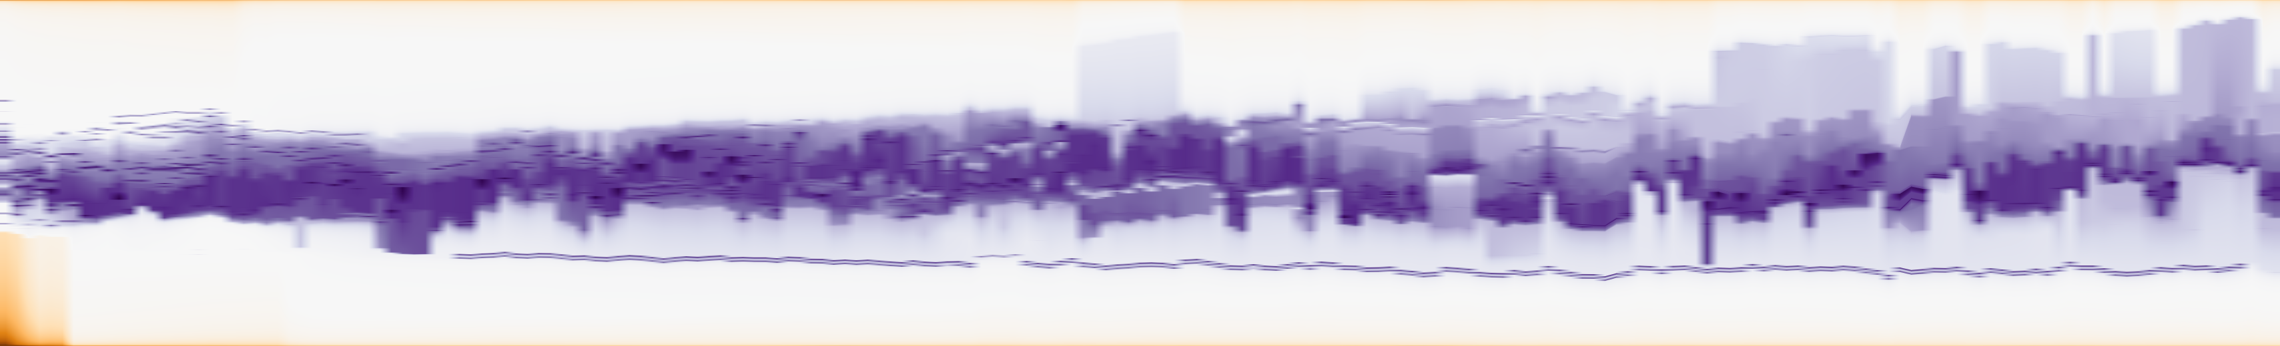
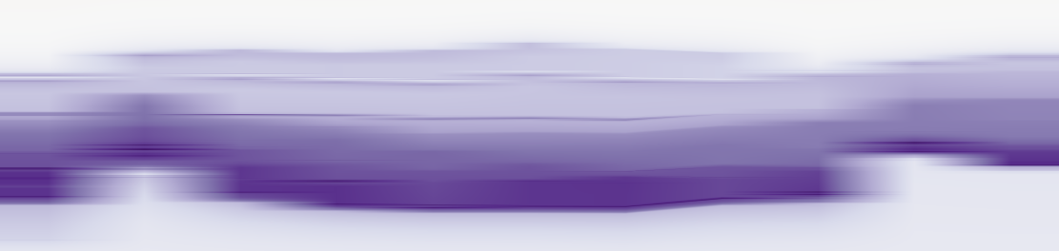
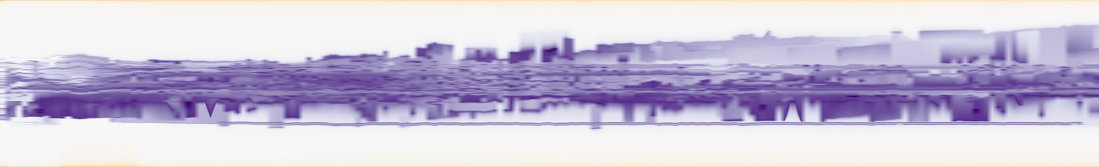
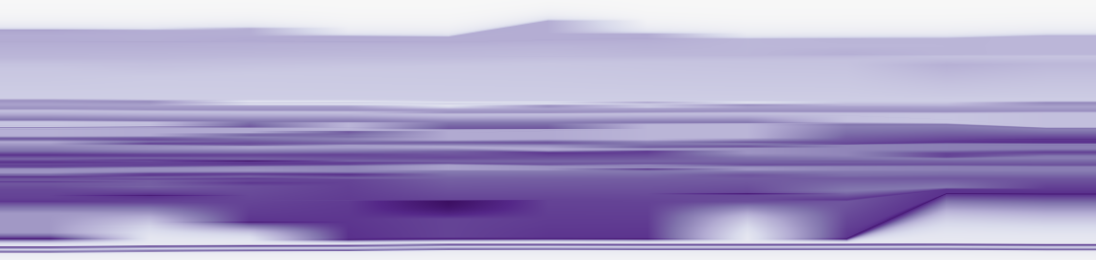
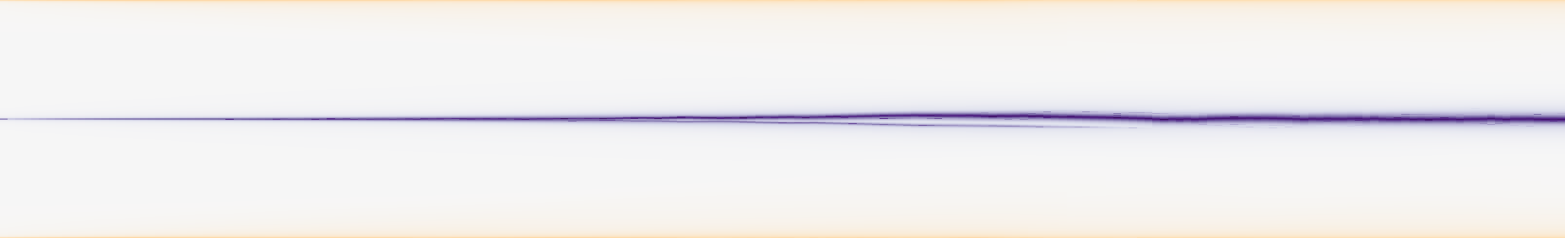
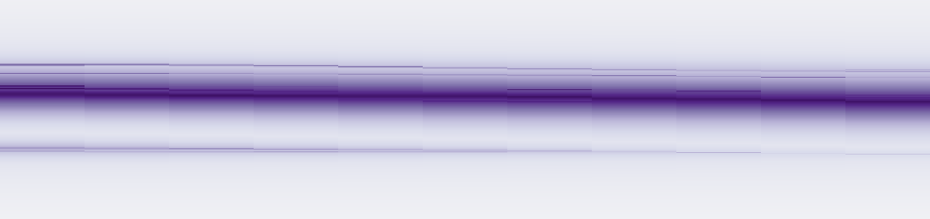
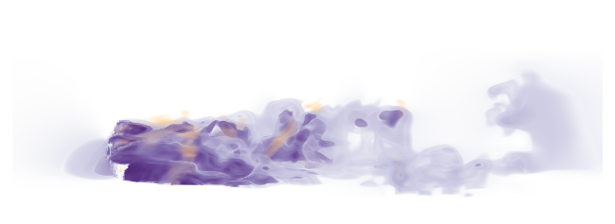

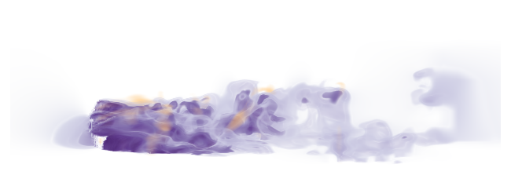
(a) Full sequence
(b) Local window
0
200
135
145
1
0.85
RG-P
A
B
C
0
0.24
1
0
200
0.86
135
145
RG-R20
A
B
C
0
0.23
0
200
135
145
(c) 3D source snapshots
Frame 139
Frame 140
Frame 141
A
C
A
C
A
C
z
B
B
y
B
x
Notes:
{"source": "saved real_case_studies/evidence", "case": "tangaroa", "selection": {"t": 140, "witness": [9, 16, 24], "node": 182010, "bound": 0.0854500980666667, "tracks": [432, 462, 388], "persistent_three_frames": true, "H": 0.1374416505655397, "gain": 0.13744130257793488, "errorP": 0.1476048264047157, "errorR": 0.010163523826780806, "delta": 0.2750041335821152, "rule": "Among H_lower>2% frames with a three-frame matched witness triple and positive measured relaxation cost, choose largest achieved P-to-R max-error reduction (earliest tie). Descriptive selection biased toward visible relaxation benefit.", "snapshots": [139, 140, 141], "window": [135, 146]}, "identity": "computed positive-overlap Hungarian scalar-feature assignment; not physical entity truth", "baseline_vertical_semantics": "TMTM full native sample-rank domain; ST-MTM full shared discretized native domain; RG fixed physical directional reference domain. Baselines are not geographical coordinates.", "rendering": "exact saved anchors over native scalar maps; 3D display map is subsampled; no scientific values recomputed"}
Palette audit 2026-10-22: all six scalar map images exactly match the original TMTM author-workspace RGB transfer function. Three volume images match the original transfer-function renders and original scalar hashes. Low speed purple, central values white, high speed orange/brown; scalar range [0,2]. FAU source-provider thumbnail depicts vorticity, a different variable from the displayed velocity magnitude. Original author workspace: https://github.com/Wiebke/TemporalMergeTreeMaps/blob/2c75a10ed2cd55177a25ff751e0c0a8261200717/modules/mergetreemaps/data/workspaces/sequence_tangaroa_volRendering.inv
Temporal display revision: intermediate time columns interpolate existing saved profiles for display only. Integer-frame profiles, native extrema and metrics are unchanged before pixel integration. Broad bands and true order changes remain visible. See evidence/temporal_display20261023/provenance.json.

