Slide 1
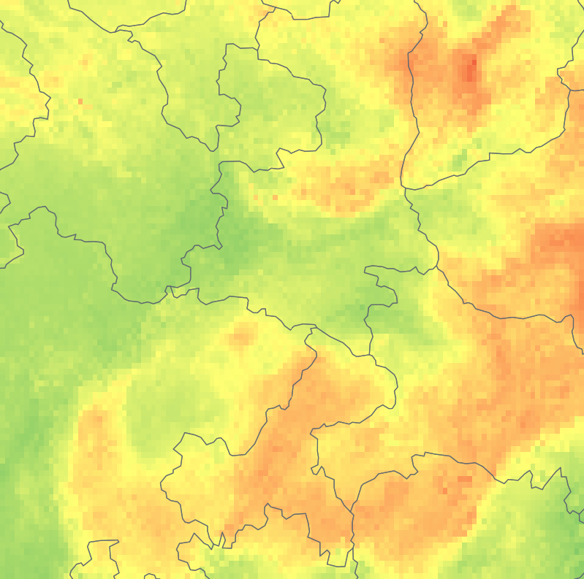
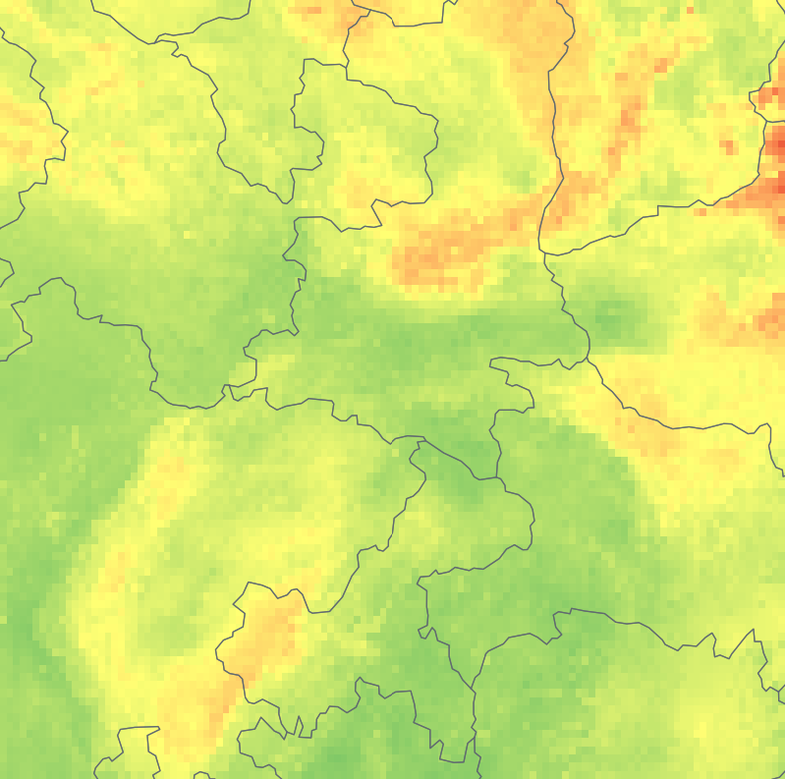
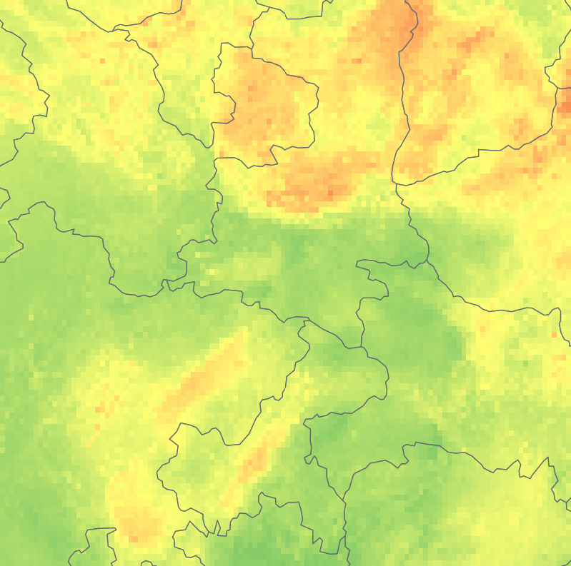
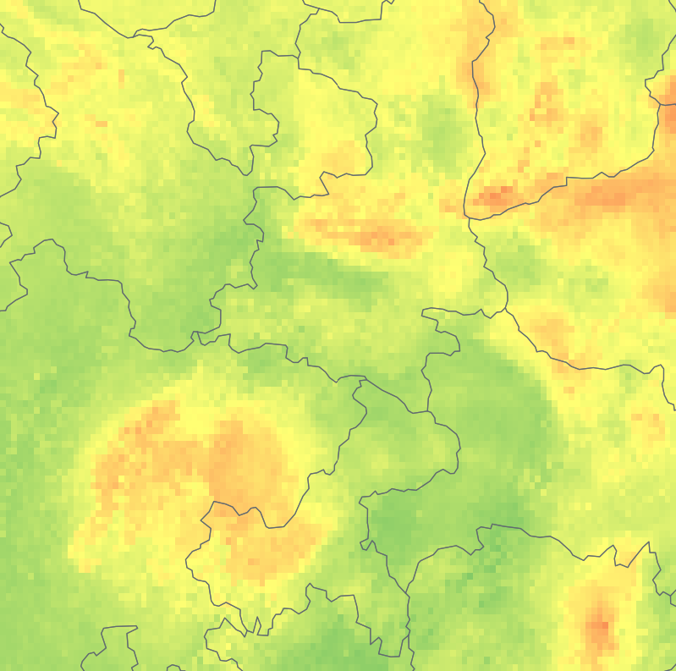
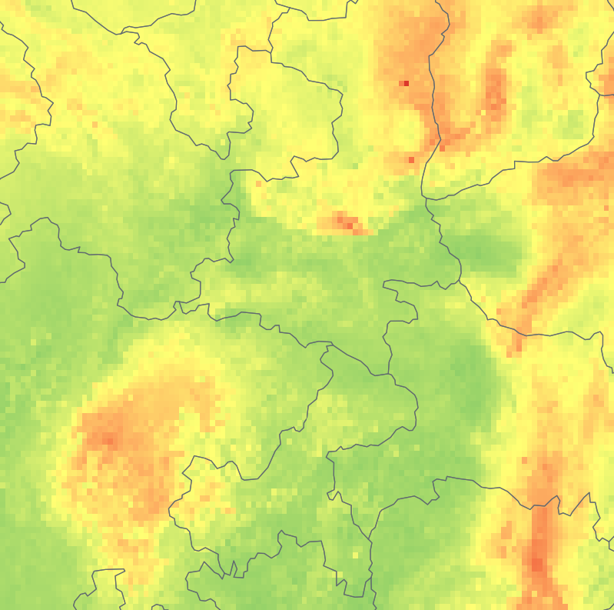
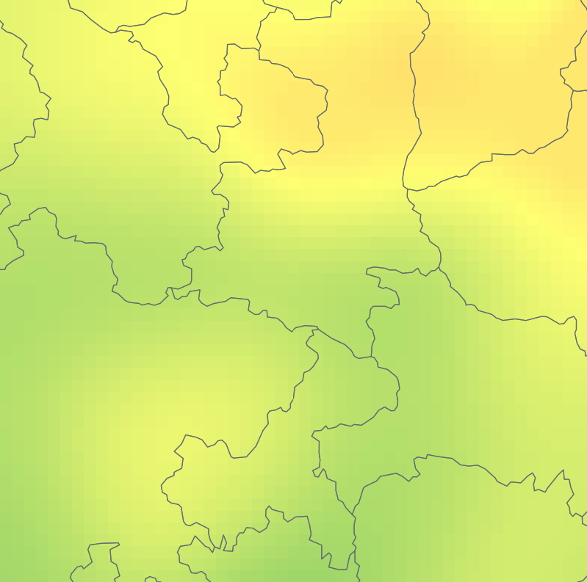
(a) PM2.5 in 2000: complete RG-MTM-R20 map
1
Jul 10-20
0.5
0
Jan 1
Apr 1
Jul 1
Oct 1
Dec 31
Normalized fixed reference position
0
40
80
120
165
(b) Supplied concentration fields: Jul 12-16
Panel (a): concentration (ug m-3)
38
2000-07-12
2000-07-13
2000-07-14
2000-07-15
2000-07-16
B
B
B
B
33
B
C
C
C
C
A
A
A
28
102
108
114
102
108
114
102
108
114
102
108
114
102
108
114
Longitude (degrees E); latitude (degrees N). All five dates share the local 0-100 concentration scale.
(c) Jul 14: supplied field and actual analysis input
(d) Jul 10-20: same tracks, same fixed reference
38
Supplied grid
38
Analysis: 100 km smoothing
1
RG-MTM-P (source hierarchy)
B
B
C
0.5
B
0
A
33
33
d
07-10
07-12
07-14
07-16
07-18
07-20
C
C
1
RG-MTM-R20
A
A
0.5
C
B
28
28
A
102
108
114
102
108
114
0
07-10
07-12
07-14
07-16
07-18
07-20
0
25
50
75
100
Panels (b,c,d): concentration (ug m-3), shared 0-100 scale
A=153, B=146, C=152: extrema of the processed field, projected onto both source views.
Solid traces: saved anchors. Dashed traces: fixed references. Gaps retain saved births and deaths.
Jul 14: max displayed anchor error P 14.88% L to R20 0.84% L; measured NMLE 1.12% (window max 3.33%).
Pair merge levels (ug m-3): source = P AB 25.94, AC 22.63, BC 22.63; R20 AB = AC = BC = 24.28.
Notes:
{"dataset": "pm25_2000", "frames": 366, "selection_rule": "Among frames whose strongest 3-feature interleaving witness exceeds 2% L and whose three tracks coexist for at least 3 consecutive saved dates, choose the frame closest to the median witness obstruction; earliest tie. No error, motion, or gain criterion.", "candidate_frames": 35, "eligible_frames": 5, "median_witness_share": 0.10257453129283257, "candidates": [{"frame": 57, "date": "2000-02-27", "indices": [1, 3, 0], "tracks": [51, 53, 50], "witness_bound_share": 0.11864576520129538, "common_interval": [57, 57], "consecutive_frames": 1}, {"frame": 59, "date": "2000-02-29", "indices": [1, 3, 2], "tracks": [59, 56, 50], "witness_bound_share": 0.145126512428109, "common_interval": [59, 59], "consecutive_frames": 1}, {"frame": 68, "date": "2000-03-09", "indices": [0, 1, 3], "tracks": [67, 68, 59], "witness_bound_share": 0.020130089102266973, "common_interval": [68, 68], "consecutive_frames": 1}, {"frame": 71, "date": "2000-03-12", "indices": [1, 2, 0], "tracks": [72, 59, 71], "witness_bound_share": 0.100461221925475, "common_interval": [71, 71], "consecutive_frames": 1}, {"frame": 78, "date": "2000-03-19", "indices": [1, 2, 0], "tracks": [75, 59, 74], "witness_bound_share": 0.03972112084022017, "common_interval": [78, 78], "consecutive_frames": 1}, {"frame": 89, "date": "2000-03-30", "indices": [0, 2, 1], "tracks": [83, 82, 79], "witness_bound_share": 0.06126127507877781, "common_interval": [89, 89], "consecutive_frames": 1}, {"frame": 99, "date": "2000-04-09", "indices": [0, 2, 1], "tracks": [90, 89, 91], "witness_bound_share": 0.1645497806251511, "common_interval": [99, 99], "consecutive_frames": 1}, {"frame": 105, "date": "2000-04-15", "indices": [0, 1, 2], "tracks": [96, 97, 89], "witness_bound_share": 0.08227667864965493, "common_interval": [105, 106], "consecutive_frames": 2}, {"frame": 106, "date": "2000-04-16", "indices": [1, 2, 3], "tracks": [96, 97, 89], "witness_bound_share": 0.08562513626407582, "common_interval": [105, 106], "consecutive_frames": 2}, {"frame": 116, "date": "2000-04-26", "indices": [0, 4, 1], "tracks": [104, 97, 105], "witness_bound_share": 0.14671507112778534, "common_interval": [116, 116], "consecutive_frames": 1}, {"frame": 125, "date": "2000-05-05", "indices": [1, 3, 2], "tracks": [110, 114, 113], "witness_bound_share": 0.1290624318679621, "common_interval": [125, 125], "consecutive_frames": 1}, {"frame": 126, "date": "2000-05-06", "indices": [1, 3, 0], "tracks": [110, 116, 112], "witness_bound_share": 0.11899917565390755, "common_interval": [126, 126], "consecutive_frames": 1}, {"frame": 132, "date": "2000-05-12", "indices": [1, 2, 0], "tracks": [122, 123, 112], "witness_bound_share": 0.0676226632257989, "common_interval": [132, 132], "consecutive_frames": 1}, {"frame": 146, "date": "2000-05-26", "indices": [1, 2, 0], "tracks": [132, 122, 130], "witness_bound_share": 0.04873129904475394, "common_interval": [146, 146], "consecutive_frames": 1}, {"frame": 180, "date": "2000-06-29", "indices": [0, 2, 1], "tracks": [132, 144, 143], "witness_bound_share": 0.16260781147286274, "common_interval": [180, 180], "consecutive_frames": 1}, {"frame": 185, "date": "2000-07-04", "indices": [0, 2, 1], "tracks": [132, 147, 146], "witness_bound_share": 0.07750384920230999, "common_interval": [185, 187], "consecutive_frames": 3}, {"frame": 186, "date": "2000-07-05", "indices": [0, 2, 1], "tracks": [132, 147, 146], "witness_bound_share": 0.12111248502126526, "common_interval": [185, 187], "consecutive_frames": 3}, {"frame": 195, "date": "2000-07-14", "indices": [0, 2, 1], "tracks": [153, 146, 152], "witness_bound_share": 0.10257453129283257, "common_interval": [195, 197], "consecutive_frames": 3}, {"frame": 196, "date": "2000-07-15", "indices": [0, 2, 1], "tracks": [153, 146, 152], "witness_bound_share": 0.18043894429607085, "common_interval": [195, 197], "consecutive_frames": 3}, {"frame": 197, "date": "2000-07-16", "indices": [0, 2, 1], "tracks": [153, 154, 152], "witness_bound_share": 0.17267106768691734, "common_interval": [197, 197], "consecutive_frames": 1}, {"frame": 205, "date": "2000-07-24", "indices": [1, 2, 0], "tracks": [146, 157, 156], "witness_bound_share": 0.028958197069257816, "common_interval": [205, 205], "consecutive_frames": 1}, {"frame": 223, "date": "2000-08-11", "indices": [0, 3, 1], "tracks": [164, 165, 163], "witness_bound_share": 0.14954235474868316, "common_interval": [223, 223], "consecutive_frames": 1}, {"frame": 224, "date": "2000-08-12", "indices": [0, 2, 1], "tracks": [164, 158, 163], "witness_bound_share": 0.05861248502126494, "common_interval": [223, 224], "consecutive_frames": 2}, {"frame": 233, "date": "2000-08-21", "indices": [0, 3, 1], "tracks": [158, 170, 168], "witness_bound_share": 0.07397332135034518, "common_interval": [233, 233], "consecutive_frames": 1}, {"frame": 237, "date": "2000-08-25", "indices": [1, 3, 0], "tracks": [172, 174, 158], "witness_bound_share": 0.08315841644410643, "common_interval": [237, 237], "consecutive_frames": 1}, {"frame": 242, "date": "2000-08-30", "indices": [0, 2, 1], "tracks": [178, 174, 176], "witness_bound_share": 0.09710561096273759, "common_interval": [242, 242], "consecutive_frames": 1}, {"frame": 291, "date": "2000-10-18", "indices": [1, 2, 0], "tracks": [198, 203, 202], "witness_bound_share": 0.10893591943985323, "common_interval": [291, 291], "consecutive_frames": 1}, {"frame": 307, "date": "2000-11-03", "indices": [1, 2, 0], "tracks": [208, 198, 206], "witness_bound_share": 0.09480665468367891, "common_interval": [307, 307], "consecutive_frames": 1}, {"frame": 308, "date": "2000-11-04", "indices": [1, 2, 0], "tracks": [198, 209, 206], "witness_bound_share": 0.09321809598400267, "common_interval": [308, 309], "consecutive_frames": 2}, {"frame": 309, "date": "2000-11-05", "indices": [1, 4, 0], "tracks": [198, 211, 206], "witness_bound_share": 0.1108778885921416, "common_interval": [309, 309], "consecutive_frames": 1}, {"frame": 311, "date": "2000-11-07", "indices": [1, 2, 0], "tracks": [198, 212, 206], "witness_bound_share": 0.06956463237808728, "common_interval": [311, 311], "consecutive_frames": 1}, {"frame": 317, "date": "2000-11-13", "indices": [1, 2, 0], "tracks": [198, 216, 214], "witness_bound_share": 0.0669158423205744, "common_interval": [315, 317], "consecutive_frames": 3}, {"frame": 327, "date": "2000-11-23", "indices": [0, 2, 1], "tracks": [225, 224, 222], "witness_bound_share": 0.13524174977744002, "common_interval": [327, 328], "consecutive_frames": 2}, {"frame": 354, "date": "2000-12-20", "indices": [0, 1, 2], "tracks": [240, 241, 234], "witness_bound_share": 0.13135781147286307, "common_interval": [354, 355], "consecutive_frames": 2}, {"frame": 363, "date": "2000-12-29", "indices": [0, 2, 1], "tracks": [251, 234, 248], "witness_bound_share": 0.03813256214054377, "common_interval": [363, 363], "consecutive_frames": 1}], "selected": {"frame": 195, "date": "2000-07-14", "indices": [0, 2, 1], "tracks": [153, 146, 152], "witness_bound_share": 0.10257453129283257, "common_interval": [195, 197], "consecutive_frames": 3}, "local_window": [191, 202], "snapshot_frames": [193, 194, 195, 196, 197], "source_window": {"lon": [102, 114], "lat": [28, 38]}, "concentration_scales": {"annual_panel_a": [0, 165], "local_panels_bcd": [0, 100]}, "local_max_concentration": 81.18504185031695, "local_NMLE": [{"frame": 191, "date": "2000-07-10", "share": 0.0}, {"frame": 192, "date": "2000-07-11", "share": 0.0}, {"frame": 193, "date": "2000-07-12", "share": 0.0}, {"frame": 194, "date": "2000-07-13", "share": 0.0}, {"frame": 195, "date": "2000-07-14", "share": 0.011192097482450621}, {"frame": 196, "date": "2000-07-15", "share": 0.012491422624427628}, {"frame": 197, "date": "2000-07-16", "share": 0.03332004115957044}, {"frame": 198, "date": "2000-07-17", "share": 0.0}, {"frame": 199, "date": "2000-07-18", "share": 0.0}, {"frame": 200, "date": "2000-07-19", "share": 0.0}, {"frame": 201, "date": "2000-07-20", "share": 0.0}], "source_max": 281.70679108457335, "displayed_anchor_error": {"P": 0.14880906339640654, "R20": 0.008373065523806122}, "measured_NMLE": 0.011192097482450621, "scalar_normalization_range": 147.8858659252793, "pair_merges": [{"pair": "AB", "source": 25.93643493028604, "P": 25.93643493028604, "R20": 24.281281902573696}, {"pair": "AC", "source": 22.626128874861347, "P": 22.626128874861347, "R20": 24.281281902573696}, {"pair": "BC", "source": 22.626128874861347, "P": 22.626128874861347, "R20": 24.281281902573696}], "track_C_Jul14_to_15": [{"method": "reference", "change_L": 0.016242574123531917}, {"method": "P", "change_L": -0.3184371184371184}, {"method": "R20", "change_L": 0.03272283272283272}], "markers": [{"frame": 193, "date": "2000-07-12", "label": "B", "track": 146, "leaf": 468, "layout_xy": [47.80336928385022, 16.387979319297813], "lonlat": [108.73469387755102, 29.85551384381592], "reference": 0.2891963701725391, "anchor_P": 0.28083028083028083, "anchor_R20": 0.28083028083028083}, {"frame": 194, "date": "2000-07-13", "label": "B", "track": 146, "leaf": 2093, "layout_xy": [61.70980398460661, 73.3146443231745], "lonlat": [110.6938775510204, 36.60314462193435], "reference": 0.6292337720830314, "anchor_P": 0.6376068376068376, "anchor_R20": 0.6376068376068376}, {"frame": 194, "date": "2000-07-13", "label": "C", "track": 152, "leaf": 454, "layout_xy": [23.467108557526544, 16.387979319297813], "lonlat": [105.30612244897962, 29.85551384381592], "reference": 0.4078421353738342, "anchor_P": 0.39951159951159954, "anchor_R20": 0.39951159951159954}, {"frame": 195, "date": "2000-07-14", "label": "A", "track": 153, "leaf": 290, "layout_xy": [79.09284736055223, 9.487777500646105], "lonlat": [113.14285714285717, 29.070185313506308], "reference": 0.0872172716379102, "anchor_P": 0.07081807081807082, "anchor_R20": 0.07887667887667887}, {"frame": 195, "date": "2000-07-14", "label": "B", "track": 146, "leaf": 2093, "layout_xy": [61.70980398460661, 73.3146443231745], "lonlat": [110.6938775510204, 36.60314462193435], "reference": 0.6292337720830314, "anchor_P": 0.4942612942612943, "anchor_R20": 0.6376068376068376}, {"frame": 195, "date": "2000-07-14", "label": "C", "track": 152, "leaf": 553, "layout_xy": [25.205412895121093, 19.8380802286237], "lonlat": [105.55102040816328, 30.250495012532976], "reference": 0.4240847094973663, "anchor_P": 0.5728937728937729, "anchor_R20": 0.4158730158730159}, {"frame": 196, "date": "2000-07-15", "label": "A", "track": 153, "leaf": 190, "layout_xy": [75.61623868536313, 6.037676591320252], "lonlat": [112.65306122448982, 28.67976573811708], "reference": 0.07944939502875653, "anchor_P": 0.28205128205128205, "anchor_R20": 0.08766788766788766}, {"frame": 196, "date": "2000-07-15", "label": "B", "track": 146, "leaf": 2161, "layout_xy": [9.560673856770016, 76.76474523250033], "lonlat": [103.34693877551021, 37.03019851006583], "reference": 0.9081919691522886, "anchor_P": 0.8490842490842491, "anchor_R20": 0.8998778998778999}, {"frame": 196, "date": "2000-07-15", "label": "C", "track": 152, "leaf": 652, "layout_xy": [26.94371723271564, 23.288181137949554], "lonlat": [105.79591836734696, 30.647070610326907], "reference": 0.44032728362089824, "anchor_P": 0.25445665445665444, "anchor_R20": 0.4485958485958486}, {"frame": 197, "date": "2000-07-16", "label": "A", "track": 153, "leaf": 337, "layout_xy": [75.61623868536313, 11.212827955309049], "lonlat": [112.65306122448982, 29.26594961849858], "reference": 0.11652530248562187, "anchor_P": 0.29743589743589743, "anchor_R20": 0.11282051282051282}, {"frame": 197, "date": "2000-07-16", "label": "B", "track": 146, "leaf": 2191, "layout_xy": [61.70980398460661, 76.76474523250033], "lonlat": [110.6938775510204, 37.03019851006583], "reference": 0.6539510437209414, "anchor_P": 0.6554334554334554, "anchor_R20": 0.6593406593406593}, {"frame": 197, "date": "2000-07-16", "label": "C", "track": 152, "leaf": 599, "layout_xy": [19.990499882337307, 21.56313068328661], "lonlat": [104.81632653061224, 30.44858111473888], "reference": 0.46186743785945655, "anchor_P": 0.2644688644688645, "anchor_R20": 0.4534798534798535}], "annual_motion": {"P": "42/95", "R20": "47/95"}, "interpretation": "Selected mechanism witness, not an independently validated pollution episode or representative estimate. The concentration timestamps are 10:30; daily averaging is not established.", "source_sha256": {"/Users/lele/Desktop/MergeTreeMaps/RG-MTM/code/results/pm25_2000/dataset.pkl": "c6762bd2e5f9f974c9d0bd5ff7f2b6a3fd0bc40c95743d5d1da8af4b573033ee", "/Users/lele/Desktop/MergeTreeMaps/RG-MTM/code/results/pm25_2000/maps.npz": "f6b888c288107baf20c2b65b39ff7c8281346de5342ab3245624e632eeca0cb5", "/Users/lele/Desktop/MergeTreeMaps/RG-MTM/code/results/pm25_2000/landmarks.npz": "d386aabc5cb56206af09bc671750c724fc3ed7cfb01c8cd3a6fd88be93ea0720", "/Users/lele/Desktop/MergeTreeMaps/RG-MTM/data/geo/pm25_context/china_admin1.geojson": "82f37cad6a44cc48dcac7249e4eed411c47f5c46ca3d7a78668e7d5ad95a2187", "/Users/lele/Desktop/MergeTreeMaps/RG-MTM/data/geo/pm25_context/source.json": "e054976f1e6e06a1df9ebbc39196fc8a9253f0942cd8d6af4335471121f02bd5", "/Users/lele/Desktop/MergeTreeMaps/RG-MTM/paper/scripts/prepare_pm25_case.py": "a13875090a93808c754a4ed34c3dbadcd7731ca082cbd0570c808265dee11825", "/Users/lele/Desktop/MergeTreeMaps/RG-MTM/code/data/public_scalar/pm25_2000_20000101_20001231.nc": "44b8d32f0114f5befb5a55bf32e51406bf3f65884f9b4abc3b6bdcca93d11411"}}

