Slide 1








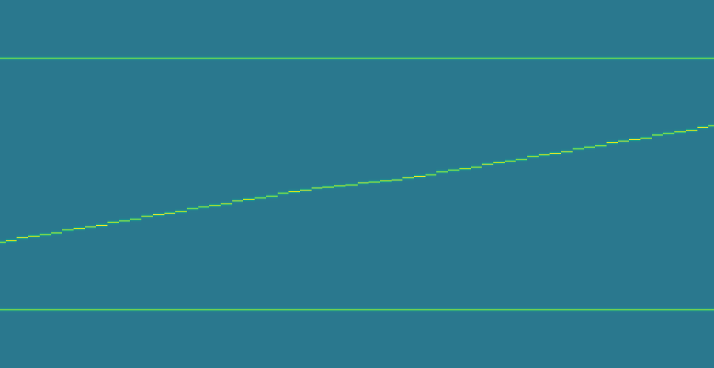
(a) Source fields and d-axis projections
Scalar value
0
1.05
t = 0
t = 12
t = 25
t = 38
t = 51
t = 63
C
C
C
C
C
C
d = x
B
B
B
B
B
B
A
A
A
A
A
A
A
B
C
A
B
C
A
B
C
A
B
C
A
B
C
A
B
C
20
40
100
20
47.5
100
20
56
100
20
64
100
20
72.5
100
20
80
100
(b) TMTM
(c) ST-MTM
(d) RG-MTM-R
1.0
Native map coordinate
1.0
Native map coordinate
120
Source x
C
C
C
80
B
0.5
B
0.5
B
A
40
A
A
0.0
0.0
0
0
12
25
38
51
63
0
12
25
38
51
63
0
12
25
38
51
63
Time
Time
Time
Notes:
Source: /Users/lele/Desktop/MergeTreeMaps/03-figures/pdf/three_method_position_comparison/bisector_highres_x_three_methods.npz; SHA256 676c5d3b4c323d7cfbcd1b735e8bf63c0cba7955fa5dbcd25e1d4ed3c48afb6f. Six source frames 0,12,25,38,51,63 and all three saved full 64-frame scalar maps restored. No experiment or smoothing rerun. Common fixed scalar range [0,1.05]. A/B/C source rings and d-axis symbols reproduce the original scalar peak colors sampled from the saved source image: {"A":"#ECE51B","B":"#FDE725","C":"#D9E219"}. No blue/orange/green categorical identity colors. Symbol radii 4.4/6.1/7.8 px differentiate identities only, not quantities. Black dashed source-to-axis links are exact x projections. TMTM/ST-MTM use their original native spans normalized to [0,1]. RG-MTM-R uses source x [0,120]. Source fields, Gaussian widths and scalar maps are unchanged. Scalar layers are raster evidence; all markers, links, axes and black Arial labels are native editable objects. This is a PPT/figure-only revision; manuscript files are intentionally unchanged.

