Slide 1
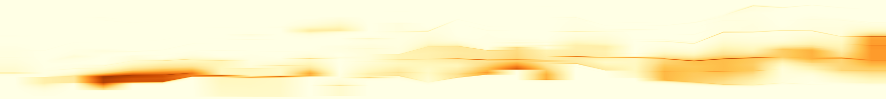
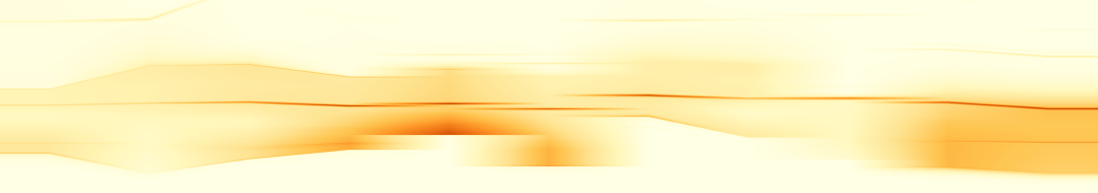
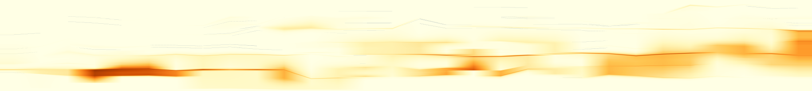
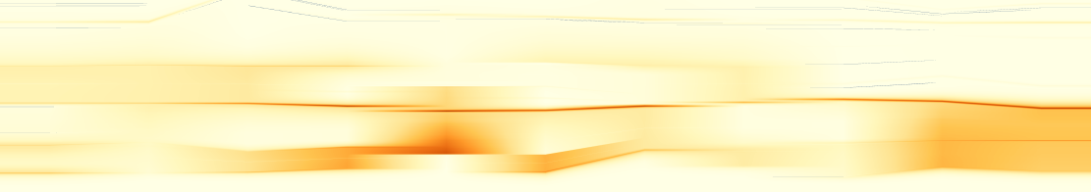
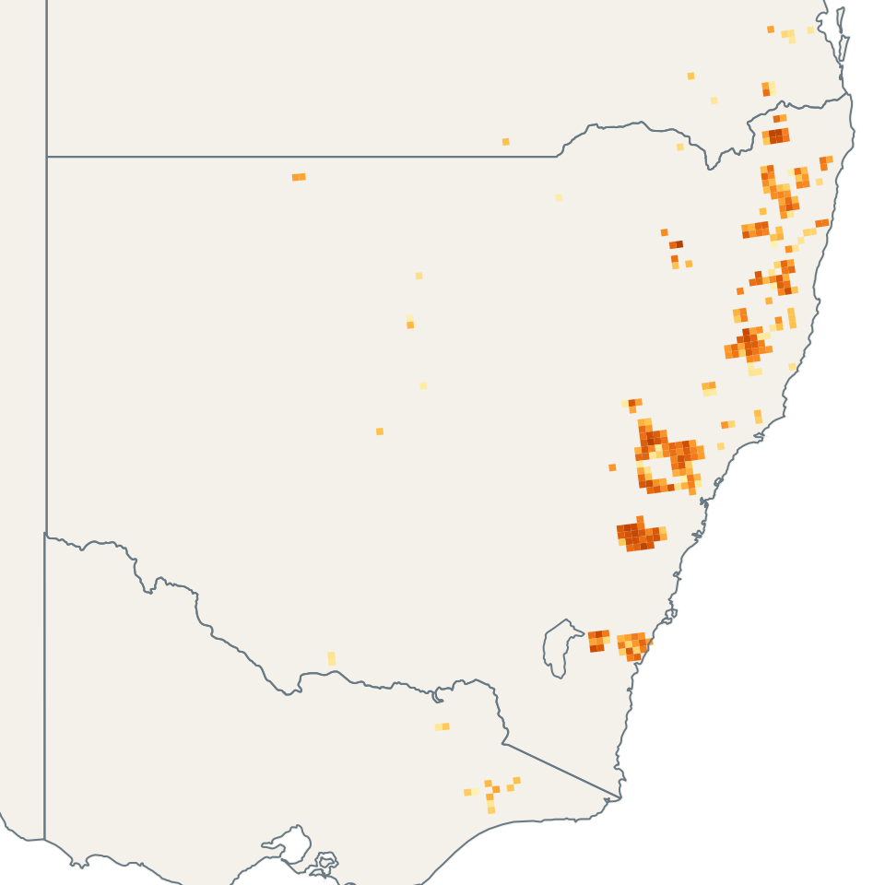
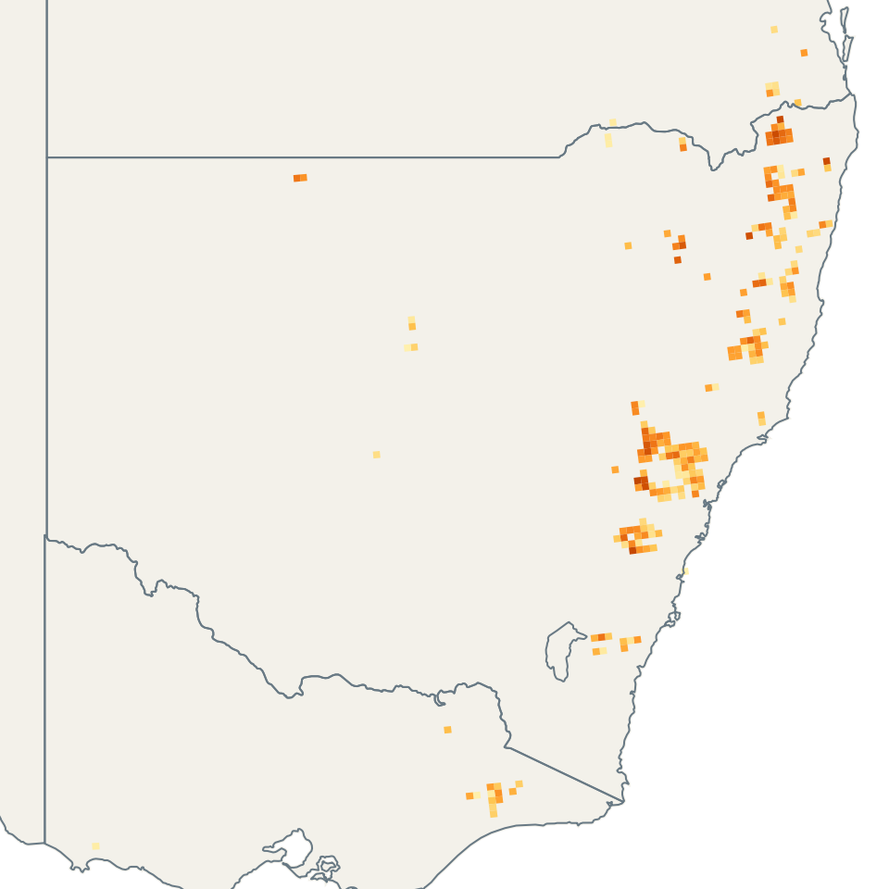
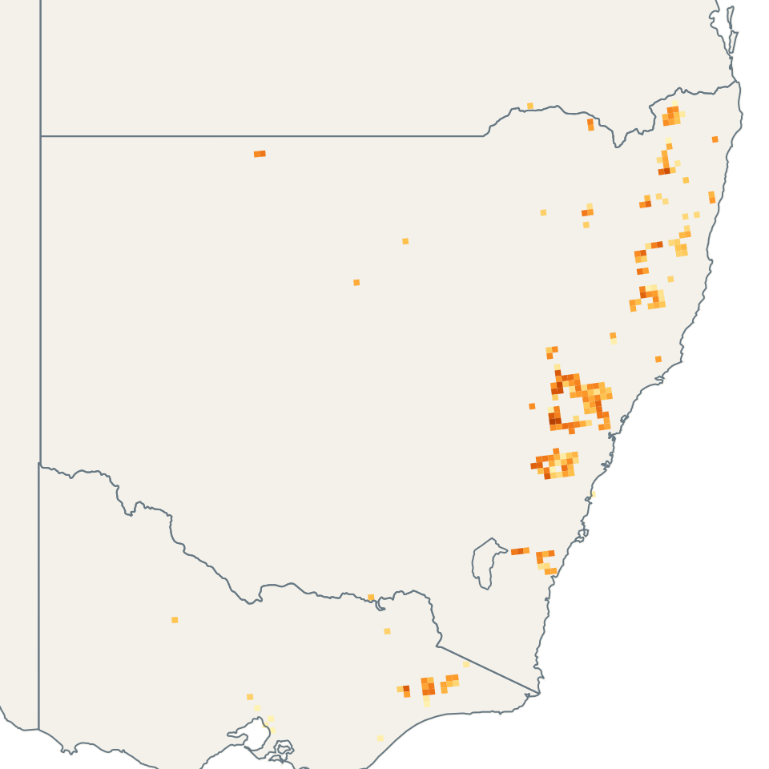
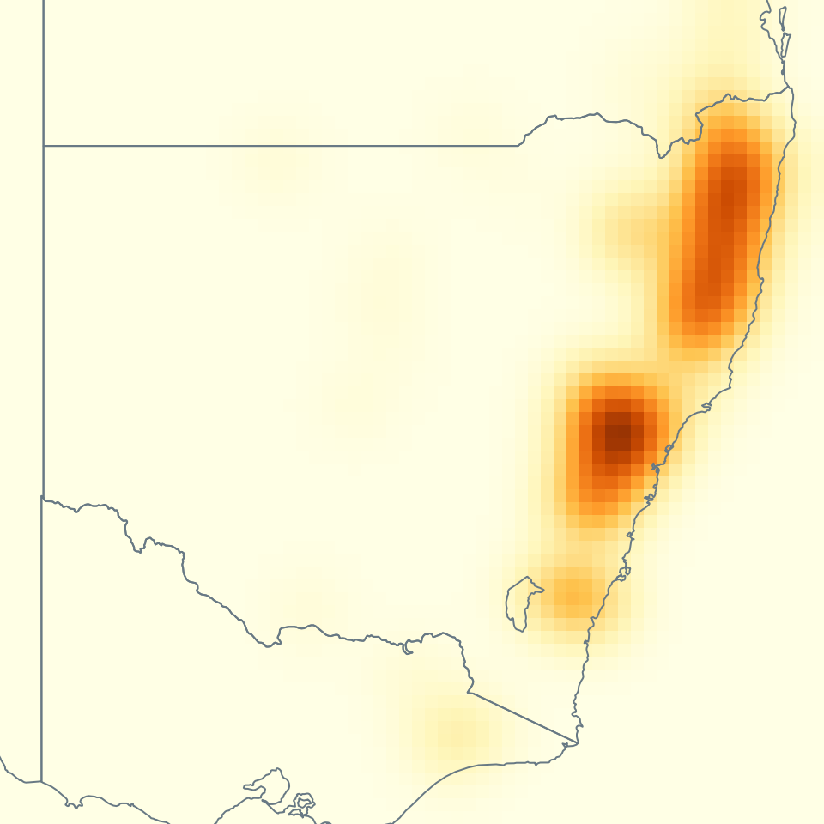
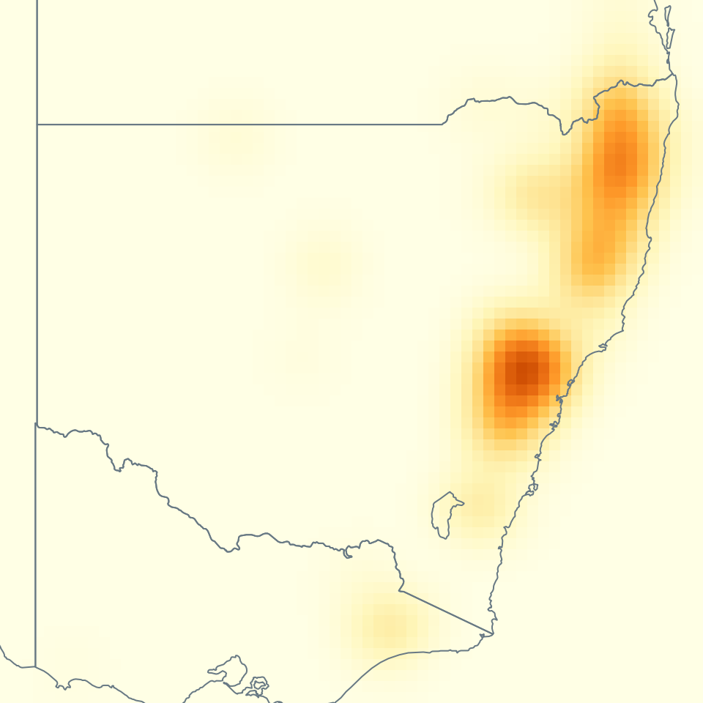
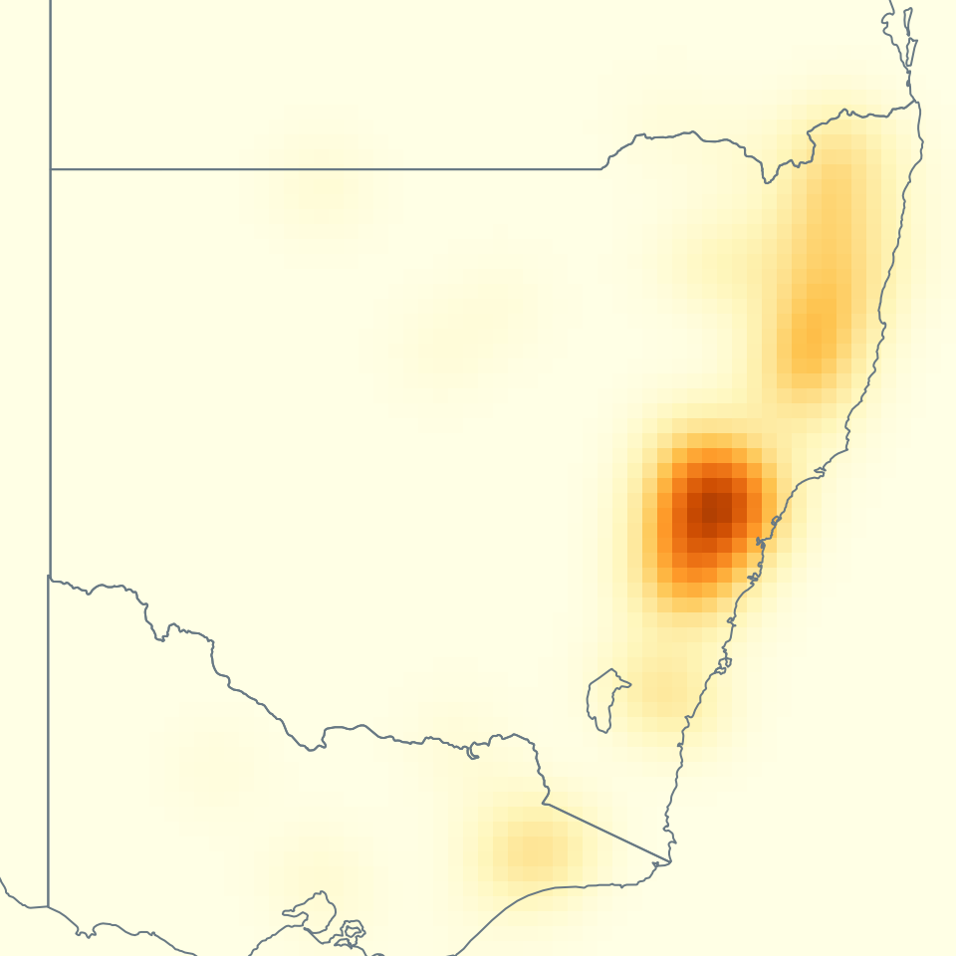
(a) Full sequence
(b) Local window
1
0
29
0.75
13
23
RG-P
B
C
A
0
0.10
1
0.76
B
RG-R20
C
0
0.10
A
0
29
13
23
(c) Actual FRP records and corresponding analysis fields
(d) Frame 18: saved profiles
Supplied 10 km cells: two-date FRP sums
Processed log-FRP
f17: 12-05 to 12-06
f18: 12-07 to 12-08
f19: 12-09 to 12-10
28 S
QLD
C
QLD
C
QLD
C
4
A
A
A
A
A
32 S
2
NSW
NSW
NSW
C
B
B
0
C
36 S
B
B
B
VIC
200 km
VIC
200 km
VIC
200 km
0
0.5
1
142 E
148 E
154 E
142 E
148 E
154 E
142 E
148 E
154 E
Normalized reference coordinate
283 cells with positive FRP
221 cells with positive FRP
206 cells with positive FRP
P
R20
log(1 + FRP sum / MW)
0
12.05
Analysis input: 64 x 64 grid, 50.7 km Gaussian smoothing
(e) Pair merge levels, frame 18
28 S
QLD
C
A
QLD
C
A
QLD
C
Pair
Source = P
R20
A
AB
0.0608
-0.5743
32 S
AC
0.0036
0.0011
NSW
NSW
NSW
BC
0.0036
-0.5743
36 S
B
B
B
VIC
200 km
VIC
200 km
VIC
200 km
Measured NMLE: 15.09% of range
142 E
148 E
154 E
142 E
148 E
154 E
142 E
148 E
154 E
Max anchor error: 14.75% to 2.63% L
Processed log-FRP
0
4.21
Negative R connections are artificial
values in the one-dimensional map.
A/B/C: extrema of the analysis field, located on both rows. Positive FRP cells describe detections, not a burn perimeter.
Notes:
{"display_revision_only": true, "frames": [17, 18, 19], "tracks": [3, 48, 52], "source": "Franke et al., hierarchically aggregated satellite FRP, supplied 10 km cells", "source_sha256": {"/Users/lele/Desktop/MergeTreeMaps/RG-MTM/data/real/wildfire/wildfire.json": "2a8dd31bf6d222d7de673c7e7b2af94550660f1996b0a5db256d97f2b9c2ed9f", "/Users/lele/Desktop/MergeTreeMaps/RG-MTM/code/results/real_case_studies/evidence/wildfire.npz": "1bb6b2e907b8be9e4dd424ade3b3e68adbb70c806c675b08bc0ee99f65f93feb", "/Users/lele/Desktop/MergeTreeMaps/RG-MTM/code/results/real_case_studies/evidence/wildfire.json": "3d5f4cc0341749201e376f17191e6ab933a5906185626aaf6774d7adab099c80", "/Users/lele/Desktop/MergeTreeMaps/RG-MTM/code/results/real_case_studies/evidence/wildfire_event.json": "bc9a741be36faa9f21efd18c6bad53f36891d659b9e8b1d4de5f2626cd34f5b5", "/Users/lele/Desktop/MergeTreeMaps/RG-MTM/data/geo/wildfire_context/australia_admin1.geojson": "9baf965a96eef53004360b17e4ea2e3a85d1de83ee3c3eaedb31f0e0a8942b4e", "/Users/lele/Desktop/MergeTreeMaps/RG-MTM/data/geo/wildfire_context/source.json": "6734fd56bb68b2ee150c12b338c9b7f2941f55f79f2ed82a013d38662b076ba5"}, "projection": {"type": "existing equirectangular coordinates", "cos_phi0": 0.8428449975274017, "x0_km": 13160.951216013425, "y0_km": -4274.791808586651, "side_km": 1298.3527628070003, "extent_lonlat": [[140.2705074543924, -38.661407330981746], [154.10845867118266, -26.919047171743248]]}, "analysis": {"grid": 64, "cell_km": 20.28676191885938, "sigma_cells": 2.5, "sigma_km": 50.71690479714845, "background": "1e-3 * ptp(smoothed) * Gaussian(raw_log, sigma=16, truncate=50) / maximum", "raw_grid_exact": true, "processed_exact": true}, "snapshots": [{"frame": 17, "date_start": "2019-12-05", "date_end": "2019-12-06", "positive_source_cells": 283, "positive_64_grid_cells": 141}, {"frame": 18, "date_start": "2019-12-07", "date_end": "2019-12-08", "positive_source_cells": 221, "positive_64_grid_cells": 120}, {"frame": 19, "date_start": "2019-12-09", "date_end": "2019-12-10", "positive_source_cells": 206, "positive_64_grid_cells": 111}], "source_color_range": [0, 12.050886763399191], "analysis_color_range": [0, 4.207268782981147], "markers": [{"frame": 17, "analysis": false, "label": "A", "track": 3, "layout_xy": [105.9375, 90.9375], "lonlat": [152.48682376296503, -29.76290002280882], "slide_xy": [254.21875, 388.28125]}, {"frame": 17, "analysis": false, "label": "B", "track": 48, "layout_xy": [66.5625, 12.1875], "lonlat": [147.94624601995574, -37.468823877309084], "slide_xy": [182.03125, 532.65625]}, {"frame": 17, "analysis": false, "label": "C", "track": 52, "layout_xy": [40.3125, 96.5625], "lonlat": [144.91919419128286, -29.21247689034452], "slide_xy": [133.90625, 377.96875]}, {"frame": 18, "analysis": false, "label": "A", "track": 3, "layout_xy": [105.9375, 92.8125], "lonlat": [152.48682376296503, -29.579425645320722], "slide_xy": [537.21875, 384.84375]}, {"frame": 18, "analysis": false, "label": "B", "track": 48, "layout_xy": [66.5625, 12.1875], "lonlat": [147.94624601995574, -37.468823877309084], "slide_xy": [465.03125, 532.65625]}, {"frame": 18, "analysis": false, "label": "C", "track": 52, "layout_xy": [40.3125, 96.5625], "lonlat": [144.91919419128286, -29.21247689034452], "slide_xy": [416.90625, 377.96875]}, {"frame": 19, "analysis": false, "label": "A", "track": 3, "layout_xy": [102.1875, 77.8125], "lonlat": [152.05438778744036, -31.04722066522553], "slide_xy": [813.34375, 412.34375]}, {"frame": 19, "analysis": false, "label": "B", "track": 48, "layout_xy": [66.5625, 12.1875], "lonlat": [147.94624601995574, -37.468823877309084], "slide_xy": [748.03125, 532.65625]}, {"frame": 19, "analysis": false, "label": "C", "track": 52, "layout_xy": [40.3125, 96.5625], "lonlat": [144.91919419128286, -29.21247689034452], "slide_xy": [699.90625, 377.96875]}, {"frame": 17, "analysis": true, "label": "A", "track": 3, "layout_xy": [105.9375, 90.9375], "lonlat": [152.48682376296503, -29.76290002280882], "slide_xy": [254.21875, 733.28125]}, {"frame": 17, "analysis": true, "label": "B", "track": 48, "layout_xy": [66.5625, 12.1875], "lonlat": [147.94624601995574, -37.468823877309084], "slide_xy": [182.03125, 877.65625]}, {"frame": 17, "analysis": true, "label": "C", "track": 52, "layout_xy": [40.3125, 96.5625], "lonlat": [144.91919419128286, -29.21247689034452], "slide_xy": [133.90625, 722.96875]}, {"frame": 18, "analysis": true, "label": "A", "track": 3, "layout_xy": [105.9375, 92.8125], "lonlat": [152.48682376296503, -29.579425645320722], "slide_xy": [537.21875, 729.84375]}, {"frame": 18, "analysis": true, "label": "B", "track": 48, "layout_xy": [66.5625, 12.1875], "lonlat": [147.94624601995574, -37.468823877309084], "slide_xy": [465.03125, 877.65625]}, {"frame": 18, "analysis": true, "label": "C", "track": 52, "layout_xy": [40.3125, 96.5625], "lonlat": [144.91919419128286, -29.21247689034452], "slide_xy": [416.90625, 722.96875]}, {"frame": 19, "analysis": true, "label": "A", "track": 3, "layout_xy": [102.1875, 77.8125], "lonlat": [152.05438778744036, -31.04722066522553], "slide_xy": [813.34375, 757.34375]}, {"frame": 19, "analysis": true, "label": "B", "track": 48, "layout_xy": [66.5625, 12.1875], "lonlat": [147.94624601995574, -37.468823877309084], "slide_xy": [748.03125, 877.65625]}, {"frame": 19, "analysis": true, "label": "C", "track": 52, "layout_xy": [40.3125, 96.5625], "lonlat": [144.91919419128286, -29.21247689034452], "slide_xy": [699.90625, 722.96875]}], "pairs": [{"pair": "AB", "source": 0.060799693879450493, "P": 0.060799693879450493, "R": -0.5742620829234841}, {"pair": "AC", "source": 0.0036173000043960707, "P": 0.0036173000043960707, "R": 0.0011437994999446977}, {"pair": "BC", "source": 0.0036173000043960707, "P": 0.0036173000043960707, "R": -0.5742620829234841}], "interpretation": "Actual supplied cell polygons, no interpolation of source observations. Analysis smoothing is explicitly separate. Zero source cells are omitted. No fire boundary or burned area is inferred.", "basemap_source": {"source": "https://raw.githubusercontent.com/nvkelso/natural-earth-vector/master/geojson/ne_10m_admin_1_states_provinces.geojson", "description": "Natural Earth 1:10m admin-1 polygons, Australia subset", "license": "public domain", "download_sha256": "22d0e3ad85eb3e27f17cabf8ba2d50e554fbc27a87796ff891d958185da62fb5", "subset_sha256": "9baf965a96eef53004360b17e4ea2e3a85d1de83ee3c3eaedb31f0e0a8942b4e", "features": 11}}
Temporal display revision: intermediate time columns interpolate existing saved profiles for display only. Integer-frame profiles, native extrema and metrics are unchanged before pixel integration. Broad bands and true order changes remain visible. See evidence/temporal_display20261023/provenance.json.

