Slide 1
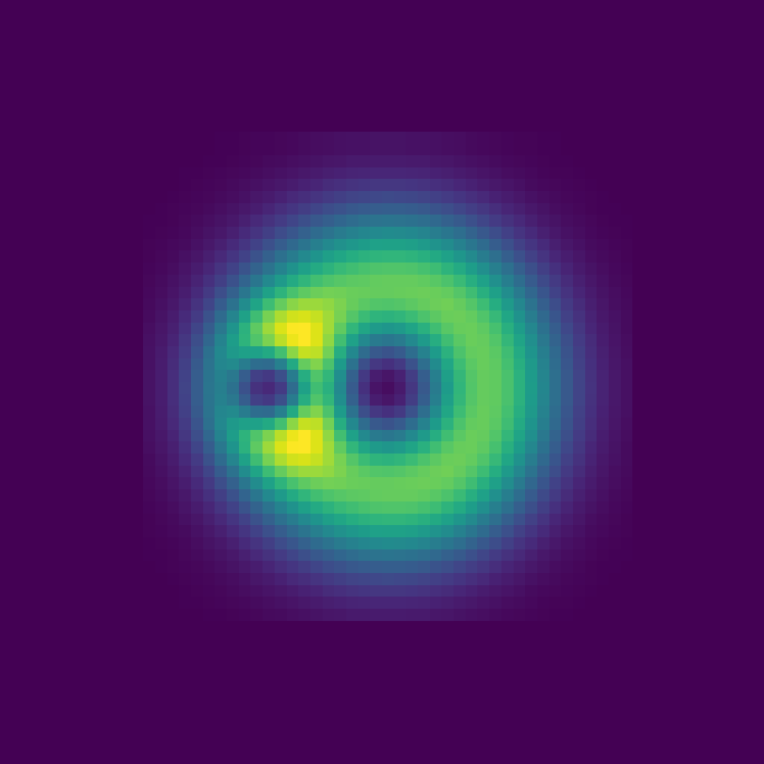
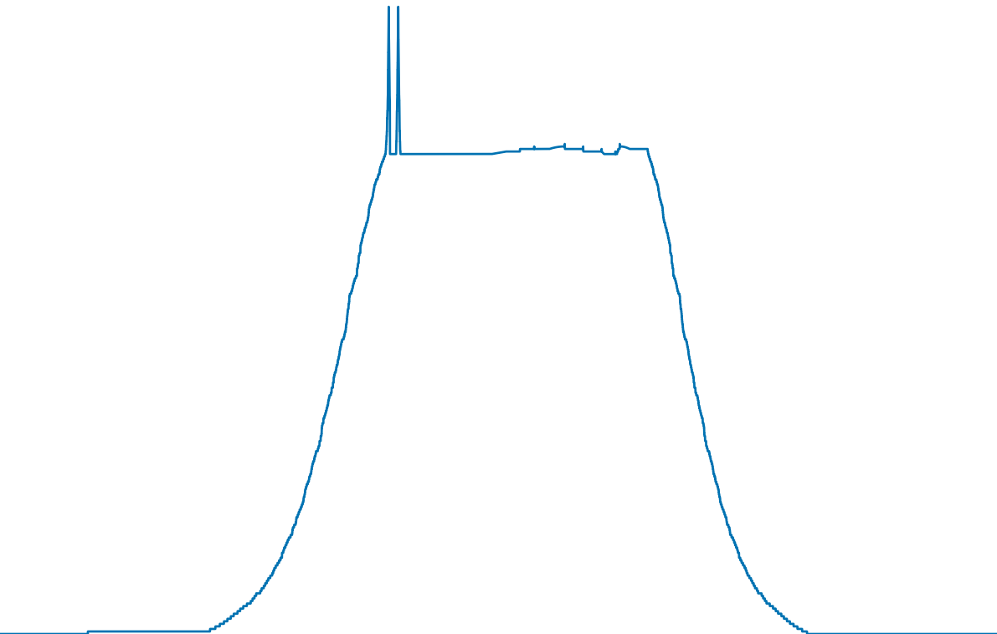
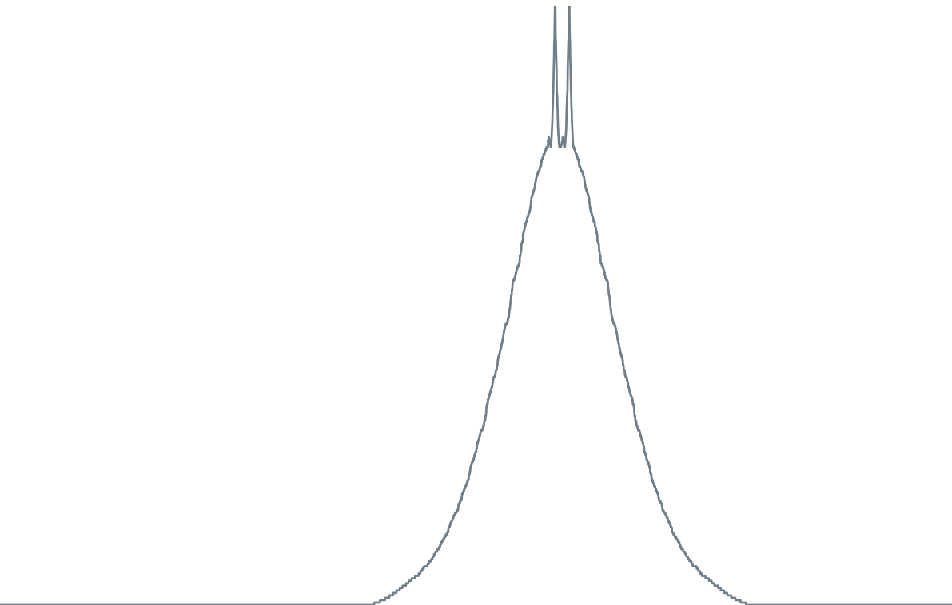
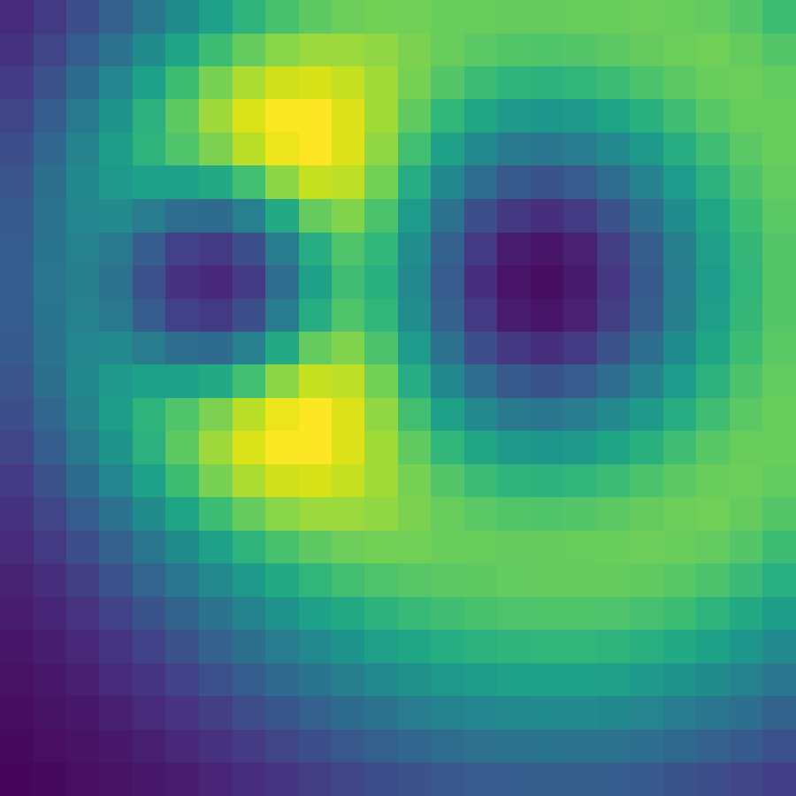

(a) Source field
(b) RG-MTM-P / R
63
200
32
100
0
0
0
0.5
1
0
32
63
0
247
Notes:
{"dataset": "Nucleon", "source": "TMTM author padded 64x64 uint8 scalar slice; author commit 2c75a10ed2cd55177a25ff751e0c0a8261200717.", "result": "02-RG-MTM/results/paper1_suite/nucleon; one static frame,13 leaves,26 nodes (reference table:28 nodes).", "profiles": "Full saved arrays; source scalar recovered by -profile*247. Native axes/text are editable, profile raster layers are scientific plots of all samples. TMTM profile has4096 samples; RG32768.", "coincident_R": "All three stored R arrays are byte-for-byte equal to P; the shared curve is labelled P/R.", "scope": "Static layout test; not temporal or volumetric evidence."}

