Slide 1




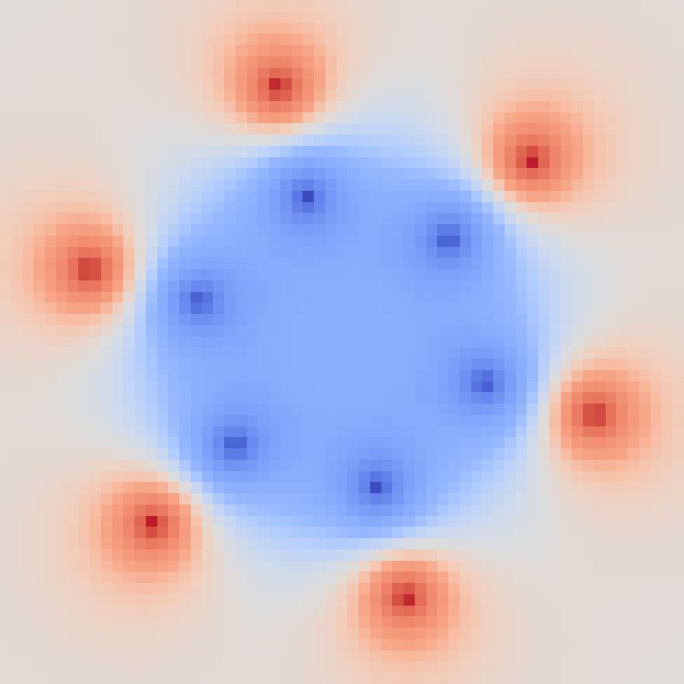


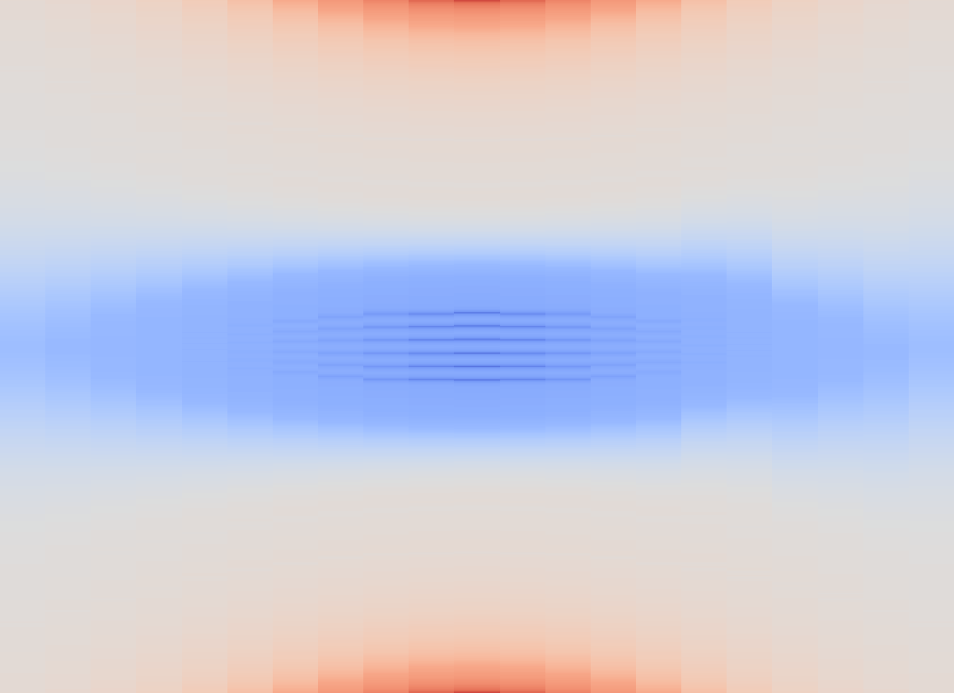


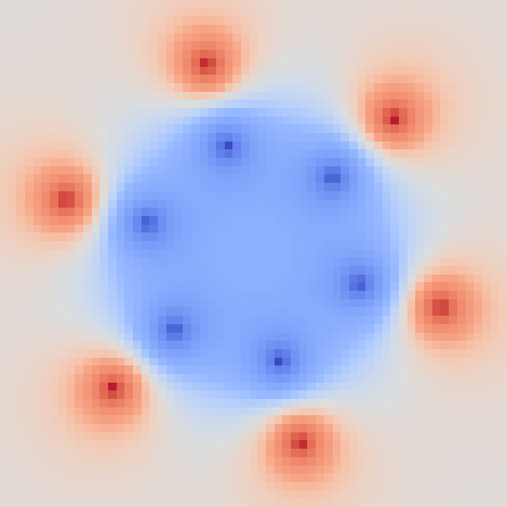


(a) RG-MTM-P
(b) RG-MTM-R
1
1
0.5
0.5
0
-2
-1
0
1
2
0
-2
-1
0
1
2
Section z (bohr)
Section z (bohr)
V (a.u.)
-2
-0.1
0
0.1
2
(c) Potential sections
z = -2 bohr
z = -1 bohr
z = 0 bohr
z = 1 bohr
z = 2 bohr
6
0
-6
-6
0
6
-6
0
6
-6
0
6
-6
0
6
-6
0
6
x (bohr)
x (bohr)
x (bohr)
x (bohr)
x (bohr)
Notes:
{"dataset":"Benzene (reconstructed potential)","source":"02-RG-MTM/results/paper1_suite/benzene-potential-reconstructed2d","model":"OPLS-AA 12-site Coulomb potential; carbon -0.115e and hydrogen +0.115e; atomic geometry from the public Inviwo cube header. No density samples used.","charge_source":"https://zarbi.chem.yale.edu/doc/boss49.pdf, January 2013, Table1 p67.","geometry_source":"https://github.com/inviwo/modules/blob/6152a00ab100ec10c1eb36f078fb42dc949010ab/molvis/gaussian/data/volumes/benzene-dens.cube.xz","scope":"21 parallel 61x61 static 2-D sections, z=-2 to2 bohr. Section z is not physical time. Reconstructed model, not TMTM original potential or exact electronic structure.","maps":"Full saved profiles interpolated onto32768 common map coordinates, then rendered with nearest-neighbor display sampling. No artificial extremum or track overlays.","normalization":{"normalization":"shared symmetric logarithmic","linthresh_potential_au":0.07842339515686035,"vmin":-2.2076358795166016,"vmax":2.2076358795166016,"scalar_arrays_modified":false,"minima_markers":"all retained leaves, including boundary leaves","source_slice_indices":[0,5,10,15,20],"map_sampling":"full maps interpolated onto 32768 common display coordinates","physical_time":false},"all_leaves":"Includes four boundary extrema per section. Boundary sensitivity and internal-leaf diagnostics are in Supplement S9.","R_equivalence":"R2,R20,R100 have identical measured metrics. Fig12 shows R2; the complete table keeps all three."}

