Slide 1
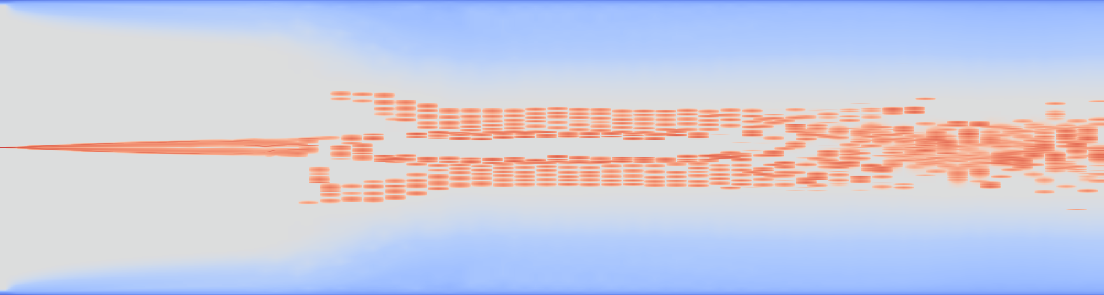
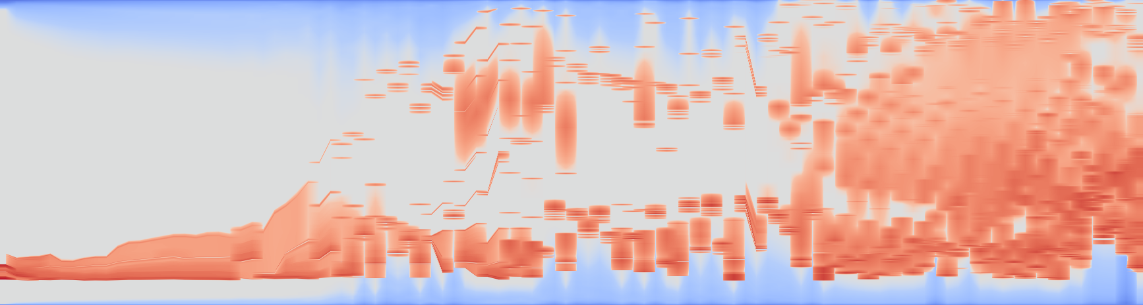
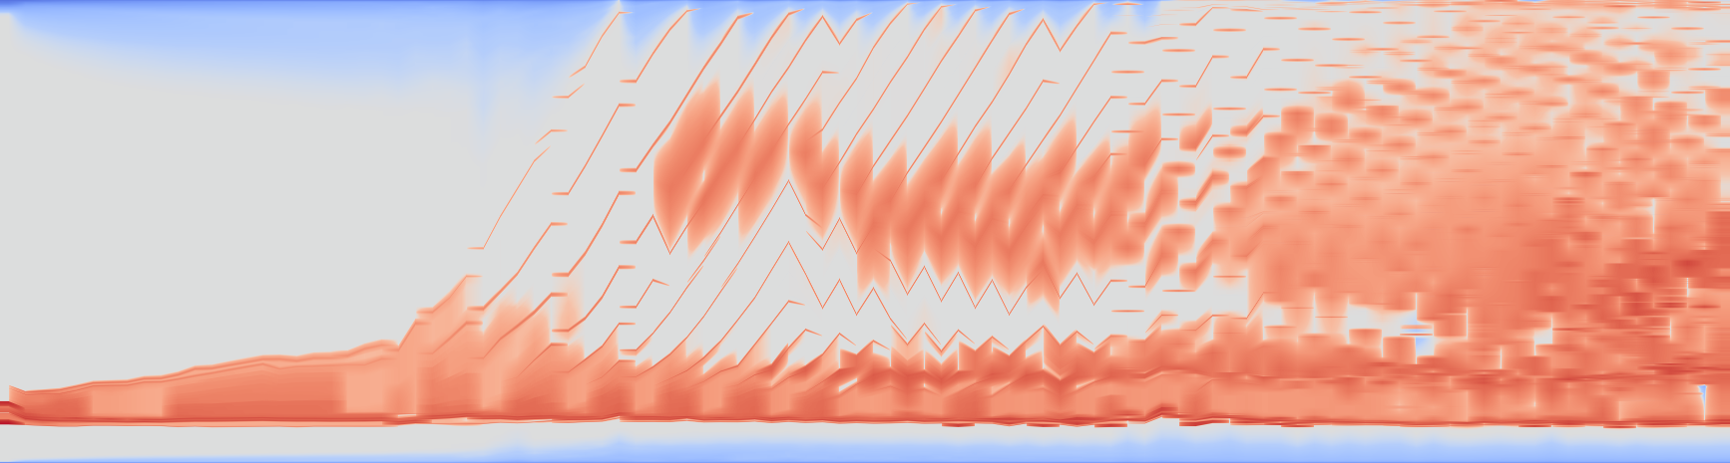
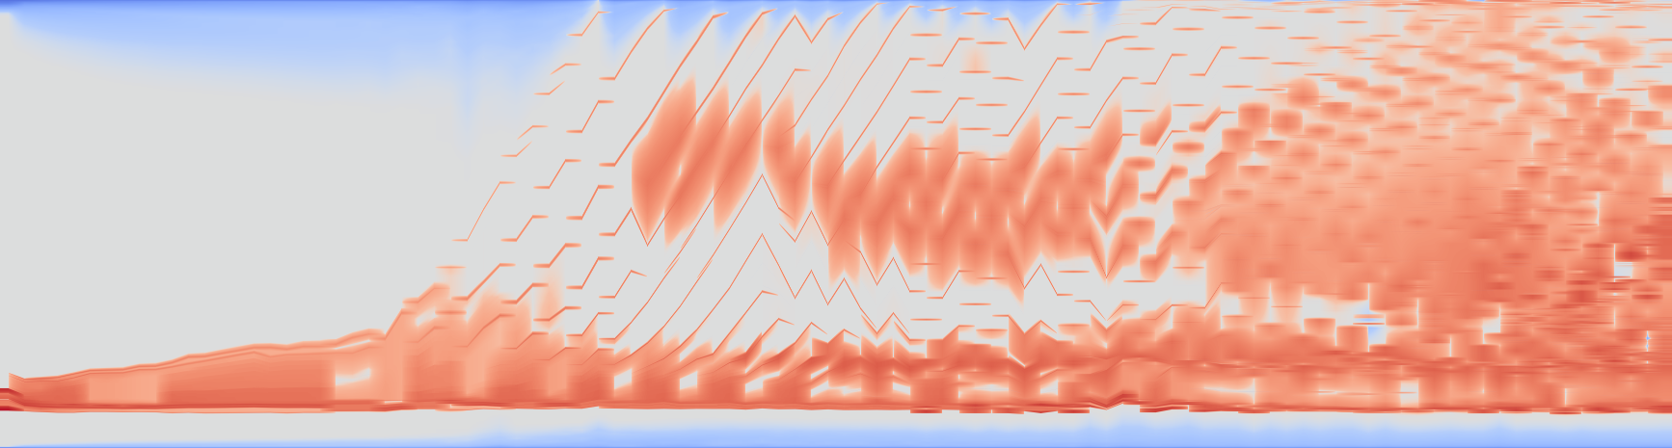


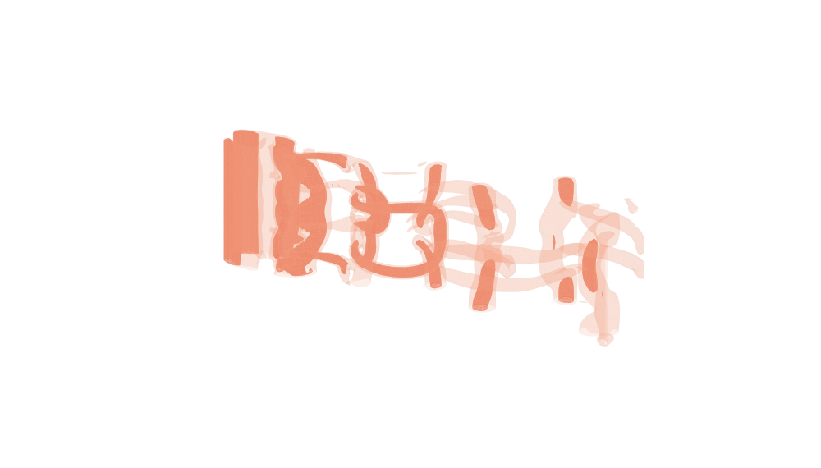
(a) TMTM
(b) RG-MTM-P
1
1
0.5
0.5
0
0
25
51
75
101
0
0
25
51
75
101
(c) RG-MTM-R, 2%
(d) RG-MTM-R, 20%
Time (frame)
Time (frame)
1
1
0.5
0.5
0
0
25
51
75
101
0
0
25
51
75
101
Time (frame)
Time (frame)
Q
-20
-1
-0.02
0
0.02
1
20
(e) Three-dimensional source fields
Frame 0
Frame 51
Frame 101
Notes:
{"dataset": "Cylinder", "source": "02-RG-MTM/results/paper1_suite/square-cylinder3d", "source_page": "https://tinoweinkauf.net/notes/squarecylinder.html", "data_credit": "Camarri, Salvetti, Buffoni and Iollo (2005); uniform resampling by Tino Weinkauf, used by von Funck et al. (2008).", "frames": 102, "input_shape_xyz": [135, 64, 48], "maps": "Saved 2048-row previews, no artificial point or trajectory overlay. Metrics use complete saved maps.", "color": "coolwarm, common symmetric logarithmic normalization; linear within Q +/-0.02; fixed global range +/-20.46343994140625. This display transform does not change Q.", "volumes": "True three-dimensional isosurfaces from the original cropped Q arrays at frame 0,51,101. Q=0.1 translucent and Q=0.5 opaque; same physical aspect, orthographic camera, levels and opacity for all three. Native frame edges project the actual volume corners.", "reference": "fixed x direction. TMTM ordinate is native map coordinate; RG ordinate is normalized physical reference position."}
Temporal display revision: intermediate time columns interpolate existing saved profiles for display only. Integer-frame profiles, native extrema and metrics are unchanged before pixel integration. Broad bands and true order changes remain visible. See evidence/temporal_display20261023/provenance.json.

