Slide 1








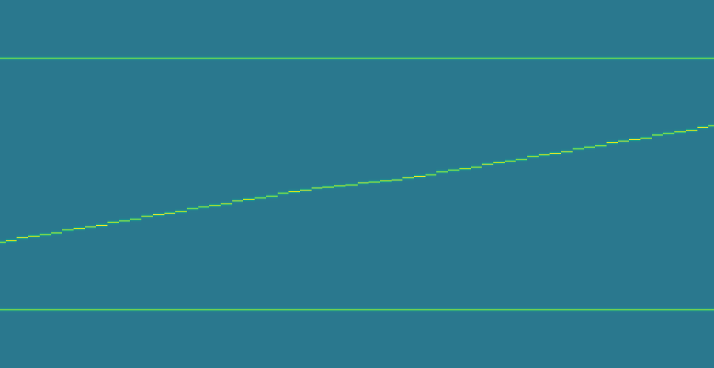
(a) Source fields and x projections
0
1.05
t = 0
t = 12
t = 25
t = 38
t = 51
t = 63
C
C
C
C
C
C
d = x
B
B
B
B
B
B
A
A
A
A
A
A
A
B
C
A
B
C
A
B
C
A
B
C
A
B
C
A
B
C
20
40
100
20
47.5
100
20
56
100
20
64
100
20
72.5
100
20
80
100
(b) TMTM
(c) ST-MTM
(d) RG-MTM-R
1.0
1.0
120
C
C
C
80
B
0.5
B
0.5
B
A
40
A
A
0.0
0.0
0
0
12
25
38
51
63
0
12
25
38
51
63
0
12
25
38
51
63
Time
Time
Time
Notes:
All source fields, projections and 64-frame trajectories are from frozen bisector_highres_x_three_methods.npz, SHA256 676c5d3b4c323d7cfbcd1b735e8bf63c0cba7955fa5dbcd25e1d4ed3c48afb6f. No experiment, calibration or smoothing rerun. Common fixed scalar range [0,1.05]. TMTM and ST-MTM use their native coordinate spans normalized to [0,1]; RG-MTM-R uses source x [0,120]. Scalar data are embedded images; x projections, references, guides, frames and Arial text are native editable objects. Source-field peak glyphs and trajectory overlays are omitted so the scalar field and temporal maps supply the visual evidence. Source rendering follows the field/map comparison in ST-MTM Figure 2 (local PDF page 4), adapted to this separate nonnegative bisector control. Truncated viridis [0.4,1] encodes the unchanged scalar domain [0,1.05].
Figure 6 identity-label override: all A/B/C text is black, with no white halo. The saved scalar field and the blue/orange/green projection symbols remain unchanged.

