Slide 1
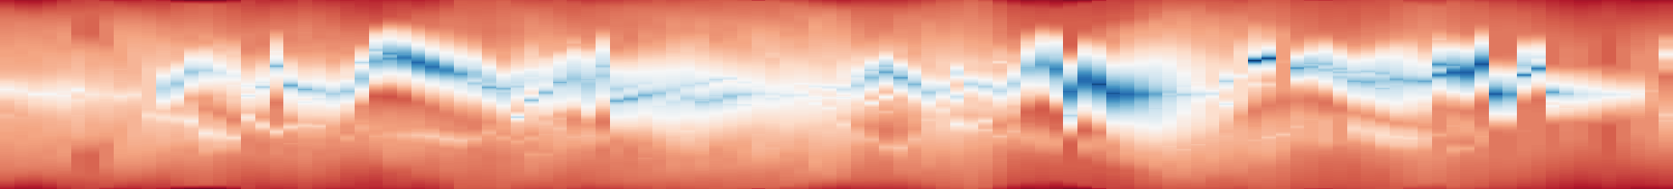

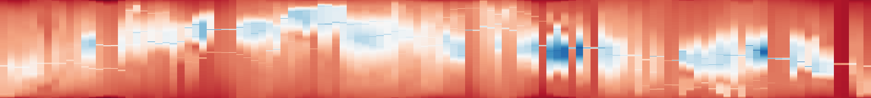

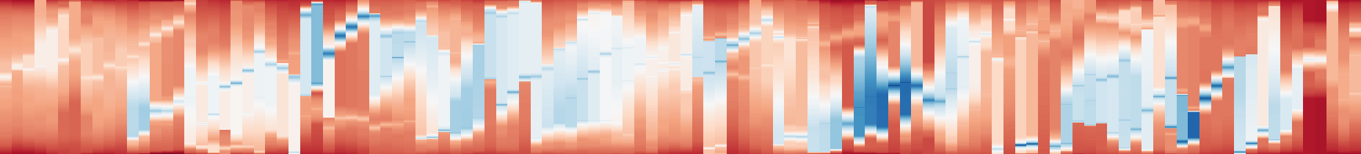

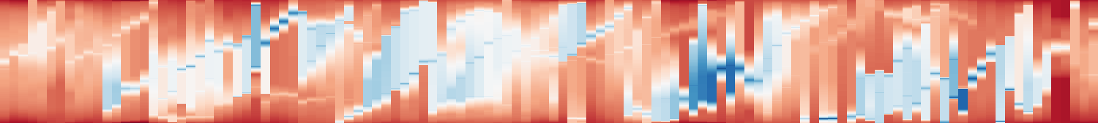

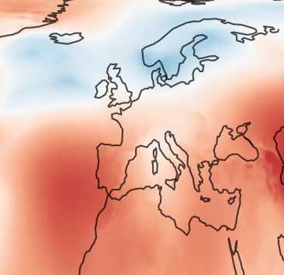
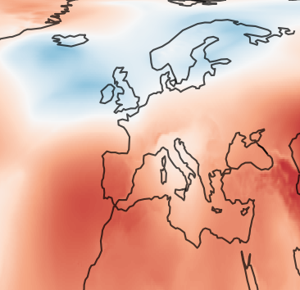
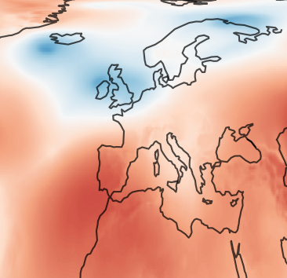
(a) Full sequence (118 frames); vertical guide: f48
(b) Local window: exact anchors
1
0.74
TMTM
A
B
native rank
C
0
0.26
1
0
117
0.87
43
53
ST-MTM
A
B
native rank
C
0
0.46
1
0
117
0.97
43
53
RG-P
A
B
fixed q axis
C
0
0.13
1
0
117
0.97
43
53
RG-R20
A
B
fixed q axis
C
0
0.13
0
117
43
53
(c) f47 1999-12-10 12:00
f48 1999-12-11 00:00
f49 1999-12-11 12:00
A/B/C IDs: 60, 38, 56
B
A
A
f48: max displacement (% L)
B
B
P 8.87 → R 0.83
C
C
C
Hierarchy 8.45% L; NMLE 13.21%
d
d
d
pressure (hPa)
952.06
1046.84
Notes:
{"source": "saved real_case_studies/evidence", "case": "era5", "selection": {"t": 48, "witness": [3, 4, 0], "node": 1937, "bound": 6.699526531238625, "tracks": [60, 38, 56], "persistent_three_frames": false, "H": 0.08448388930010664, "gain": 0.0803319508751224, "errorP": 0.08866528420845578, "errorR": 0.008333333333333375, "delta": 12.557165664888316, "rule": "Retained interior witness frame 48 from fig_witness.py; selected before this presentation revision; not chosen by proxy accuracy.", "snapshots": [47, 48, 49], "window": [43, 54]}, "identity": "computed positive-overlap Hungarian scalar-feature assignment; not physical entity truth", "baseline_vertical_semantics": "TMTM full native sample-rank domain; ST-MTM full shared discretized native domain; RG fixed physical directional reference domain. Baselines are not geographical coordinates.", "rendering": "exact saved anchors over native scalar maps; 3D display map is subsampled; no scientific values recomputed"}

