Slide 1
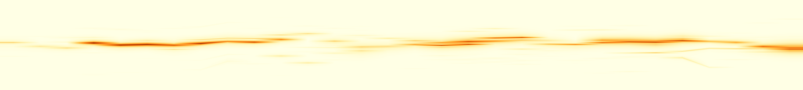

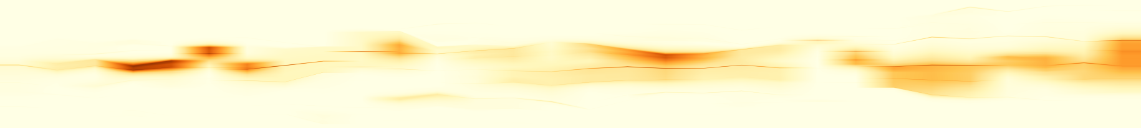
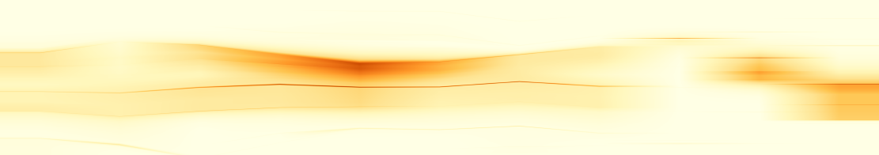
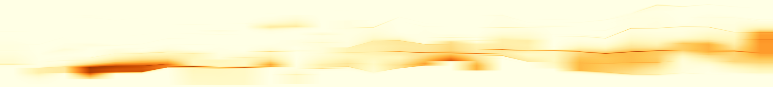

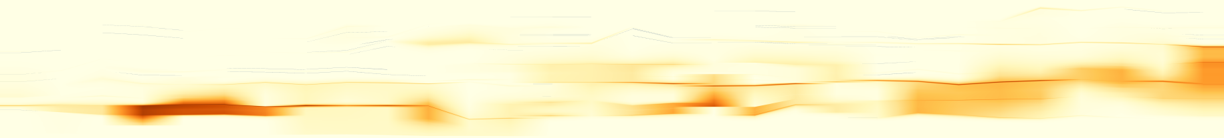
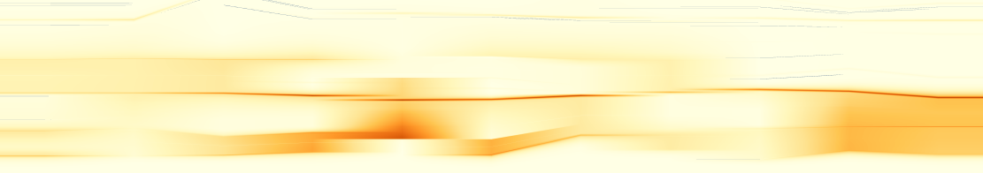
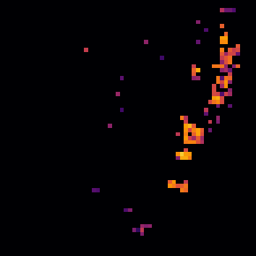
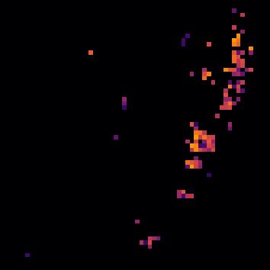
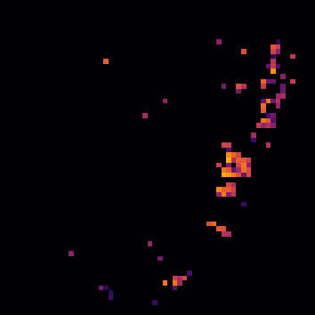
(a) Full sequence (30 frames); vertical guide: f18
(b) Local window: exact anchors
1
0.73
TMTM
A
B
0
0.24
C
1
0
29
0.86
13
23
ST-MTM
C
B
A
0
0
29
0.16
13
23
1
0.75
RG-P
B
C
0
0.10
A
1
0
29
0.76
13
23
RG-R20
B
C
0
0.10
A
0
29
13
23
(c) Source snapshots
Frame 17
Frame 18
Frame 19
C
A
C
A
C
A
d
d
d
B
B
B
Notes:
{"source": "saved real_case_studies/evidence", "case": "wildfire", "selection": {"t": 18, "witness": [7, 1, 8], "node": 871, "bound": 20.792130615669763, "tracks": [3, 48, 52], "persistent_three_frames": true, "H": 0.13921149643185637, "gain": 0.12121684405613914, "errorP": 0.14754482976518962, "errorR": 0.026327985709050483, "delta": 0.6350617768029346, "rule": "Among H>2% frames with a witness triple matched in all three adjacent frames and positive P-to-R max-error reduction and measured cost, choose largest H (earliest tie). Descriptive selection, not unbiased performance evidence.", "snapshots": [17, 18, 19], "window": [13, 24]}, "identity": "computed positive-overlap Hungarian scalar-feature assignment; not physical entity truth", "baseline_vertical_semantics": "TMTM full native sample-rank domain; ST-MTM full shared discretized native domain; RG fixed physical directional reference domain. Baselines are not geographical coordinates.", "rendering": "exact saved anchors over native scalar maps; 3D display map is subsampled; no scientific values recomputed"}
Temporal display revision: intermediate time columns interpolate existing saved profiles for display only. Integer-frame profiles, native extrema and metrics are unchanged before pixel integration. Broad bands and true order changes remain visible. See evidence/temporal_display20261023/provenance.json.

