Slide 1
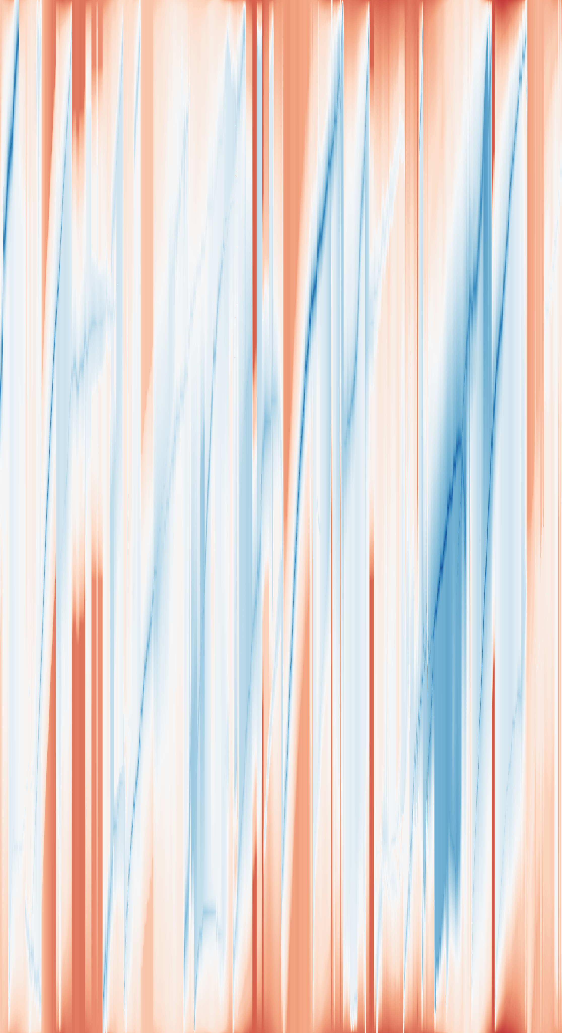
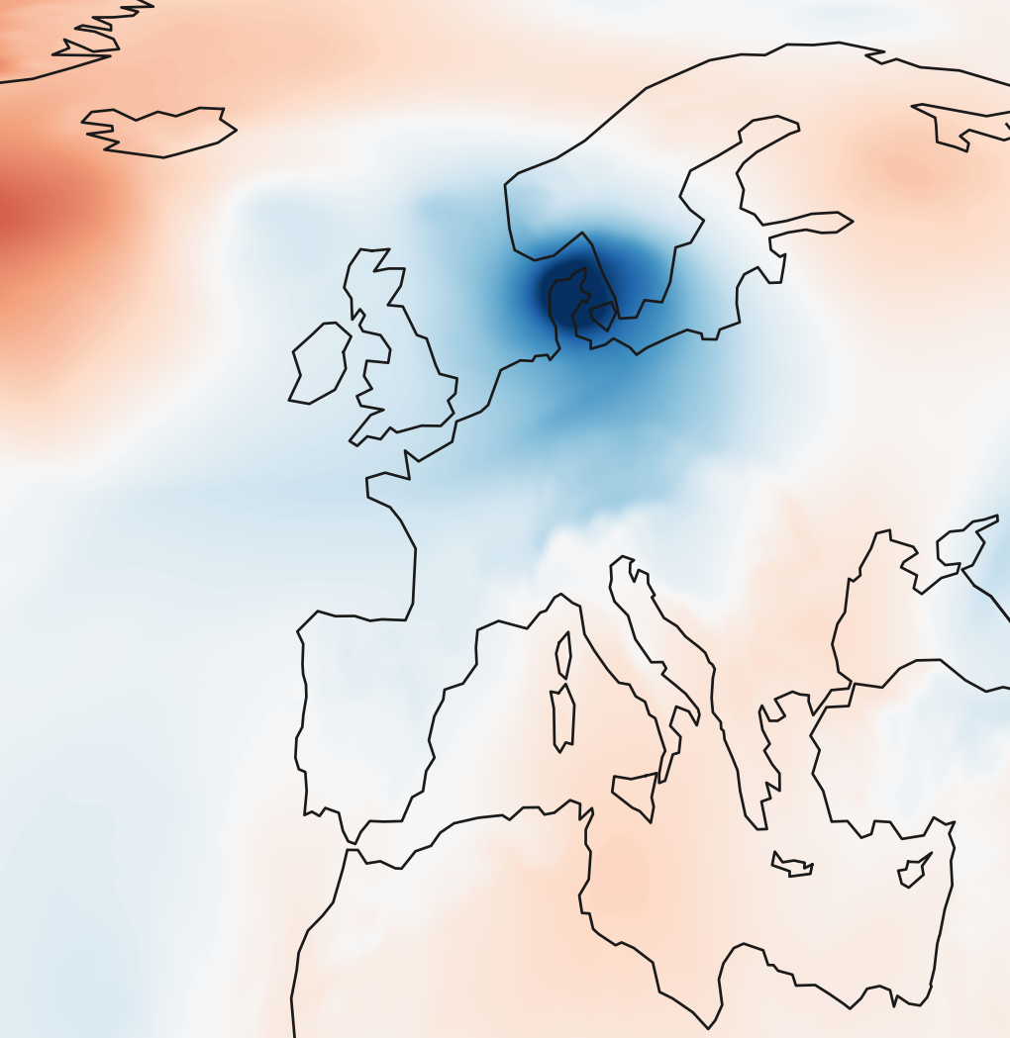
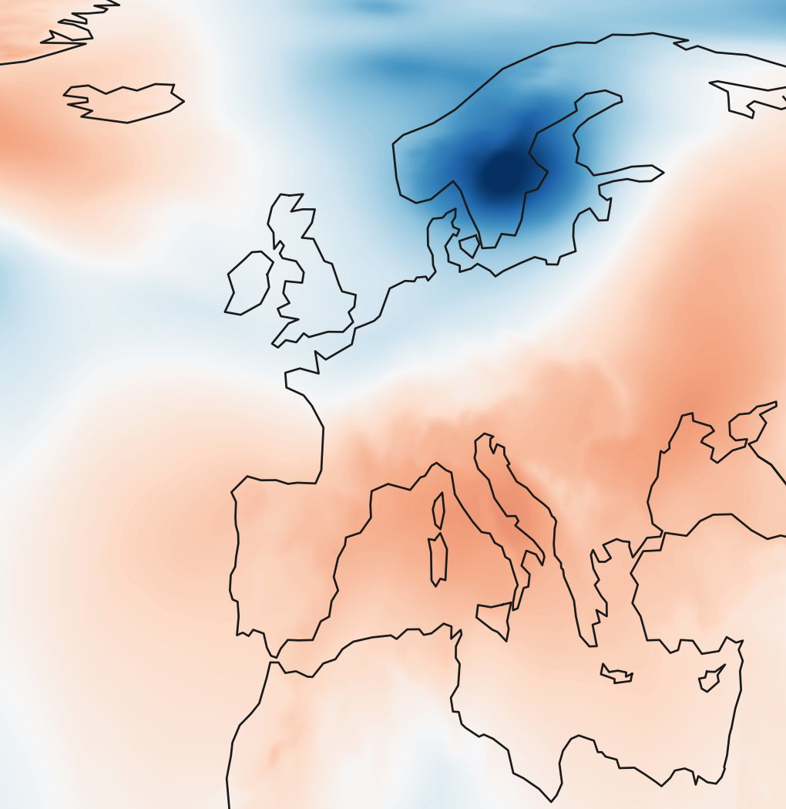
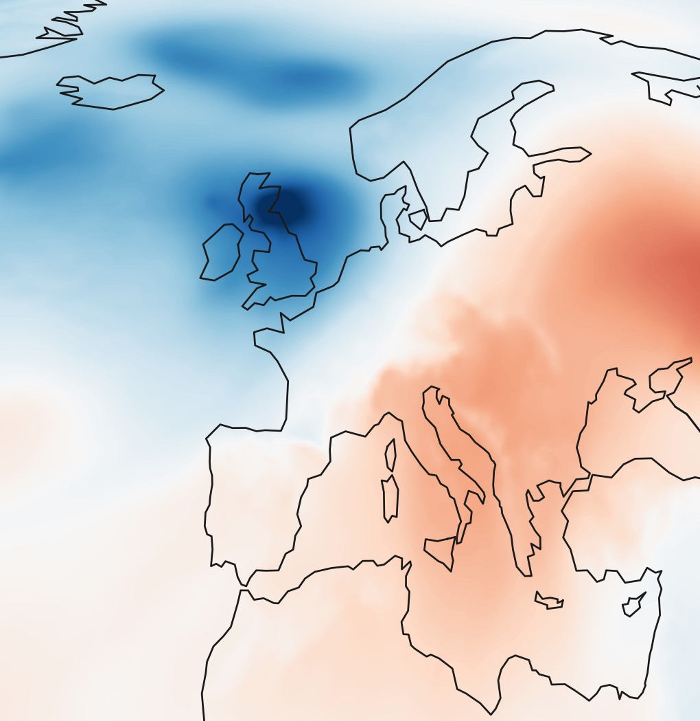
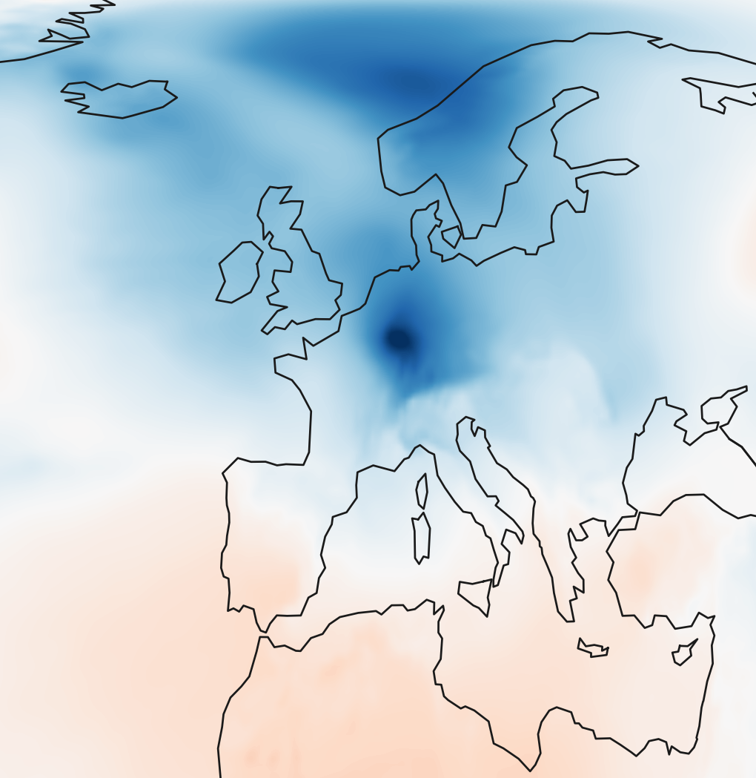
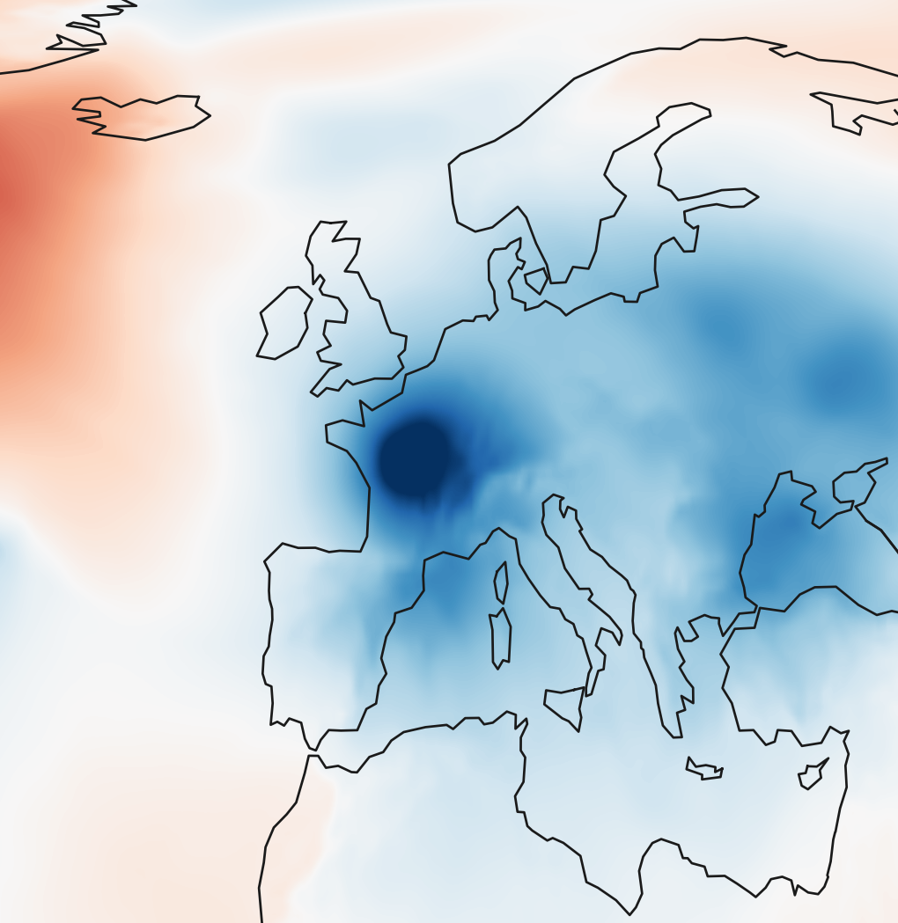
RG-MTM-R20
d = (1, 0) · eastward
MSLP anomaly [hPa]
-35
0
35
Cyclone Martin
Strong storm over Scandinavia
Reference position along d
Cyclone Lothar
Cyclone Anatol
Strong storm over the British Isles and Norway
1 Dec
8 Dec
15 Dec
22 Dec
31 Dec
Time
d
d
d
d
d
1999-12-03 18:00
1999-12-17 21:00
1999-12-24 23:00
1999-12-26 10:00
1999-12-27 21:00
Notes:
New authorized experiment: ERA5 December 1 00:00–December31 23:00 1999, 744 actual hourly observations. d=[1.0, 0.0], angle=0.000000 degrees in equal-area coordinates. RG-MTM-R20 recomputed with the existing solver and optimal scalar barriers. Analysis:49x49 grid,250km smoothing,192-hour centered pressure anomaly baseline. This differs from the reference papers spatial preprocessing. Five published event dates/names follow TMTM Fig1, https://www.csc.kth.se/~weinkauf/publications/documents/koepp22.pdf . Annotation targets are actual computed minima nearest the published event region; identities are not independently validated cyclone tracks. Maps are native 0.25degree ERA5 hourly anomaly fields. Intermediate display columns use conservative anchor alignment; original744 scalar columns unchanged. This is an additional experiment; existing manuscript numbers and the118-frame main suite are unchanged. Events: [{"frame": 66, "date": "1999-12-03 18:00", "label": "Cyclone Anatol", "computed_track_id": 10, "computed_minimum_lonlat": [10.714285714285714, 55.898925088212714], "anchor": 0.5833333333333394, "value_hPa": -23.769877835416683, "association": "nearest computed extremum to published event region; no independently verified physical tracking identity"}, {"frame": 405, "date": "1999-12-17 21:00", "label": "Strong storm over Scandinavia", "computed_track_id": 68, "computed_minimum_lonlat": [15.000000000000002, 61.11526665243035], "anchor": 0.6458333338200309, "value_hPa": -26.117821436974296, "association": "nearest computed extremum to published event region; no independently verified physical tracking identity"}, {"frame": 575, "date": "1999-12-24 23:00", "label": "Strong storm over the British Isles and Norway", "computed_track_id": 113, "computed_minimum_lonlat": [-2.142857142857143, 55.898925088212714], "anchor": 0.4041666666666666, "value_hPa": -25.9252721915634, "association": "nearest computed extremum to published event region; no independently verified physical tracking identity"}, {"frame": 610, "date": "1999-12-26 10:00", "label": "Cyclone Lothar", "computed_track_id": 130, "computed_minimum_lonlat": [7.857142857142858, 50.44356386922743], "anchor": 0.5333333333333333, "value_hPa": -21.563336802880915, "association": "nearest computed extremum to published event region; no independently verified physical tracking identity"}, {"frame": 645, "date": "1999-12-27 21:00", "label": "Cyclone Martin", "computed_track_id": 141, "computed_minimum_lonlat": [3.5714285714285743, 47.135364049152884], "anchor": 0.48749999999999993, "value_hPa": -27.33887300096107, "association": "nearest computed extremum to published event region; no independently verified physical tracking identity"}]

