Slide 1
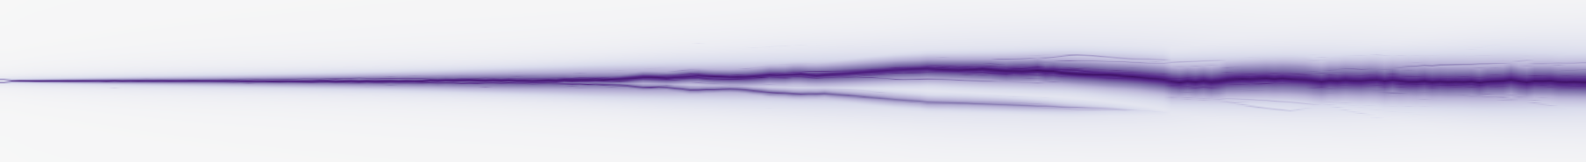

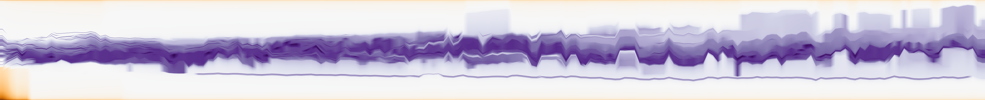
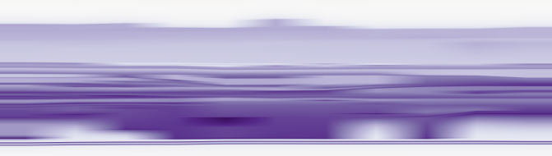
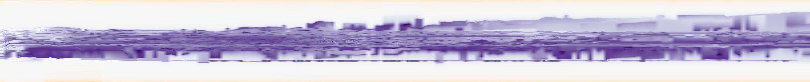
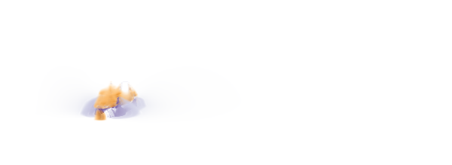
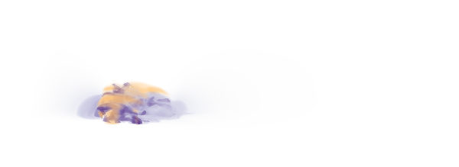
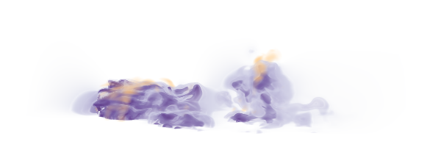
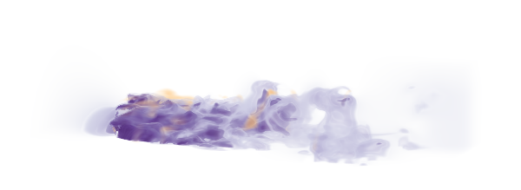
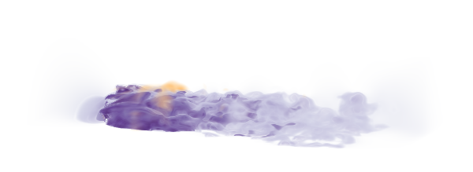
(a) Whole-sequence comparison
(b) Local position correspondence
201 fields; persistence 10%; TMTM shown at native rank 0.4-0.6
layout u
reference q
0.6
RG-P
TMTM
0.9
native rank
B
0.4
0.5
A
1
C
RG-P
0.2
fixed d axis
135
140
145
RG-R20
0
0.9
1
B
RG-R20
0.5
C
fixed d axis
A
0
0
25
100
145
200
0.2
135
140
145
Original frame
(c) Source-field evolution
One camera and transfer function for every frame
Frame 0
Frame 25
Frame 100
Frame 145
Frame 200
1
2
d
Initial field
Early deformation
Separated regions
Late evolution
Later state
At frame 100, 1/2 mark the two largest connected regions with speed below 0.6.
0
Speed
2
A/B/C in (b) are local extremum matches. RG colors between saved frames use stable-anchor display interpolation.
Notes:
{
"source": "Existing Tangaroa fixed-10%-persistence result population; 201 original 300x180x120 fields",
"scope": "Source snapshots show morphology at 0,25,100,145,200. The two component markers refer only to f100, without claiming physical identity across these times. Local A/B/C denote saved extremum matches. Inter-frame colors are display reconstruction; scientific results are unchanged.",
"methods": "Native TMTM, RG-MTM-P, RG-MTM-R eligibility 20%; R20 is not a hard NMLE cap.",
"coordinates": "TMTM ordinate is normalized native rank, explicitly zoomed to [0.4,0.6] with its full 201-frame duration. P/R use the same fixed directional reference extent. All Emax values compare saved normalized anchors with the retained fixed reference. Local panels share y=[0.2,0.9].",
"display": "RG display uses monotone convex interpolation along a maximum-weight stable subset of common tracked extrema, with displacement at most 0.2L, minimum knot spacing 0.003L and local spatial stretch between 0.5 and 2. Native TMTM retains its previous display interpolation. Original integer-frame scalar profiles remain exact; excluded order changes are not asserted as matched interpolated tracks. No scientific layout or metric was recomputed.",
"source_regions": "f100: two largest 6-connected components of source speed<0.6. These labels do not establish cross-time group identity. Stages are morphological context, without claiming exact detachment/exit boundaries.",
"reference": "Kopp and Weinkauf, Temporal Merge Tree Maps, DOI 10.1109/TVCG.2022.3209387, Fig15 and Sec5. https://www.csc.kth.se/~weinkauf/publications/documents/koepp22.pdf",
"inputs": {
"/Users/lele/Desktop/MergeTreeMaps/RG-MTM/code/results/real_case_studies/evidence/tangaroa.npz": "c893b7003e9c86a93b76208e90d232b3a6fe4c4ce8ad190496293d5d49286dae",
"/Users/lele/Desktop/MergeTreeMaps/RG-MTM/code/results/real_case_studies/evidence/tangaroa_event.json": "4a06cc5595abc1a8292007a66da32f358bc38cb449c7a28c062545ca6ecb7777",
"/Users/lele/Desktop/MergeTreeMaps/RG-MTM/code/results/real_case_studies/evidence/tangaroa_event_volumes.npz": "36f0d393bd95dc626e300bbf7ad89ef8583e843eac8980bf174ec5d3cf985847",
"/Users/lele/Desktop/MergeTreeMaps/RG-MTM/code/results/volume3d/tangaroa-paper-p10-full201/frame_metrics.json": "9008832c03acb1ef4f3c74c99a1ef35b47b38431c6210c0c50505fe8b1037d98",
"/Users/lele/Desktop/MergeTreeMaps/RG-MTM/data/real/Tangaroa-FAU/paper_full_201/scalar_100.npy": "5fd2aa233888b00482ad827f52582fc5ac11eeee7867bd8788bdeeba78a7de75"
}
}

