Slide 1
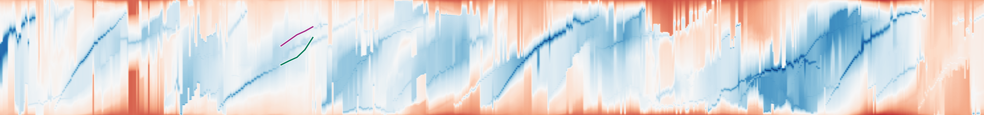






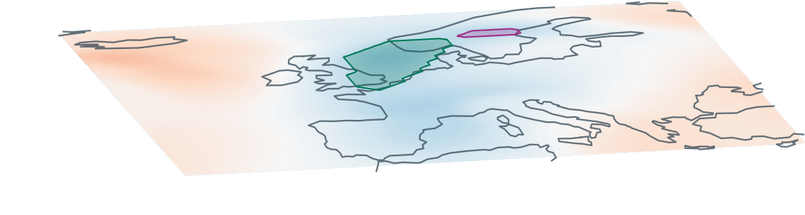

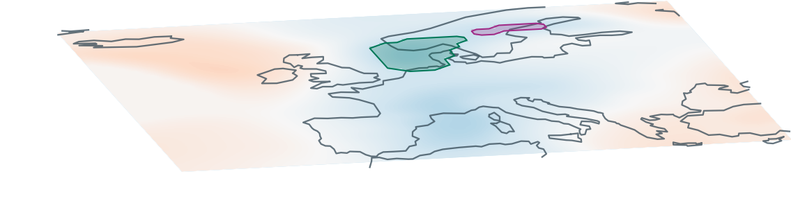

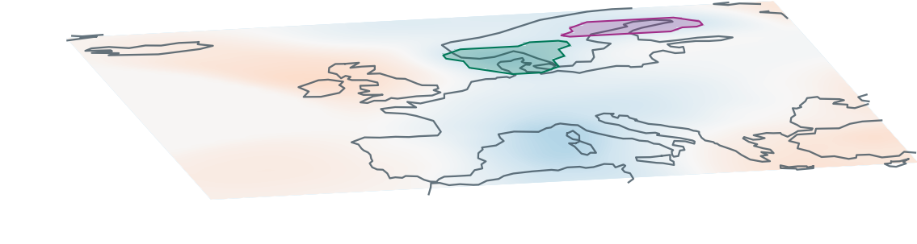

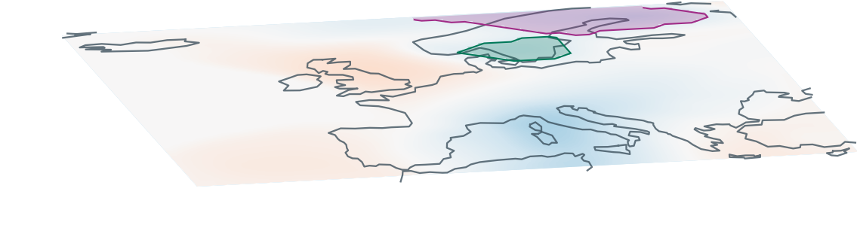

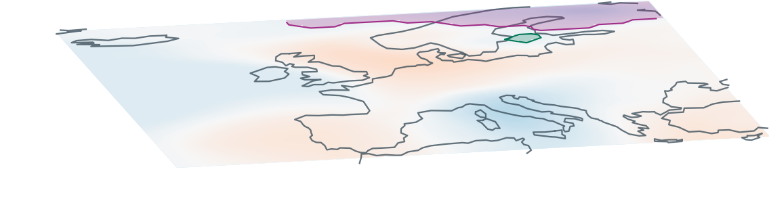
(a) Full sequence · ε = 5%
1.0
35
SLP anomaly [hPa]
Mapped position
0
0.5
Selected window
0.0
−35
0
150
300
450
600
743
(b) Matched supports
(c) Reference q and mapped x
Reference q
ε = 0%
ε = 0%
ε = 1%
ε = 2%
ε = 3%
ε = 5%
t = 212
0.75
1.0
A
B
B
B
B
B
B
B
0.60
q
0.45
A
A
Mapped position
A
A
t = 218
0.75
B
0.5
A
A
A
B
0.60
q
0.45
A
t = 224
0.0
212
224
236
212
224
236
212
224
236
212
224
236
212
224
236
A
0.75
B
B
0.60
q
0.45
A
(d) Displayed hierarchy · t = 236
t = 230
0.75
4 levels
4 levels
3 levels
3 levels
2 levels
A
B
B
0.60
A
0
q
0.45
t = 236
Levels below root
A
0.75
2
A
B
B
0.60
B
B
A
B
A
A
4
B
A
B
A
q
0.45
merge error 0.00%
merge error 0.00%
merge error 1.07%
merge error 1.07%
merge error 3.08%
Shaded support: matched feature Solid curve: displayed x Dashed curve / diamond: spatial reference q
Notes:
Hybrid authoring: 16 scientific panels (heatmaps, snapshots with coastlines, scalar strips and scientific trajectory curves) were rendered from the audited code and inserted as PNG images. All 159 text items, axes/ticks, Aij/Bij instance labels, circular markers, reference diamonds, reference projection segments and right-angle marks, position-gap lines, selection frame, callout arrow and gradient colorbar are native editable PowerPoint objects. All 57 topology branches are native editable PowerPoint lines and exactly match the audited hierarchy. Parameters are 0%,1%,2%,3%,5%. Snapshots are t=212,218,224,230,236. c retains real hourly data through 239. Layout, data and topology are unchanged from the indexed scientific figure.
Root-aligned display: each complete tree and its A/B leaf labels are translated vertically so the root merge node has a shared top position. Branch connectivity, vertical inter-level spacing, leaf identity, scalar merge values and depth counts are unchanged. Vertical axis now reads Levels below root (0 at the common root).
Revision: the native source PPT was imported and edited in place. True support samples are extremum plus leaf-arc regular vertices, read from saved hourly frames, not manually drawn basins. Positive-overlap global one-to-one matching assigns computational feature IDs. Native scientific panel images, correspondence q curves and actual t=236 merge errors clarify positional faithfulness. A/B denote matched leaf features, not independently validated cyclone identities. Repeated parameter/time codes were removed. Complete native trees and their scalar data are unchanged. Full q trajectories are computed from frozen frame references.

