Slide 1
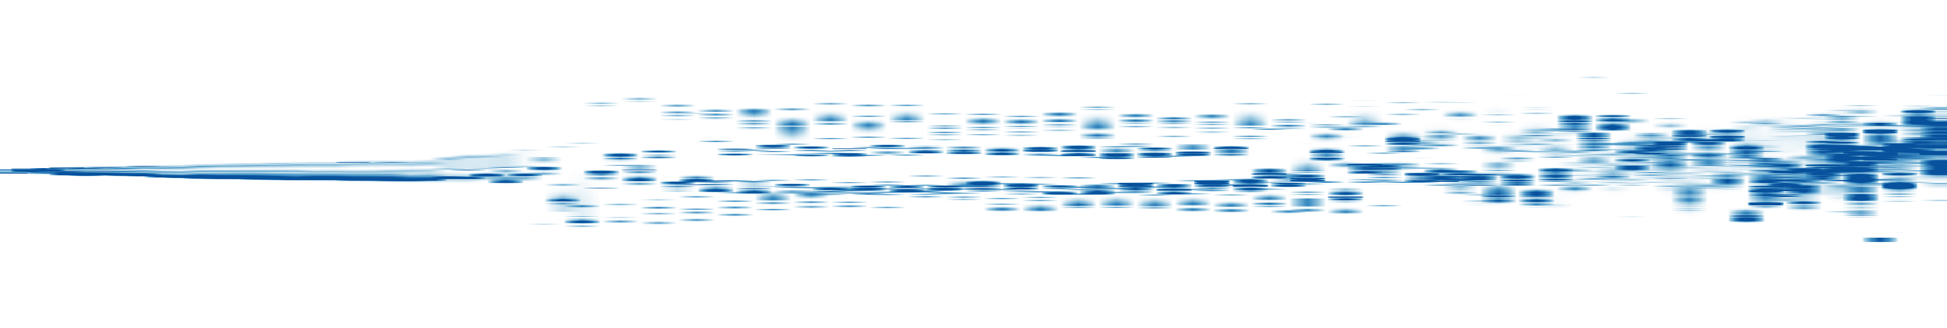

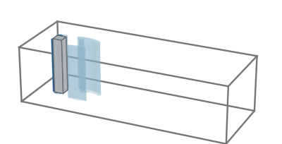
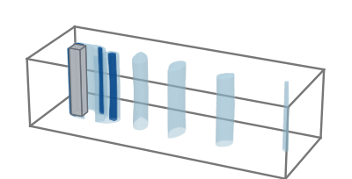
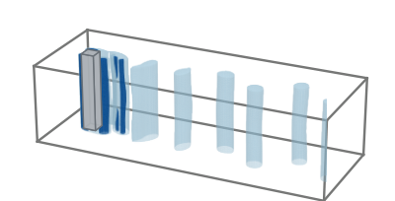
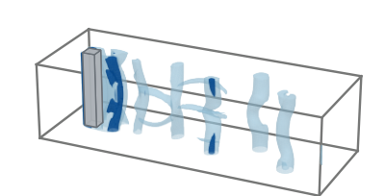
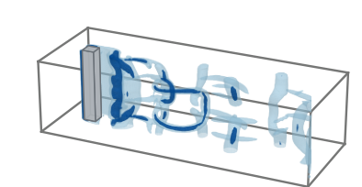
Q
0.5
1.0
I: Early
II: Transition
III: Shedding
IV: Transition
V: Late
1D layout position
0.0
0.5
−0.5
0.0
0
32.1
56.1
80.2
120.3
162.0
t = 32.1
t = 56.1
t = 80.2
t = 120.3
t = 162.0

