Slide 1
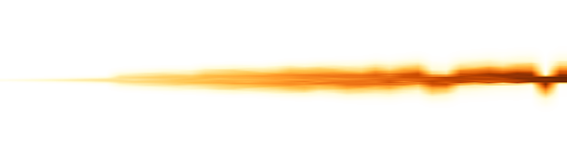

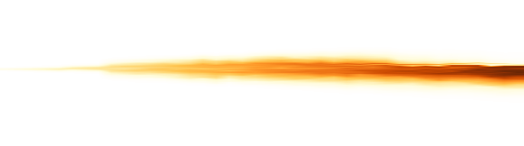

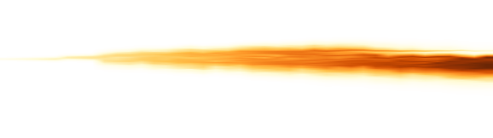
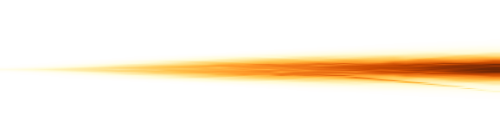



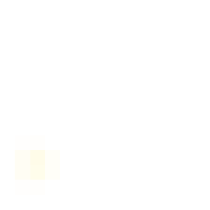




AnchorMTM
0
6
12
ε = 0%
Hilbert
1
0
ε = 2%
1
Morton
0
ε = 5%
1
Normalized position
TMTM
0
ε = 10%
1
0
ε = 20%
ST-MTM
1
0
0
39
0
39
t
t = 0
t = 10
t = 20
t = 30
t = 39

