Slide 1
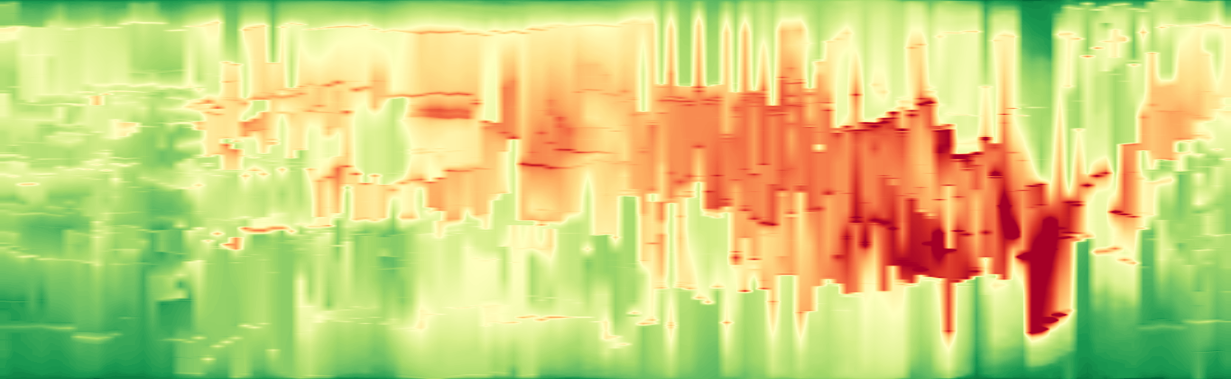
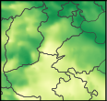
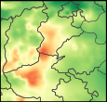
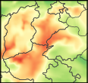
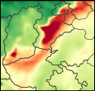
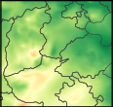
1.0
0.5
Mapped position
0.0
2017-01-22 00:00
2017-01-25 00:00
2017-01-27 12:00
2017-01-22 00:00
2017-01-23 12:00
2017-01-25 00:00
2017-01-26 12:00
2017-01-27 12:00
0
100
200
300
400
PM2.5 [µg/m³]

