Slide 1
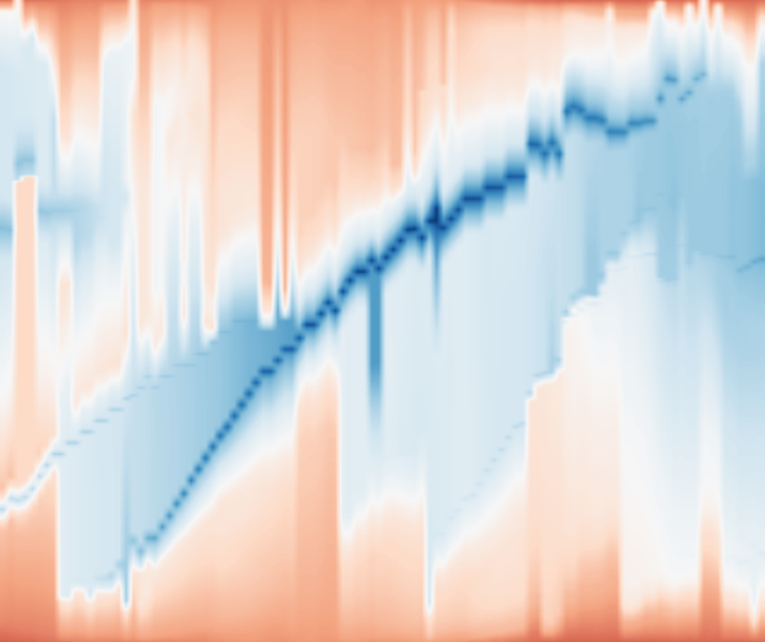
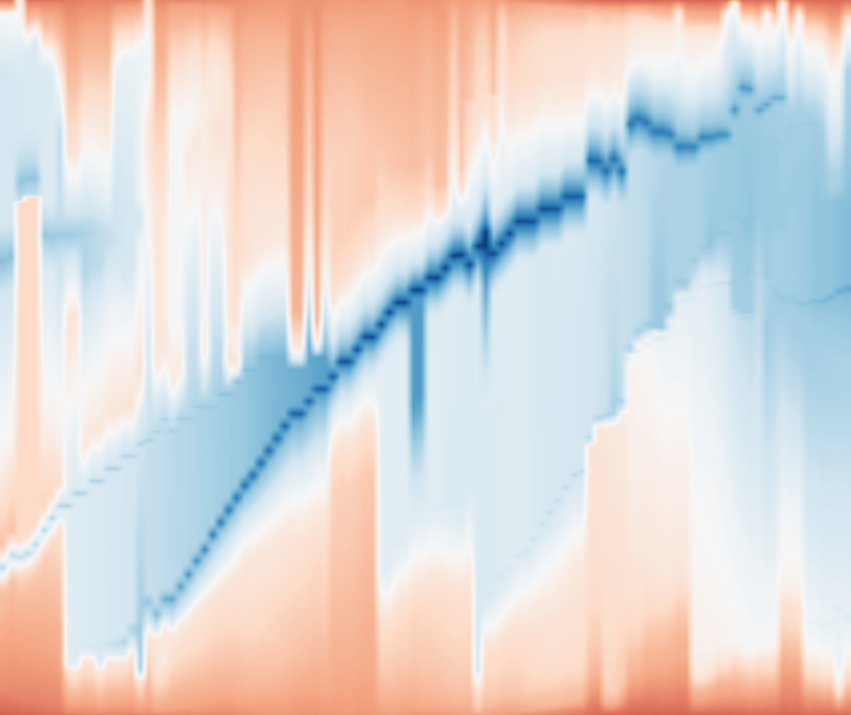
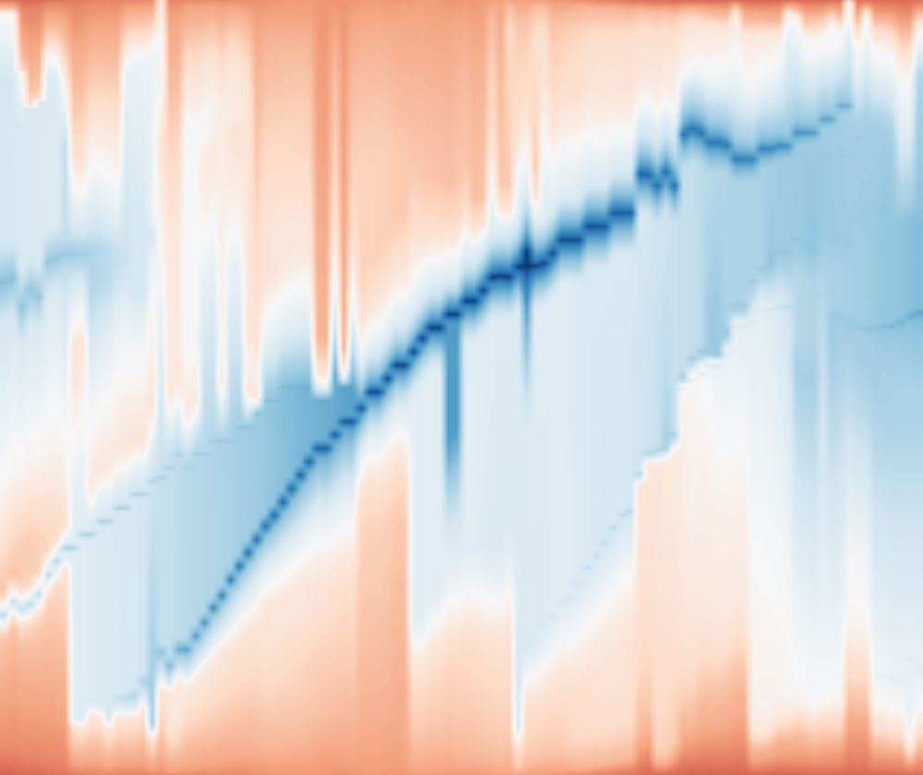

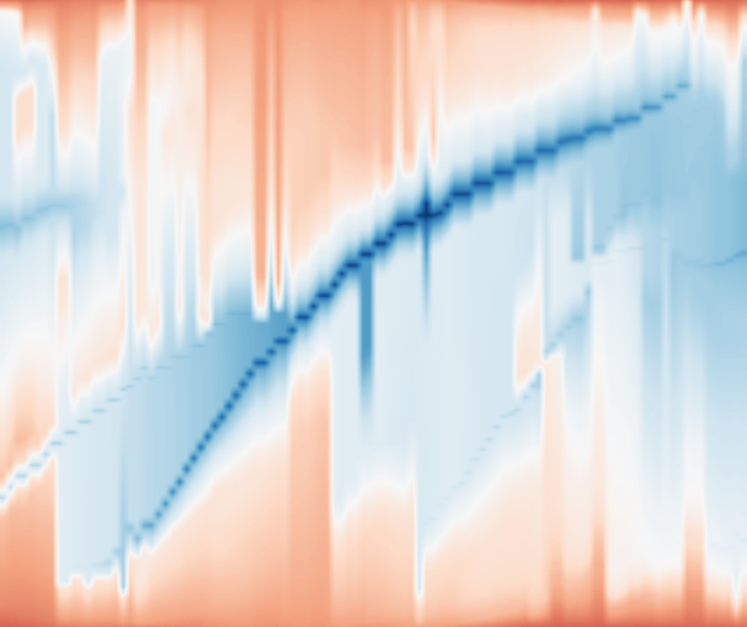



ε = 0%
ε = 2%
ε = 5%
ε = 10%
ε = 20%
35
MSLP
anomaly
[hPa]
0
t = 433
-35
0
0.5
1
0
0.5
1
0
0.5
1
0
0.5
1
0
0.5
1
Normalized position
Normalized position
Normalized position
Normalized position
Normalized position
Storms
Notes:
Actual Storms track260; upper row: scalar profile M_epsilon(:,433) of the rendered temporal map, not a geographic transect or raw source scanline. Lower row: same original event window355–460, with same fixed lower-left inset at428–437 around focus433. All five columns use common source time, position and scalar axes. Layouts are real, no artificial offsets. Source: /Users/lele/Desktop/MergeTreeMaps/output/storms_hourly_anomaly_fine_20261030/coherent/maps.npz; /Users/lele/Desktop/MergeTreeMaps/output/storms_hourly_anomaly_fine_20261030/input.json. Curves are native editable PPT paths with display-only RDP tolerance0.18px; background maps are images. 0/2/5% overlap locally,10/20% improve;30% was checked separately and removed by user request; displayed budgets are0/2/5/10/20%.

