Slide 1






















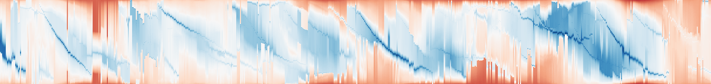
1999-12-16 03:00
1999-12-17 01:00
1999-12-18 00:00
1999-12-18 22:00
1999-12-19 20:00
90°
90°
90°
90°
90°
1.0
strong storm over Scandinavia
Mapped position
0.5
0.0
1999-12-01 00:00
1999-12-08 18:00
1999-12-16 12:00
1999-12-24 06:00
1999-12-31 23:00
Time
Notes:
Real Storms data from output/storms_hourly_anomaly_fine_20261030, coherent/maps.npz eps_0.05; tracked leaf identity 260. Five actual frames 363,385,408,430,452 and twelve actual intermediate frame strips. Scalar-field images remain raster layers; labels, coastlines, exact feature-support cell boundaries, markers, projection lines, right-angle symbols, 90-degree rotation symbols, borders, selection box, axes and two exterior connectors are native editable objects. Date labels copied from snapshot_data.npz dates, no time-zone conversion. Overlap-matched identity endpoints do not certify physical genesis/dissipation. This is a one-slide figure, without an added title or gray panels.

