Slide 1
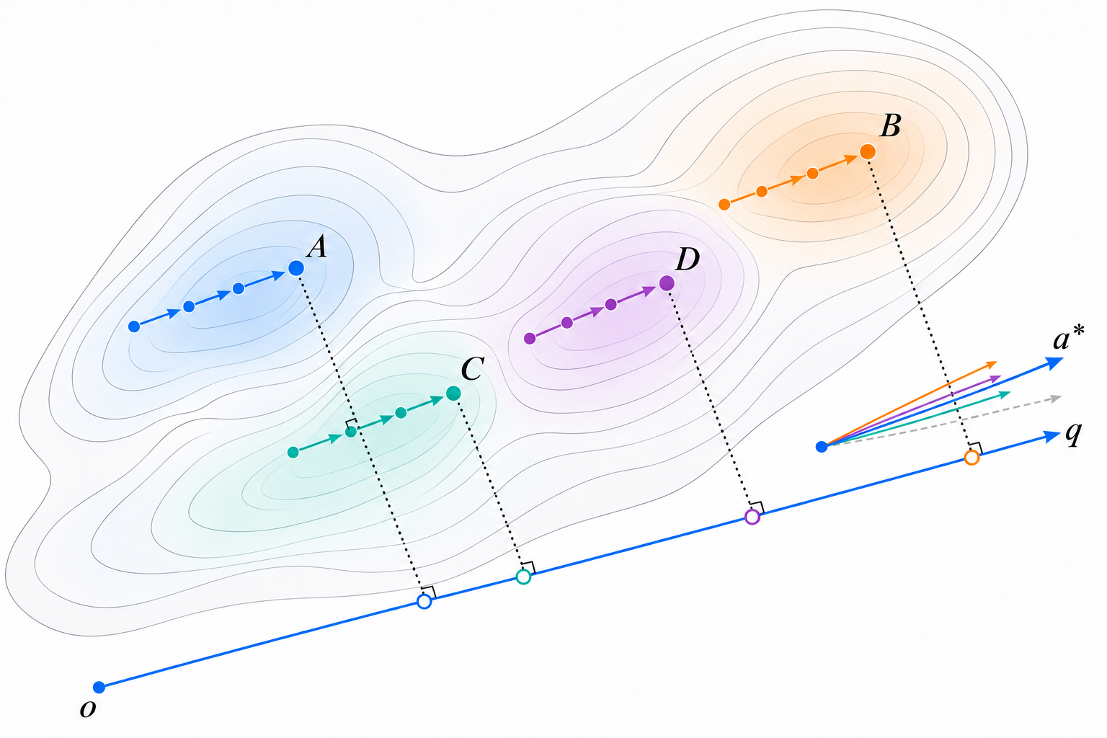
Notes:
Motion-derived fixed spatial reference. Source: independently generated illustration refined in this chat, 01_direction.png. Artwork is embedded at its original resolution to preserve the requested appearance. The image can be moved or replaced as a picture; its internal labels/lines are raster, not individual native objects. Scientific conceptual schematic, not experimental evidence. No mapping figure is included. Main-paper usage: single-column figure. All coordinate and height positions are schematic. Source diagrams were based on the current AnchorMTM method text.

Slide 2
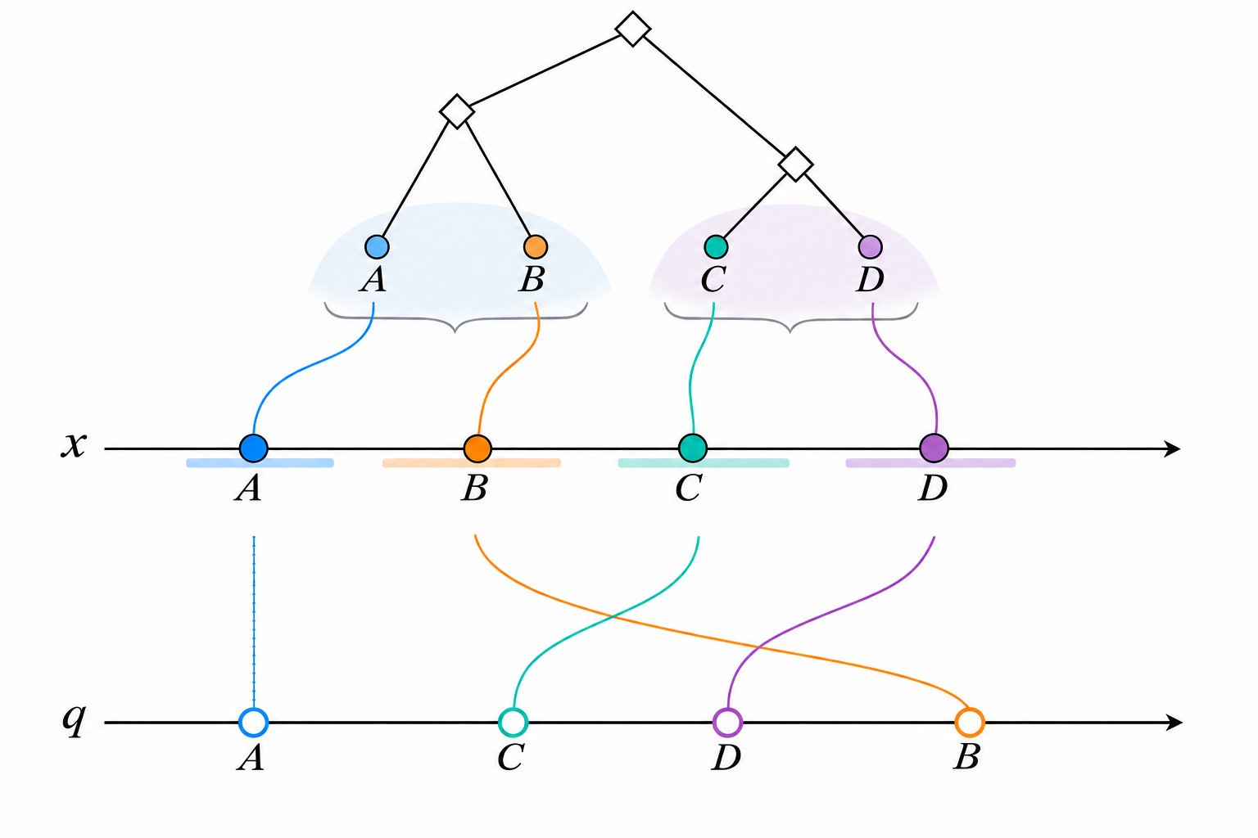
Notes:
Spatial targets and exact-topology order conflict; x above q; three requested braces removed. Source: independently generated illustration refined in this chat, 02_conflict.png. Artwork is embedded at its original resolution to preserve the requested appearance. The image can be moved or replaced as a picture; its internal labels/lines are raster, not individual native objects. Scientific conceptual schematic, not experimental evidence. No mapping figure is included. Main-paper usage: single-column figure. All coordinate and height positions are schematic. Source diagrams were based on the current AnchorMTM method text.

Slide 3
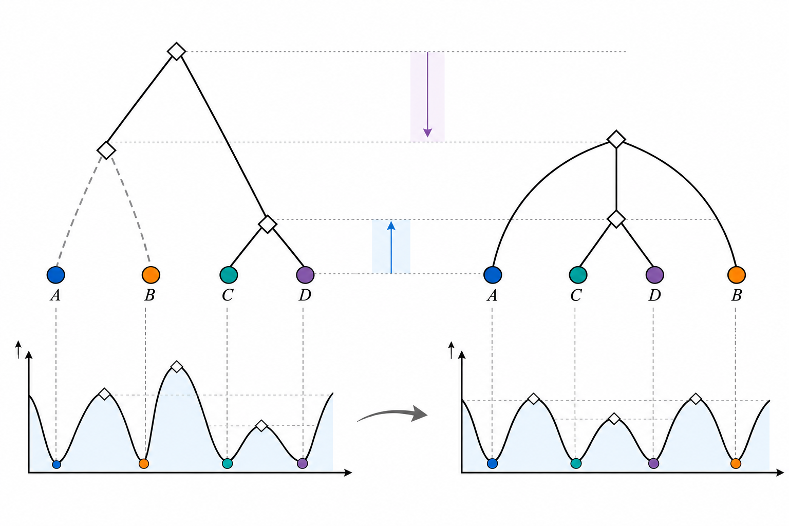
Notes:
Selective relaxation of AB contiguity while CD remains grouped. Source: independently generated illustration refined in this chat, 03_relaxation.png. Artwork is embedded at its original resolution to preserve the requested appearance. The image can be moved or replaced as a picture; its internal labels/lines are raster, not individual native objects. Scientific conceptual schematic, not experimental evidence. No mapping figure is included. Main-paper usage: single-column figure. All coordinate and height positions are schematic. Source diagrams were based on the current AnchorMTM method text.

