Slide 1
Unit Testing in Swift

Slide 2
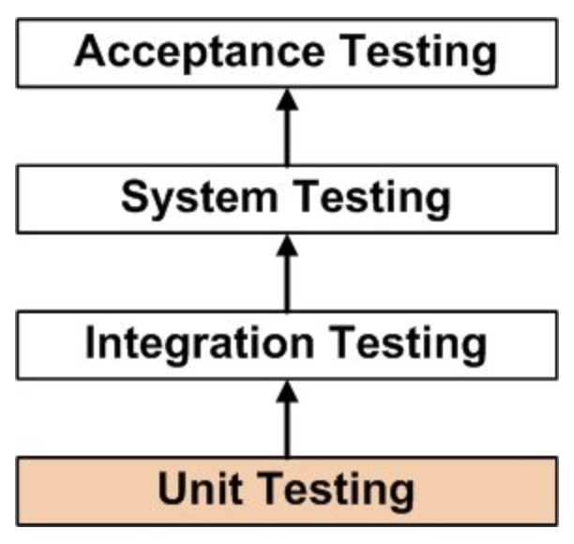
Unit Testing
UNIT TESTING is a level of software testing where individual units/ components of a software are tested. The purpose is to validate that each unit of the software performs as designed.

Slide 3
Reasons
Decrease development time needed for solid changes (refactoring, dependency changing, architecture migration, migration from Objective-C to Swift)
Decrease regression possibility
Code improvement
Handy bugfixing
Documented code

Slide 4
When to start
Released application in active development or support phase
Time resource availability
Possibility of solid changes in future
Continuous regressions

Slide 5
What should you cover firstly?
Storing, retrieving and updating data layers
Business logic
Processing and presenting data layers
User Interface

Slide 6
Ideal Unit Test has to (be):
Reliable
Independent from the environment
Easily supportable
Clean and easy for understanding
Follow same name conventions
Running regularly in automatic mode

Slide 7
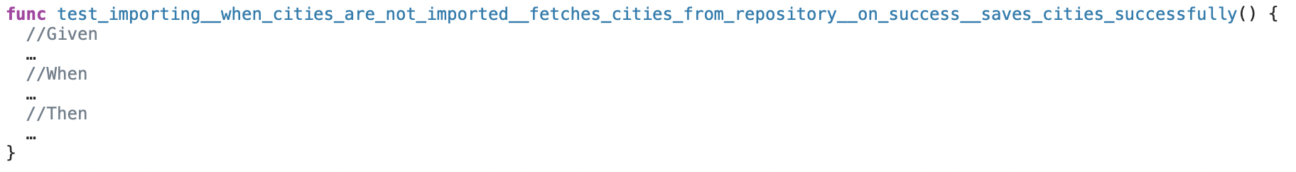
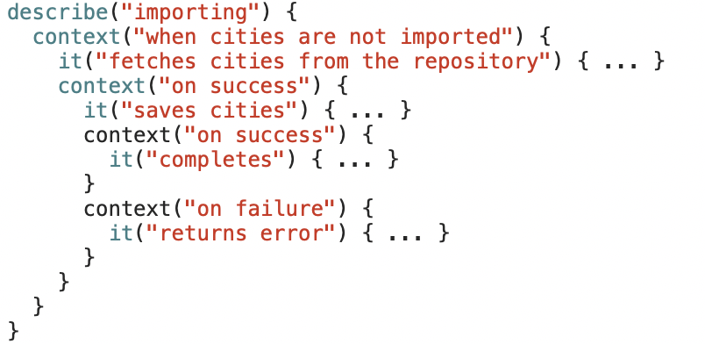
TDD (XCTest) or BDD (Quick)

Slide 8
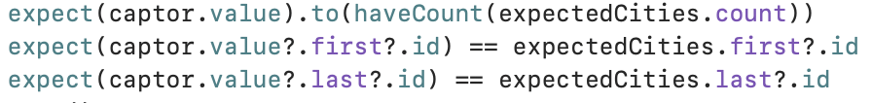

Nimble – make your expectations readable

Slide 9
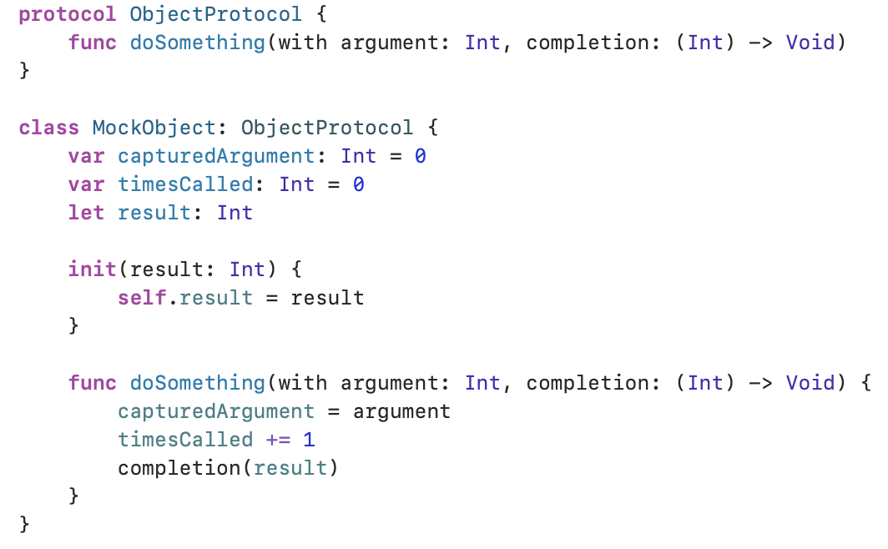
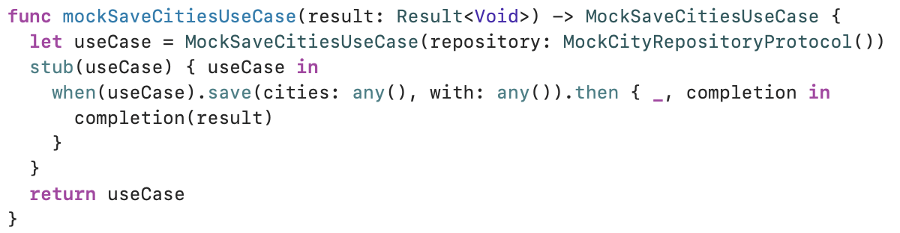
Mocking
Manual
Cuckoo or SwiftyMocky

Slide 10
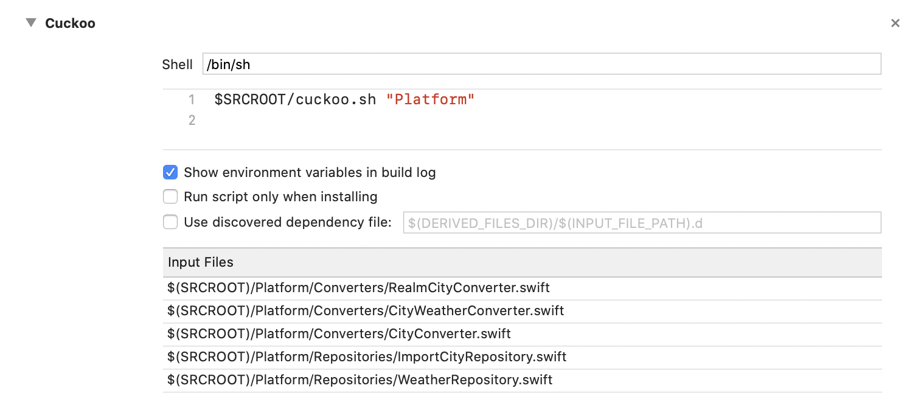
Cuckoo

Slide 11
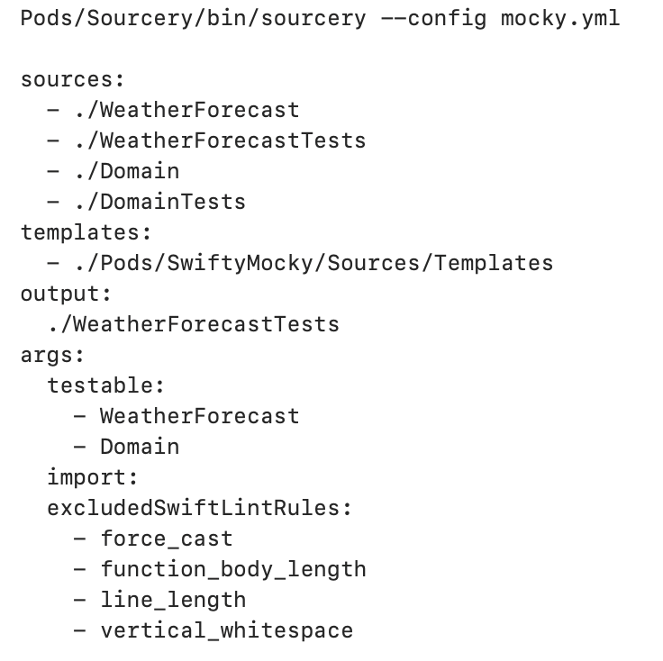
SwiftyMocky

Slide 12

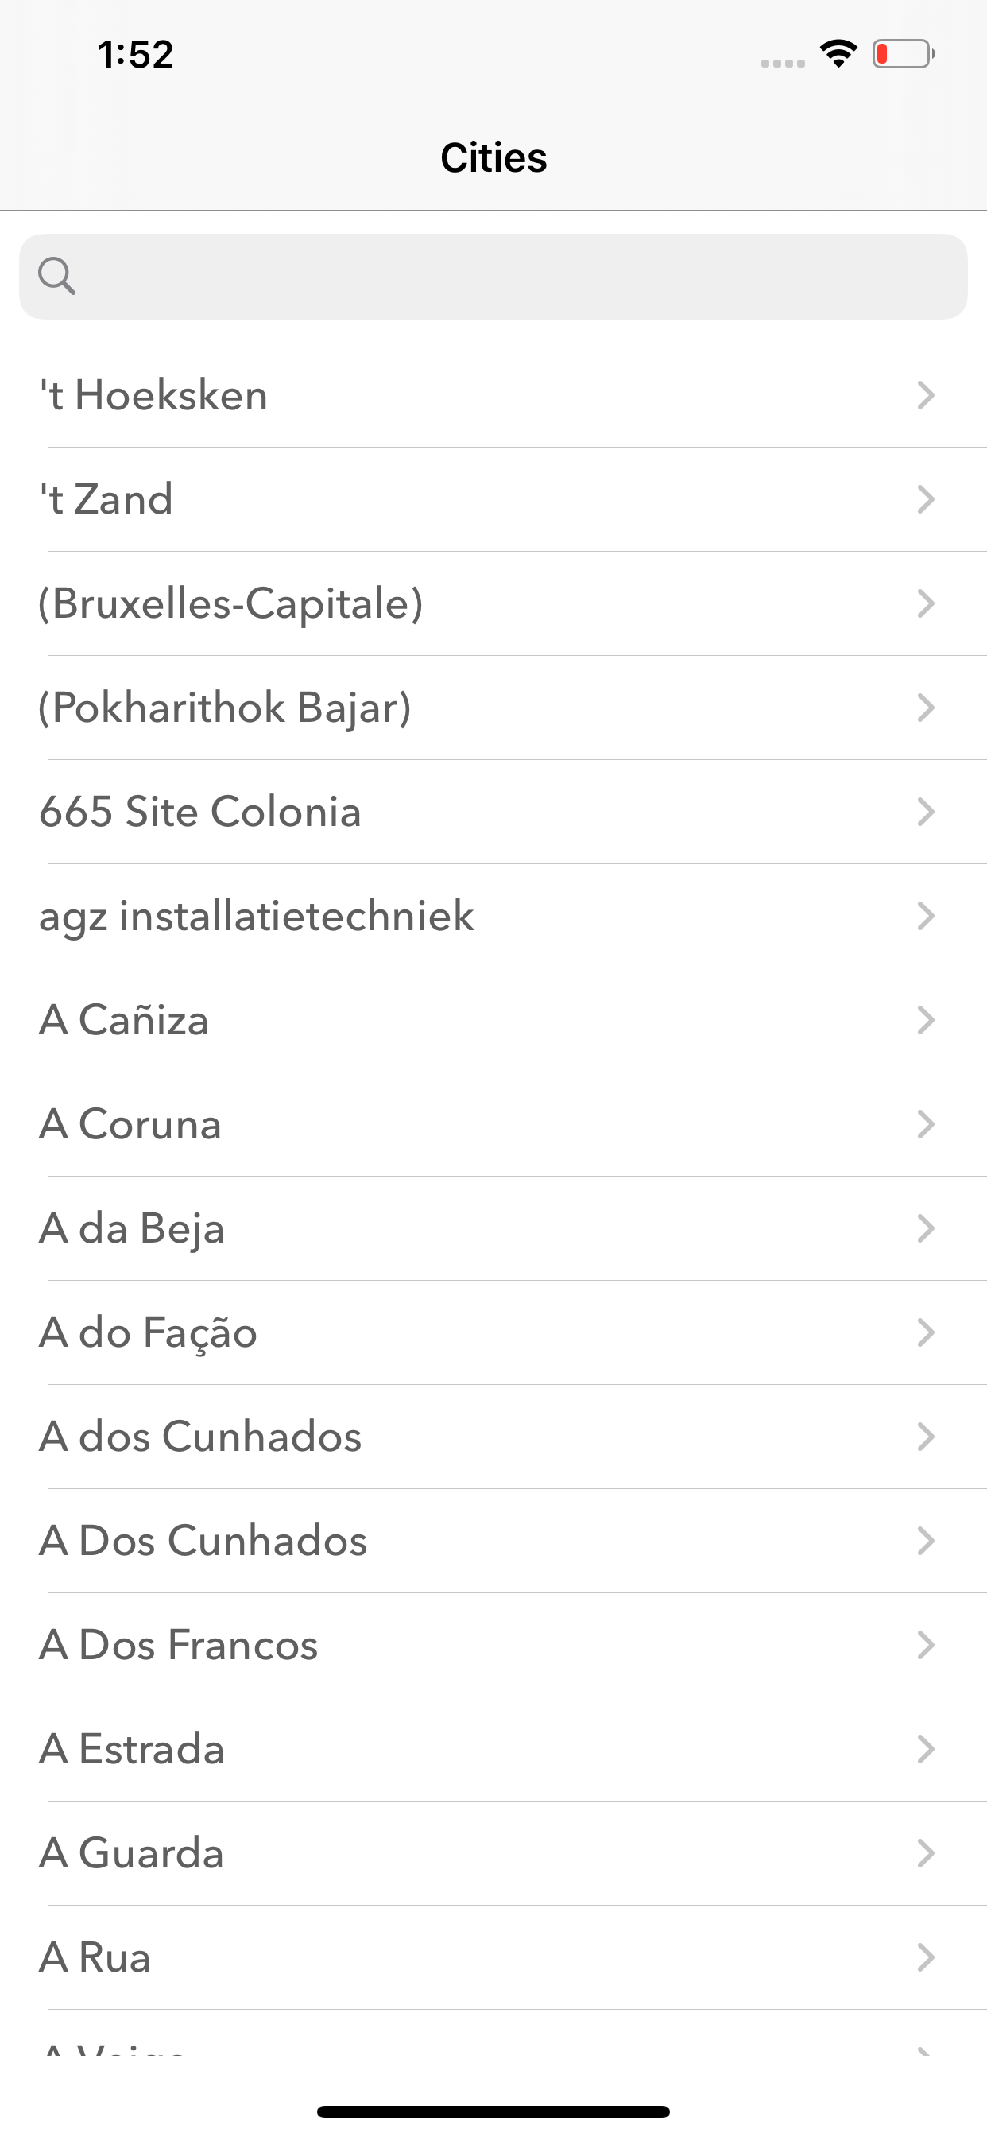
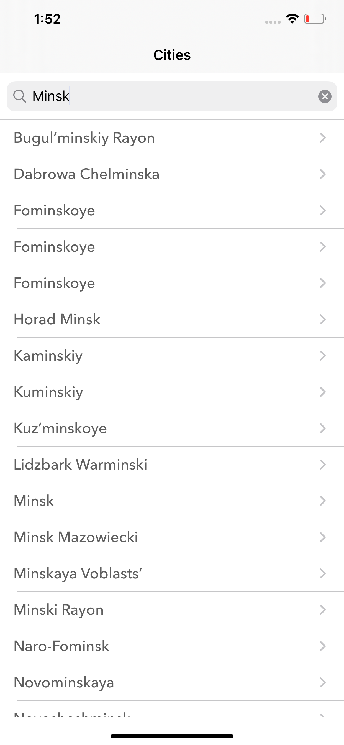
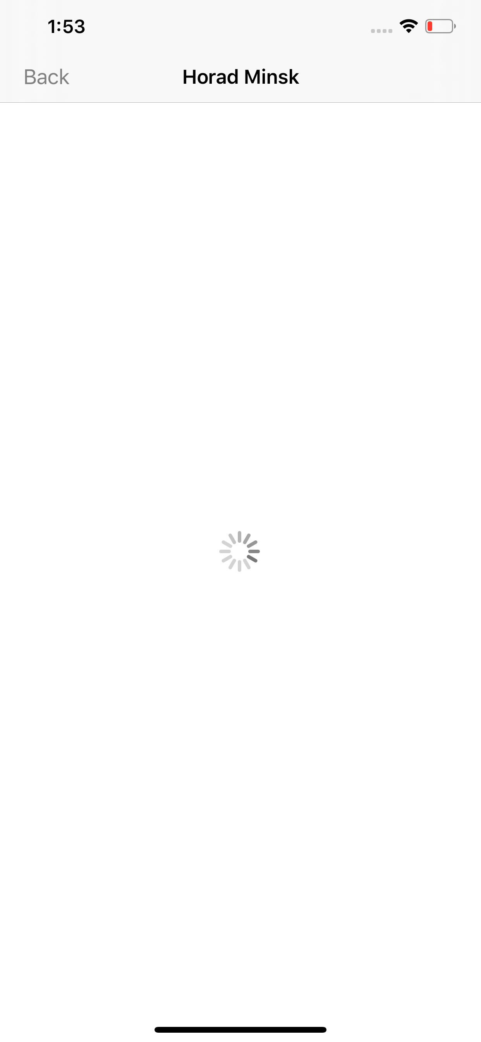
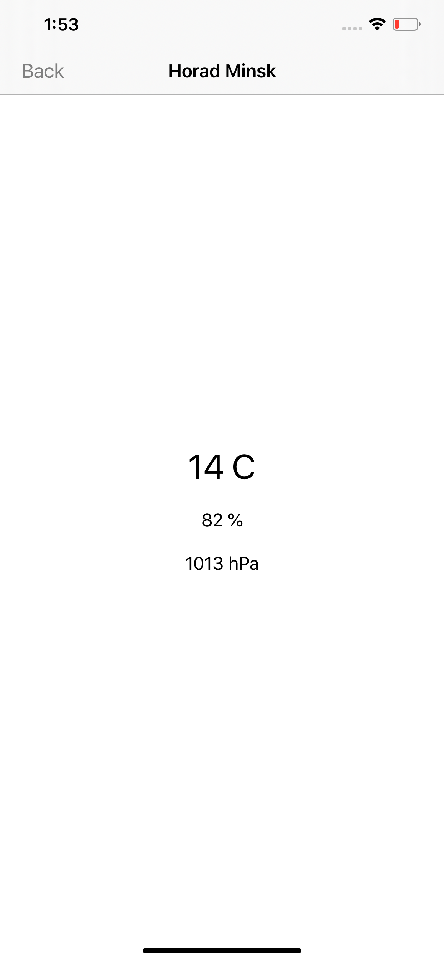
Example

Slide 13
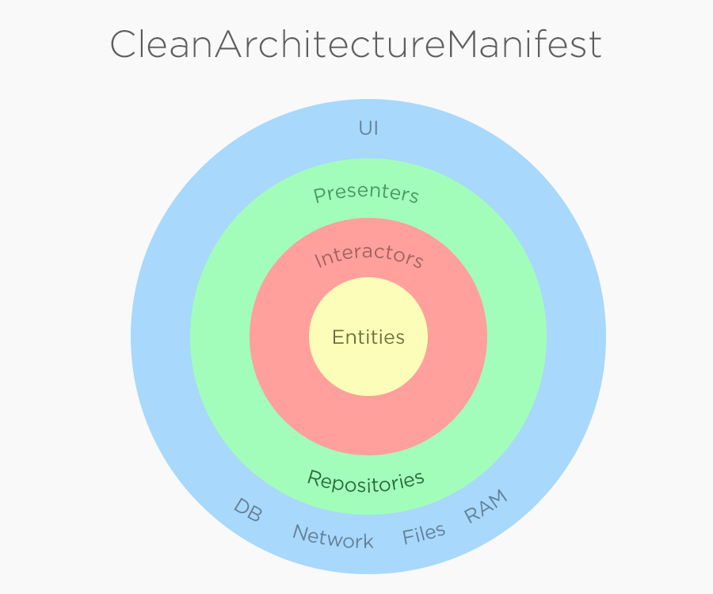
Clean Architecture

Slide 14
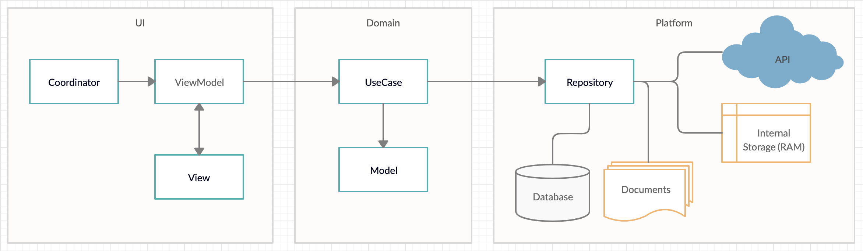
MVVM-C + Clean Architecture

Slide 15
Resources
Demo project
https://github.com/lelicman/weather_forecast
Quick – BDD library for Swift and Objective-C
https://github.com/Quick/Quick
Nimble – express the expected outcomes of Swift and Objective-C
https://github.com/Quick/Nimble
Cuckoo – Mocking library for Swift
https://github.com/Brightify/Cuckoo
SwiftyMocky – Mocking library for Swift
https://github.com/MakeAWishFoundation/SwiftyMocky
Kiwi – BDD and Mocking library for Objective-C
https://github.com/kiwi-bdd/Kiwi

Slide 16

Questions?

