Slide 1
Introduction to XML and TEI
31 January 2023

Slide 2
https://www.youtube.com/watch?v=pQHX-SjgQvQ

Slide 3
XML, TEI, HTML, CSS ?
XML: eXtensible Markup Language – functions independent of platform, software, or system.
TEI: Text Encoding Initiative – a ruleset for guiding the development of XML files for encoding text.
HTML: HyperText Markup Language – Processed by software (browsers). Uses similar syntax to XML.
CSS: Cascading Style Sheet—Instructions for formatting HTML

Slide 4
Text
encoding
XML-TEI
XPath XQuery
XSLT
transforming
querying
constraining
ODD & Schematron

Slide 5
Vocabulary
Tag: anything inside < >
Root: the topmost tag of a document, which contains all other parts of the document. | <TEI> <html>
Element: name for a structure to be coded | <body> <div> <p>
Attribute: information about an element | <div type=“poem”> <name ref=“LIEB2”>
Path (1): the location where documents are stored within the file system | /Users/leliebe/Documents/GitHub/DHUM630_Spr2023/TEI_Practice/MinimalTEI.xml
Path (2): the road between elements in an XML-TEI document | /child::TEI/child::text/child::body

Slide 6
Descriptive vs Presentational Markup
The goal of XML (and, more broadly, HTML) is to describe what data is.
One XML document can become lots of other kinds of documents (HTML, PDF, etc.)
Other languages are used to decide how each element is presented (e.g., a CSS file decides how an HTML file is displayed. See www.csszengarden.com for example)

Slide 7
Parts of a TEI Document
<?xml version="1.0" encoding="UTF-8"?>
XML declaration. This is a processing instruction that identifies the type of document as XML. The version number specifies which version of XML is being used, while the encoding attribute determines which encoding character set is used. UTF-8 is a good default.
<TEI xmlns="http://www.tei-c.org/ns/1.0">
<TEI> is our root element, which will open and close the document.
The xmlns attribute is a namespace, telling the document that we are using the TEI rules.
<teiHeader>
<text>
Contains metadata about the document being encoded.
Contains all parts of the encoded text, from title page to endnotes.

Slide 8
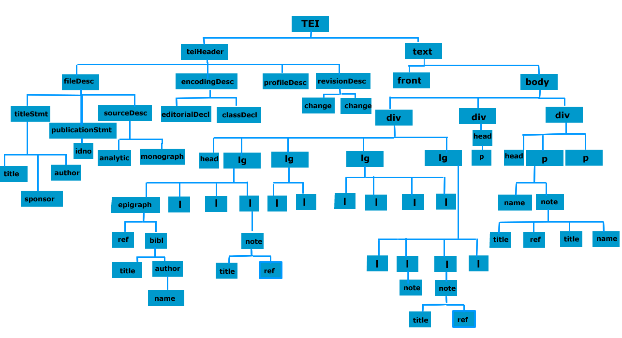

Slide 9
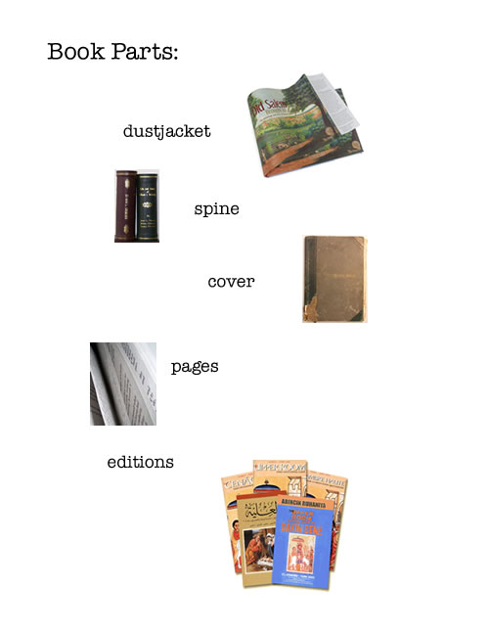

Slide 10
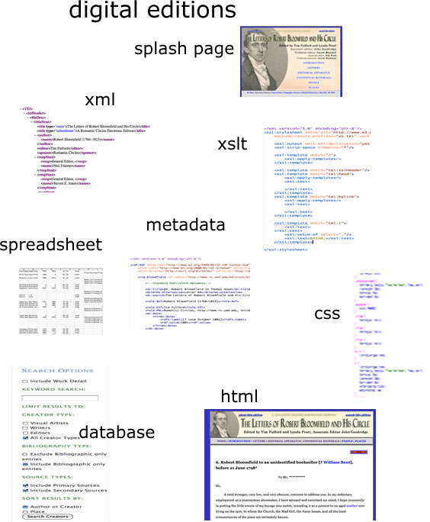

Slide 11
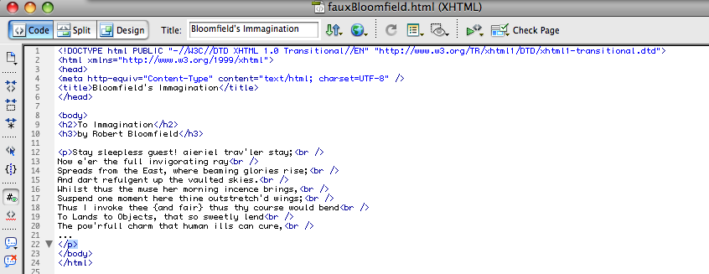

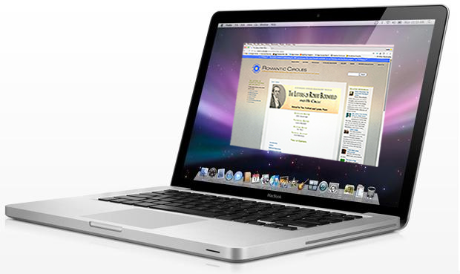
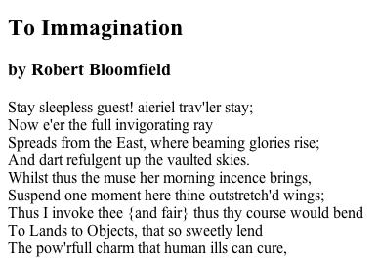

Slide 12
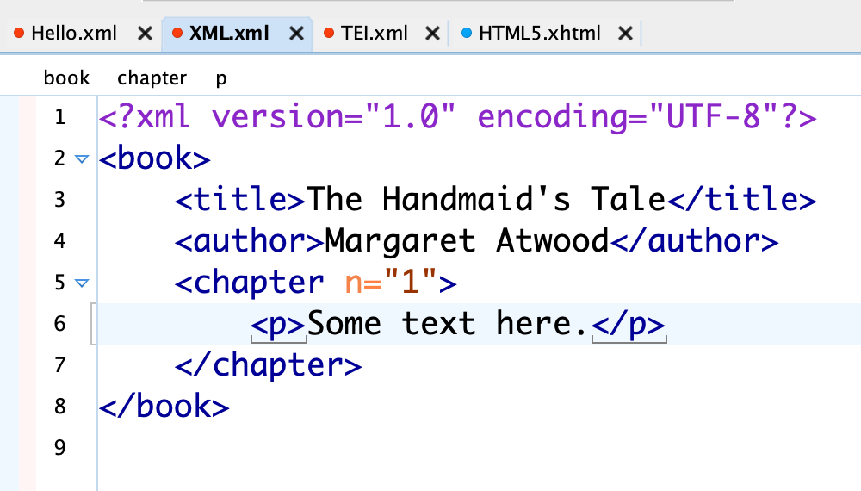

Slide 13
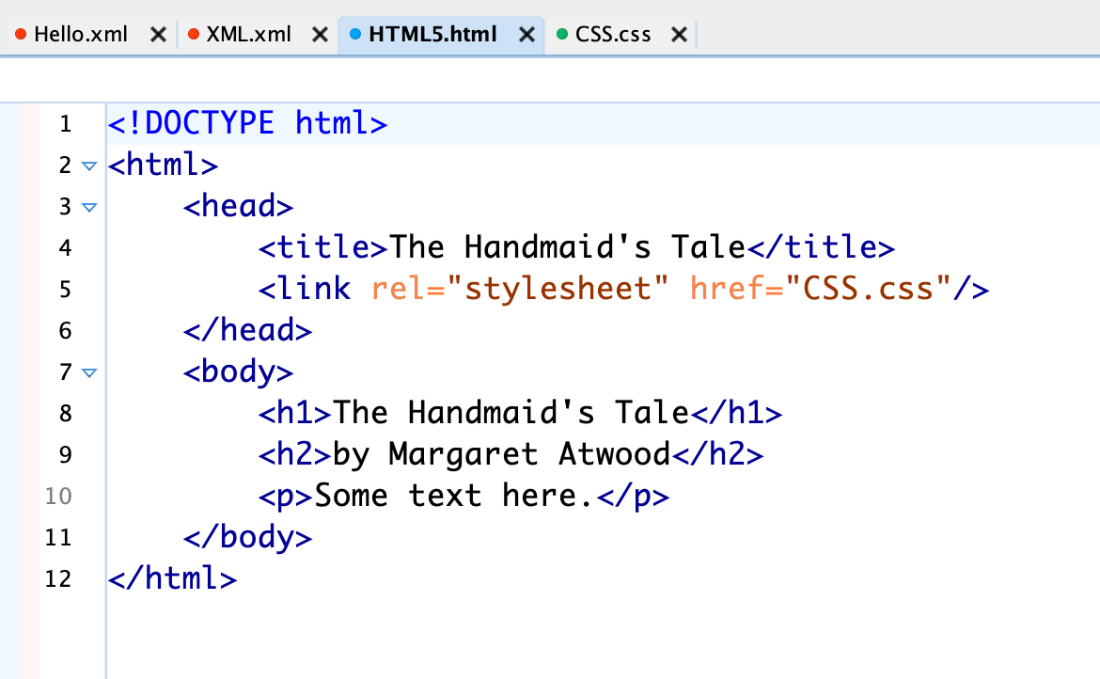

Slide 14
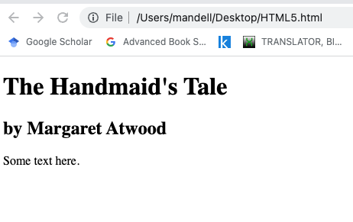

Slide 15
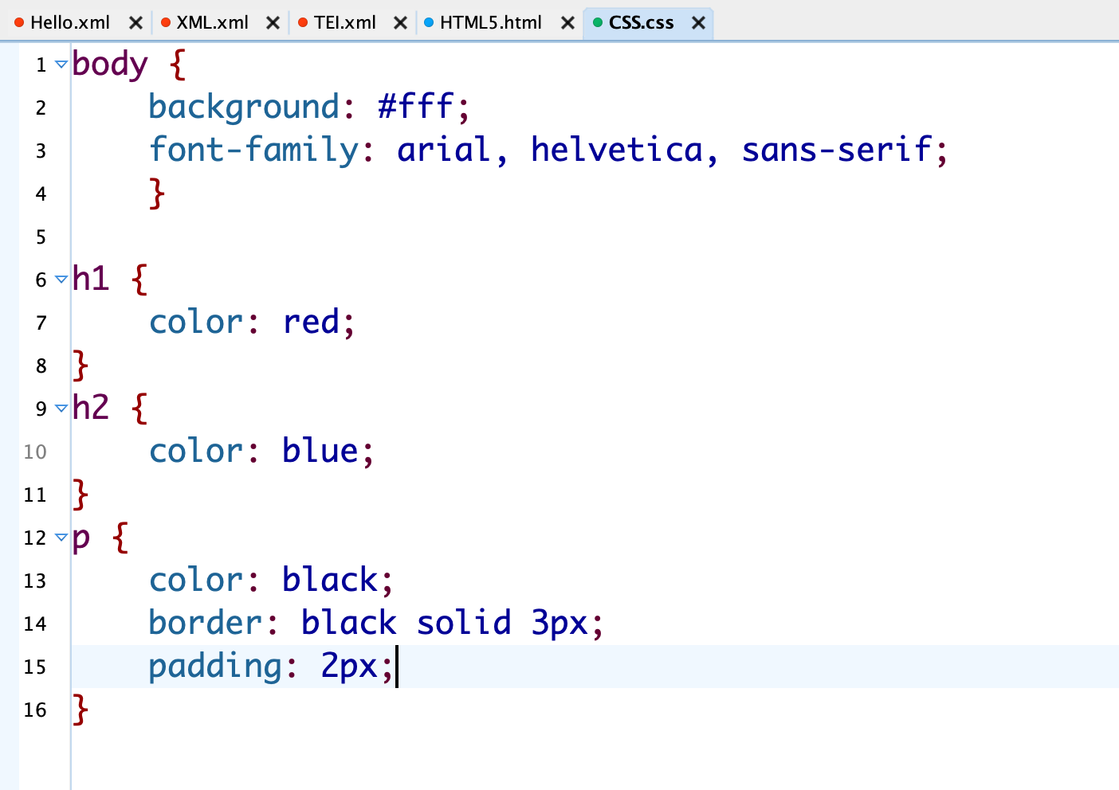

Slide 16
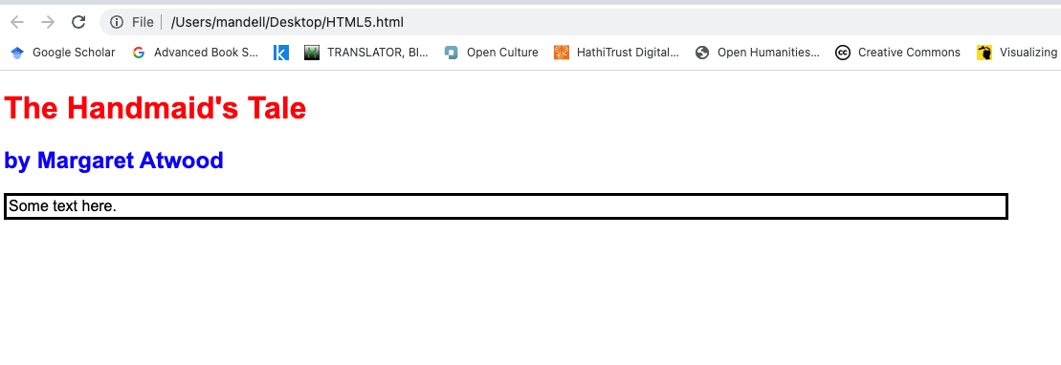

Slide 17
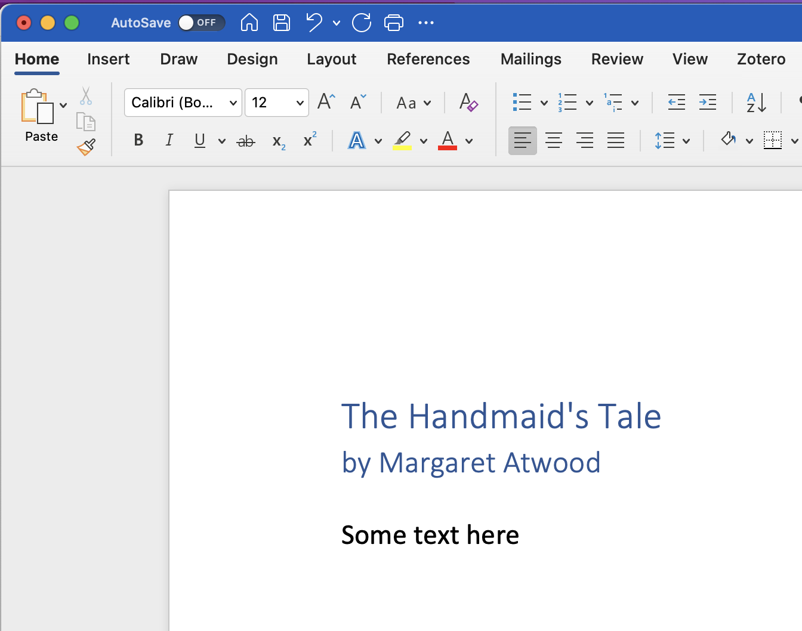

Slide 18
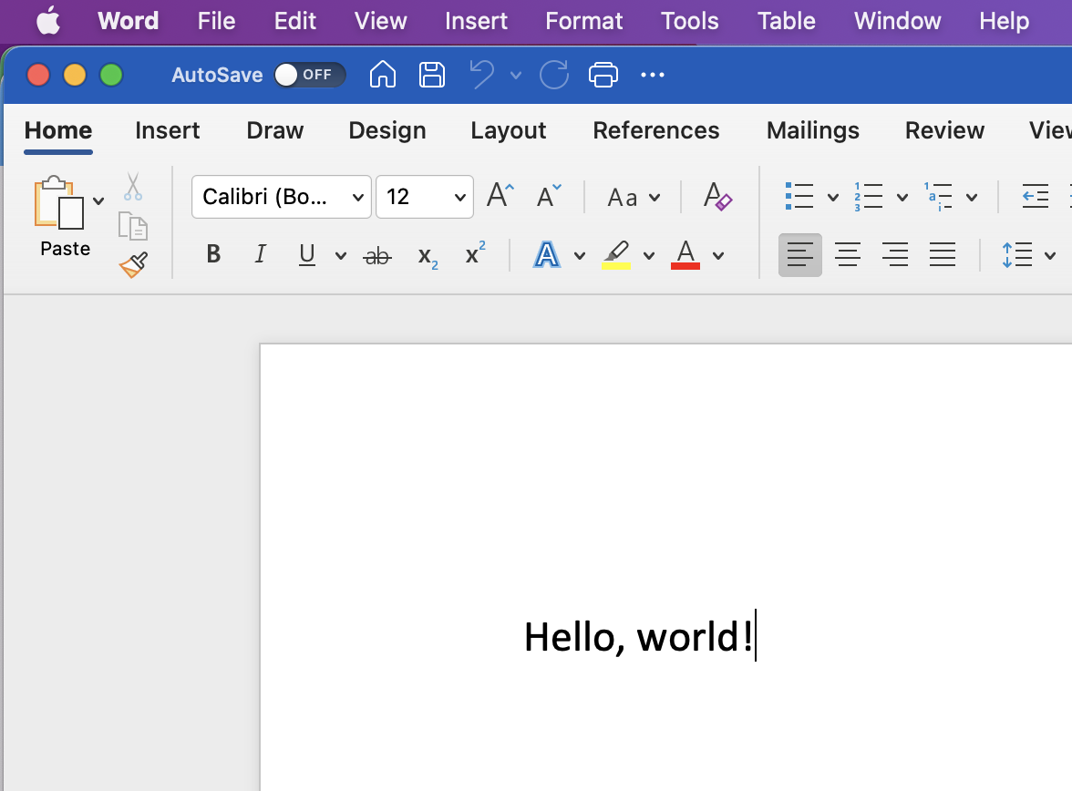

Slide 19
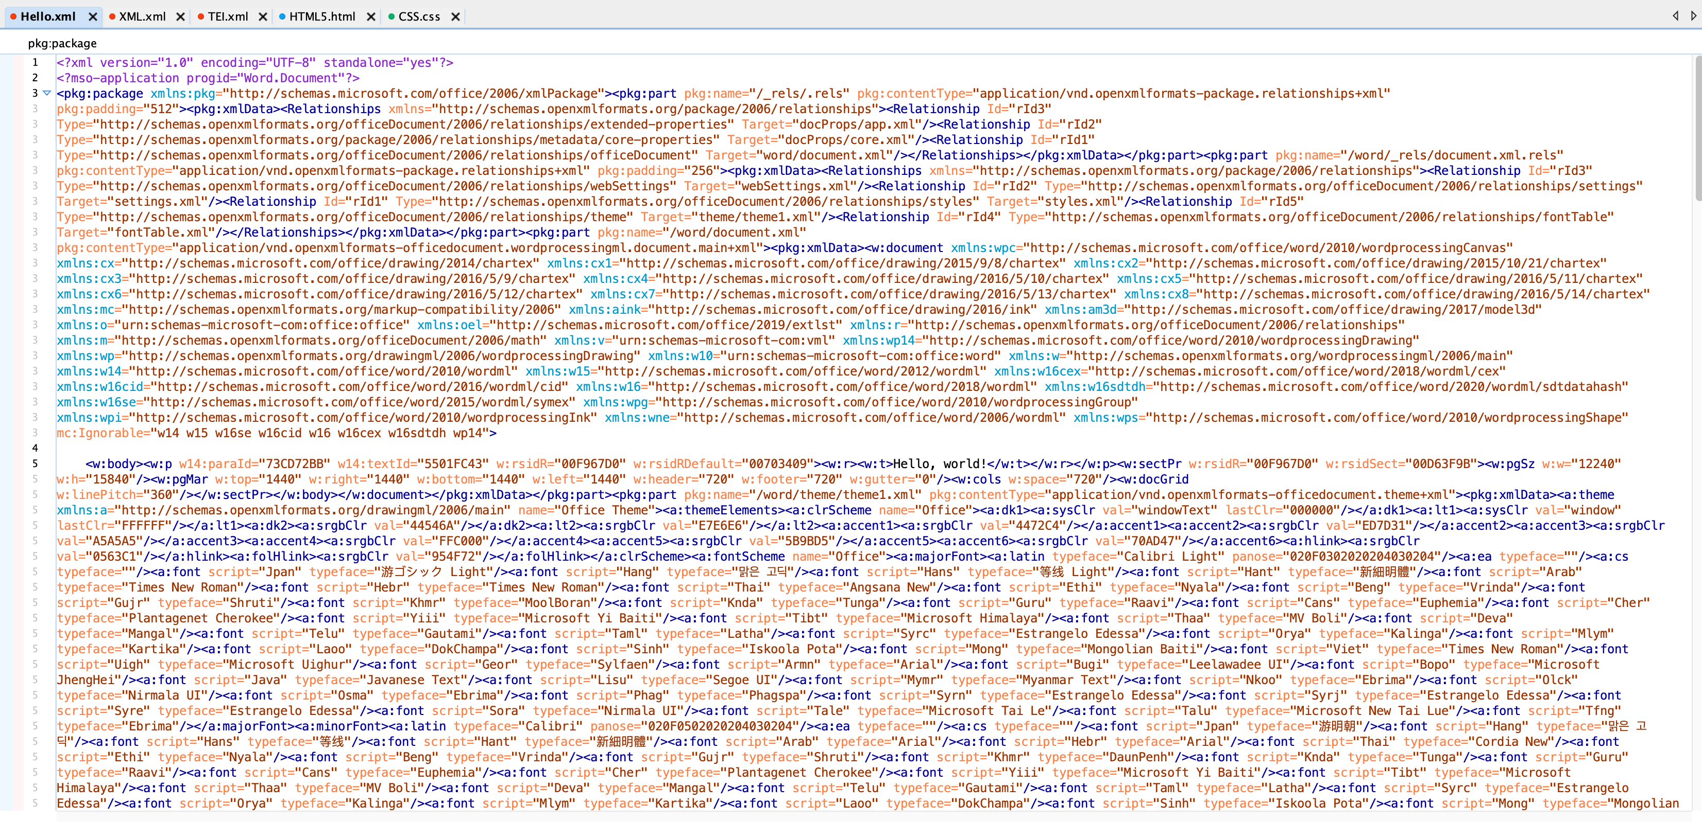

Slide 20
Practice
“The Yellow Wallpaper” (Project Gutenberg) (https://www.gutenberg.org/files/1952/1952-0.txt)
Shakespeare, Sonnet 20 (http://shakespeare.mit.edu/Poetry/sonnet.I.html)
Montague letter (Project Gutenberg)

