Slide 1

中国科学院大学：VLSI测试与可测试性设计
第10讲 存储器诊断与BISR
韩银和
中科院计算技术研究所
Email: yinhes@ict.ac.cn
URL: www.carch.ac.cn/~yinhes
Notes:
EE141

Slide 2
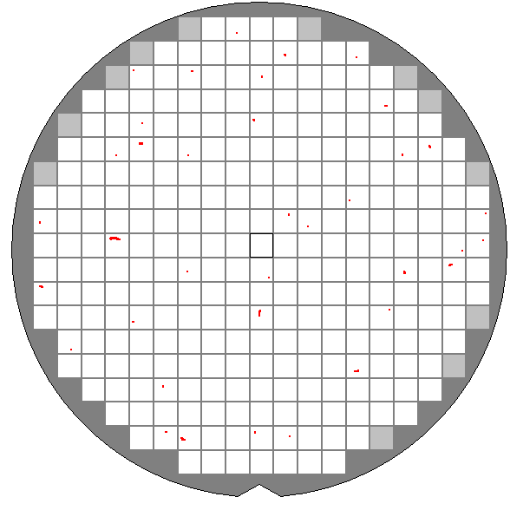
From fault detection to defect tolerance
Notes:
EE141

Slide 3
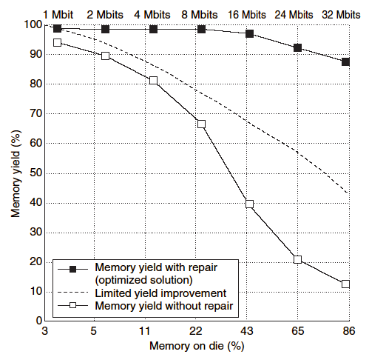
Memory yield is a challenge
12x12mm²
0.13 um
Notes:
EE141

Slide 4
Typical RAM Production Flow
测试
诊断和修复
√
√
Wafer
Full Probe Test
Laser Repair
Packaging
Marking
Post-BI Test
Burn-In (BI)
Pre-BI Test
Final Test
Visual Inspection
QA Sample Test
Shipping
Notes:
EE141

Slide 5
CPUs with memory repair
Company | Year | CPU | Tech (um) | Freq (MHz) | BISR | Overhead
Alpha | 1995 | 21164 | 0.35 | 366~625 | Laser | 2%
 | 1998 | 21264 | 0.18/0.28 | 600~1250 | Laser | 0.2%
 | 2003 | 21364 | 0.13/0.88 | 1200~1700 | Laser | -
AMD | 1997 | K6 | 0.35 | 166~500 | Laser | -
SUN | 1999 | UltraSparc 3 | 0.15 | 500~1590 | Laser | -
Motorola | - | PowerPC7400 | 0.2 | 700 | Laser | -
 | - | MPC750 | 0.29 | - | Laser | -
IBM | 2005 | UltraSparc T1 | 0.09 | 1200 | Efuse | -
IBM/Toshiba/Sony | 2005 | Cell | 0.09 | 4600 | - | -
Notes:
EE141

Slide 6
Chapter 9
Memory Diagnosis and Built-In Self-Repair
Notes:
EE141

Slide 7
What is this chapter about?
Why diagnostics?
  Yield improvement
    Repair and/or design/process debugging
BIST design with diagnosis support
MECA: a system for automatic identification of fault site and fault type
Built-in self-repair (BISR) for embedded memories
  Redundancy analysis (RA) algorithms
  Built-in redundancy analysis (BIRA)
Notes:
EE141

Slide 8
测试、诊断和修复
测试： 发现故障？芯片有无故障？
诊断：故障在那？定位故障
修复：修复故障？寻找最优修复/替代方案
Notes:
EE141

Slide 9
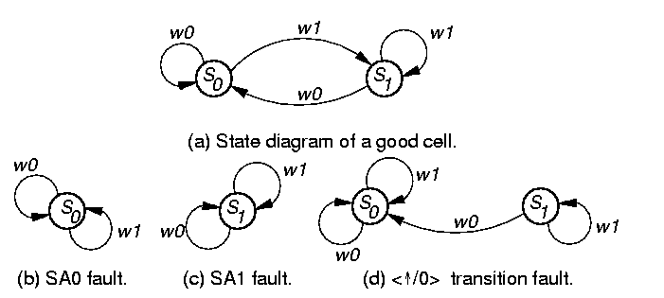
Static RAM Fault Models: SAF
Stuck-At Fault (SAF)
  Cell (line) SA0 or SA1
    A stuck-at fault (SAF) occurs when the value of a cell or line is always 0 (a stuck-at-0) or always 1 (a stuck-at-1).
    A test that detects all SAFs guarantees that from each cell, a 0 and a 1 must be read.
Notes:
EE141

Slide 10
Static RAM Fault Models: TF
Transition Fault (TF)
  Cell fails to transit from 0 to 1 or 1 to 0 in specified time period.
    A cell has a transition fault (TF) if it fails to transit from 0 to 1 (a <↑/0> TF) or from 1 to 0 (a <↓/1> TF).
< /0> transition fault
Notes:
EE141

Slide 11
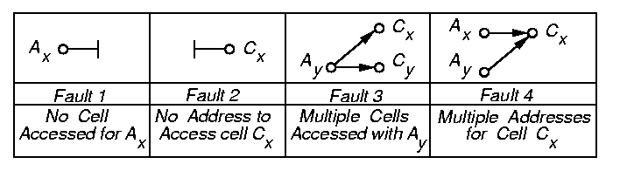
Static RAM Fault Models: AF
Address-Decoder Fault (AF)
  An address decoder fault (AF) is a functional fault in the address decoder that results in one of four kinds of abnormal behavior:
    Given a certain address, no cell will be accessed
    A certain cell is never accessed by any address
    Given a certain address, multiple cells are accessed
    A certain cell can be accessed by multiple addresses
Notes:
EE141

Slide 12
Static RAM Fault Models: SOF
Stuck-Open Fault (SOF)
  A stuck-open fault (SOF) occurs when the cell cannot be accessed due to, e.g., a broken word line.
  A read to this cell will produce the previously read value.
Notes:
EE141

Slide 13
RAM Fault Models: CF
Coupling Fault (CF)
  A coupling fault (CF) between two cells occurs when the logic value of a cell is influenced by the content of, or operation on, another cell.
  State Coupling Fault (CFst)
    Coupled (victim) cell is forced to 0 or 1 if coupling (aggressor) cell is in given state.
  Inversion Coupling Fault (CFin)
    Transition in coupling cell complements (inverts) coupled cell.
  Idempotent Coupling Fault (CFid)
    Coupled cell is forced to 0 or 1 if coupling cell transits from 0 to 1 or 1 to 0.
Notes:
EE141

Slide 14
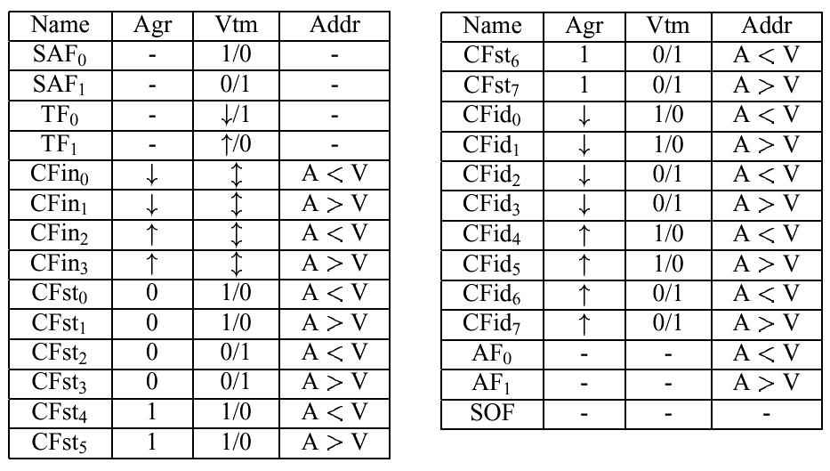
Fault Model Subtypes
Notes:
EE141

Slide 15
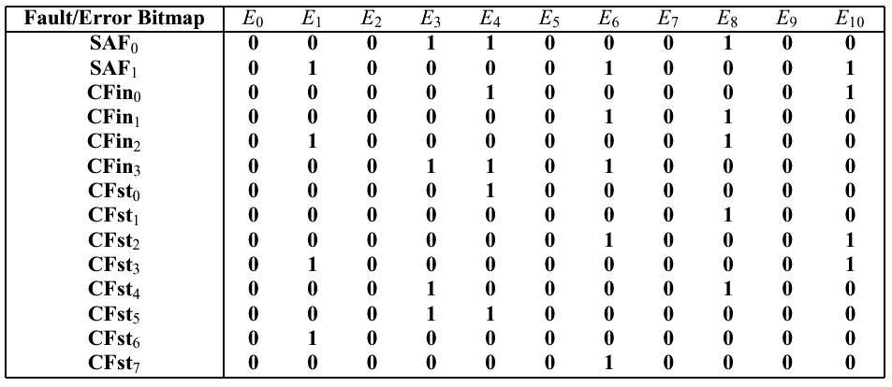
March Signature & Dictionary
March 11N
E0
E1 E2
E3
E4 E5
E6 E7
E8 E9
E10
Notes:
EE141

Slide 16
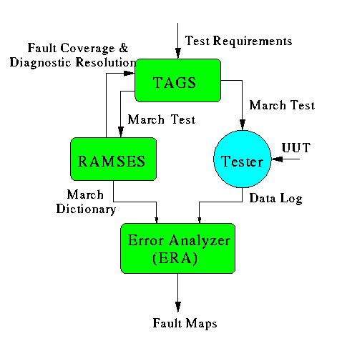
Memory Error Catch and Analysis (MECA)
Source: Wu, et al., ICCAD00
Notes:
EE141

Slide 17
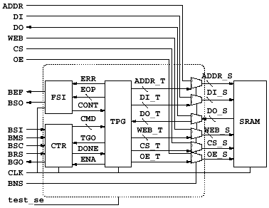
BIST with Diagnosis Support
FSI: fault site indicator
Source: Wang, et al., ATS00
Notes:
EE141

Slide 18
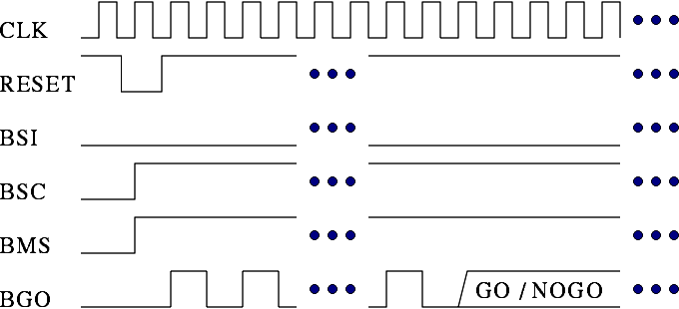
Test Mode
In Test Mode it runs a fixed algorithm for production test and repair.
  Only a few pins need to be controlled, and BGO reports the result (Go/No-Go).
BIST Serial-In
BIST State Control
BIST Mode Select
Go/No-Go indicator signal
Notes:
EE141

Slide 19

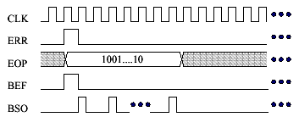
Fault Analysis Mode (FSI Timing)
In Fault Analysis Mode, we can apply a longer March algorithm for diagnosis
  FSI captures the error information of the faulty cells
EOP format:
Error Operation Protocol
BIST Error Flag
BIST Serial-Out
Notes:
EE141

Slide 20

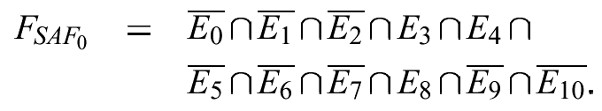
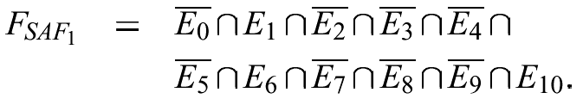
Fault Analysis
Derive analysis equations from the fault dictionary
Convert error maps to fault maps by the equations
Notes:
EE141

Slide 21
Diagnostic Test Algorithm Generation
Start from a base test: generated by TAGS, or user-specified
Generation options reduced to Read insertions
  Diagnostic resolution: percentage of faults that can be distinguished. =|distinguishable faults|/|detectable faults|
{SAF₁}
{CF_{in2}}
{CF_{in3}}
{TF₁, SAF₀}
{SOF₀, AF₀}
{SOF₂, AF₁, CF_{in1}}
{CF_{id6}, CF_{st3}, CF_{st6}}
{CF_{st1}, CF_{st4}, CF_{id1}, CF_{id4}}
{TF₀, CF_{id3}, CF_{id7}, CF_{st2}, CF_{st7}}
{CF_{st0}, CF_{st5}, CF_{id0}, CF_{id5}, CF_{in0}}
  DR=10/27
Notes:
EE141

Slide 22
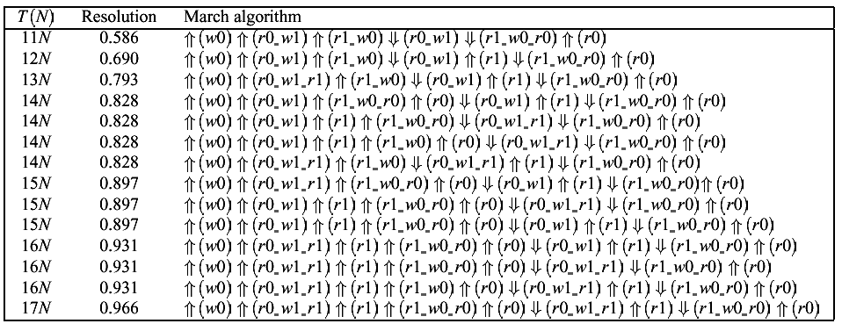
Example of Diagnostic Resolution
Notes:
EE141

Slide 23


Fault Bitmap Examples
Idempotent Coupling Fault
Stuck-at 0
Notes:
EE141

Slide 24
修复和设计实例
Notes:
EE141

Slide 25
Redundancy and Repair
Problem:
  We keep shrinking RAM cell size and increasing RAM density and capacity. How do we maintain the yield?
Solutions:
  Fabrication
    Material, process, equipment, etc.
  Design
    Device, circuit, etc.
  Redundancy and repair
    On-line
      ECC (extended Hamming code; product code)
    Off-line
      Spare rows, columns, blocks, etc.
Notes:
EE141

Slide 26
From BIST to BISR
BIST
BISD
BIRA
BISR
BIST: built-in self-test
BIECA: built-in error catch & analysis
  BISD: built-in self diagnosis
  BIRA: built-in redundancy analysis
BISR: built-in self-repair
Notes:
EE141

Slide 27
RAM Built-In Self-Repair (BISR)
Reconfiguration Mechanism
Redundancy
Analyzer
RAM
MUX
Spare Elements
BIST
Notes:
EE141

Slide 28
Redundancy Architectures
Local spare columns
Global spare columns
Bank1
Bank2
Bank1
Bank2
Global spare rows
Local spare rows
Notes:
EE141

Slide 29
Redundancy Analysis Simulation
Memory
Defect Injection
Fault Translation
Faulty Memory
RA
Algorithm
Spare
Elements
Test Algorithm
Simulation
RA Simulation
Result
Fail bit map and sub-maps
Ref: MTDT02
Notes:
EE141
We show the redundancy analysis simulation flow in this slide, which has many steps. First, we inject defects into the memory. Each defect may result in different faults, so we need to translate the defects into different faults. Then, we do the test algorithm simulation. During test algorithm simulation, we partition the faults into n groups, corresponding to the n Read operations of the test algorithm, to simulate the sequence of the faults detected. After that, the redundancy analysis algorithm and spare element configuration are imported for evaluation of the RA algorithm, and the simulator calculates and reports the repair rate and area overhead. We will show more details in the next few slides.

Slide 30
RAM Redundancy Allocation
1-D: spare rows (or columns) only
  SRAM
  Algorithm: Must-Repair
2-D: spare rows and columns (or blocks)
  Local and/or global spares
  NP-complete problem
  Conventional algorithm:
    Must-Repair phase
    Final-Repair phase
      Repair-Most (greedy) [Tarr et al., 1984]
      Fault-Driven (exhaustive, slow) [Day, 1985]
      Fault-Line Covering (b&b) [Huang et al., 1990]
Notes:
EE141

Slide 31
Definitions
Faulty line: row or column with at least one faulty cell
  A faulty line is covered if all faulty cells in the line are repaired by spare rows and/or columns.
A faulty cell not sharing any row or column with any other faulty cell is an orthogonal faulty cell
r: number of (available) spare rows
c: number of (available) spare columns
F: number of faulty cells in a block
F’:number of orthogonal faulty cells in a block
Notes:
EE141

Slide 32
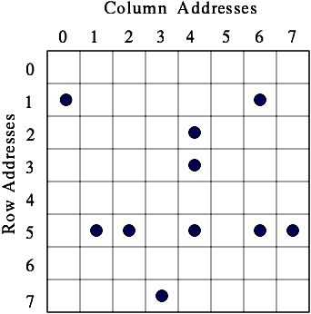
Example Block with Faulty Cells
Notes:
EE141

Slide 33
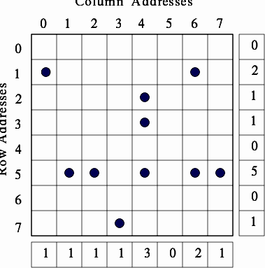
Repair-Most (RM)
Run BIST and construct bitmap
Construct row and column error counters
Run Must-Repair algorithm
Any faulty row (column) with k faulty cells, where k > c (k > r), is a must-repair faulty line.
4. Run greedy final-repair algorithm
r=2; c=4
Notes:
EE141

Slide 34
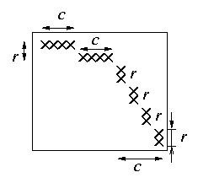
Irreparable Condition
Condition 1
  After must-repair phase, F>2rc (rc+rc)
Condition 2
  F’ >r+c
r=2; c=4
Notes:
EE141

Slide 35
Essential Spare Pivoting (ESP)
Maintain high repair rate without using a bitmap
  Small area overhead
Fault Collection (FC)
  Collect and store faulty-cell address using row-pivot and column-pivot registers
    If there is a match for row (col) pivot, the pivot is an essential pivot
    If there is no match, store the row/col addresses in the pivot registers
  If F > r+c, the RAM is irreparable
Spare Allocation (SA)
  Use row and column pivots for spare allocation
    Spare rows (cols) for essential row (col) pivots
  SA for orthogonal faults
Ref: Huang et al., IEEE TR, 11/03
Notes:
EE141

Slide 36
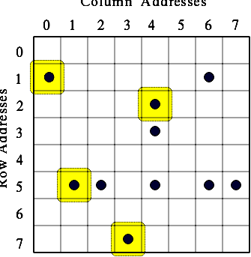

ESP Example
(1,0)
(1,6)
(2,4)
(3,4)
(5,1)
(5,2)
(7,3)
Notes:
EE141

Slide 37
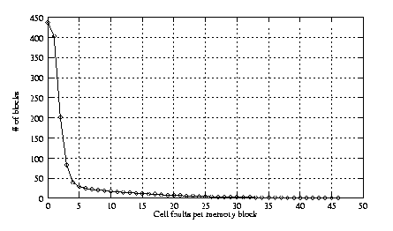
Cell Fault Size Distribution
Mixed Poisson and exponential distribution model
1552 memory blocks with a core size of 1024×64 bits are simulated, assuming r=10 and c ranges from 2 to 6.
Notes:
EE141

Slide 38
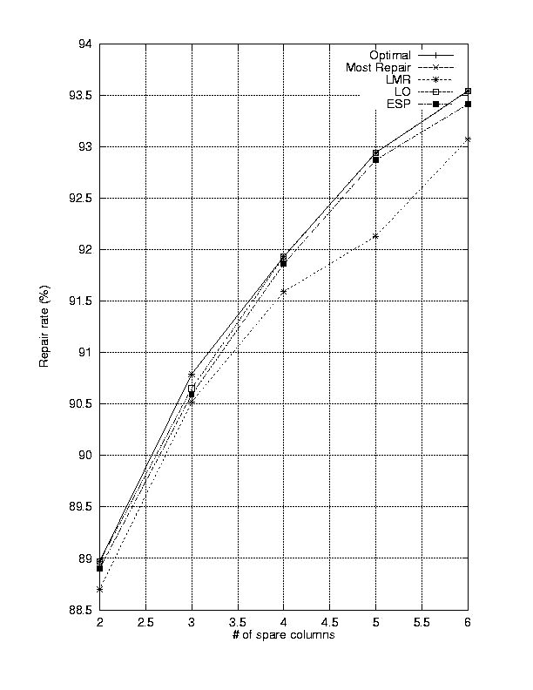
Repair Rate (r=10)
Notes:
EE141

Slide 39
Redundancy Organization
SEG0
SEG1
SR0
SR1
SCG0
SCG1
SR: Spare Row; SCG: Spare Column Group; SEG: Segment
ITC03
Notes:
EE141

Slide 40
BISR Architecture
Q
D
A
Main Memory
Wrapper
MAO
BIRA
POR
BIST
Spare Memory
MAO: mask address output; POR: power-on reset
Ref: ITC03
Notes:
EE141

Slide 41
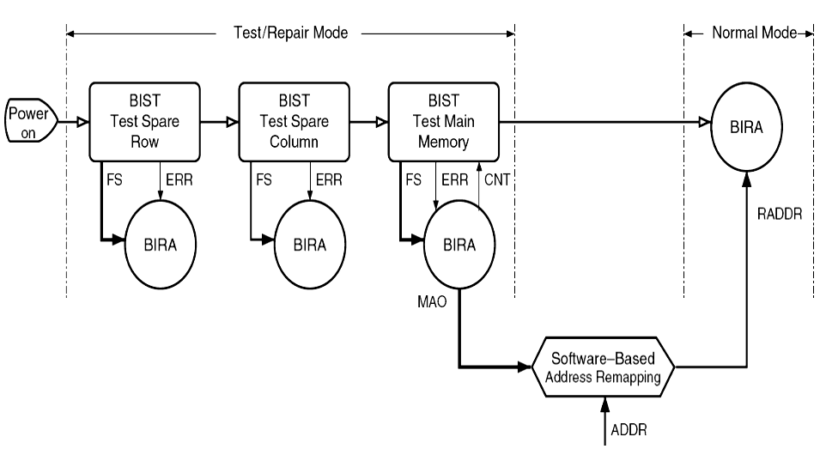
Power-On BISR Procedure
Notes:
EE141

Slide 42
Subword Definition
Subword
  A subword is consecutive bits of a word.
  Its length is the same as the group size.
Example: a 32x16 RAM with 3-bit row address and 2-bit column address
A word with 4 subwords
A subword with 4 bits
Notes:
EE141

Slide 43
Row-Repair Rules
To reduce the complexity, we use two row-repair rules
  If a row has multiple faulty, we repair the faulty row by a spare row if available.
  If there are multiple faulty subwords with the same column address and different row addresses within a segment, the last detected faulty subword should be repaired with an available spare row.
Examples:
subword
subword
Notes:
EE141

Slide 44
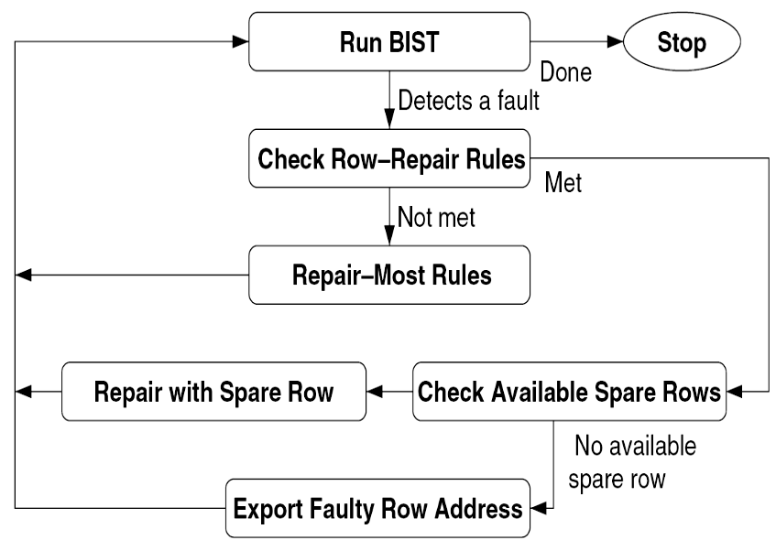
BIRA Procedure
Notes:
EE141

Slide 45
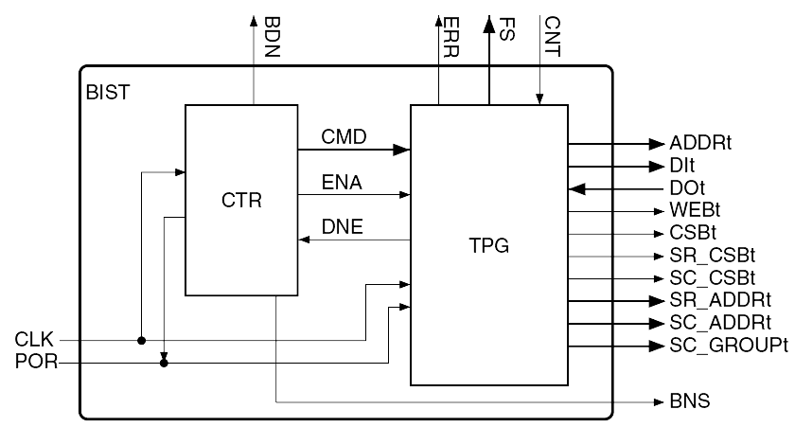
Basic BIST Module
Notes:
EE141

Slide 46
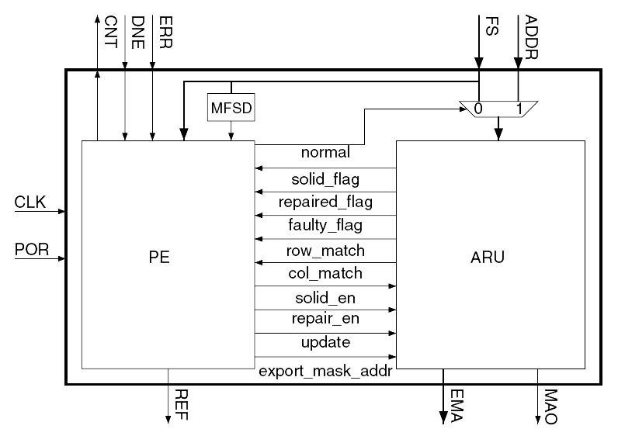
BIRA Module
process element (PE) address remapping unit (ARU)
Notes:
EE141

Slide 47
Repair Rate Analysis
Repair rate
  The ratio of the number of repaired memories to the number of defective memories
A simulator has been implemented to estimate the repair rate of the proposed BISR scheme
[Huang et al., MTDT02]
Industrial case:
  SRAM size: 8Kx64
  # of injected random faults: 1~10
  # of memory samples: 534
  RA algorithms: proposed and exhaustive search algorithms
Notes:
EE141

Slide 48
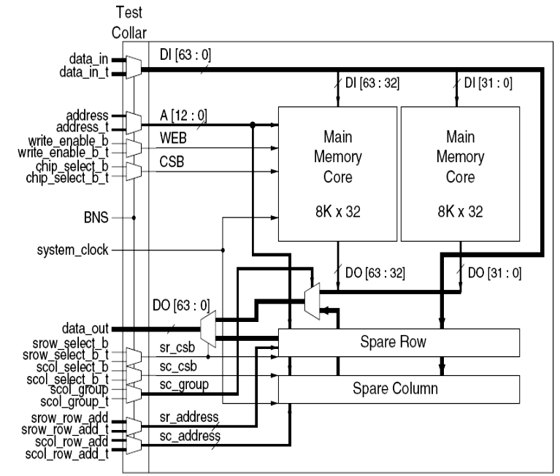
An Industrial Case
An 8K×64 repairable SRAM with 4 spare rows and 2 spare column groups
Notes:
EE141

Slide 49
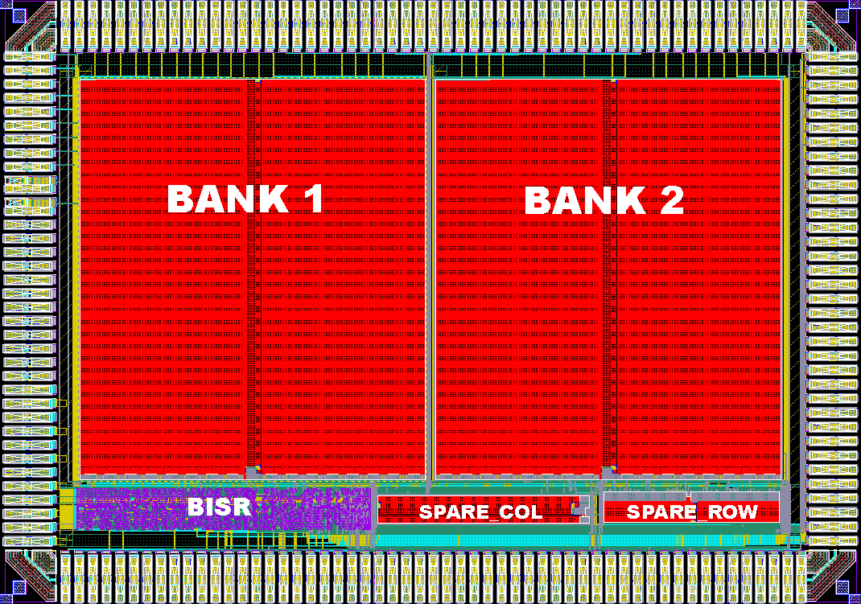
A 8Kx64 Repairable SRAM
Technology: 0.25um
SRAM area: 6.5 mm²
BISR area : 0.3 mm²
Spare area : 0.3 mm²
HO_{spare}: 4.6%
HO_{bisr}: 4.6%
Repair rate: 100%
(if # random faults is no more than 10)
Redundancy: 4 spare rows and 2 spare column groups
Group size: 4
hardware overhead (HO)
Notes:
EE141

Slide 50
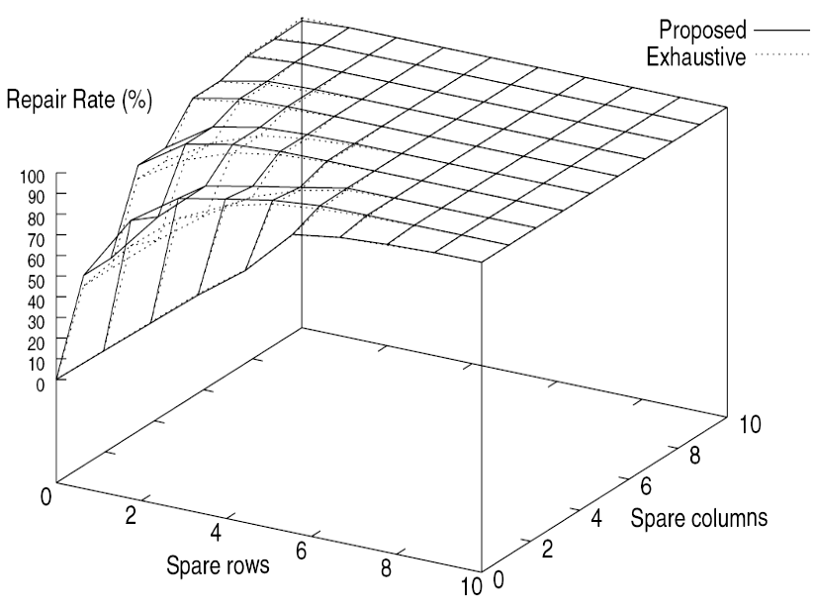
Repair Rate (Group Size 2)
Exhaustive: without spare row or column grouping or segmentation
The number of injected random faults varies from 1 to 10.
The total number of memory samples is 534.
Notes:
EE141

Slide 51
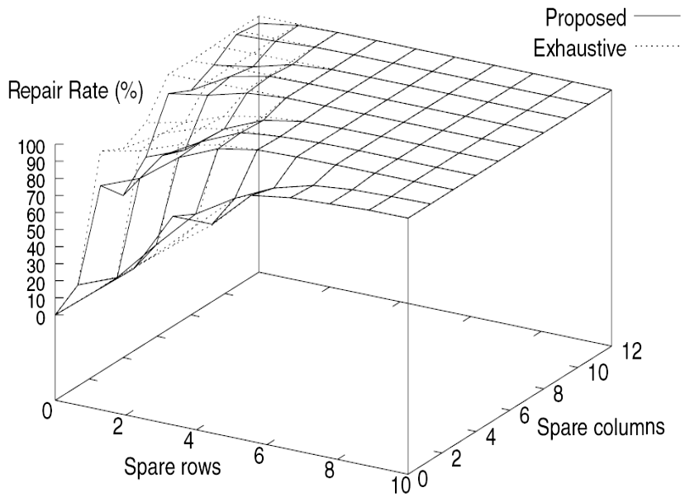
Repair Rate (Group Size 4)
↓area cost
The number of injected random faults varies from 1 to 10.
The total number of memory samples is 534.
Notes:
EE141

Slide 52
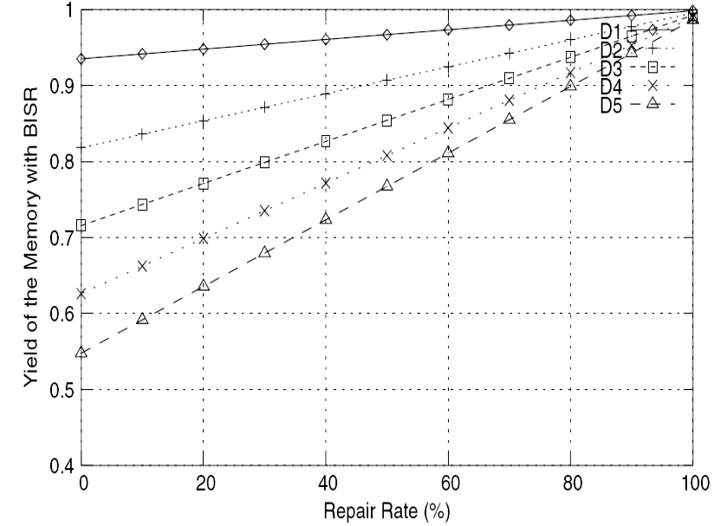
Yield vs. Repair Rate
D1, D2, D3, D4, and D5: defect densities 0.01, 0.03, 0.05, 0.07, and 0.09 defect/um².
Notes:
EE141

Slide 53
Concluding Remarks
BIST with diagnosis support
  Fault type identification done by an offline diagnosis process using MECA
  RAM design and process debugging for yield enhancement
From BIST to BIRA
  Effective implementation by ESP
    Greedy algorithm
An industrial case has been experimented
  Full repair achieved (for # random faults no more than 10)
  Only 4.6% area overhead for the 8Kx64 SRAM
Notes:
EE141

Slide 54
Exercises
9.1 为MSCAN (⇑(w0); ⇑(r0); ⇑(w1); ⇑(r1))构造March字典，考虑SAF和inter-word CF。
9.2 （a）采用2维冗余资源（行冗余和列冗余），冗余分配的must-repair阶段完成什么任务？
（b）假定一个R行C列的RAM的must-repair阶段已经完成，假定这时候还有n个故障单元未被修复，r个冗余行，c个冗余列，如果这个RAM是可以修复的，那么n的上界是什么？

Slide 55
中国科学院大学：VLSI测试与可测试性设计
下次课预告
时间：2019年12月4日（周三19:00-21:30）
地点：教1-109
内容：边界扫描与SOC测试
教材：VLSI TEST PRINCIPLES AND ARCHITECTURES
Chapter 10 Boundary Scan and Core-Based Testing

