Slide 1

中国科学院大学：VLSI测试与可测试性设计(712002H)
第9讲 存储器测试与BIST
韩银和
中科院计算技术研究所
Email: yinhes@ict.ac.cn
URL: www.carch.ac.cn/~yinhes
Notes:
EE141

Slide 2
What is this chapter about?
Basic concepts of memory testing and BIST
Memory fault models and test algorithms
Memory fault simulation and test algorithm generation
  RAMSES: fault simulator
  TAGS: test algorithm generator
Memory BIST
  BRAINS: BIST generator
Notes:
EE141

Slide 3
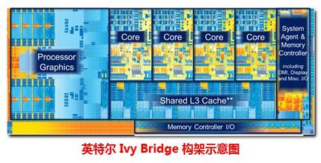
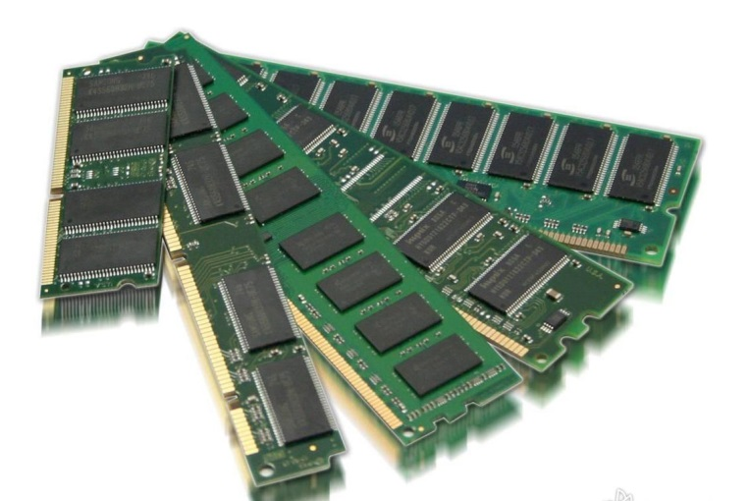
Memory Testing
独立的Memory器件
Memory占到整个面积的1/4
Memory Testing: 测试Memory单元及其外围部件是否与故障？
测试对象可以是嵌入式的Memory，也可以是分离式的纯Memory部件

Slide 4
Memory 故障模型
Stuck-at-0
0
1
Stuck-at-1
0
0
1
Transition ↑/0
1
Transition ↓/1
1
1
0
0
0
Reset coupling
1
Set coupling
1
0
0
1
0
1
0
Inversion coupling
1
Inversion coupling
AND bridging
0
0
1
1
0
0
1
1
OR bridging
0
1
Neighborhood
pattern sensitive
faults (active)
Neighborhood
pattern sensitive
faults (passive)
1
0
0
1
0
1
1
0
1
1
0
Address decoder
faults
ADR
ADR
ADR
ADR
ADR

Slide 5
Typical RAM Production Flow
Wafer
Full Probe Test
Laser Repair
Packaging
Marking
Post-BI Test
Burn-In (BI)
Pre-BI Test
Final Test
Visual Inspection
QA Sample Test
Shipping
Notes:
EE141

Slide 6
Off-Line Testing of RAM
Parametric Test: DC & AC
Reliability Screening
  Long-cycle testing
  Burn-in: static & dynamic BI
Functional Test
  Device characterization
    Failure analysis
  Fault modeling
    Simple but effective (accurate & realistic?)
  Test algorithm generation
    Small number of test patterns (data backgrounds)
    High fault coverage
    Short test time
Notes:
EE141

Slide 7
DRAM Functional Model
Address
Refresh
Address latch
Column decoder
Refresh logic
Row
Memory
decoder
Write driver
cell
array
Sense amplifiers
Data register
Data flow
Data
Data
Read/write
Control flow
out
in
&
chip enable
Notes:
EE141

Slide 8
Functional Fault Models
Classical fault models are not sufficient to represent all important failure modes in RAM.
Sequential ATPG is not possible for RAM.
Functional fault models are commonly used for memories:
  They define functional behavior of faulty memories.
New fault models are being proposed to cover new defects and failures in modern memories:
  New process technologies
  New devices
Notes:
EE141

Slide 9
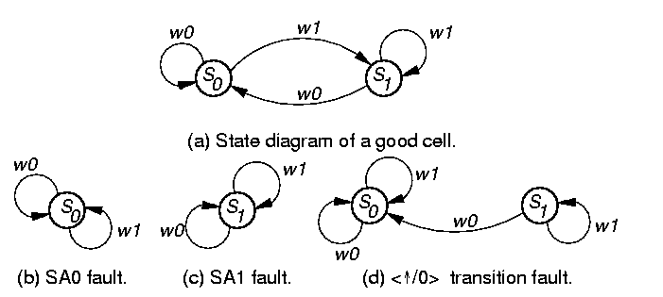
Static RAM Fault Models: SAF
Stuck-At Fault (SAF)
  Cell (line) SA0 or SA1
    A stuck-at fault (SAF) occurs when the value of a cell or line is always 0 (a stuck-at-0) or always 1 (a stuck-at-1).
    A test that detects all SAFs guarantees that from each cell, a 0 and a 1 must be read.
Notes:
EE141

Slide 10
Static RAM Fault Models: TF
Transition Fault (TF)
  Cell fails to transit from 0 to 1 or 1 to 0 in specified time period.
    A cell has a transition fault (TF) if it fails to transit from 0 to 1 (a <↑/0> TF) or from 1 to 0 (a <↓/1> TF).
< /0> transition fault
Notes:
EE141

Slide 11
Static RAM Fault Models: SOF
Stuck-Open Fault (SOF)
  A stuck-open fault (SOF) occurs when the cell cannot be accessed due to, e.g., a broken word line.
  A read to this cell will produce the previously read value.
Notes:
EE141

Slide 12
RAM Fault Models: CF
Coupling Fault (CF)
  A coupling fault (CF) between two cells occurs when the logic value of a cell is influenced by the content of, or operation on, another cell.
  State Coupling Fault (CFst)
    Coupled (victim) cell is forced to 0 or 1 if coupling (aggressor) cell is in given state.
  Inversion Coupling Fault (CFin)
    Transition in coupling cell complements (inverts) coupled cell.
  Idempotent Coupling Fault (CFid)
    Coupled cell is forced to 0 or 1 if coupling cell transits from 0 to 1 or 1 to 0.
Notes:
EE141

Slide 13
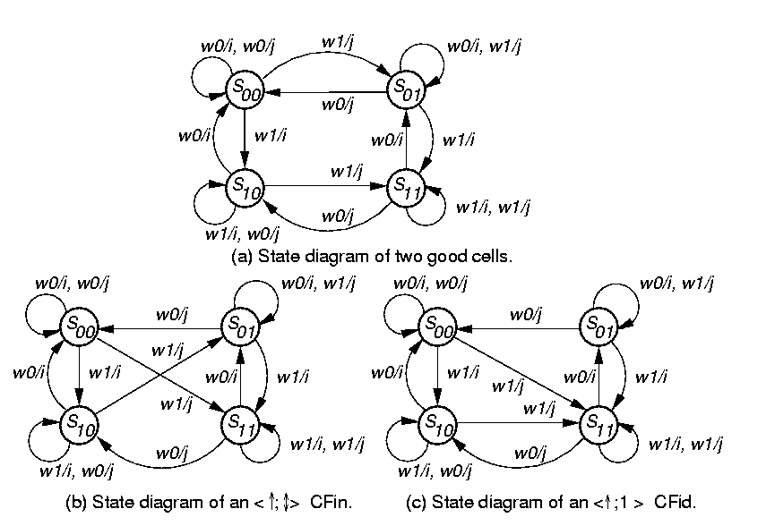
Good Machine State Transition Diagram
Notes:
EE141

Slide 14
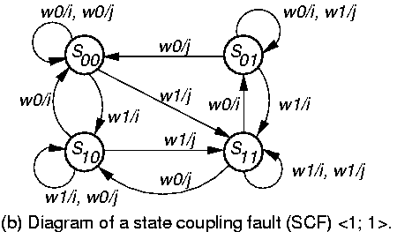
State Coupling Faults
Coupling cell / line j is in a given state y that forces coupled cell / line i into state x
< 0;0 >, < 0;1 >, < 1;0 >, < 1;1 >
w1/j
故障： if j=1, then i=1
Notes:
EE141

Slide 15
Inversion Coupling Faults (CFin)
or in cell j inverts contents of cell i
Condition: For all cells that are coupled, each should be read after a series of possible CFins may have occurred, and the # of coupled cell transitions must be odd (to prevent the CFins from masking each other).
< ; > and < ; >
<j, i>
Notes:
EE141

Slide 16
CFin State Transition Diagram
w1/j
w1/j
无故障状态机
<j, i>
故障： 单元j发生0->1值变化，
则单元i值翻转
Notes:
EE141

Slide 17
Idempotent Coupling Faults (CFid)
or transition in j sets cell i to 0 or 1
Condition: For all coupled faults, each should be read after a series of possible CFids may have happened, such that the sensitized CFids do not mask each other.
Asymmetric: coupled cell only does or
Symmetric: coupled cell does both due to fault
< ; 0>, < ; 1>, < ; 0>, < ; 1>
<j, i>
Notes:
EE141

Slide 18
CFid Example
w1/j
无故障状态机
<j, i>
Notes:
EE141

Slide 19
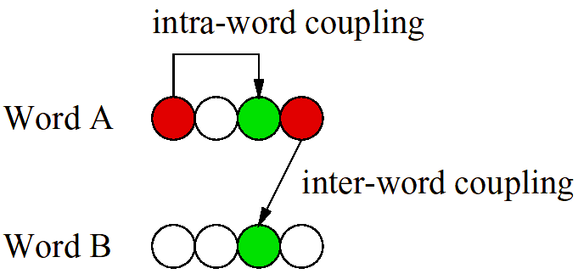
Intra-Word & Inter-Word CFs
Notes:
EE141

Slide 20
RAM Fault Models: DF
Disturb Fault (DF)
  Victim cell forced to 0 or 1 if we (successively) read or write aggressor cell (may be the same cell):
  Read Disturb Fault (RDF)
    There is a read disturb fault (RDF) if the cell value will flip when being read (successively).
读写强行置值
读翻转
Notes:
EE141

Slide 21
RAM Fault Models: DRF
Data Retention Fault (DRF)
Fail to retain value after a period of time
  DRAM
    Refresh Fault
    Leakage Fault
  SRAM
    Leakage Fault
      Static Data Losses---defective pull-up
Notes:
EE141

Slide 22
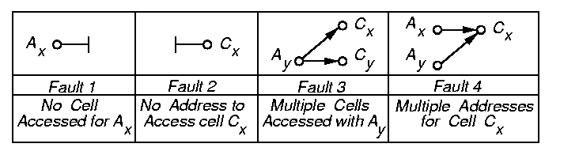
Static RAM Fault Models: AF
Address-Decoder Fault (AF)
  An address decoder fault (AF) is a functional fault in the address decoder that results in one of four kinds of abnormal behavior:
    Given a certain address, no cell will be accessed
    A certain cell is never accessed by any address
    Given a certain address, multiple cells are accessed
    A certain cell can be accessed by multiple addresses
Notes:
EE141

Slide 23
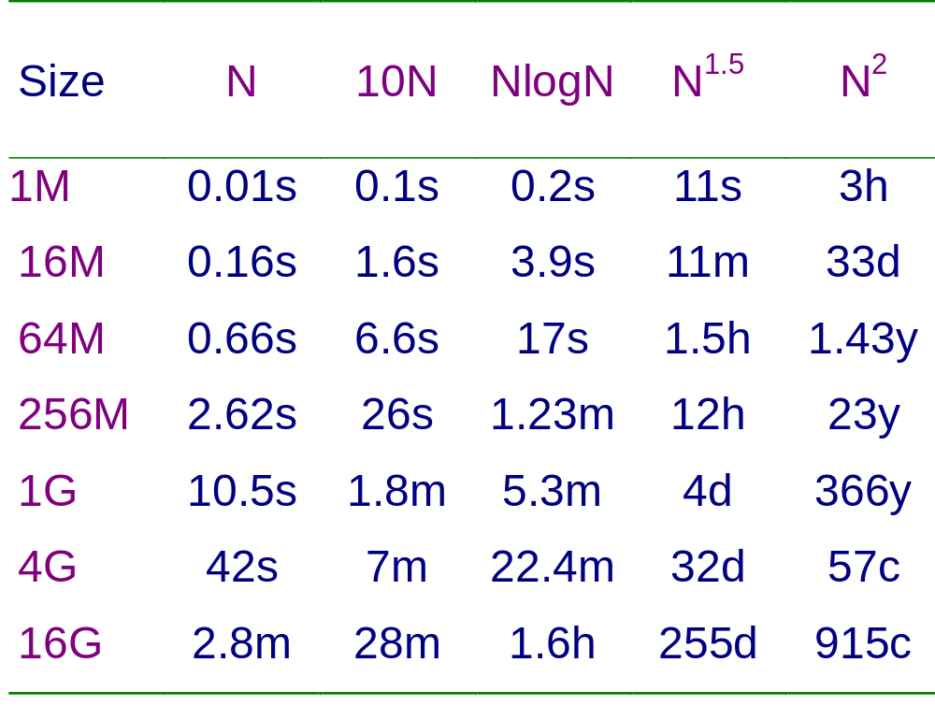
Test Time Complexity (100MHz)
Notes:
EE141

Slide 24
RAM Test Algorithm
A test algorithm (or simply test) is a finite sequence of test elements:
  A test element contains a number of memory operations (access commands)
    Data pattern (background) specified for the Read and Write operation
    Address (sequence) specified for the Read and Write operations
A march test algorithm is a finite sequence of march elements:
  A march element is specified by an address order and a finite number of Read/Write operations
Notes:
EE141

Slide 25
课 间
Notes:
EE141

Slide 26

March Test Notation
⇑: address sequence is in the ascending order
⇓: address changes in the descending order
: address sequence is either ⇑ or ⇓
r: the Read operation
  Reading an expected 0 from a cell (r0); reading an expected 1 from a cell (r1)
w: the Write operation
  Writing a 0 into a cell (w0); writing a 1 into a cell (w1)
Example (MATS+):
Notes:
EE141

Slide 27


Simple March Tests
Zero-One (MSCAN)
Modified Algorithmic Test Sequence (MATS)
MATS+
Notes:
EE141

Slide 28
MATS+ March Test
M0: { March element (w0) }
  for cell := 0 to n - 1 (or any other order) do
    write 0 to A [cell];
M1: { March element (r0, w1) }
  for cell := 0 to n - 1 do
    read A [cell]; { Expected value = 0}
    write 1 to A [cell];
M2: {March element (r1, w0) }
  for cell := n – 1 down to 0 do
    read A [cell]; { Expected value = 1 }
    write 0 to A [cell];
Notes:
EE141

Slide 29
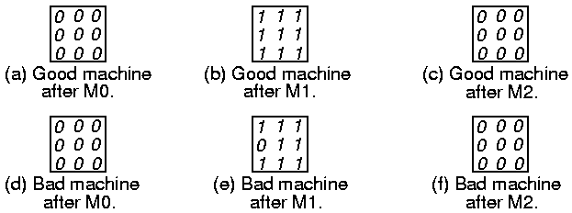
MATS+ Example Cell (2,1) SA0 Fault
Cell(2,1) 发生SA-0故障
MATS+:
{ M0: (w0); M1: (r0, w1); M2: (r1, w0) }
此时检出故障
要点：要想检测出故障，需要及时读操作
Notes:
EE141

Slide 30
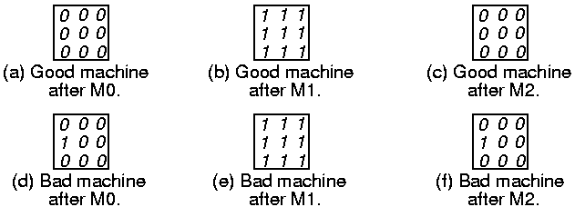
MATS+ Example Cell (2, 1) SA1 Fault
MATS+:
{ M0: (w0); M1: (r0, w1); M2: (r1, w0) }
此时检出故障
Notes:
EE141

Slide 31
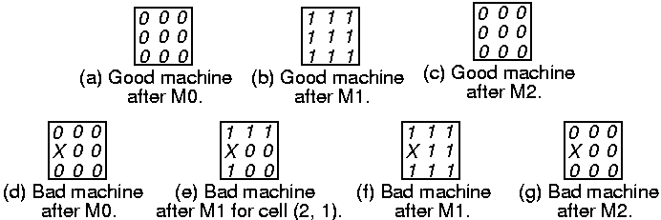
MATS+ Example Multiple AF Type C
Cell (2,1) is unaddressable
Address (2,1) maps into (3,1) & vice versa
Can’t write (2,1), read (2,1) gives random #
MATS+:
{ M0: (w0); M1: (r0, w1); M2: (r1, w0) }
二者之一检出故障
Notes:
EE141

Slide 32
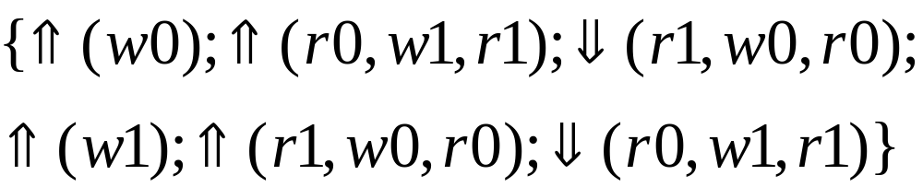
March Tests: Marching-1/0
Marching-1/0
  Marching-1: begins by writing a background of 0s, then read and write back complement values (and read again to verify) for all cells (from cell 0 to n-1, and then from cell n-1 to 0), in 7N time
  Marching-0: follows exactly the same pattern, with the data reversed
  For AF, SAF(固定型故障), and TF(翻转故障) (but only part of the CFs)
  It is a complete test, i.e., all faults that should be detected are covered
  It however is a redundant test, because only the first three march elements are necessary
Notes:
EE141

Slide 33

March Tests: MATS++
MATS++
  Also for AF, SAF (固定型故障), and TF (翻转故障)
  Optimized marching-1/0 scheme—complete and irredundant
  Similar to MATS+, but allow for the coverage of TFs
  The suggested test for unlinked SAFs & TFs
  帮助检测出1->0的翻转故障
Note: Unlinked fault (simple fault): a fault which does not influence the behavior of other faults
Notes:
EE141

Slide 34
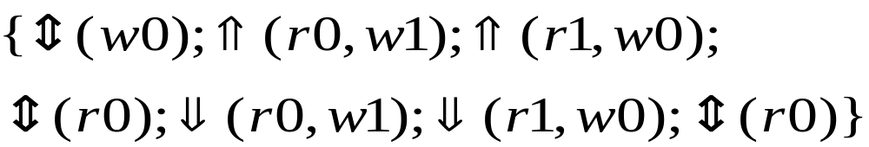
March Tests: March X/C
March X
  Called March X because the test has been used without being published
  For AF, SAF, TF, & Cfin(反向耦合故障）
March C
  For AF, SAF, TF, & all CFs, but semi-optimal (redundant)
写0/1和下一步读0/1要分开来
MATS++
< , >
< , >
< , >
< , >
Notes:
EE141

Slide 35
March Tests: March C-
March C-
  Remove the redundancy in March C
  Also for AF, SAF, TF, & all CFs
  Optimal (irredundant)
Extended March C-
  Covers SOF in addition to the above faults
写后紧跟一个读
Notes:
EE141

Slide 36
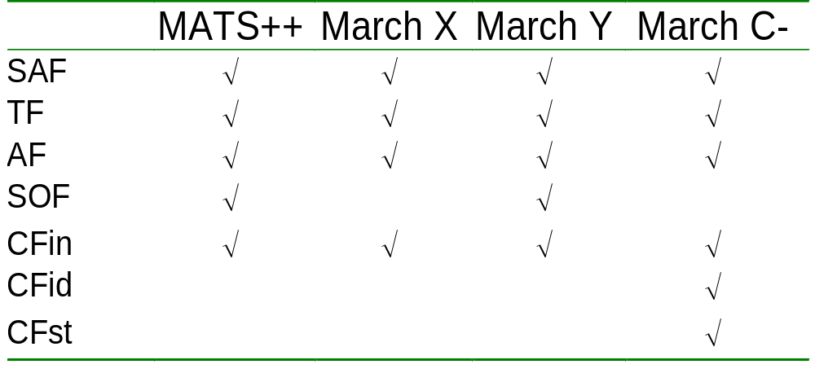
Comparison of March Tests
Notes:
EE141

Slide 37
内存的故障模拟和
测试结构

Slide 38
Why Memory Fault Simulation?
Fault coverage evaluation can be done efficiently, especially when the number of fault models is large.
In addition to bit-oriented memories, word-oriented memories can be simulated easily even with multiple backgrounds.
Test algorithm design and optimization can be done in a much easier way.
Detection of a test algorithm on unexpected faults can be discovered.
Fault dictionary can be constructed for easy diagnosis.
Notes:
EE141

Slide 39
Sequential Memory Fault Simulation
Complexity is N^3 for 2-cell CF
For each fault /* N^2 for 2-cell CF */
Inject fault;
For each test element /* N for March */
{
Apply test element;
Report error output;
}
Notes:
EE141

Slide 40
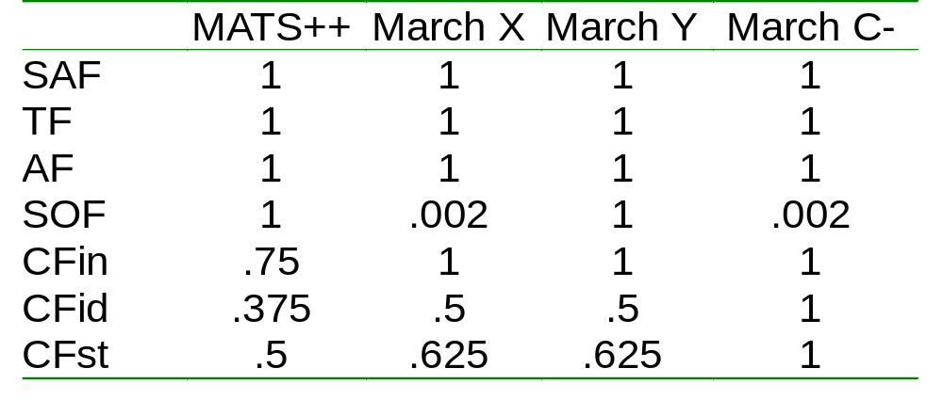
Coverage of March Tests
Extended March C- has 100% coverage of SOF
Notes:
EE141

Slide 41
Test Algorithm Generation Goals
Given a set of target fault models, generate a test with 100% fault coverage
Given a set of target fault models and a test length constraint, generate a test with the highest fault coverage
Priority setting for fault models
  Test length/test time can be reduced
Diagnostic test generation
  Need longer test to distinguish faults
Notes:
EE141

Slide 42
Test Algorithm Generation by Simulation (TAGS)
March template abstraction:
↑(w0); ↑(r0,w1); ↓(r1,w0,r0)
↑(w) ↑(r,w); ↓(r,w,r)
(w)(rw)(rwr)

Slide 43
Template Set
Exhaustive generation: complexity is very high, e.g., 6.7 million templates when N = 9
Heuristics should be developed to select useful templates
T(1N)
(w)
T(2N)
(ww)
(w)(w)
(wr)
(w)(r)
T(3N)
(www)
(ww)(w)
(w)(ww)
(wwr)
(wrw)
(wr)(w)
(w)(rw)
….

Slide 44
TAGS Procedure
Initialize test length as 1N, T(1N) = {(w)};
Increase test length by 1N: apply generation options;
Apply filter options;
Assign address orders and data backgrounds;
Fault simulation using RAMSES;
Drop ineffective tests;
Repeat 2-6 using the new template set until constraints met;
Notes:
EE141

Slide 45
Template Generation/Filtering
Generation heuristics:
  (r) insertion
  (…r), (r…) expansion
  (w) insertion
  (…w), (w…) expansion
Filtering heuristics:
  Consecutive read: (…rr…)
  Repeated read: (r)(r)
  Tailing single write: …(w)
Notes:
EE141

Slide 46
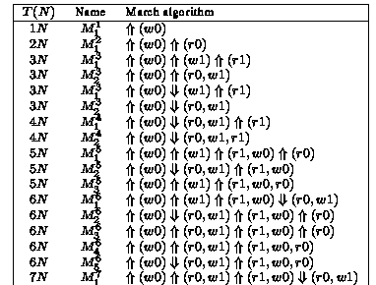
TAGS Example (1/2)
Target fault models (SAF, TF, AF, SOF, Cfin, Cfid, CFst), time constraints ∞:
Notes:
EE141

Slide 47
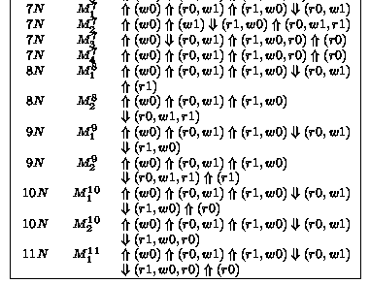
TAGS Example (2/2)
Notes:
EE141

Slide 48
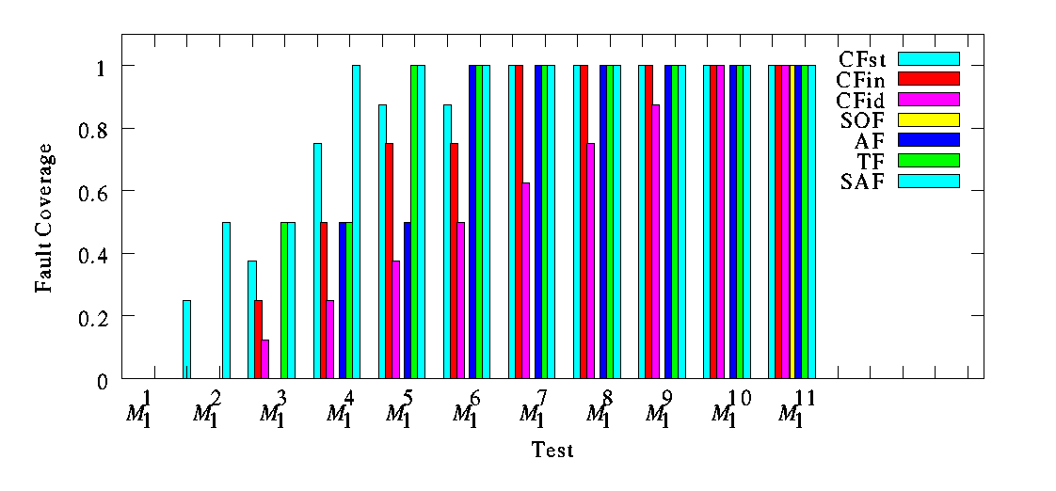
RAMSES Simulation Results
Notes:
EE141

Slide 49
What Can BIST do?
What are the defects to be covered?
  Opens, shorts, timing parameters, voltages, currents, etc.
Can it support fault location and redundancy repair?
Can it support BI?
Can it support on-chip redundancy analysis and repair?
Does it allow characterization test as well as mass production test?
Can it really replace ATE (and laser repair machine)?
  Programmability, speed, timing accuracy, parallelism, etc.
Notes:
EE141

Slide 50
Typical RAM BIST Approaches
Methodology
  Processor-based BIST
    Programmable
  Hardwired BIST
    Fast
    Compact
  Hybrid
Interface
  Serial (scan, 1149.1)
  Parallel (embedded controller; hierarchical)
Patterns (address sequence)
  March & March-like
  Pseudorandom
  Others
Notes:
EE141

Slide 51
Typical RAM BIST Architecture
RAM
Controller
Pattern
Generator
Test Collar (MUX)
Comparator
Go/No-Go
BIST Module
RAM Controller

Slide 52
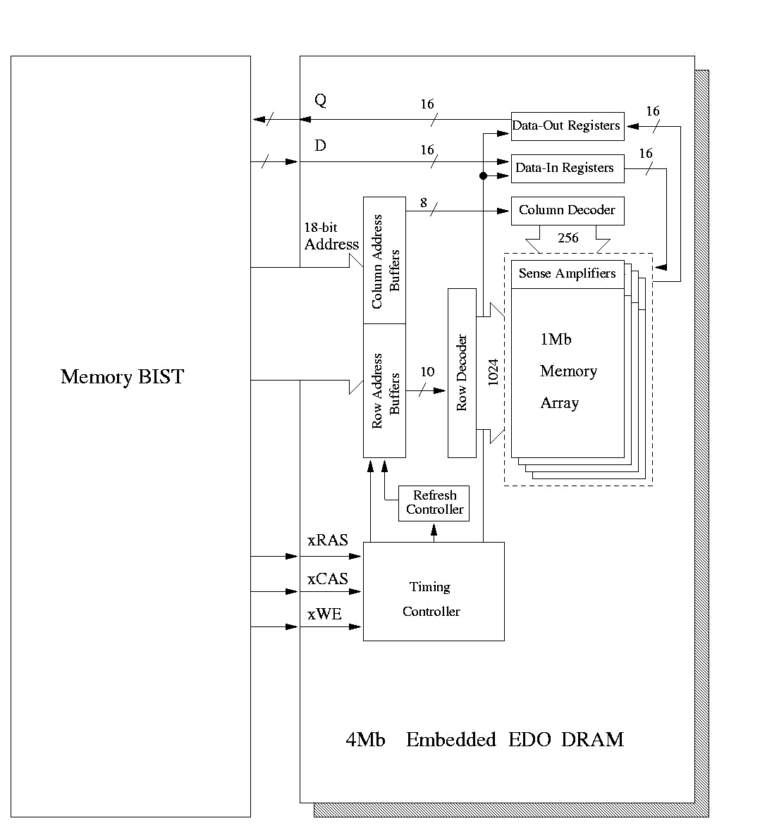
EDO DRAM BIST Example
Notes:
EE141

Slide 53
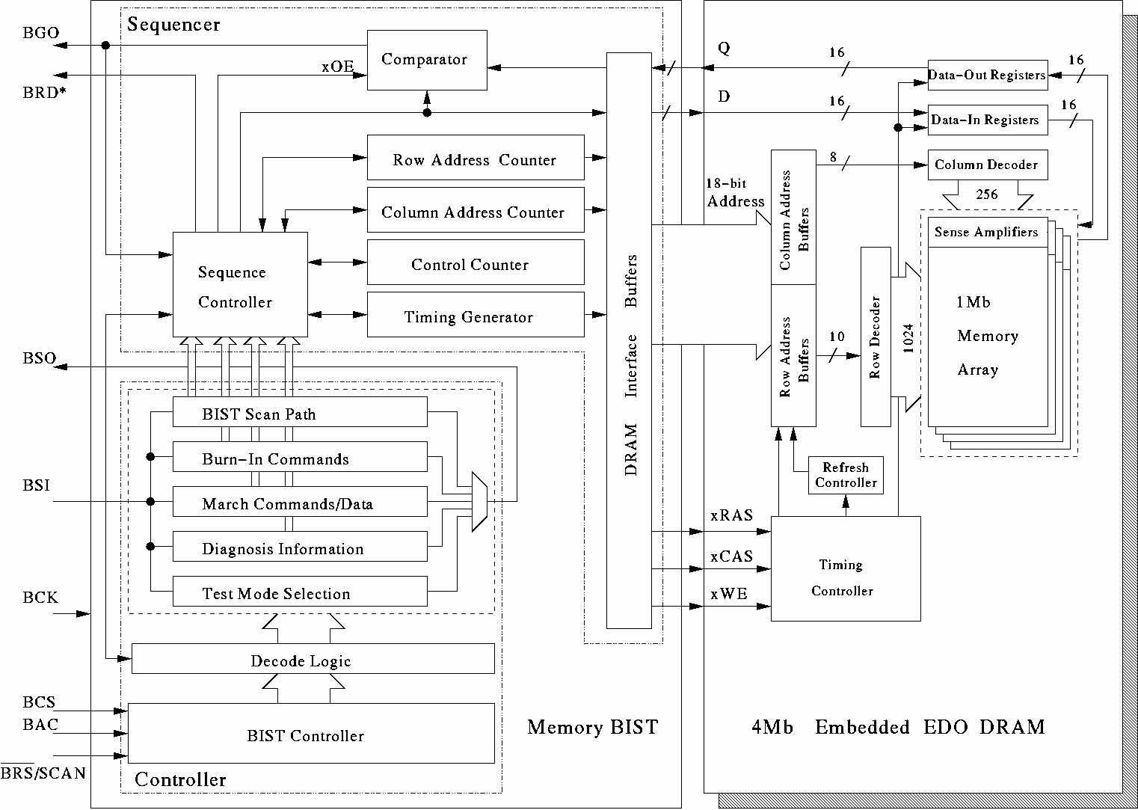
BIST Architecture
Notes:
EE141

Slide 54
BIST External I/O
MBS (Memory BIST Selection): controller test collar (normal/test mode selection)
MBC (Memory BIST Control): Controller input
MCK (Memory BIST Clock)
MBR (Memory BIST Reset)
MSI (Memory BIST Scan In): for test commands and scan test inputs
MSO (Memory BIST Scan Out): for diagnostic data and scan test outputs
MBO (Memory BIST Output): error indicator
MRD (Memory BIST Output Ready): BIST completion flag
Notes:
EE141

Slide 55
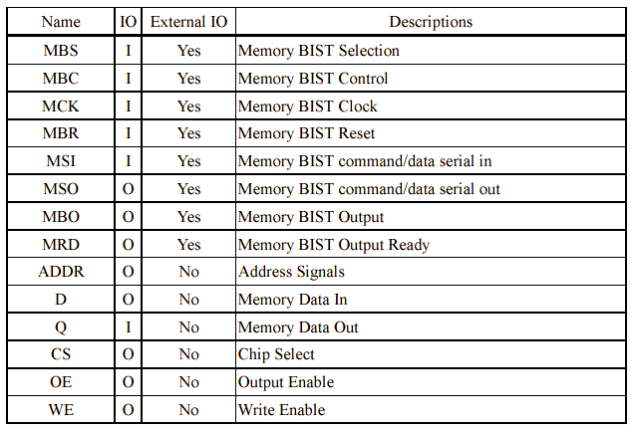
BIST I/O Summary
Notes:
EE141

Slide 56
BIST Test Modes
Scan-Test Mode
RAM-BIST Mode
  Functional faults
  Timing faults (setup/hold times, rise/fall times, etc.)
  Data retention faults
RAM-Diagnosis Mode
RAM-BI Mode
Notes:
EE141

Slide 57
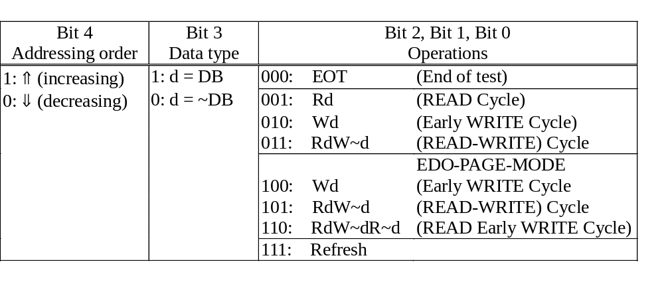
BIST Controller Commands
Notes:
EE141

Slide 58
RAM BIST Compiler
Use of RAM cores is increasing
  SRAM, DRAM, flash RAM
  Multiple cores
RAM BIST compiler is the trend
BRAINS (BIST for RAM in Seconds)
  Proposed BIST Architecture
  Memory Modeling
  Command Sequence Generation
  Configuration of the Proposed BIST
Notes:
EE141

Slide 59
BRAINS Output Specification
Synthesizable BIST design
  At-speed testing
  Programmable March algorithms
  Optional diagnosis support
    BISD
Activation sequence
Test bench
Synthesis script
Notes:
EE141

Slide 60
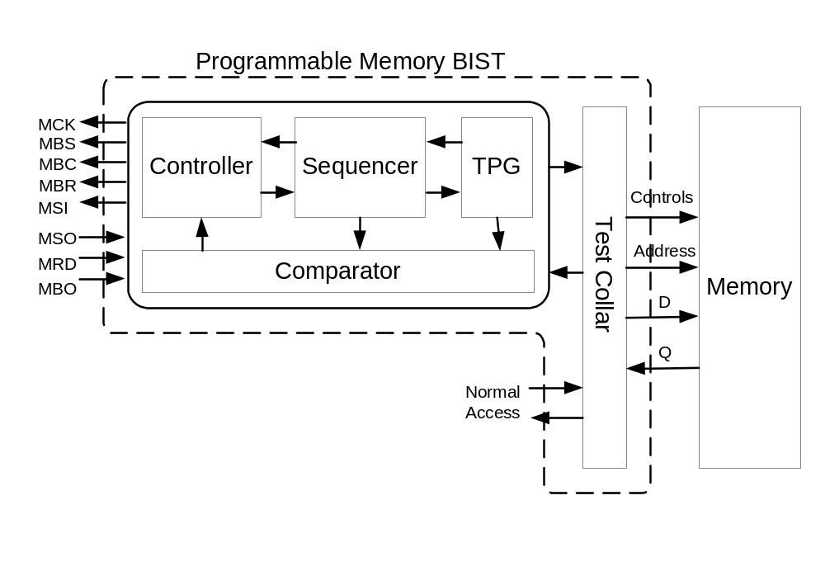
General RAM BIST Architecture
Notes:
EE141

Slide 61
Sequencer Block Diagram
March element
address
Control
Module
Address Generator
en
done
Sequence Generator
go
Command Generator
command
error
info.
go
Error Handling Module
error
signature
Notes:
EE141

Slide 62
Function of the TPG
BIST
Controller
Sequencer
TPG
RAM
The test pattern generator (TPG) translates high-level memory commands to memory input signals.
Four parameters to model a memory’s I/Os:
  Type: input, output, and in/out
  Width
  Latency: number of clock cycles the TPG generates the physical signal after it receives a command from the sequencer
  Packet_length: number of different signal values packed within a single clock cycle

Slide 63
Multiple RAM Cores
Controller and sequencer can be shared
Test pattern
generator
Ram Core A
sequencer
Test pattern
generator
Ram Core B
controller
sequencer
Test pattern
generator
Ram Core C

Slide 64
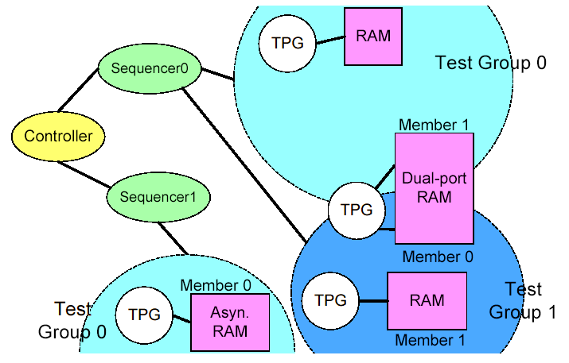
Grouping and Scheduling
Notes:
EE141

Slide 65
BRAINS BIST Architecture
External Tester
MBS
MSI
MBO
MRD
MSO
MBC
MBR
MCK
Controller
Memory
BIST
Sequencer
Sequencer
Sequencer
TPG
TPG
TPG
TPG
TPG
TPG
RAM
RAM
RAM
RAM
RAM
RAM
Source: ATS’01
Notes:
EE141
This is a top view of the BIST architecture. Each memory is tested by a Test Pattern Generator. A BIST Controller controls several Sequencers and each Sequencer controls several Test Pattern Generators. The sharing of BIST Controller and Sequencers can reduce the area overhead. The test time is also reduced since parallel testing can be done easily by a simple BIST Controller.

Slide 66
Supported Memories
The Built-In Memory List
  DRAM
    EDO DRAM
    SDRAM
    DDR SDRAM
  SRAM
    Single-Port Synchronous SRAM
    Single-Port Asynchronous SRAM
    Two-Port Synchronous Register File
    Dual-Port Synchronous SRAM
    Micron ZBT SRAM
BRAINS can support new memory architectures easily
Notes:
EE141

Slide 67
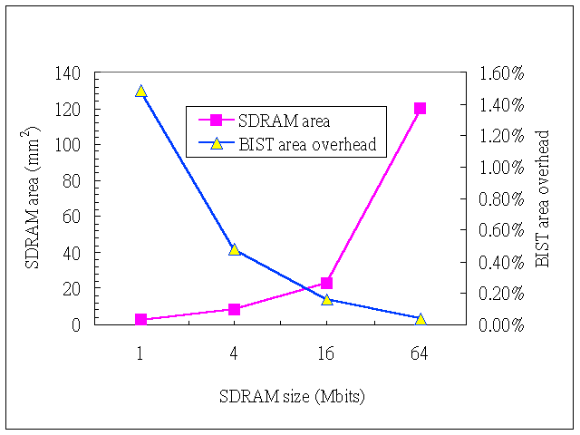
Area Overhead
Notes:
EE141

Slide 68
Concluding Remarks
BIST is considered the best solution for testing embedded memories:
  Low cost
  Effective and efficient
Further improvement can be expected to extend the scope of RAM BIST:
  Timing/delay faults and disturb faults
  BISD and BISR
  CAM BIST and flash BIST
  BIST/BISD/BISR compiler
  Wafer-level BI and test
    Known good die
Notes:
EE141

Slide 69
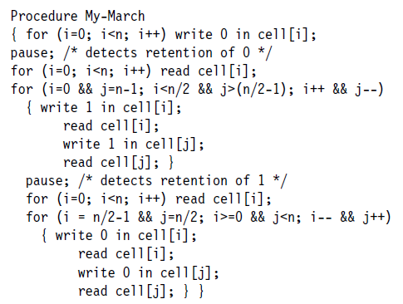
Exercises
8.1（b）为了检测存储器跳变故障TF，March测试的需求是什么。
8.4 确定右边程序的March元素类型。它能检测什么故障？

Slide 70




Exercises
8.5 以下4个March测试是否有同样的故障覆盖率？
(a)
(b)
(c)
(d)
8.6 测试一个面向bit的存储器时，能不能通过把它当做面向word的存储器来测，以节省测试时间？举例说明。

Slide 71
中国科学院大学：VLSI测试与可测试性设计
下次课预告
时间：2021年11月10日（周三18:20-21:10）
地点：教1-109
内容：存储器诊断与BISR
教材：VLSI TEST PRINCIPLES AND ARCHITECTURES
Chapter 9 Memory Diagnosis and Built-In Self-Repair

