Slide 1

Mutual Fund Analytics Capstone Project
Data Analyst Internship
Bluestock Fintech
Prepared By:
Lella Anusha Reddy

Slide 2
Problem Statement
Investors often face difficulty in selecting mutual funds due to the large number of available options and varying risk-return profiles.
The goal is to analyze mutual fund data and provide insights for better investment decisions.
Investors need a simple way to compare fund categories and performance metrics.
Risk measures such as volatility, Var, and CVaR are not easily accessible to all investors.
There is a need for a data-driven approach to evaluate mutual fund performance.

Slide 3
Project Objectives
Perform ETL on mutual fund data
Conduct Exploratory Data Analysis (EDA)
Analyze fund performance
Measure risk using Var and CVaR
Build an interactive Power BI dashboard
Generate investment recommendations

Slide 4
Project Architecture
Data Collection ↓
Data Cleaning (ETL) ↓
EDA ↓
Performance Analysis ↓
Risk Analysis ↓
Power BI Dashboard ↓
Insights & Recommendations

Slide 5
Dataset Overview
Dataset Includes:
Fund Name
Fund Category
NAV
Returns
Expense Ratio
Risk Metrics
Tools Used:
Python
Pandas
NumPy
Matplotlib
Power BI
GitHub

Slide 6
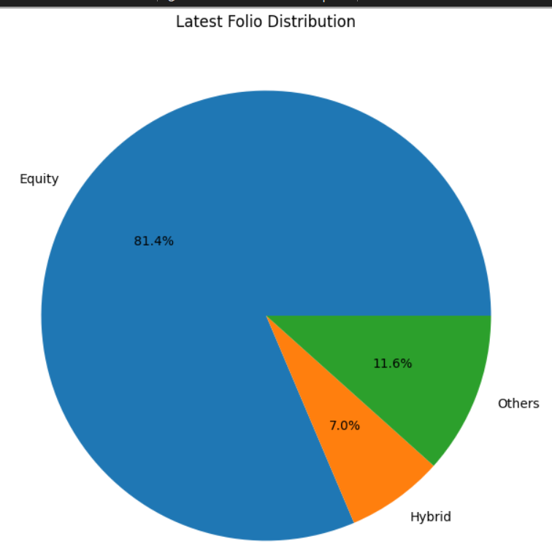
EDA Highlights
Key Findings:
Equity funds generated higher returns
Debt funds showed lower risk
Hybrid funds balanced risk and return
Fund categories performed differently

Slide 7
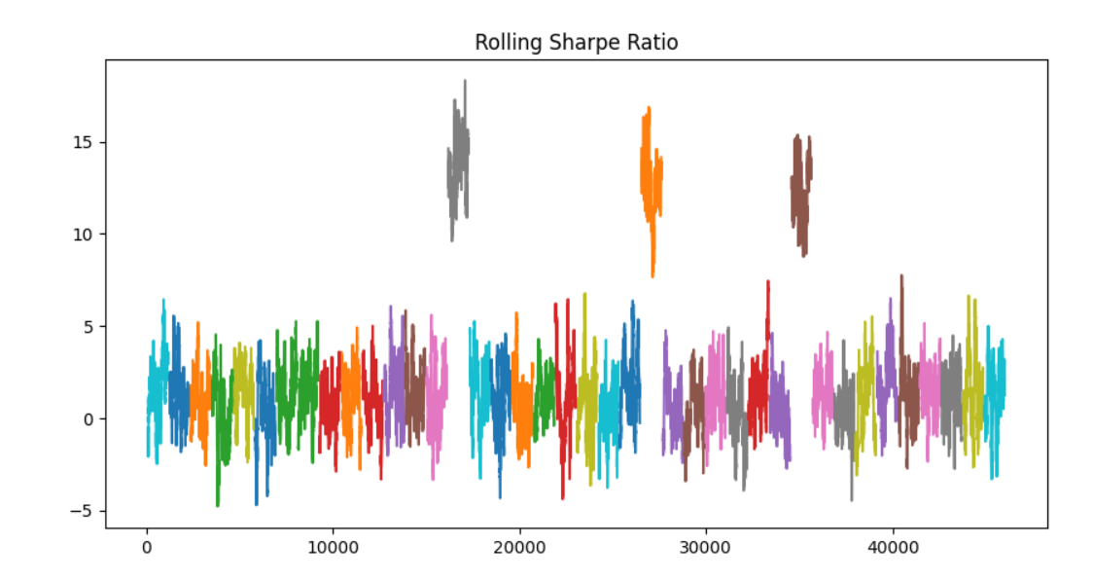
Performance Analysis
Metrics Used:
CAGR
Sharpe Ratio
Rolling Sharpe Ratio
Findings:
Top-performing funds achieved higher risk-adjusted returns
Consistent performers showed stable Sharpe Ratios

Slide 8
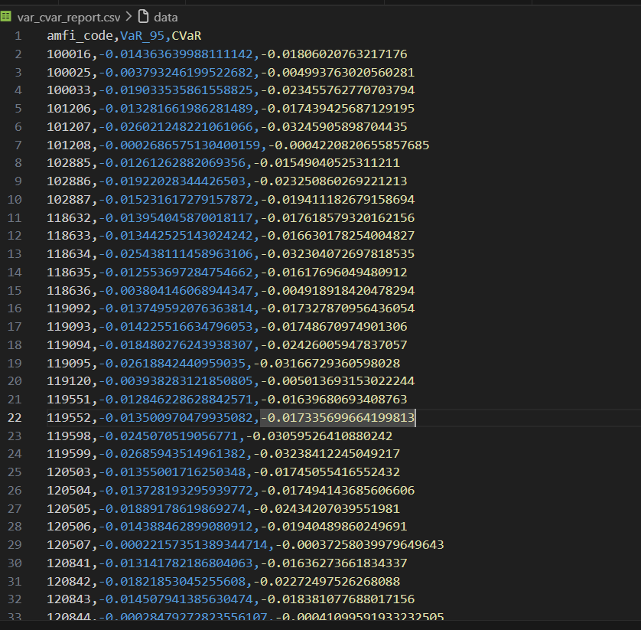
Risk Analysis
Risk Metrics:
Value at Risk (VaR)
Conditional Value at Risk (CVaR)
Insights:
High-return funds often carry higher risk
Diversified funds reduce downside risk

Slide 9
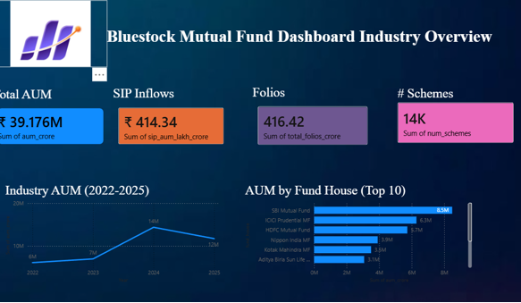
Dashboard Insights
Key Dashboard Observations:
Top fund categories identified
Risk-return relationship visualized
Easy comparison of fund performance

Slide 10
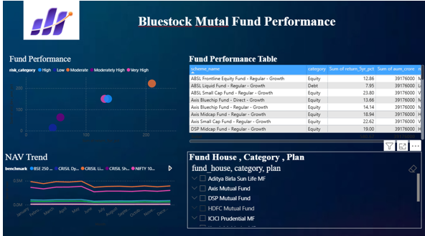
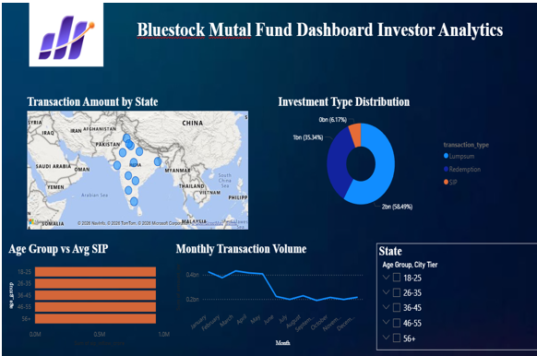
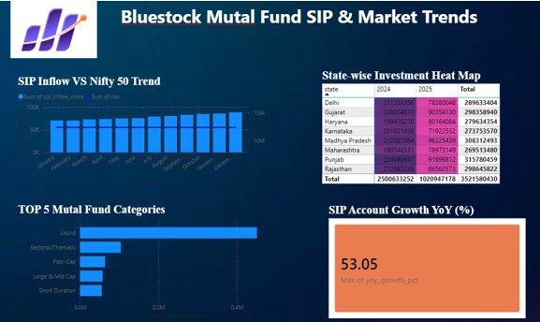

Slide 11
Key Findings & Recommendations
Key Findings:
Equity funds delivered highest returns
Debt funds offered stability
Hybrid funds balanced risk and return
Recommendations:
Conservative → Debt Funds
Moderate → Hybrid Funds
Aggressive → Equity Funds

Slide 12
THANK YOU

