Slide 1

PPT模板下载：www.1ppt.com/moban/ 行业PPT模板：www.1ppt.com/hangye/
节日PPT模板：www.1ppt.com/jieri/ PPT素材下载：www.1ppt.com/sucai/
PPT背景图片：www.1ppt.com/beijing/ PPT图表下载：www.1ppt.com/tubiao/
优秀PPT下载：www.1ppt.com/xiazai/ PPT教程： www.1ppt.com/powerpoint/
Word教程： www.1ppt.com/word/ Excel教程：www.1ppt.com/excel/
资料下载：www.1ppt.com/ziliao/ PPT课件下载：www.1ppt.com/kejian/
范文下载：www.1ppt.com/fanwen/ 试卷下载：www.1ppt.com/shiti/
教案下载：www.1ppt.com/jiaoan/ PPT论坛：www.1ppt.cn
2017
渐变简约通用模板
BUSINESS REPORT SUMMARIZES TEMPLATE
美仑设计

Slide 2

人物介绍
BASIC SITUATION
美仑设计是集PPT模板开发、PPT设计定制、PPT培训于一体的专业PPT服务提供商。深受大家的好评和肯定。还有，他是个帅哥呢，不信你去问他。
Jane
PM

Slide 3
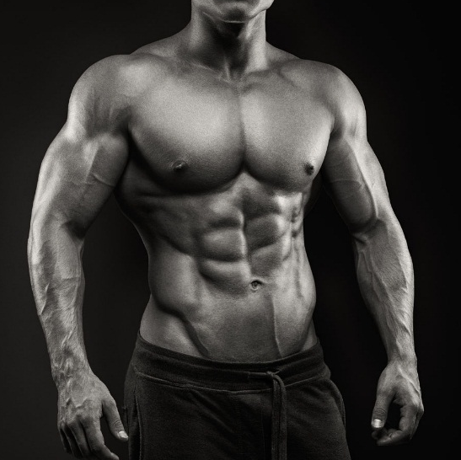
基本情况
BASIC SITUATION
Be always as merry as ever you can, for no-one delights in an sorrowful man. Be always as merry as ever you can
Be always as merry as ever you can, for no-one delights in an sorrowful man.

Slide 4



365
BE ALWAYS AS MERRY
AS EVER YOU CAN.
days
SITUATION
CUP SHOW
WET PIN

Slide 5
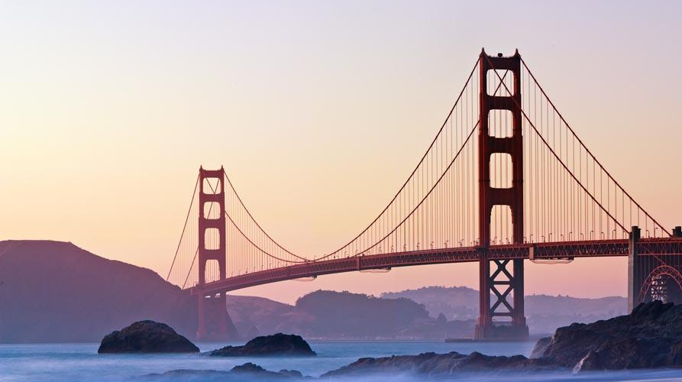
周利润
5,342,291
RMB

Slide 6
TARGET
业务营收
BASIC SITUATION
Be always as merry as ever you can, for no-one delights in an sorrowful man. Be always as merry as ever you can

Slide 7
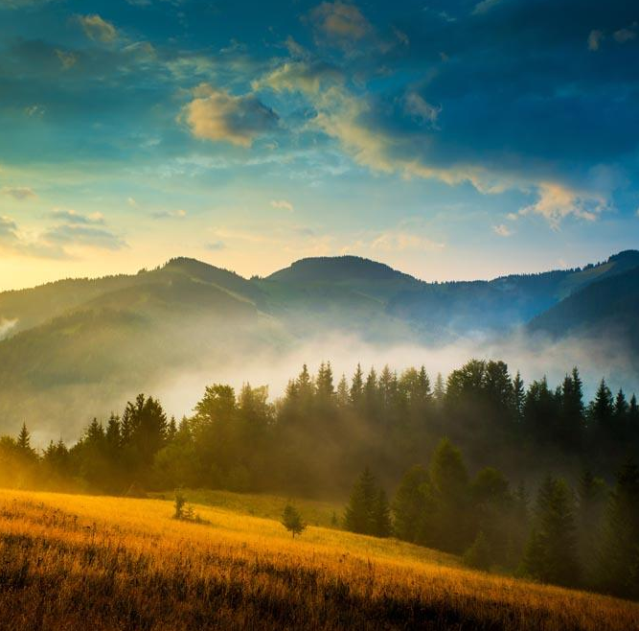








34%
23%
91%
GOOLE BOX
SHIT WMAIL
BAIDU WORK
合作企业
BASIC SITUATION
Be always as merry as ever you can, for no-one delights in an sorrowful man. Be always as merry as ever you can

Slide 8

营销环境
BASIC SITUATION
Be always as merry as ever you can, for no-one delights in an sorrowful man. Be always as merry as ever you can

Slide 9

FLY SITUATION
TV SITUATION
Be always as merry as ever you can, for no-one delights in an sorrowful man.
Be always as merry as ever you can, for no-one delights in an sorrowful man.
TARGET
GABAGE SITUATION
PLANE SITUATION
Be always as merry as ever you can, for no-one delights in an sorrowful man.
Be always as merry as ever you can, for no-one delights in an sorrowful man.
QUESTION SITUATION
RING SITUATION
Be always as merry as ever you can, for no-one delights in an sorrowful man.
Be always as merry as ever you can, for no-one delights in an sorrowful man.

Slide 10
BASIC SITUATION
BASIC SITUATION
Be always as merry as ever you can, for no-one delights in an sorrowful man.
Be always as merry as ever you can, for no-one delights in an sorrowful man.
BASIC SITUATION
BASIC SITUATION
BASIC SITUATION
Be always as merry as ever you can, for no-one delights in an sorrowful man.
Be always as merry as ever you can, for no-one delights in an sorrowful man.
Be always as merry as ever you can, for no-one delights in an sorrowful man.

