Slide 1
Chapter 2
The OSI Model
and
TCP/IP
Protocol Suite

Slide 2
Layered approach
Computer networks are layered
  Distill the process of transmitting data to its most fundamental elements
  Identify which networking functions had related uses and collected those functions into discrete groups that became layers
  A comprehensible, flexible, modular architecture

Slide 3
CONTENTS
THE OSI MODEL
LAYERS IN THE OSI MODEL
TCP/IP PROTOCOL SUITE
ADDRESSING
TCP/IP VERSIONS

Slide 4
2.1
THE
OSI
MODEL

Slide 5

ISO is the organization.
OSI is the model.

Slide 6
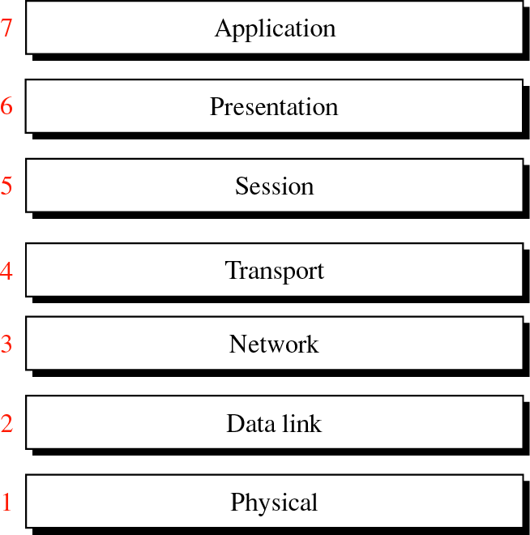
Figure 2-1
OSI
Model

Slide 7
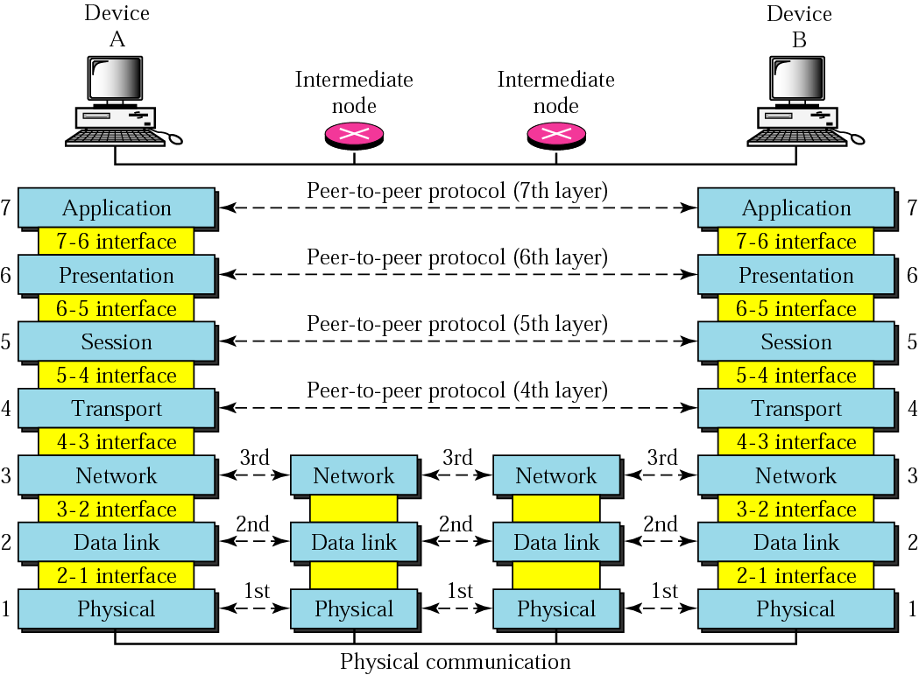
Figure 2-2
OSI layers

Slide 8
Headers are added
to the data at layers
6, 5, 4, 3, and 2.
Trailers are usually
added only at layer 2.

Slide 9
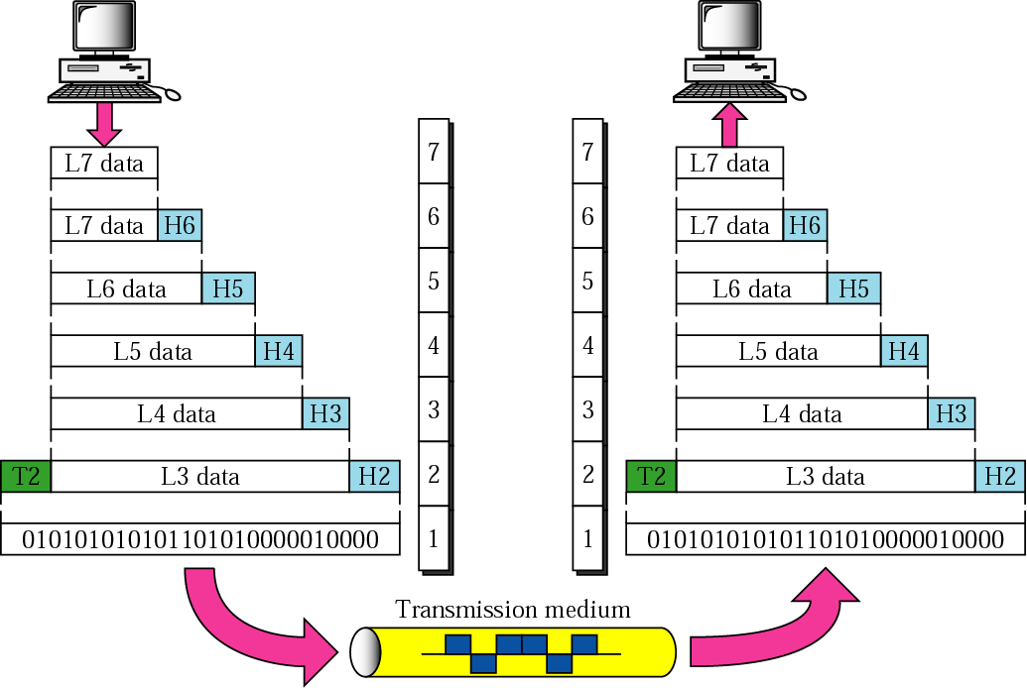
Figure 2-3
An exchange using the OSI model

Slide 10
2.2
LAYERS
IN
THE
OSI
MODEL

Slide 11
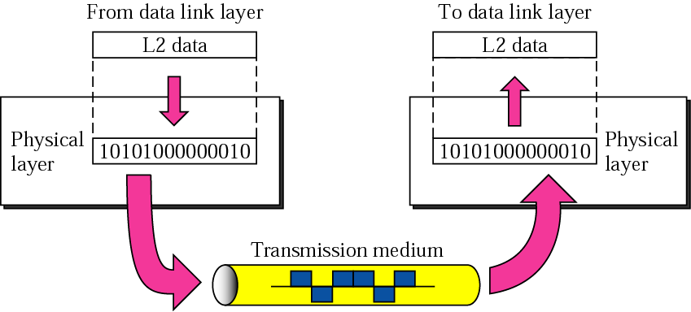
Figure 2-4
Physical Layer
  Physical Layer coordinates the functions required to transmit a bit stream over the physical medium.

Slide 12
Physical layer tasks
  Physical medium characteristics
  Transformation of data bits to a signal
  Data rate (number of bits sent each second)
  Bit synchronization
  Line configuration (point-to-point, multipoint)
  Physical topology (mesh, star, ring, bus)
  Transmission mode (simplex, half-duplex, full-duplex or simply-duplex)

Slide 13
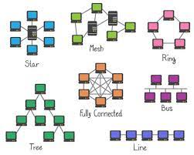
Physical topology

Slide 14
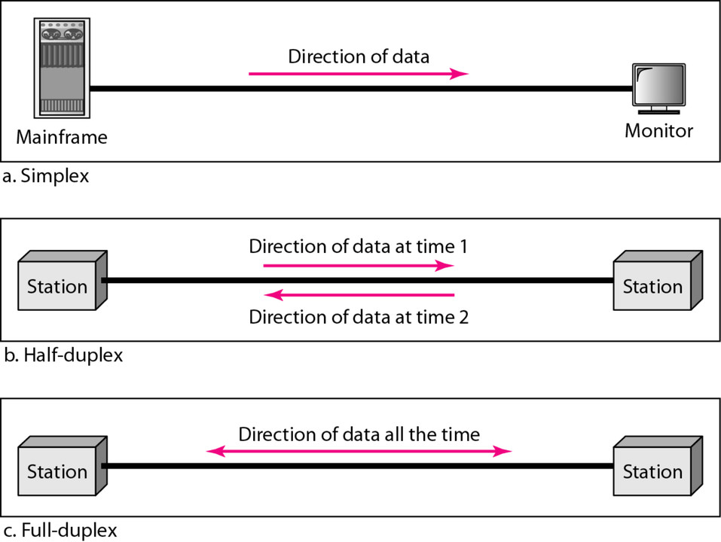
Transmission mode

Slide 15
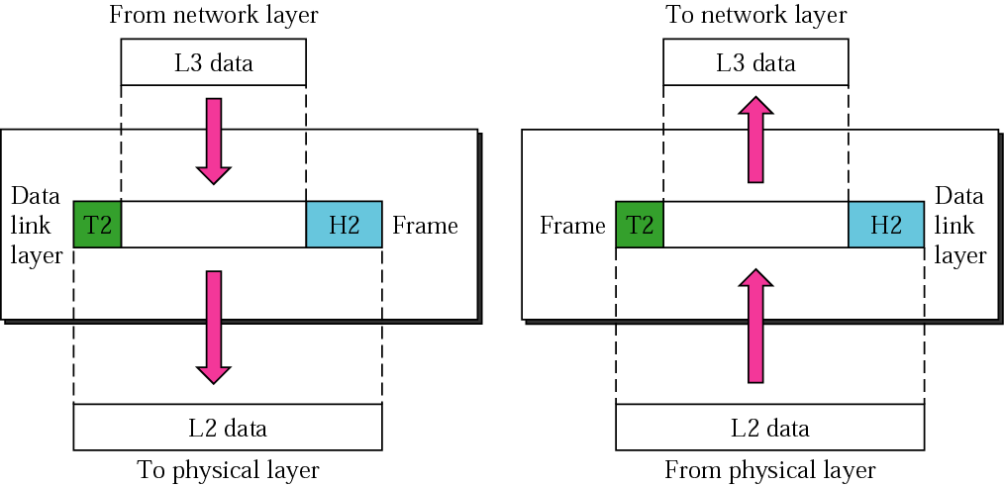
Figure 2-5
Data Link Layer
  Data Link Layer transforms the physical layer, a raw transmission facility, to a reliable link (node-to-node or hop-to-hop delivery).

Slide 16
Data link tasks
  Framing
  Physical addressing
  Flow control
  Error control and correction
  Access control

Slide 17
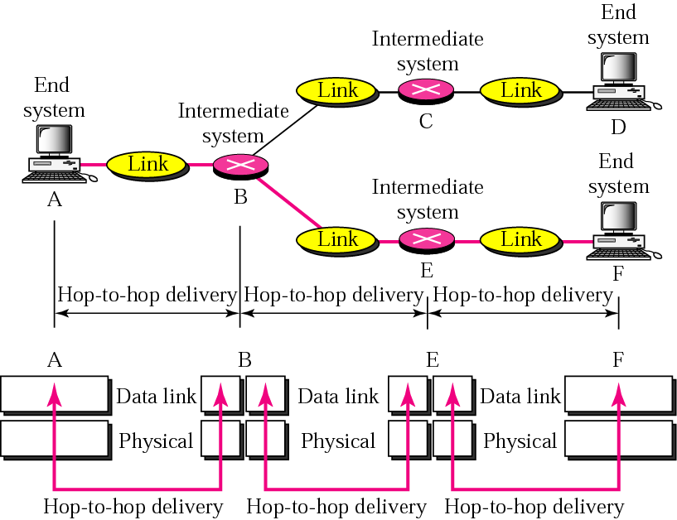
Figure 2-6
Node-to-node delivery

Slide 18
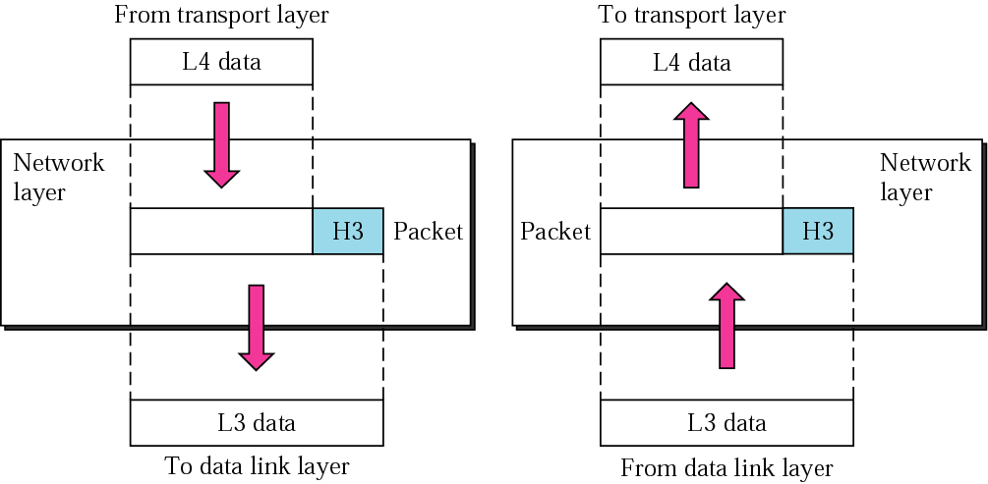
Figure 2-7
Network Layer
  Network Layer is responsible for source-to-destination delivery of packet (end-to-end delivery).

Slide 19
Network layer
  Logical addressing
  Routing

Slide 20
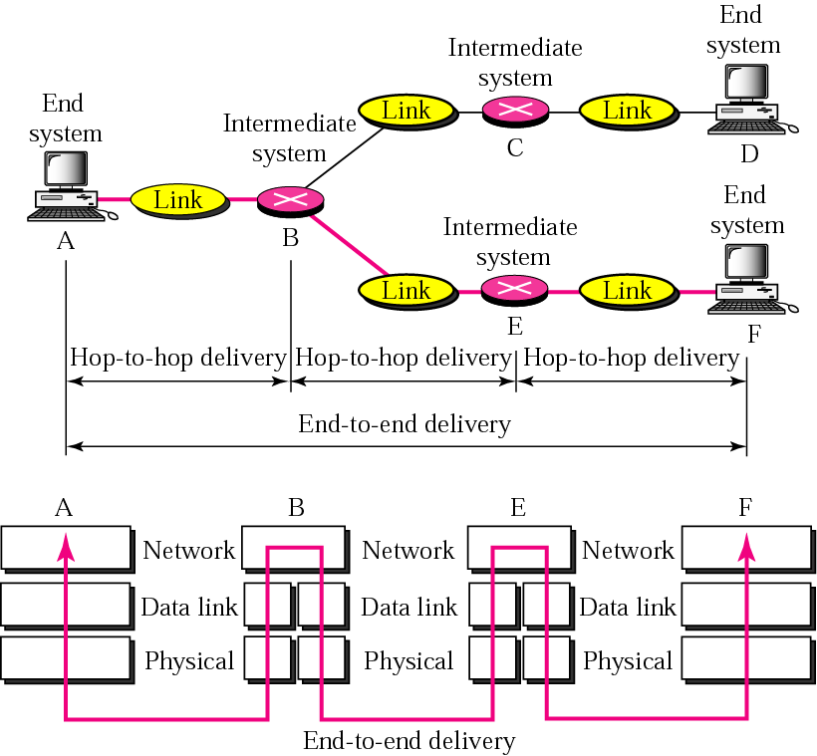
Figure 2-8
End-to-end delivery

Slide 21
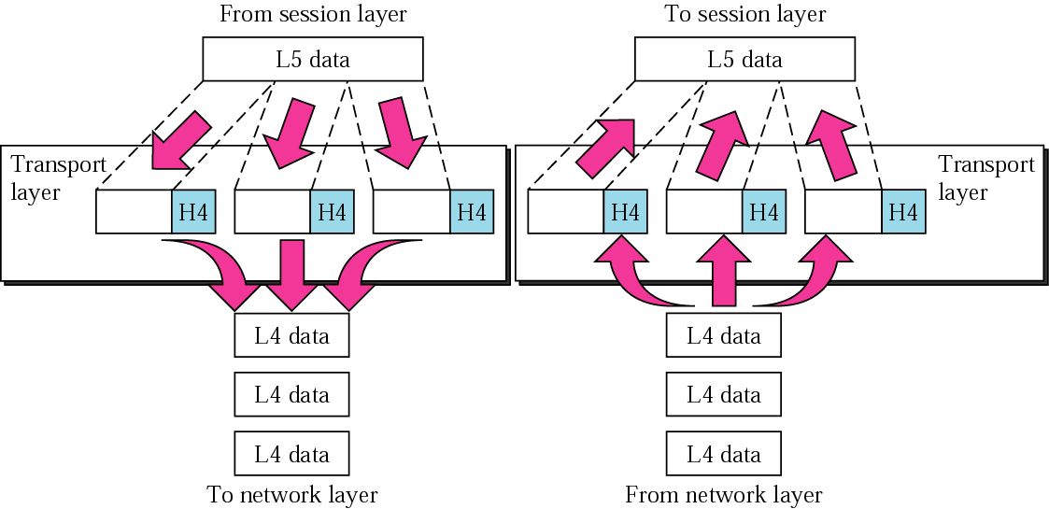
Figure 2-9
Transport Layer
  Transport Layer is responsible for source-to-destination delivery of the entire message (end-to-end delivery).

Slide 22
Transport layer task
  Ordering of packets composing a message
  Service-point addressing (process-to-process delivery)
  Segmentation and reassembly
  Connection control (connection-less, connection-oriented)
  Flow control
  Error control

Slide 23
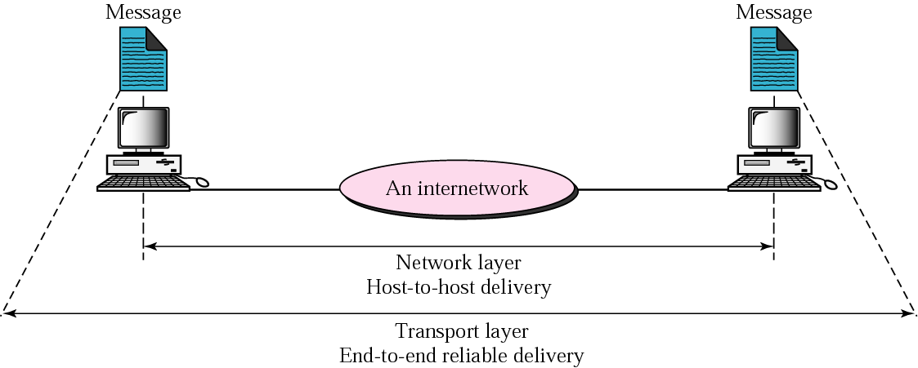
Figure 2-10
Reliable end-to-end delivery of a message

Slide 24
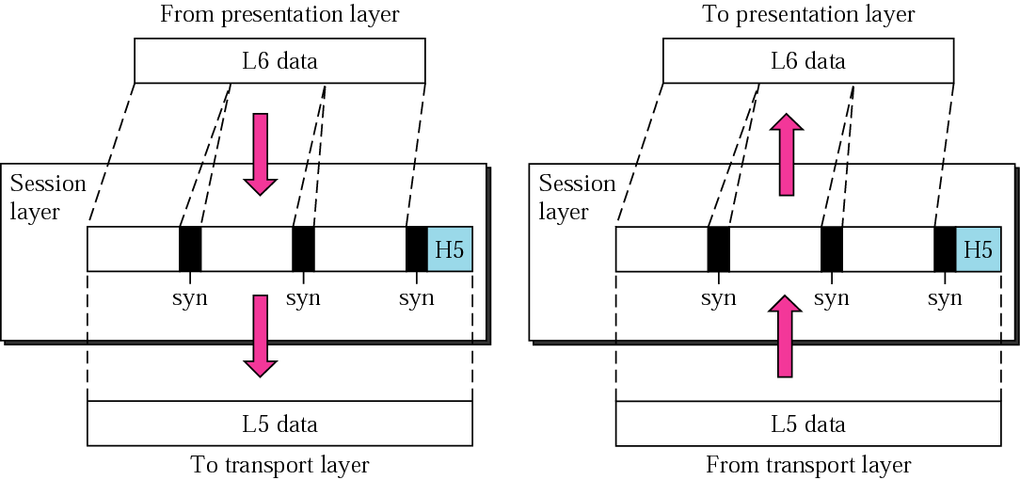
Figure 2-11
Session Layer
  Session Layer is the network dialog controller establishing, maintaining and synchronizing (using checkpoints) the interactions.

Slide 25
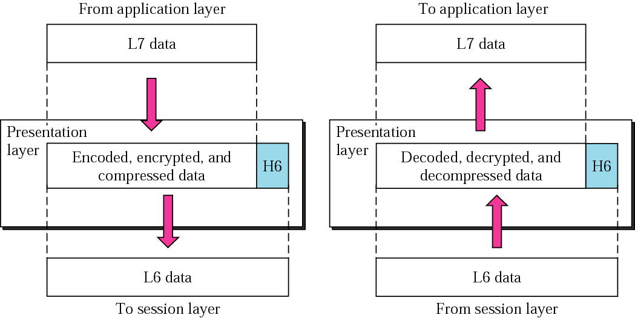
Figure 2-12
Presentation Layer
  Session Layer manages the syntax and semantics of the exchanged information.

Slide 26
Presentation layer task
  Translation to a common format (encode/decode)
  Encryption
  Compression

Slide 27
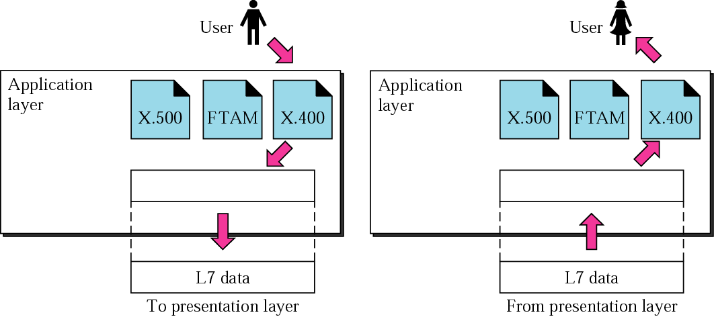
Figure 2-13
Application Layer

Slide 28
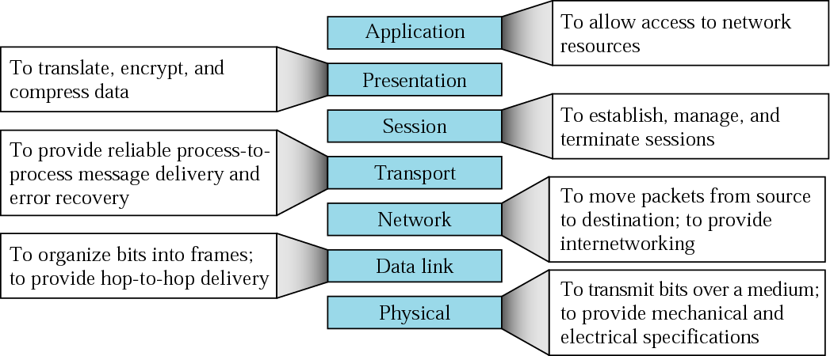
Figure 2-14
Summary of layers

Slide 29
2.3
TCP/IP
PROTOCOL
SUITE

Slide 30
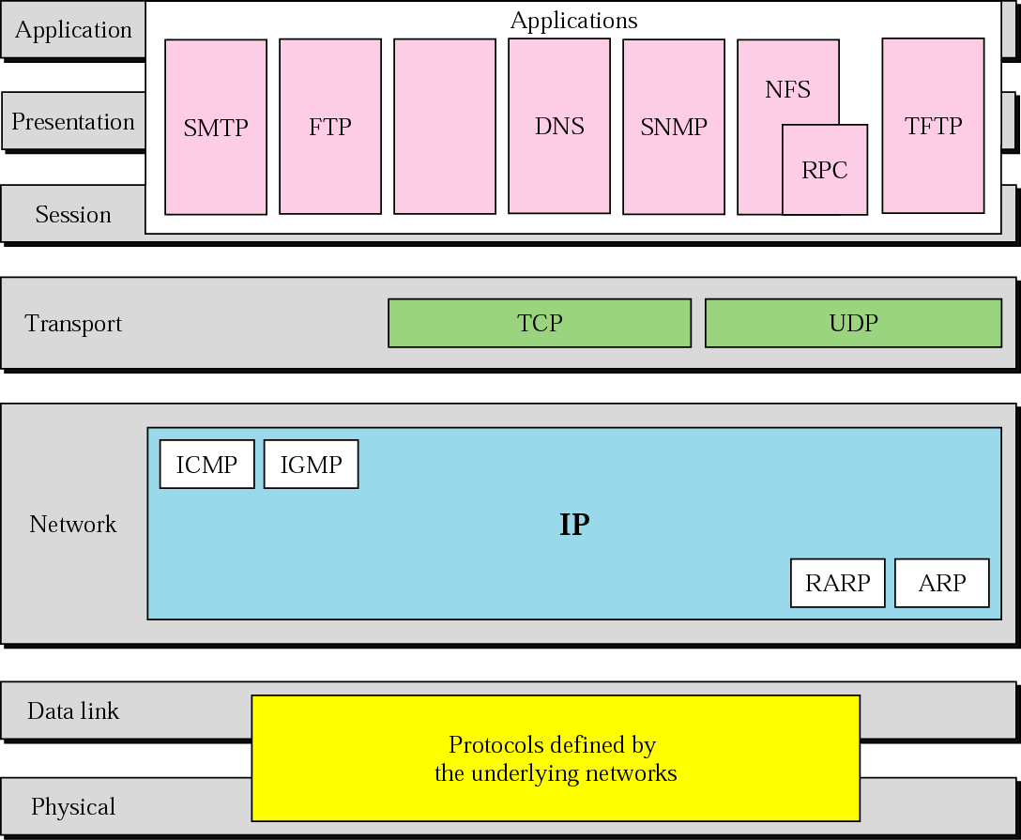
Figure 2-15
TCP/IP and OSI model

Slide 31
2.4
ADDRESSING

Slide 32
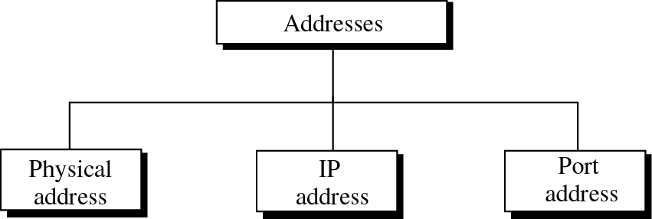
Figure 2-16
Addresses in TCP/IP

Slide 33
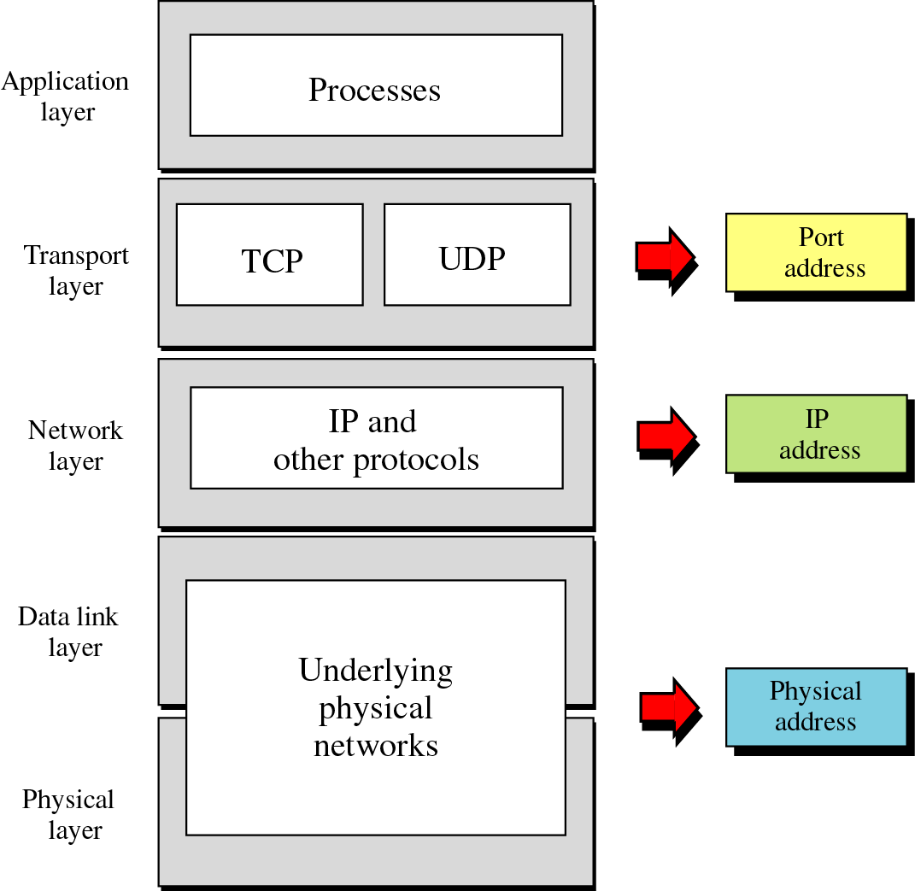
Figure 2-17
Relation-
ship
of
layers
and
addresses
in TCP/IP

Slide 34
Example 1
Figure 2.18 shows an example of physical addresses.

Slide 35
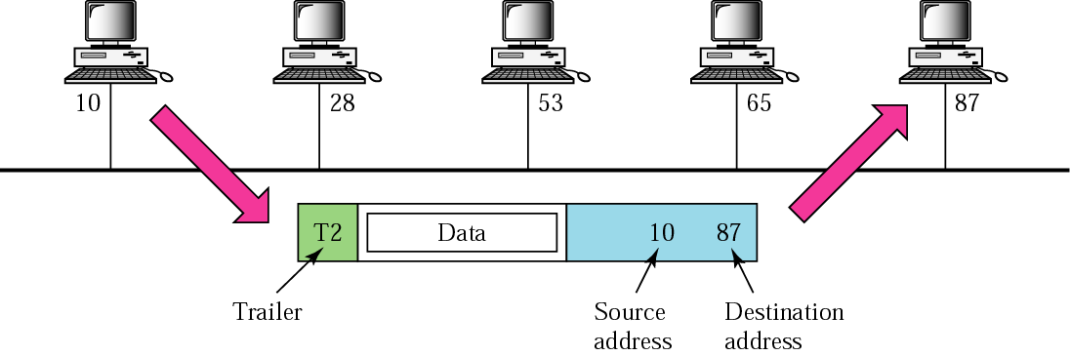
Figure 2-18
Physical addresses

Slide 36
Example 2
Most local area networks use a 48-bit (6 bytes) physical address written as 12 hexadecimal digits, with every 2 bytes separated by a hyphen as shown below:
07-01-02-01-2C-4B
A 6-byte (12 hexadecimal digits) physical address

Slide 37
Scope of physical address
  Unicast
  Broadcast
  Multicast

Slide 38
Example 3
Figure 2.19 shows an example of Internet addresses.

Slide 39
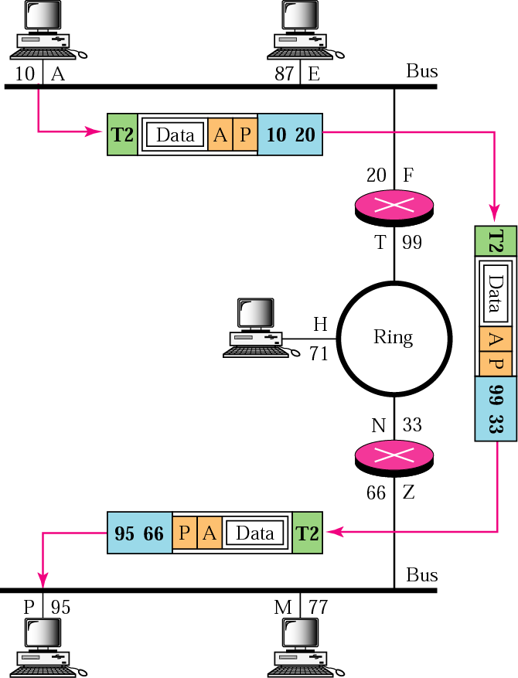
Figure 2-19
IP addresses

Slide 40
Example 4
As we will see in Chapter 4, an Internet address (in IPv4) is 32 bits in length, normally written as four decimal numbers, with each number representing 1 byte. The numbers are separated by a dot. Below is an example of such an address.
132.24.75.9

Slide 41
Example 5
Figure 2.20 shows an example of transport layer communication.

Slide 42
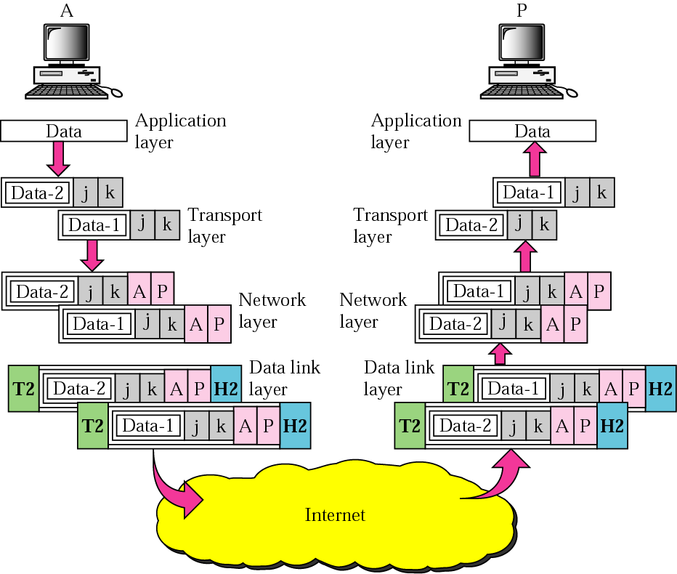
Figure 2-20
Port addresses

Slide 43
Example 6
As we will see in Chapters 11 and 12, a port address is a 16-bit address represented by one decimal number as shown below.
753 A 16-bit port address

Slide 44
2.5
TCP/IP
VERSIONS

Slide 45
Versions:
Version 4 (current)
Version 5
Version 6 (future)

Slide 46
Next week
  LAN networks and technologies
  Connecting devices

