Slide 1
2.3
TCP/IP
PROTOCOL
SUITE

Slide 2
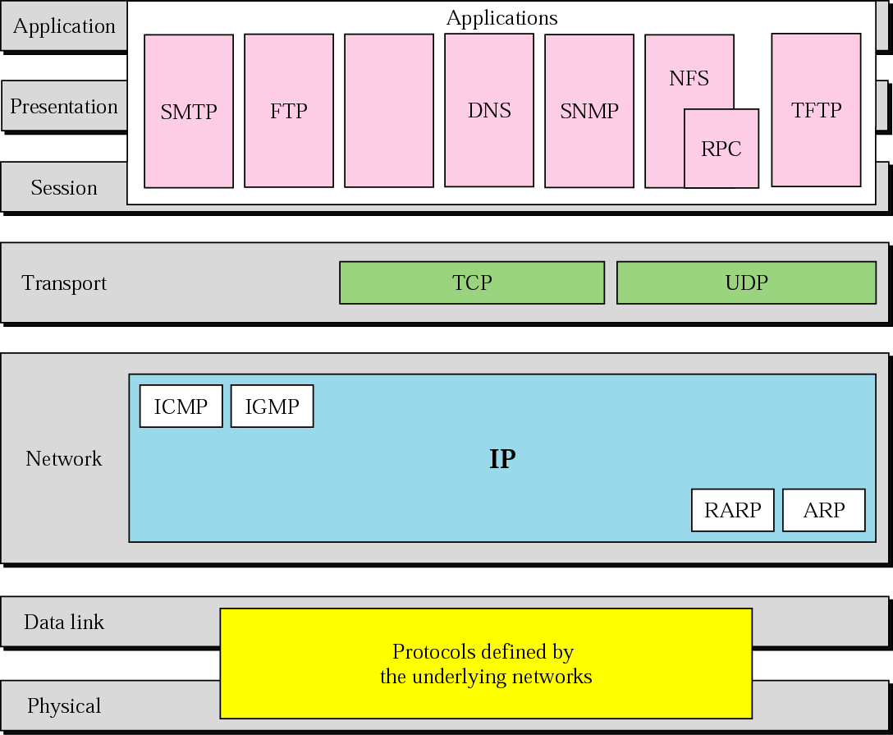
Figure 2-15
TCP/IP and OSI model

Slide 3
2.4
ADDRESSING

Slide 4
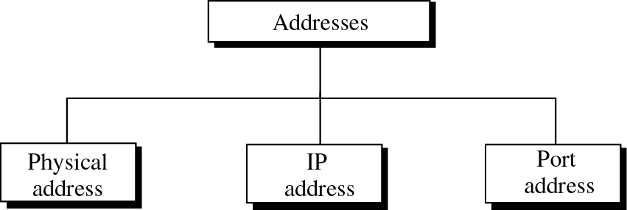
Figure 2-16
Addresses in TCP/IP

Slide 5
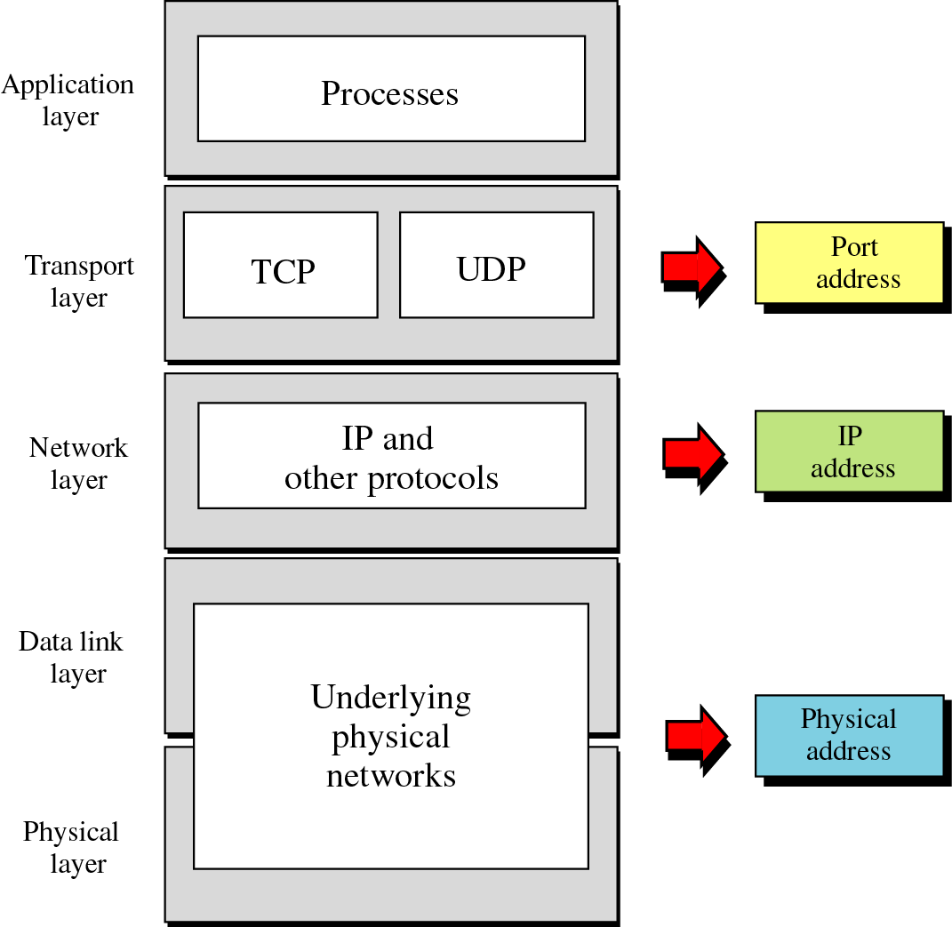
Figure 2-17
Relation-
ship
of
layers
and
addresses
in TCP/IP

Slide 6
Example 1
Figure 2.18 shows an example of physical addresses.

Slide 7
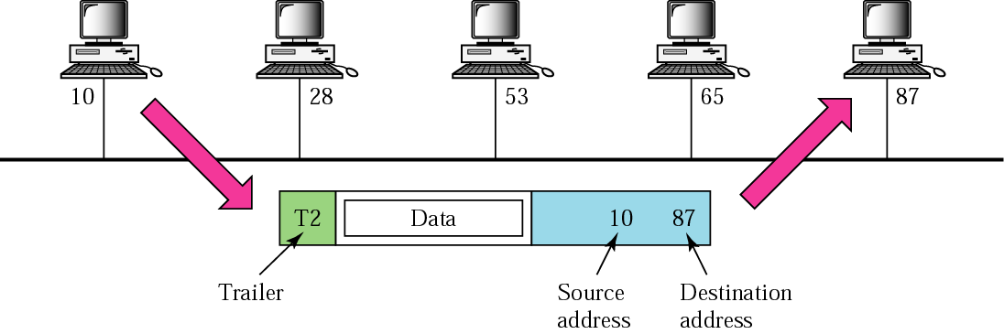
Figure 2-18
Physical addresses

Slide 8
Example 2
Most local area networks use a 48-bit (6 bytes) physical address written as 12 hexadecimal digits, with every 2 bytes separated by a hyphen as shown below:
07-01-02-01-2C-4B
A 6-byte (12 hexadecimal digits) physical address

Slide 9
Scope of physical address
  Unicast
  Broadcast
  Multicast

Slide 10
Example 3
Figure 2.19 shows an example of Internet addresses.

Slide 11
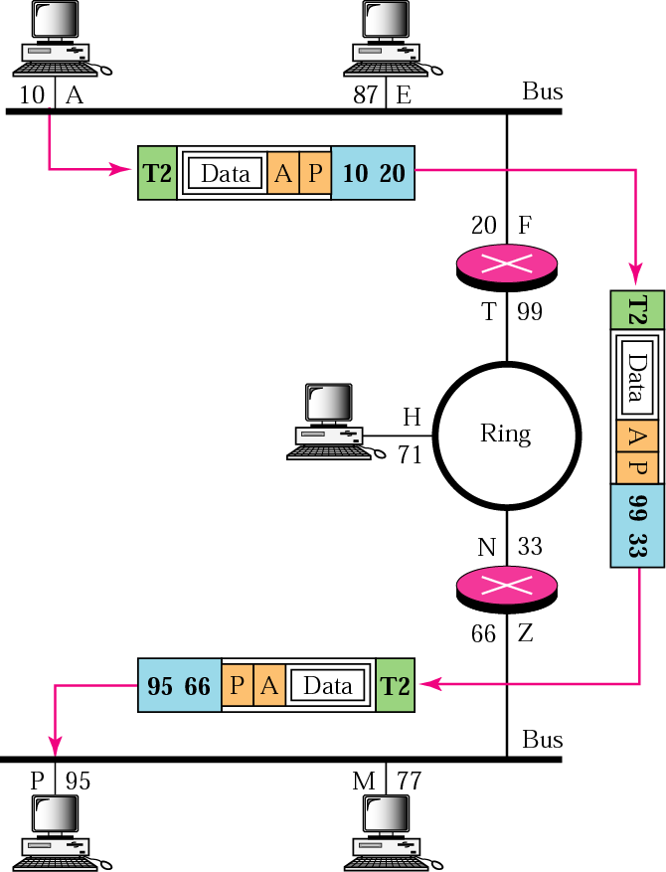
Figure 2-19
IP addresses

Slide 12
Example 4
As we will see in Chapter 4, an Internet address (in IPv4) is 32 bits in length, normally written as four decimal numbers, with each number representing 1 byte. The numbers are separated by a dot. Below is an example of such an address.
132.24.75.9

Slide 13
Example 5
Figure 2.20 shows an example of transport layer communication.

Slide 14
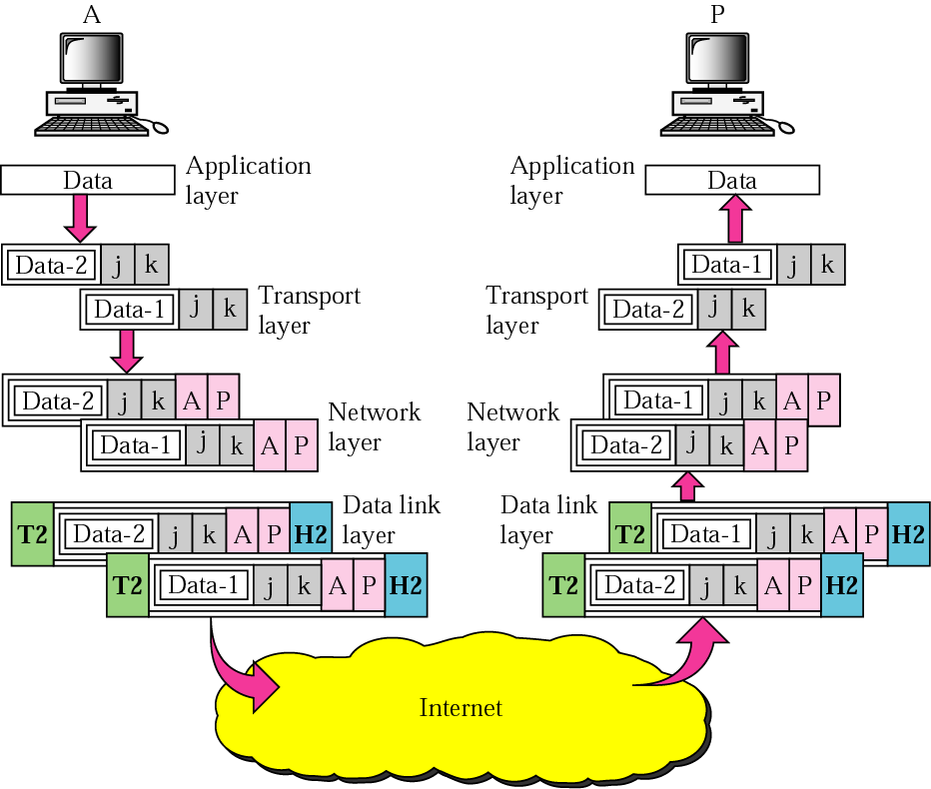
Figure 2-20
Port addresses

Slide 15
Example 6
As we will see in Chapters 11 and 12, a port address is a 16-bit address represented by one decimal number as shown below.
753 A 16-bit port address

Slide 16
2.5
TCP/IP
VERSIONS

Slide 17
Versions:
Version 4 (current)
Version 5
Version 6 (future)

Slide 18
Chapter 6
Delivery and
Routing of
IP Packets

Slide 19
CONTENTS
CONNECTION
DELIVERY
ROUTING METHODS
STATIC AND DYNAMIC ROUTING
ROUTING TABLE AND MODULE
CLASSLESS ADDRESSING

Slide 20
6.1
CONNECTION-ORIENTED
VERSUS
CONNECTIONLESS
SERVICES

Slide 21
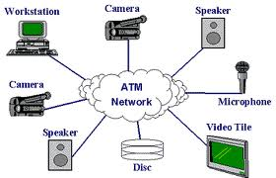
In a connection-oriented situation,
the network layer protocol
first makes a connection.

Slide 22

Figure 6-1
Direct delivery
In a connectionless situation,
the network layer protocol treats each
packet independently,
with each packet having
no relationship to any other packet.

Slide 23
6.2
DIRECT
VERSUS
INDIRECT
DELIVERY

Slide 24
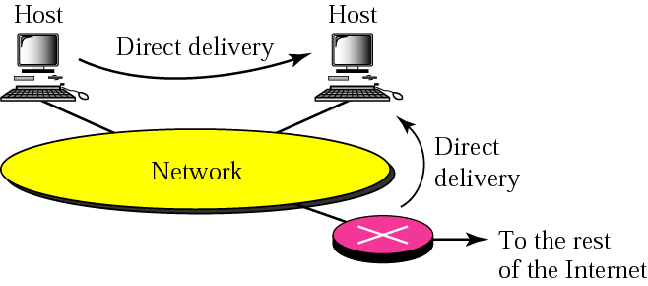
Figure 6-1
Direct delivery

Slide 25
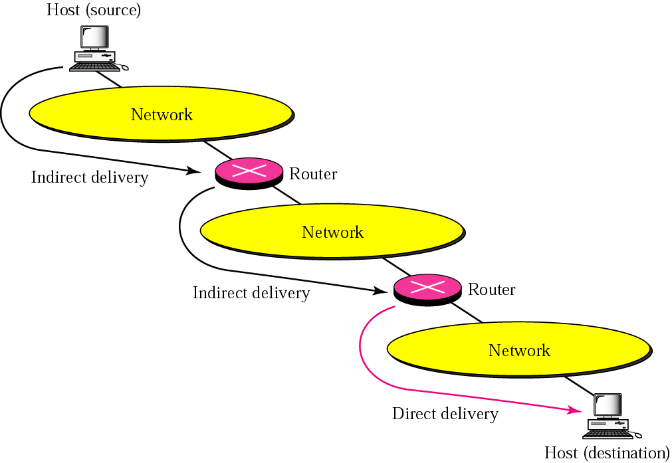
Figure 6-2
Indirect delivery

Slide 26
6.3
ROUTING
METHODS

Slide 27
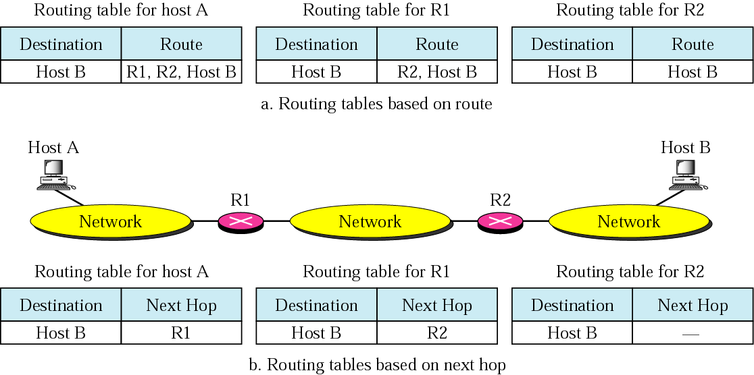
Figure 6-3
Next-hop routing

Slide 28
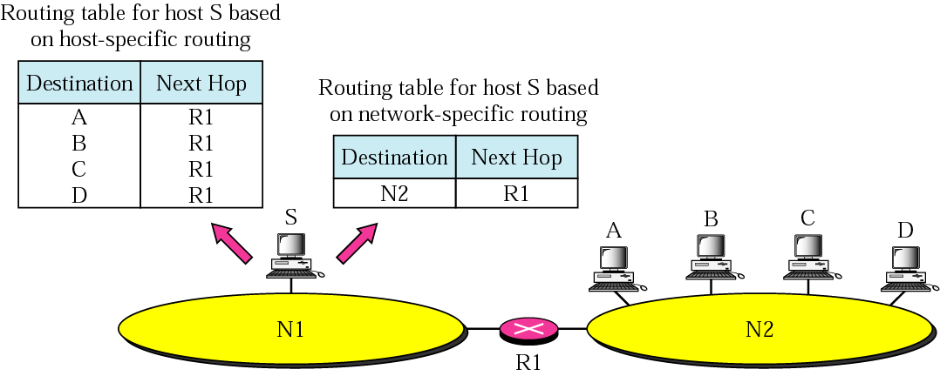
Figure 6-4
Network-specific routing

Slide 29
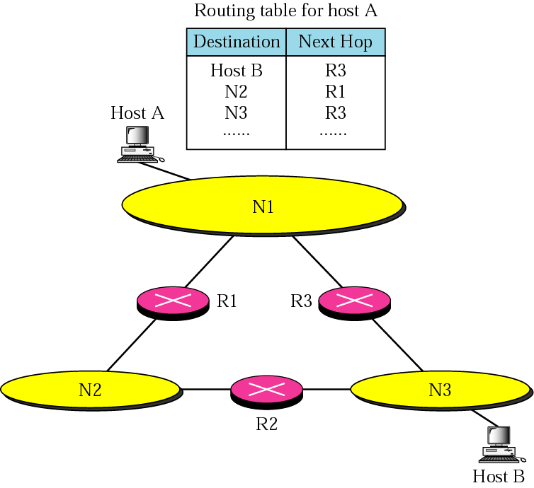
Figure 6-5
Host-specific
routing
R1

Slide 30
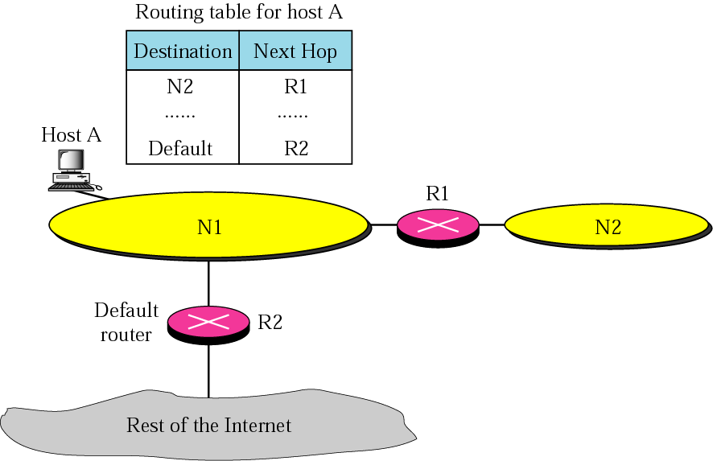
Figure 6-6
Default routing

Slide 31
6.4
STATIC
VERSUS
DYNAMIC
ROUTING

Slide 32
A static routing table
contains information entered manually.
A dynamic routing table is updated
periodically using one of the dynamic
routing protocols such as RIP, OSPF, or BGP.

Slide 33
6.5
ROUTING TABLE
AND
ROUTING MODULE

Slide 34
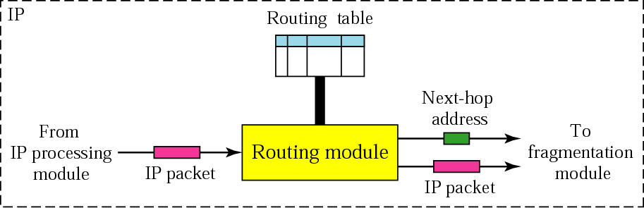
Figure 6-7
Routing module and routing table

Slide 35
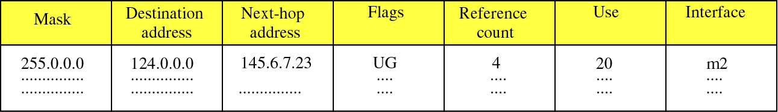
Figure 6-8
Routing Table
Flags
U The router is up and running.
G The destination is in another network.
H Host-specific address.
D Added by redirection.
M Modified by redirection.

Slide 36
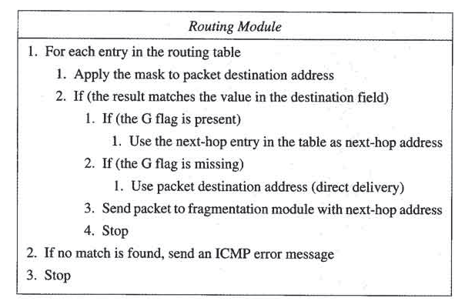
Routing Table

Slide 37
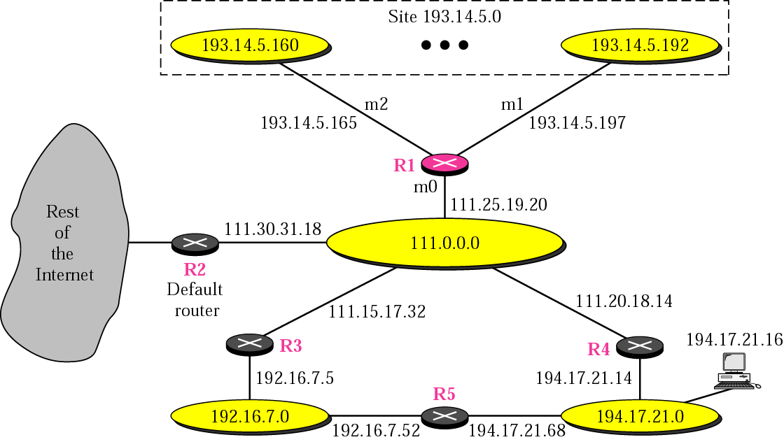
Figure 6-9
Configuration for routing example

Slide 38
Mask Dest. Next Hop I.
255.0.0.0 111.0.0.0 -- m0
255.255.255.224 193.14.5.160 - m2
255.255.255.224 193.14.5.192 - m1
-------------------------------------------------------------------------------------
255.255.255.255 194.17.21.16 111.20.18.14 m0
-------------------------------------------------------------------------------------
255.255.255.0 192.16.7.0 111.15.17.32 m0
255.255.255.0 194.17.21.0 111.20.18.14 m0
-------------------------------------------------------------------------------------
0.0.0.0 0.0.0.0 111.30.31.18 m0

Slide 39
Example 1
Router R1 receives 500 packets for destination 192.16.7.14; the algorithm applies the masks row by row to the destination address until a match (with the value in the second column) is found:

Slide 40
Solution
Direct delivery
192.16.7.14 & 255.0.0.0 ➔ 192.0.0.0 no match
192.16.7.14 & 255.255.255.224 ➔ 192.16.7.0 no match
192.16.7.14 & 255.255.255.224 ➔ 192.16.7. no match
Host-specific
192.16.7.14 & 255.255.255.255 ➔192.16.7.14 no match
Network-specific
192.16.7.14 & 255.255.255.0 ➔192.16.7.0 match

Slide 41
Example 2
Router R1 receives 100 packets for destination 193.14.5.176; the algorithm applies the masks row by row to the destination address until a match is found:

Slide 42
Solution
Direct delivery
193.14.5.176 & 255.0.0.0 ➔ 193.0.0.0 no match
193.14.5.176 & 255.255.255.224 ➔193.14.5.160 match

Slide 43
Example 3
Router R1 receives 20 packets for destination 200.34.12.34; the algorithm applies the masks row by row to the destination address until a match is found:

Slide 44
Solution
Direct delivery
200.34.12.34 & 255.0.0.0 ➔200.0.0.0 no match
200.34.12.34 & 255.255.255.224 ➔200.34.12.32 no match
200.34.12.34 & 255.255.255.224 ➔200.34.12.32 no match
Host-specific
200.34.12.34 & 255.255.255.255 ➔200.34.12.34 no match

Slide 45
Solution
Network-specific
200.34.12.34 & 255.255.255.0 ➔ 200.34.12.0 no match
200.34.12.34 & 255.255.255.0 ➔ 200.34.12.0 no match
Default
200.34.12.34 & 0.0.0.0 ➔ 0.0.0.0. match

Slide 46
Example 4
Make the routing table for router R1 in Figure 6.10

Slide 47
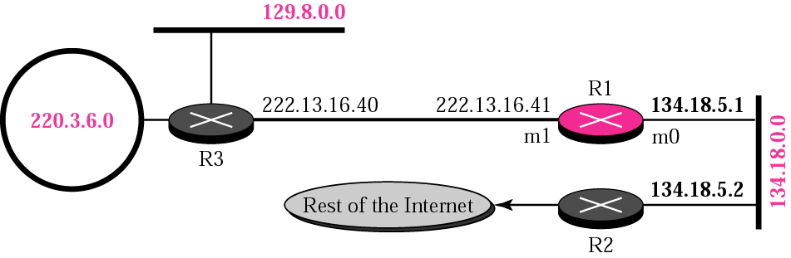
Figure 6-10
Example 4

Slide 48
Solution
Mask Destination Next Hop I.
255.255.0.0 134.18.0.0 -- m0
255.255.0.0 129.8.0.0 222.13.16.40 m1
255.255.255.0 220.3.6.0 222.13.16.40 m1
0.0.0.0 0.0.0.0 134.18.5.2 m0

Slide 49
Example 5
Make the routing table for router R1 in Figure 6.11

Slide 50
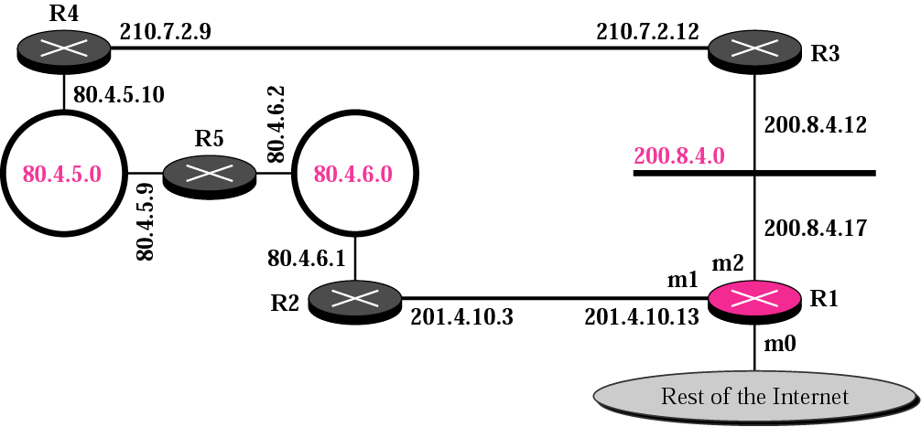
Figure 6-11
Example 5
200.4.5.0
200.4.6.0

Slide 51
Solution
Mask Destination Next Hop I.
255.255.255.0 200.8.4.0 ---- m2
-----------------------------------------------------------------------------
255.255.255.0 200.4.5.0 201.4.10.3 m1
or 200.8.4.12 or m2
------------------------------------------------------------------------------
255.255.255.0 200.4.6.0 201.4.10.3 m1
or 200.4.8.12 or m2
-------------------------------------------------------------------------------
0.0.0.0 0.0.0.0 ???????????? m0

Slide 52
Example 6
The routing table for router R1 is given below.
Draw its topology
Mask Destination Next Hop I.
255.255.0.0 110.70.0.0 - m0
255.255.0.0 180.14.0.0 - m2
255.255.0.0 190.17.0.0 - m1
255.255.0.0 130.4.0.0 190.17.6.5 m1
255.255.0.0 140.6.0.0 180.14.2.5 m2
0.0.0.0 0.0.0.0 110.70.4.6 m0

Slide 53
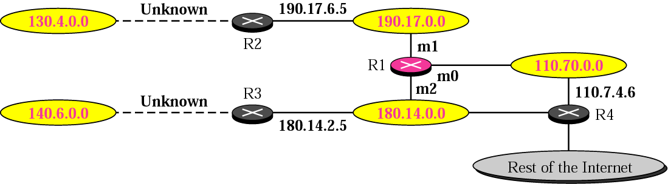
Figure 6-12
Example 6
(Solution)

Slide 54
6.6
CLASSLESS
ADDRESSING:
CIDR

Slide 55
ISSUES
Routing Table Size
Hierarchical Routing
Geographical Routing
Routing Table Search Algorithms

Slide 56

In classful addressing,
each address has self-contained
information that facilitates
routing table searching.

Slide 57
In classless addressing, there is
no self-contained information
in the destination address to
facilitate routing table searching.

