Slide 1
Chapter 8
Internet Protocol
(IP)

Slide 2
CONTENTS
DATAGRAM
FRAGMENTATION
OPTIONS
CHECKSUM
IP PACKAGE

Slide 3
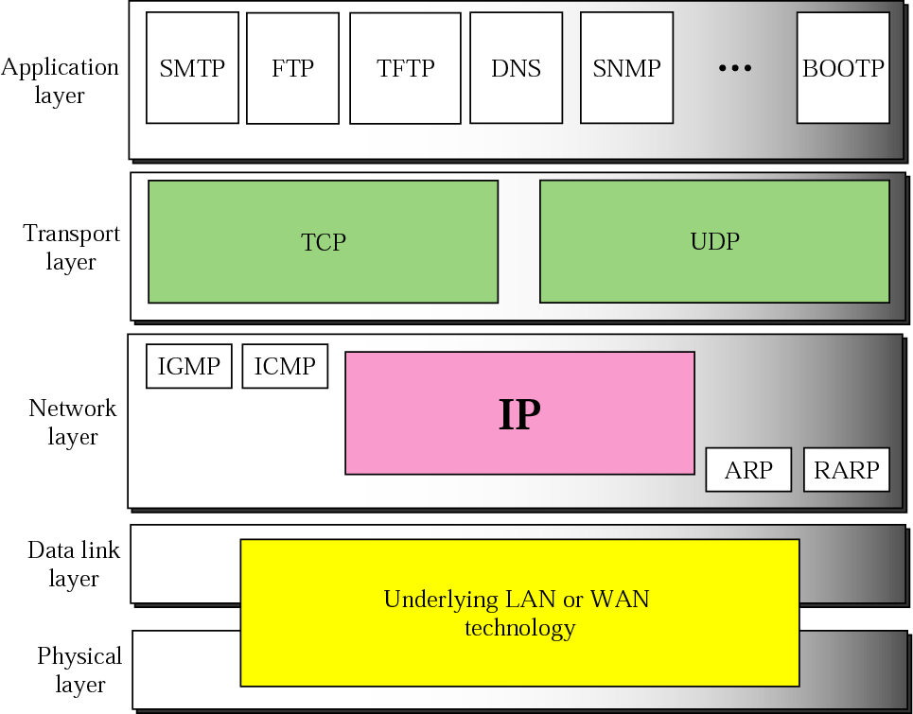
Figure 8-1
Position of IP in TCP/IP protocol suite

Slide 4
8.1
DATAGRAM

Slide 5
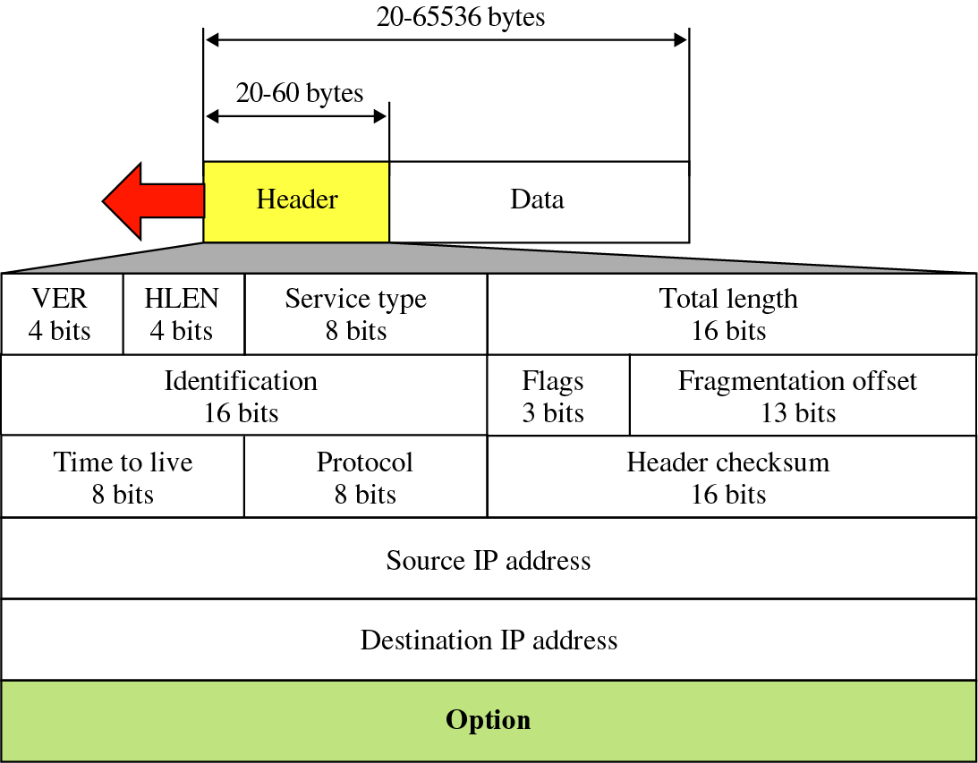
Figure 8-2
IP datagram

Slide 6
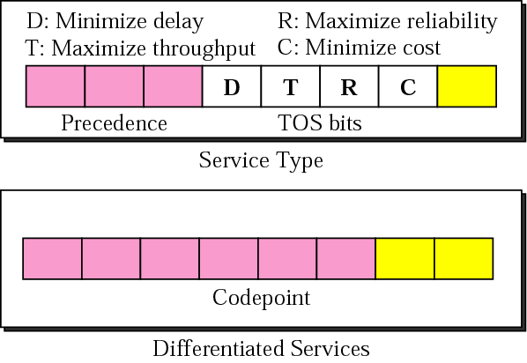
Figure 8-3
Service Type or Differentiated Services

Slide 7
Differentiated service (DS)
xxx000
  3 left-most bits interpreted as the precedence bits in Service Type interpretation
Else
  Define 64 services
    xxxxx0: Internet category - 32 services (0, 2, 4 … 62)
    xxxx11: Local category – 16 services (3, 7, 11, … 63)
    xxxx01: Temporary or exprimental – 16 services (1, 5, 9, … 61)

Slide 8

The precedence subfield is
not used in version 4.

Slide 9
The total length field defines the
total length of the
datagram including the header.

Slide 10
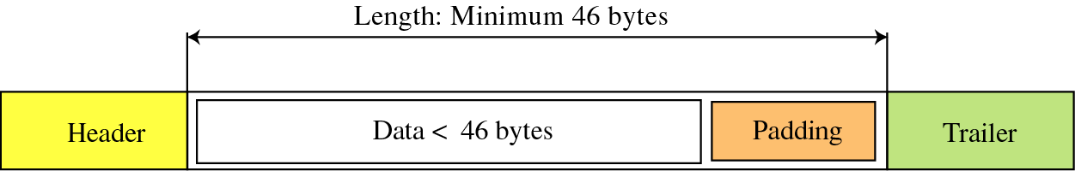
Figure 8-4
Encapsulation of a small datagram
in an Ethernet frame

Slide 11
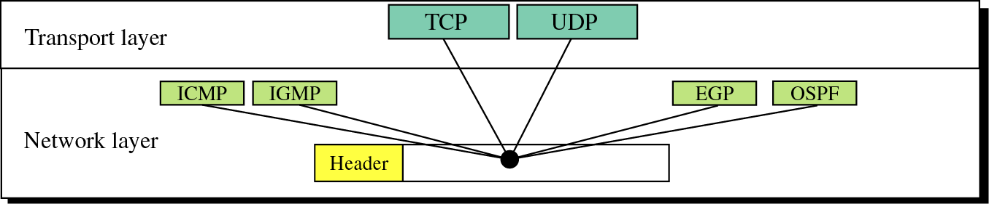
Figure 8-5
Multiplexing

Slide 12
Example 1
An IP packet has arrived with the first 8 bits as shown:
⬅ 01000010
The receiver discards the packet. Why?

Slide 13
Solution
There is an error in this packet. The 4 left-most bits (0100) show the version, which is correct. The next 4 bits (0010) show the header length, which means (2 × 4 = 8), which is wrong. The minimum number of bytes in the header must be 20. The packet has been corrupted in transmission.

Slide 14
Example 2
In an IP packet, the value of HLEN is 1000 in binary. How many bytes of options are being carried by this packet?

Slide 15
Solution
The HLEN value is 8, which means the total number of bytes in the header is 8 × 4 or 32 bytes. The first 20 bytes are the main header, the next 12 bytes are the options.

Slide 16
Example 3
In an IP packet, the value of HLEN is 5₁₆ and the value of the total length field is 0028₁₆. How many bytes of data are being carried by this packet?

Slide 17
Solution
The HLEN value is 5, which means the total number of bytes in the header is 5 × 4 or 20 bytes (no options). The total length is 40 bytes, which means the packet is carrying 20 bytes of data (40−20).

Slide 18
Example 4
An IP packet has arrived with the first few hexadecimal digits as shown below:
⬅ 45000028000100000102...................
How many hops can this packet travel before being dropped? The data belong to what upper layer protocol?

Slide 19
Solution
To find the time-to-live field, we should skip 8 bytes (16 hexadecimal digits). The time-to-live field is the ninth byte, which is 01. This means the packet can travel only one hop. The protocol field is the next byte (02), which means that the upper layer protocol is IGMP.

Slide 20
8.2
FRAGMENTATION

Slide 21
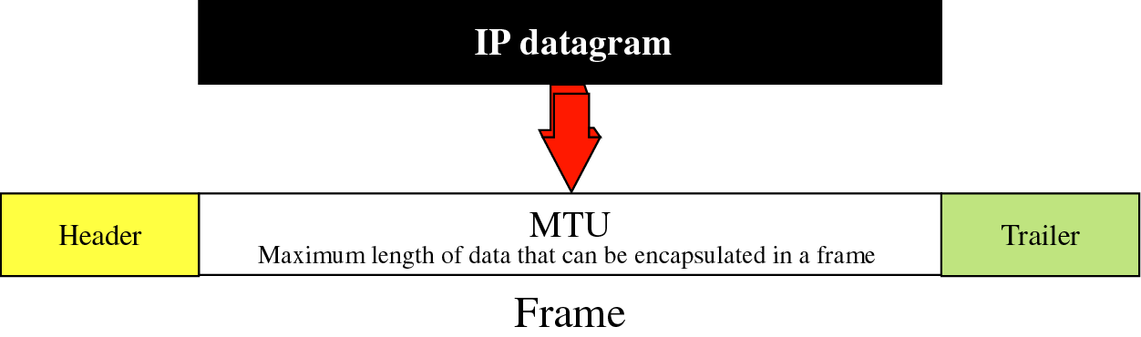
Figure 8-6
MTU

Slide 22
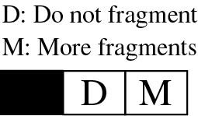
Figure 8-7
Flag field

Slide 23
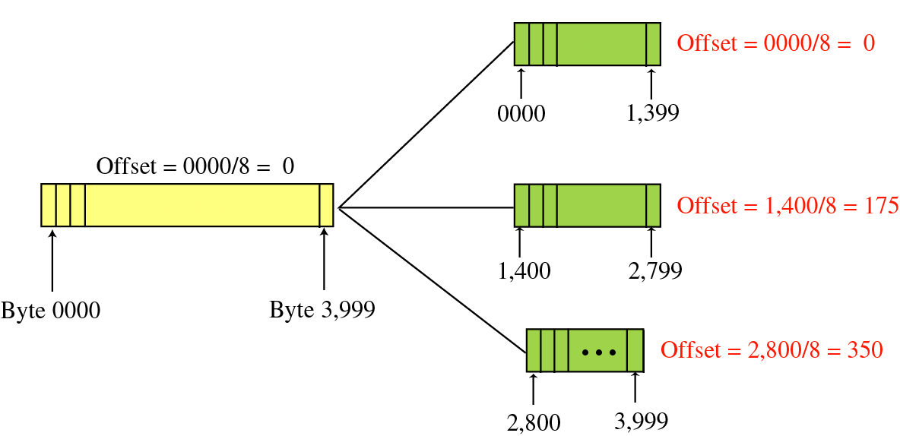
Figure 8-8
Fragmentation example

Slide 24
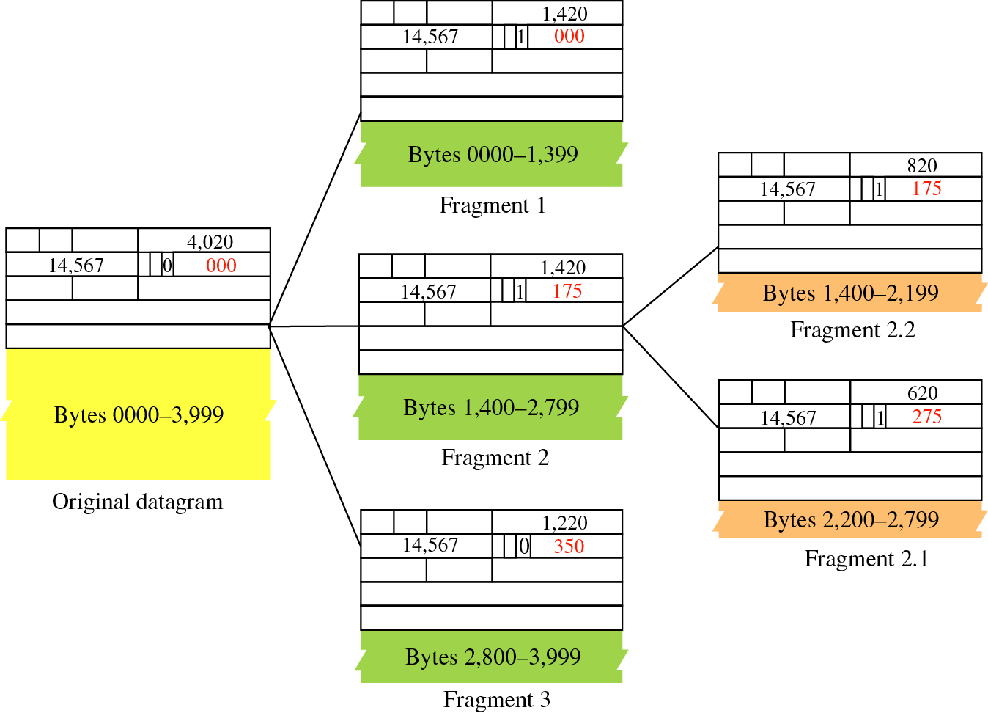
Figure 8-9
Detailed
example

Slide 25
Example 5
A packet has arrived with an M bit value of 0. Is this the first fragment, the last fragment, or a middle fragment? Do we know if the packet was fragmented?

Slide 26
Solution
If the M bit is 0, it means that there are no more fragments; the fragment is the last one. However, we cannot say if the original packet was fragmented or not. A nonfragmented packet is considered the last fragment.

Slide 27
Example 6
A packet has arrived with an M bit value of 1. Is this the first fragment, the last fragment, or a middle fragment? Do we know if the packet was fragmented?

Slide 28
Solution
If the M bit is 1, it means that there is at least one more fragment. This fragment can be the first one or a middle one, but not the last one. We don’t know if it is the first one or a middle one; we need more information (the value of the fragmentation offset). However, we can definitely say the original packet has been fragmented because the M bit value is 1.

Slide 29
Example 7
A packet has arrived with an M bit value of 1 and a fragmentation offset value of zero. Is this the first fragment, the last fragment, or a middle fragment?

Slide 30
Solution
Because the M bit is 1, it is either the first fragment or a middle one. Because the offset value is 0, it is the first fragment.

Slide 31
Example 8
A packet has arrived in which the offset value is 100. What is the number of the first byte? Do we know the number of the last byte?

Slide 32
Solution
To find the number of the first byte, we multiply the offset value by 8. This means that the first byte number is 800. We cannot determine the number of the last byte unless we know the length of the data.

Slide 33
Example 9
A packet has arrived in which the offset value is 100, the value of HLEN is 5 and the value of the total length field is 100. What is the number of the first byte and the last byte?

Slide 34
Solution
The first byte number is 100 × 8 = 800. The total length is 100 bytes and the header length is 20 bytes (5 × 4), which means that there are 80 bytes in this datagram. If the first byte number is 800, the last byte number must 879.

Slide 35
8.3
OPTIONS

Slide 36
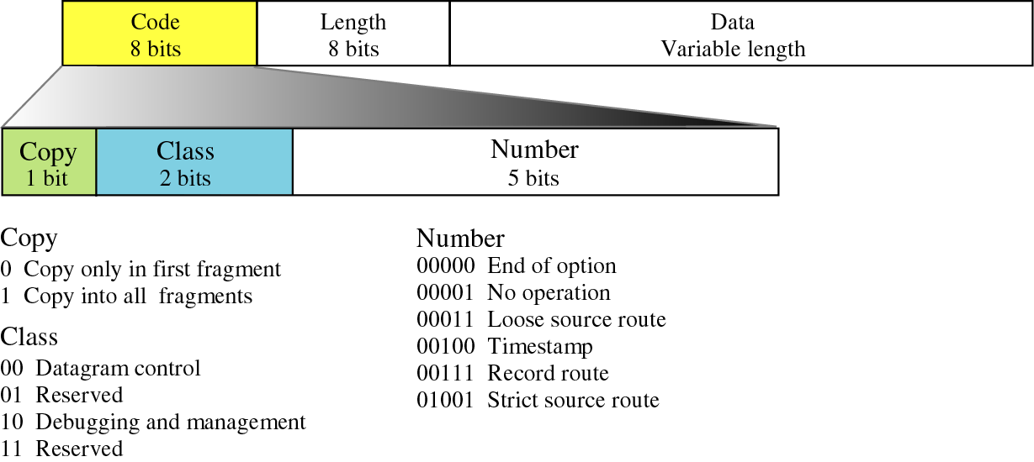
Figure 8-10
Option format

Slide 37
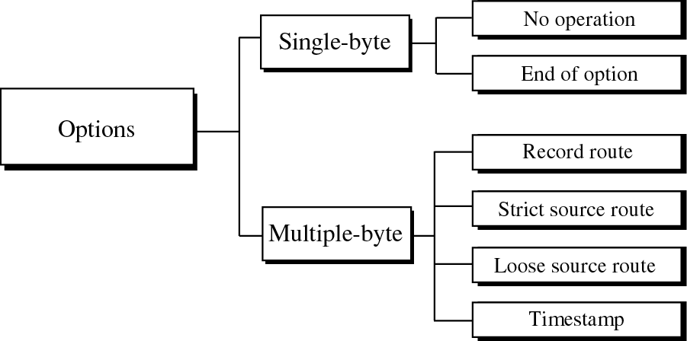
Figure 8-11
Categories of options

Slide 38
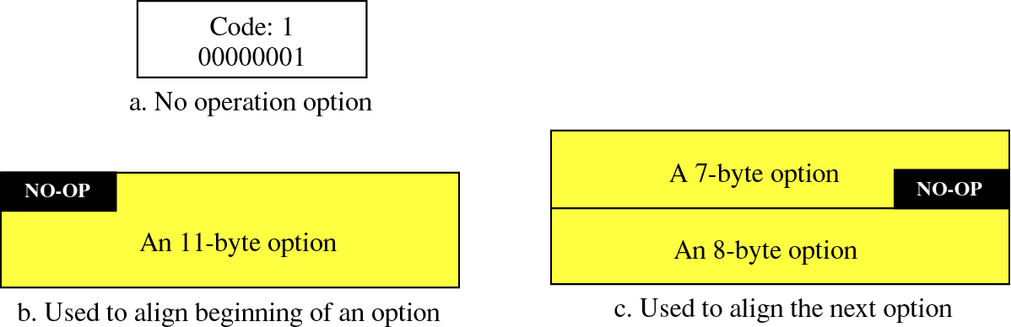
Figure 8-12
No operation option

Slide 39
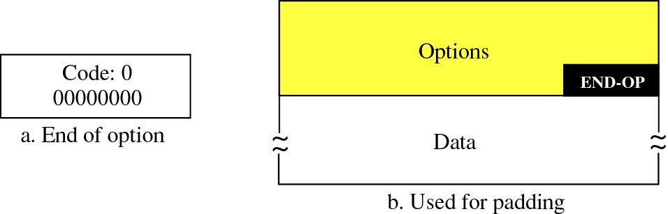
Figure 8-13
End of option option

Slide 40
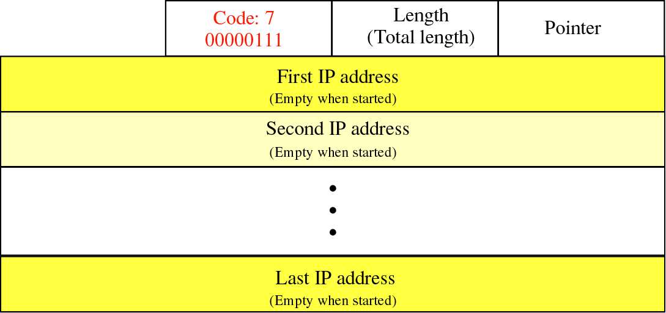
Figure 8-14
Record route option

Slide 41
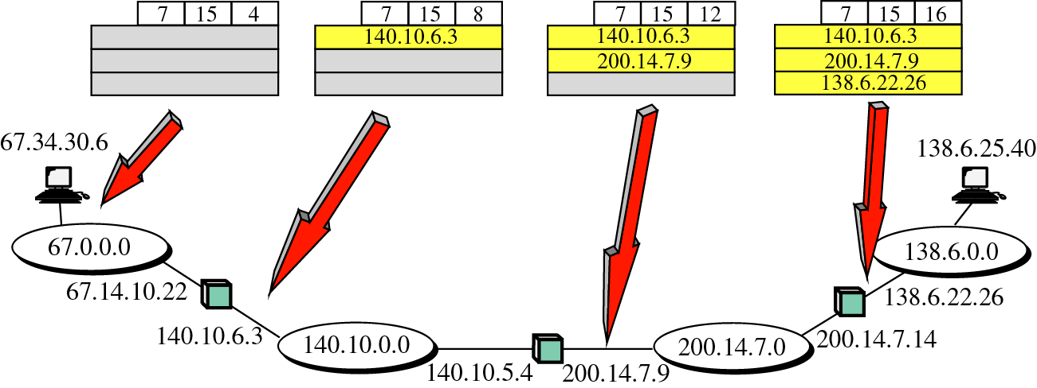
Figure 8-15
Record route concept

Slide 42
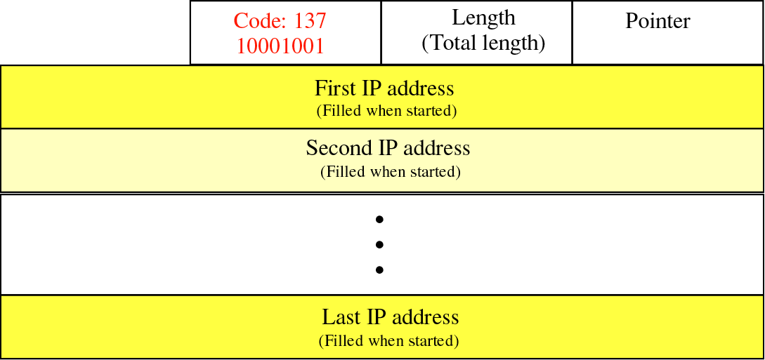
Figure 8-16
Strict source route option

Slide 43
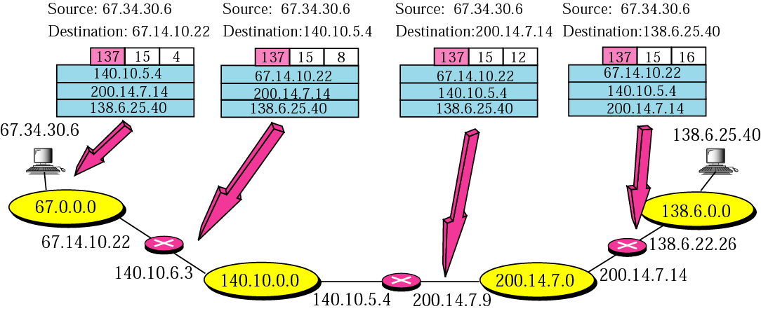
Figure 8-17
Strict source route concept

Slide 44
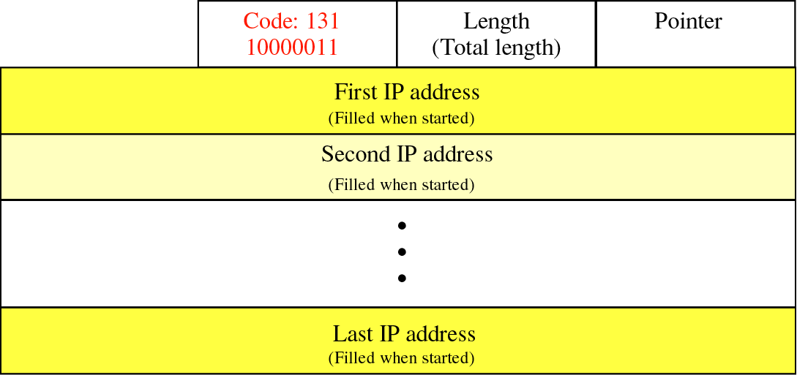
Figure 8-18
Loose source route option

Slide 45
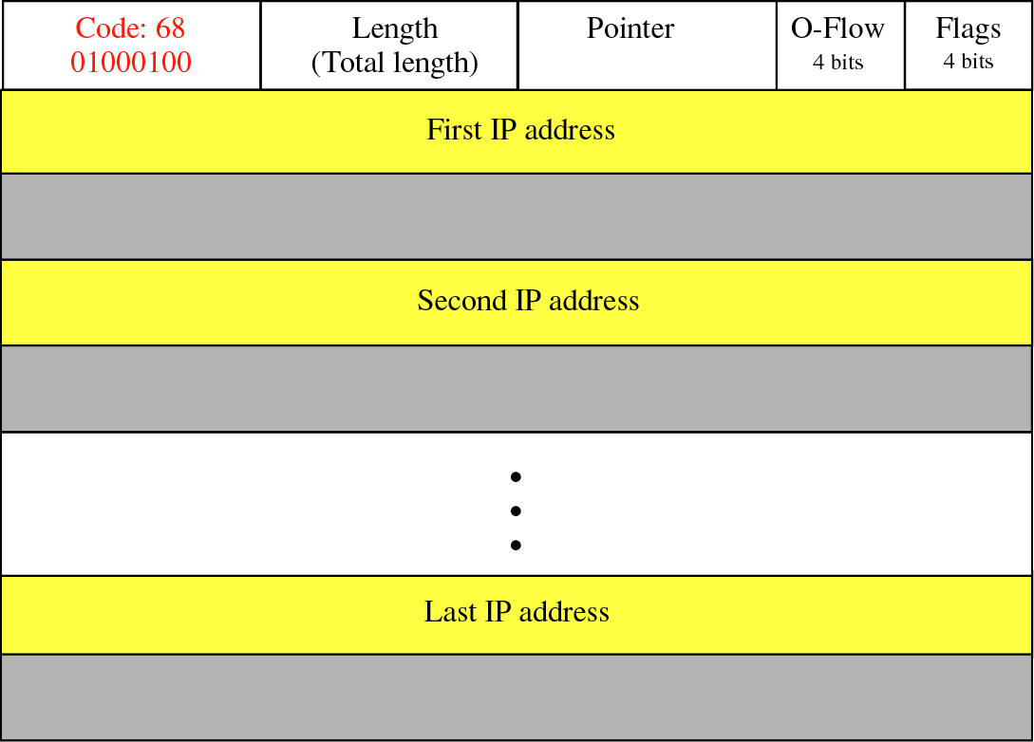
Figure 8-19
Timestamp option

Slide 46
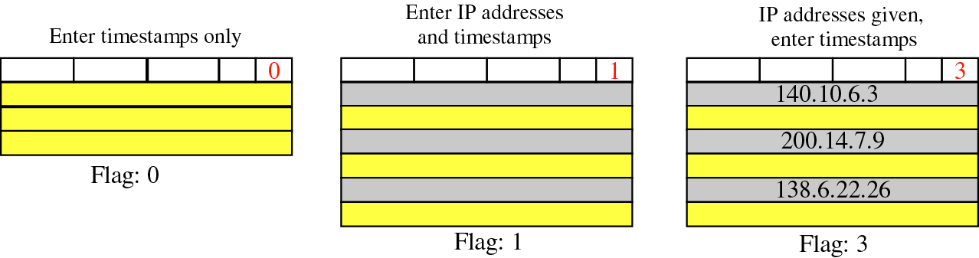
Figure 8-20
Use of flag in timestamp

Slide 47
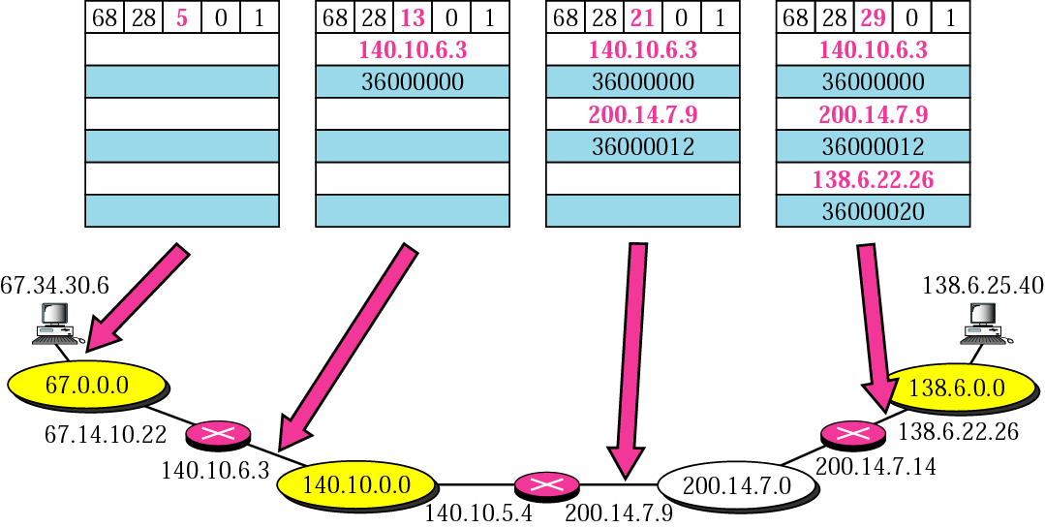
Figure 8-21
Timestamp concept

Slide 48
Example 10
Which of the six options must be copied to each fragment?

Slide 49
Solution
We look at the first (left-most) bit of the code for each option.
No operation: Code is 00000001; no copy.
End of option: Code is 00000000; no copy.
Record route: Code is 00000111; no copy.
Strict source route: Code is 10001001; copied.
Loose source route: Code is 10000011; copied.
Timestamp: Code is 01000100; no copy.

Slide 50
Example 11
Which of the six options are used for datagram control and which are used for debugging and management?

Slide 51
Solution
We look at the second and third (left-most) bits of the code.
No operation: Code is 00000001; control.
End of option: Code is 00000000; control.
Record route: Code is 00000111; control.
Strict source route: Code is 10001001; control.
Loose source route: Code is 10000011; control.
Timestamp: Code is 01000100; debugging

Slide 52
8.4
CHECKSUM

Slide 53
To create the checksum the sender does
the following:
    1. The packet is divided into k sections,
    each of n bits.
    2. All sections are added together using
    one’s complement arithmetic.
    3. The final result is complemented
    to make the checksum.

Slide 54
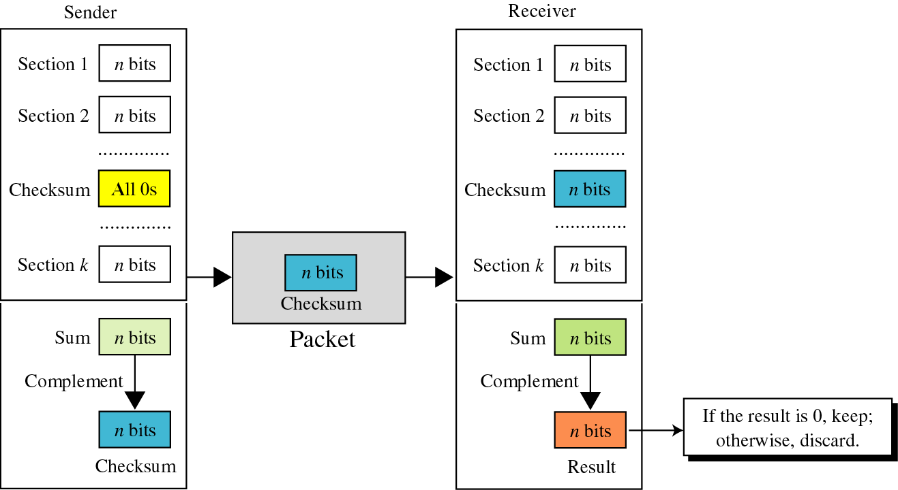
Figure 8-22
Checksum concept

Slide 55
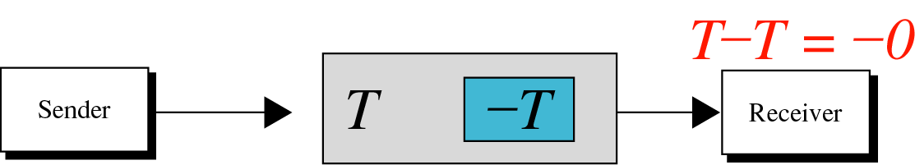
Figure 8-23
Checksum in one’s complement arithmetic

Slide 56
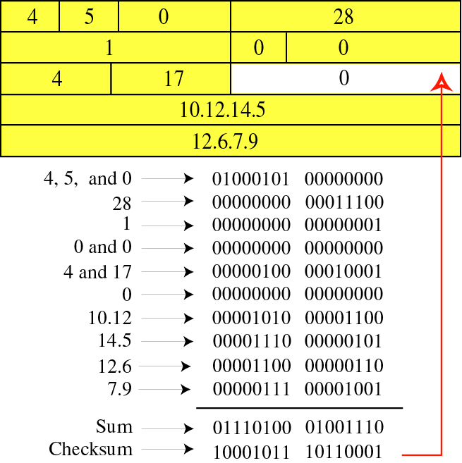
Figure 8-24
Example of
checksum
calculation
in binary

Slide 57
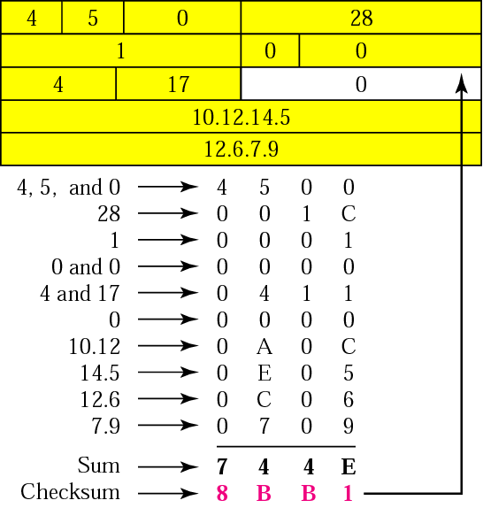
Figure 8-25
Example of
checksum
calculation
in
hexadecimal

Slide 58
Check Appendix C for a detailed
description of checksum calculation
and the handling of carries.

Slide 59
8.5
IP PACKAGE

Slide 60
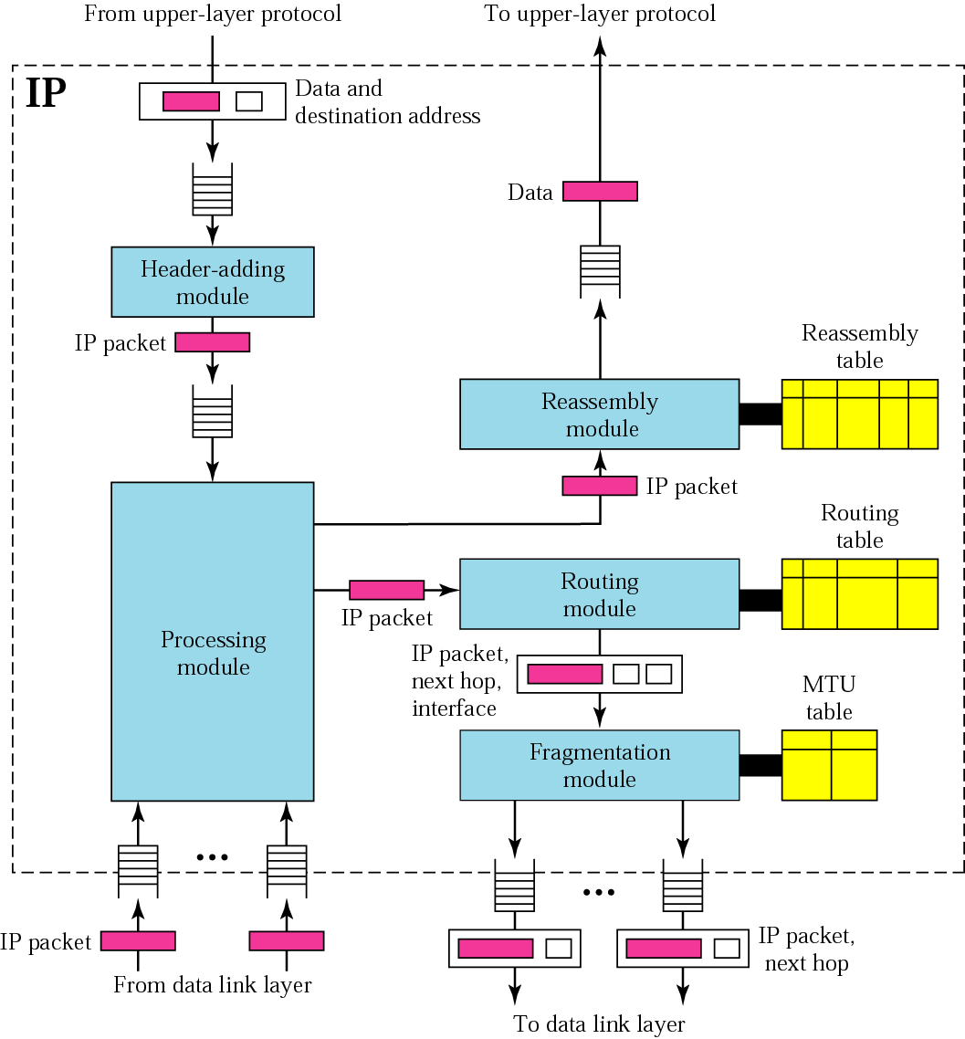
Figure 8-26
IP
components

Slide 61
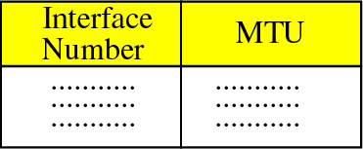
Figure 8-27
MTU table

Slide 62
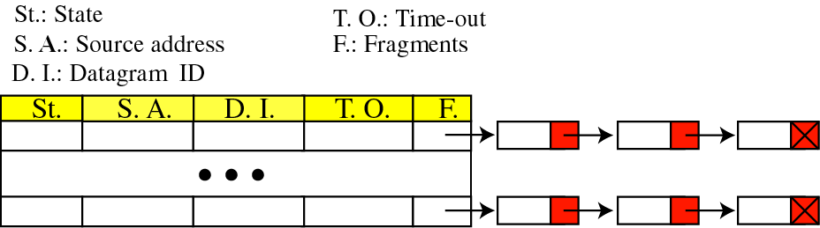
Figure 8-28
Reassembly table

