Slide 1
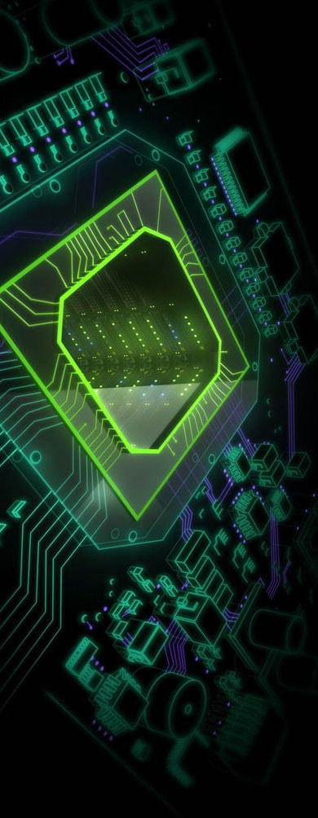
Digital Electronics
Introduction Lecture
Mahdi Fazeli
Associate Professor
Department of Computer Engineering
Iran University of Science and Technology

Slide 2


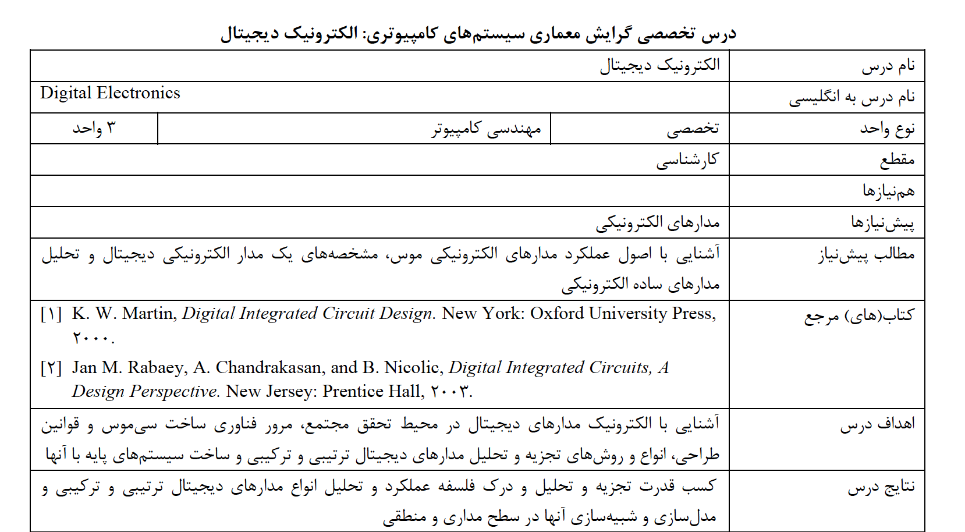
Course Syllabus (MSRT)
Syllabus
Text Books
Grading Policy
Digital Electronics
Mahdi Fazeli

Slide 3
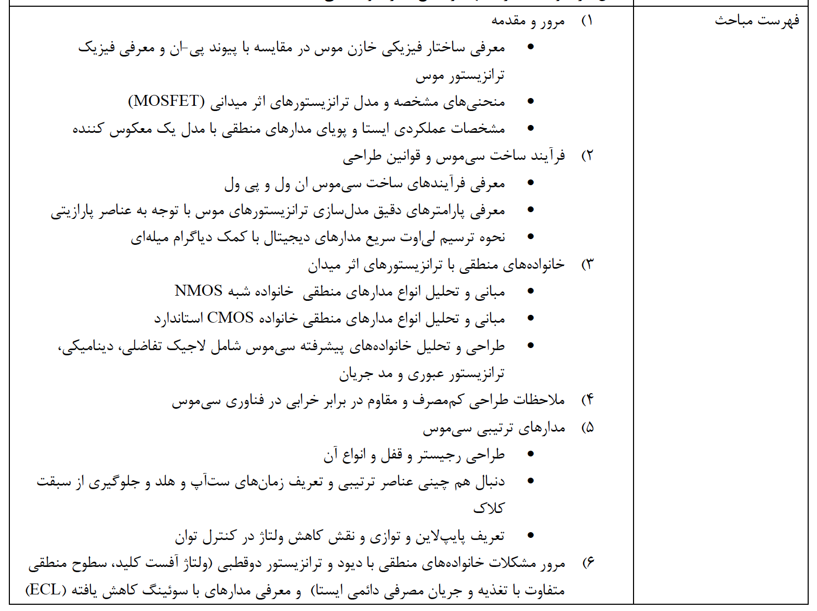
Course Syllabus (MSRT)
Syllabus
Text Books
Grading Policy
Digital Electronics
Mahdi Fazeli

Slide 4
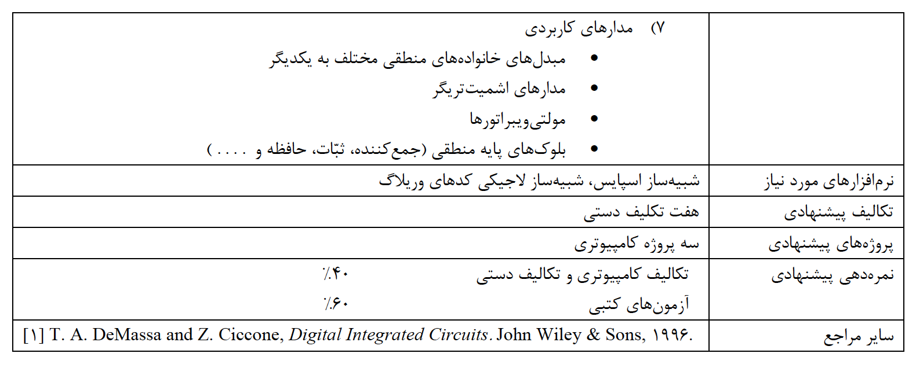
Course Syllabus (MSRT)
Syllabus
Text Books
Grading Policy
Digital Electronics
Mahdi Fazeli

Slide 5
Course Syllabus (MSRT)
Syllabus
Text Books
Grading Policy
Digital Electronics
Mahdi Fazeli

Slide 6
Course Syllabus (Our Course)
Basic Principle: The Field-Effect Principle, The Inversion-Layer MOS Transistor, Derivation of Simple MOS Formulae, Different Types of MOS Transistors, Parasitic MOS Transistors, Capacitances in MOS Structures
MOS Device: Carrier Mobility Reduction, Channel Length Modulation, Short-Channel Effects, MOS Transistor Leakage Mechanisms, MOS Transistor Models and Simulation, Manufacture of MOS Devices
CMOS Circuits: The Basic nMOS Inverter, Electrical Design of CMOS Circuits, Digital CMOS Circuits, CMOS Input and Output (I/O) Circuits, The Layout Process,
Special Circuits, Devices and Technologies: Resistor–Transistor Logic (RTL), Diode–Transistor Logic (DTL), Transistor–Transistor Logic (TTL), BICMOS Circuits,
Memories: Serial Memories, Content-Addressable Memories (CAM), Random-Access Memories (RAM), Non-volatile Memories, Embedded Memories,
Very Large Scale Integration (VLSI) and ASICs: Abstraction Levels for VLSI, Digital VLSI Design, The use of ASICs, Silicon Realization of VLSI and ASICs
Syllabus
Text Books
Grading Policy
Digital Electronics
Mahdi Fazeli

Slide 7
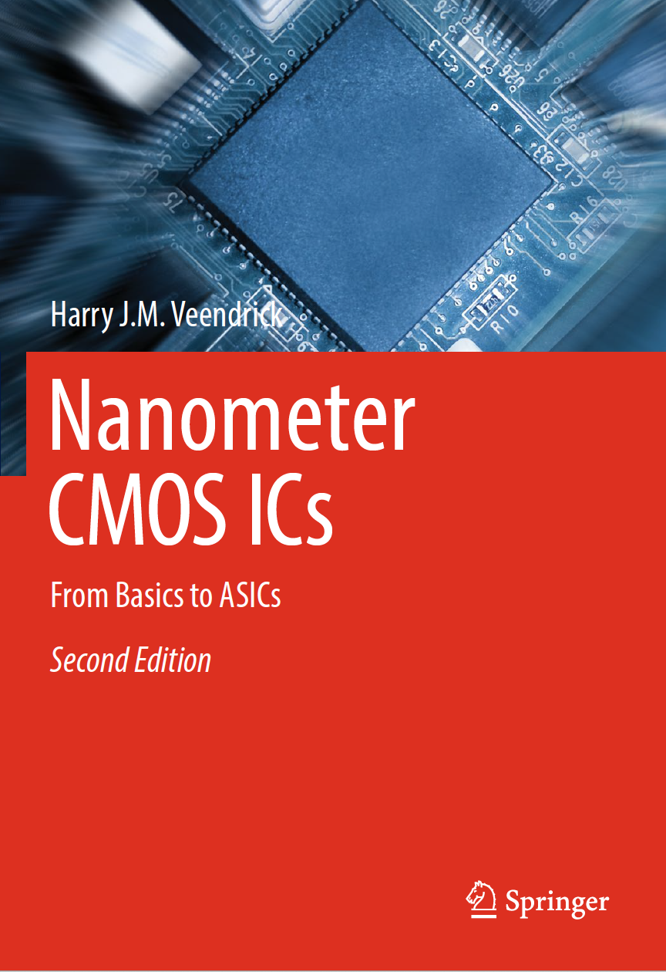
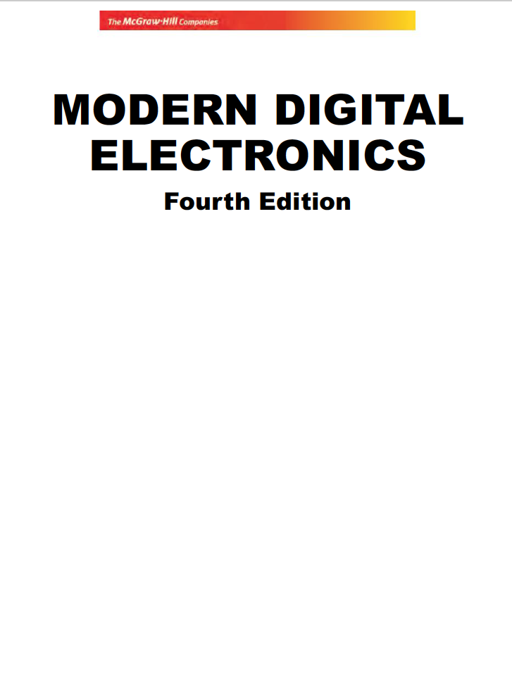
Text Books
Harry J.M. Veendrick (auth.) - Nanometer CMOS ICs_ From Basics to ASICs-Springer International Publishing (2017)
Jain - Modern Digital Electronics, 4th Edition-Mc Graw Hill India (2012)
Thomas A. DeMassa, Zack Ciccone - Digital Integrated Circuits-Wiley (1995)
Syllabus
Text Books
Grading Policy
Digital Electronics
Mahdi Fazeli

Slide 8
Grading Policies
Home work ( 10% )
Mid-term exam ( 20% )
Final exam ( 60% )
Project ( 10% )
Syllabus
Text Books
Grading Policy
Digital Electronics
Mahdi Fazeli

