Slide 1
Lecture 1
Introduction

Slide 2
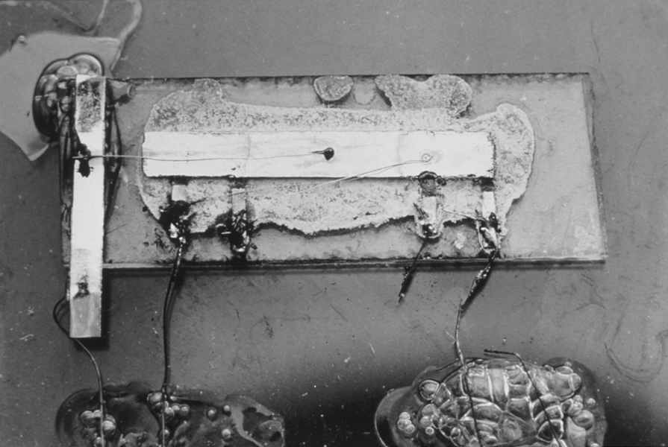
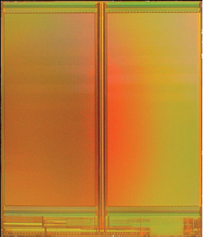
A Brief History
1958: First integrated circuit
  Flip-flop using two transistors
  Built by Jack Kilby at Texas Instruments
2010
  Intel Core i7 μprocessor
    2.3 billion transistors
  64 Gb Flash memory
    > 16 billion transistors
Courtesy Texas Instruments
[Trinh09]
© 2009 IEEE
1: Circuits & Layout

Slide 3
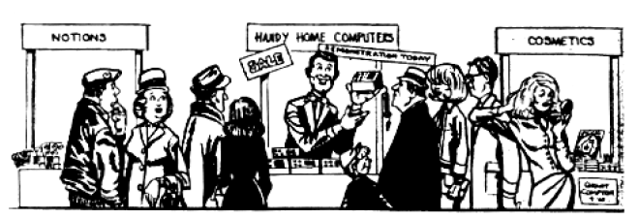
Growth Rate
53% compound annual growth rate over 50 years
  No other technology has grown so fast so long
Driven by miniaturization of transistors
  Smaller is cheaper, faster, lower in power!
  Revolutionary effects on society
[Moore65]
Electronics Magazine
1: Circuits & Layout

Slide 4
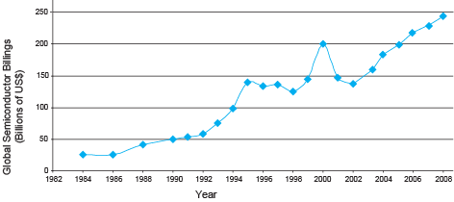
Annual Sales
>10¹⁹ transistors manufactured in 2008
  1 billion for every human on the planet
1: Circuits & Layout

Slide 5
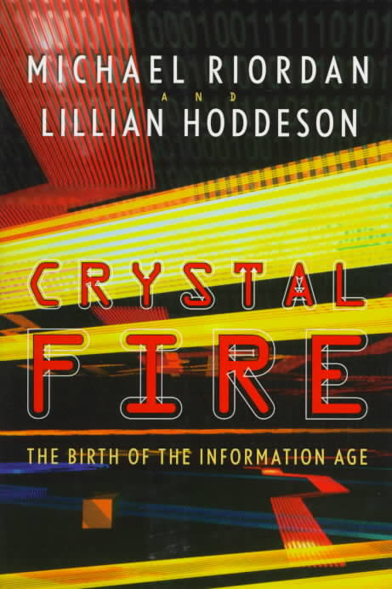
Invention of the Transistor
Vacuum tubes ruled in first half of 20th century Large, expensive, power-hungry, unreliable
1947: first point contact transistor
  John Bardeen and Walter Brattain at Bell Labs
  See Crystal Fire by Riordan, Hoddeson
Without a doubt, the transistor is the most important artifact of the twentieth century and the "nerve cell" of our electronic age. Crystal Fire recounts the story of the transistor team at Bell Labs headed up by William Shockley who shared the Nobel Prize with John Bardeen and Walter Brattain.
1: Circuits & Layout

Slide 6
Transistor Types
Bipolar transistors
  npn or pnp silicon structure
  Small current into very thin base layer controls large currents between emitter and collector
  Base currents limit integration density
Metal Oxide Semiconductor Field Effect Transistors
  nMOS and pMOS MOSFETS
  Voltage applied to insulated gate controls current between source and drain
  Low power allows very high integration
1: Circuits & Layout

Slide 7
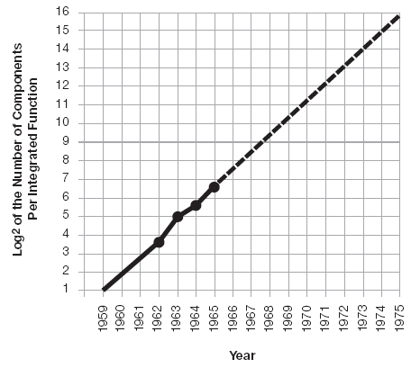
Moore’s Law: Then
1965: Gordon Moore plotted transistor on each chip
  Fit straight line on semilog scale
  Transistor counts have doubled every 18-24 months
Integration Levels
SSI: 10 gates
MSI: 1000 gates
LSI: 10,000 gates
VLSI: > 10k gates
[Moore65]
Electronics Magazine
1: Circuits & Layout

Slide 8
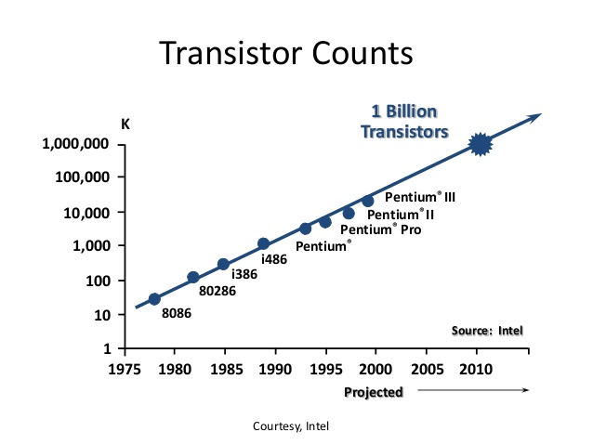
And Now…
1: Circuits & Layout

Slide 9
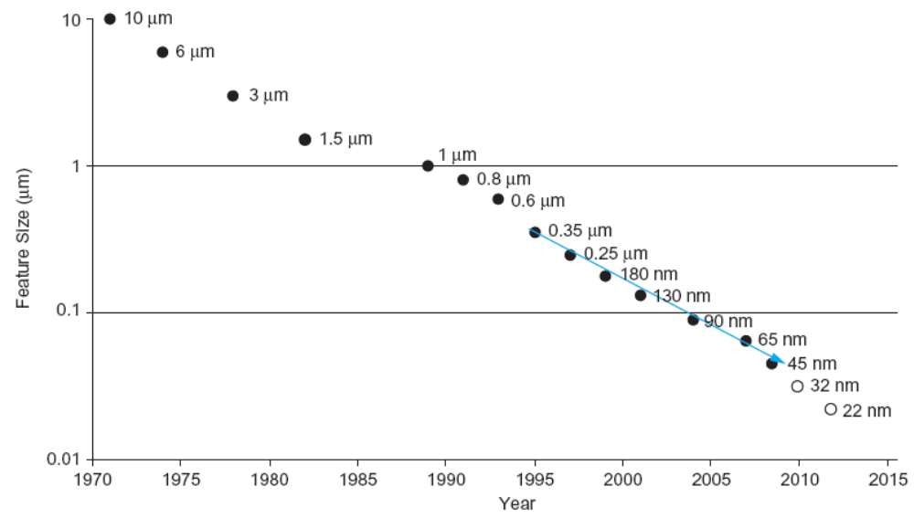
Feature Size
Minimum feature size shrinking 30% every 2-3 years
1: Circuits & Layout

Slide 10
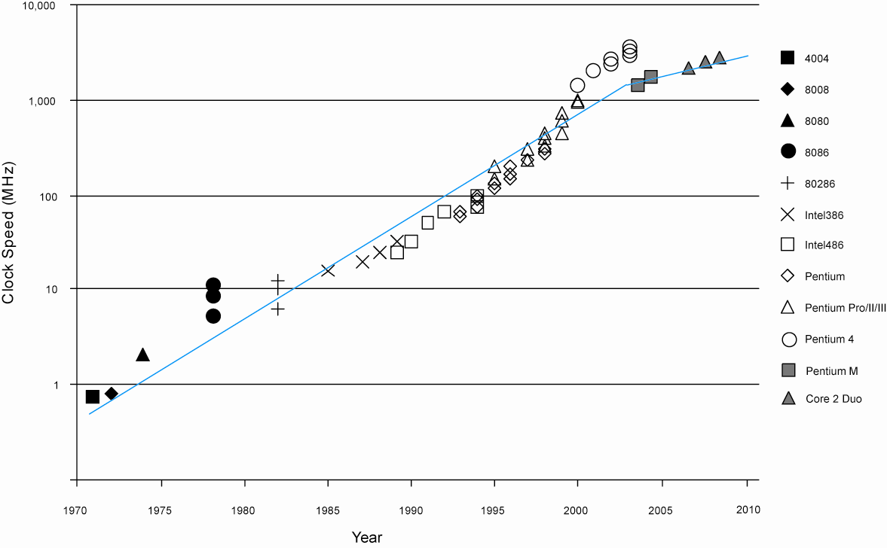
Corollaries
Many other factors grow exponentially
  Ex: clock frequency, processor performance
1: Circuits & Layout

Slide 11
Transistor Counts
1 Billion Transistors
K
1,000,000
100,000
Pentium® III
10,000
Pentium® II
Pentium® Pro
1,000
Pentium®
i486
100
i386
80286
10
8086
Source: Intel
1
1975
1980
1985
1990
1995
2000
2005
2010
Projected
Courtesy, Intel

Slide 12
Moore’s law in Microprocessors
1000
100
2X growth in 1.96 years!
10
P6
Transistors (MT)
Pentium® proc
1
486
386
0.1
286
Transistors on Lead Microprocessors double every 2 years
8085
8086
0.01
8080
8008
0.001
4004
1970
1980
1990
2000
2010
Year
Courtesy, Intel

Slide 13
Power Dissipation
100
P6
Pentium ® proc
10
286
486
Power (Watts)
8086
386
8085
1
8080
8008
4004
0.1
1971
1974
1978
1985
1992
2000
Year
Lead Microprocessors power continues to increase
Courtesy, Intel

Slide 14
Power will be a major problem
100000
18KW
10000
5KW
1.5KW
1000
500W
Pentium® proc
Power (Watts)
100
286
486
10
8086
386
8085
8080
1
8008
4004
0.1
1971
1974
1978
1985
1992
2000
2004
2008
Year
Power delivery and dissipation will be prohibitive
Courtesy, Intel

Slide 15
Power Density
10000
Rocket
Nozzle
1000
Nuclear
Power Density (W/cm2)
Reactor
100
8086
10
4004
Hot Plate
P6
8008
8085
386
Pentium® proc
8080
286
486
1
1970
1980
1990
2000
2010
Year
Power density too high to keep junctions at low temp
Courtesy, Intel

Slide 16
Semiconductor essentials: impurities
Small impurities can dramatically change conductivity:
  slight phosphorous contamination in silicon gives many extra free electrons in the material (one per P atom!)
  slight aluminum contamination gives many extra holes (one per Al atom)
P
Al

Slide 17
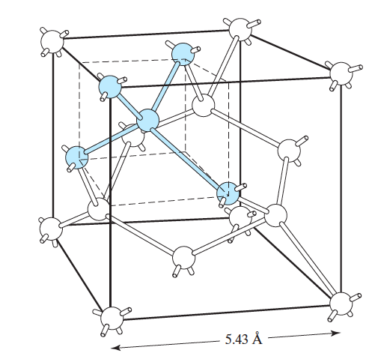
(silicon lattice is of course 3D!)
Notes:
This figure is a bit out of proportion (for reasons of clarity). A silicon atom has an atomic radius of 0.117 nm, or 0.234 nm diameter, while the lattice constant a of the silicon lattice is 0.5 nm. “Heavy” impurities like As and In have an atomic radius only slightly larger than Si, being 0.121 and 0.166 nm respectively. At a glance there seems to be enough space for an impurity to take the place of a Si atom. (The radius of a free atom is larger than the atoms in the lattice.)

Slide 18
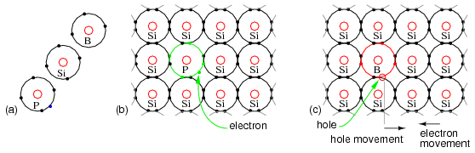
Doping impurities

Slide 19
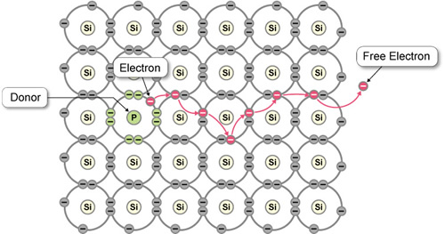
How Current Flow in a Semiconductor
0: Introduction

Slide 20
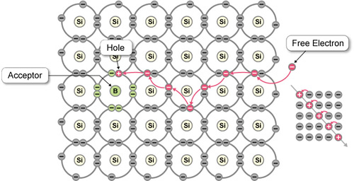
How Current Flow in a Semiconductor
0: Introduction

Slide 21
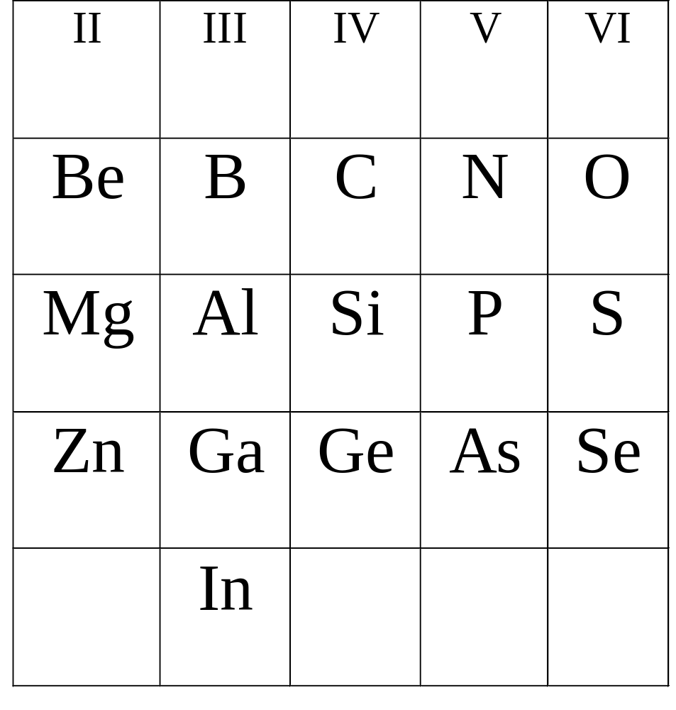
Silicon dopants
Boron most widely used
as p-type dopant;
Phosphorous and arsenic
both used widely as n-type
dopant

Slide 22
Semiconductor essentials: n and p type
n-type doped semiconductor
e.g. silicon with phosphorus impurity
electrons determine conductivity
p-type doped semiconductor
e.g. silicon with Al impurity
holes determine conductivity
p-n junction:
current can only flow one way!
Semiconductor diode

Slide 23
The field effect
+ + + + + + + +
accumulation
- - - -
depletion
- - - - - - - - - -
inversion

