Slide 1
Lecture 2
CMOS Transistor Theory

Slide 2
Outline
Introduction
MOS Capacitor
nMOS I-V Characteristics
pMOS I-V Characteristics
Gate and Diffusion Capacitance
3: CMOS Transistor Theory

Slide 3
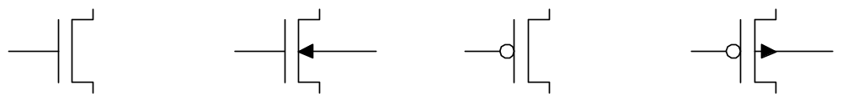
Introduction
So far, we have treated transistors as ideal switches
An ON transistor passes a finite amount of current
  Depends on terminal voltages
  Derive current-voltage (I-V) relationships
Transistor gate, source, drain all have capacitance
  I = C (ΔV/Δt) -> Δt = (C/I) ΔV
  Capacitance and current determine speed
3: CMOS Transistor Theory

Slide 4
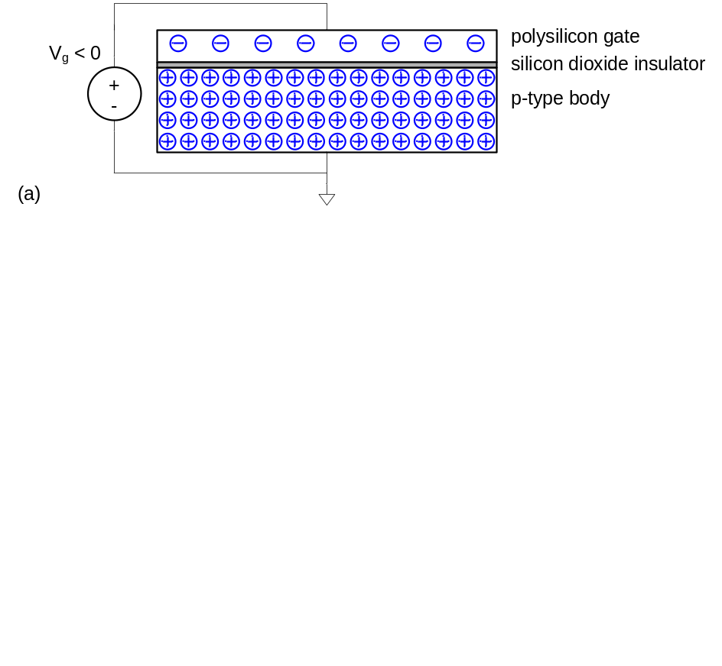
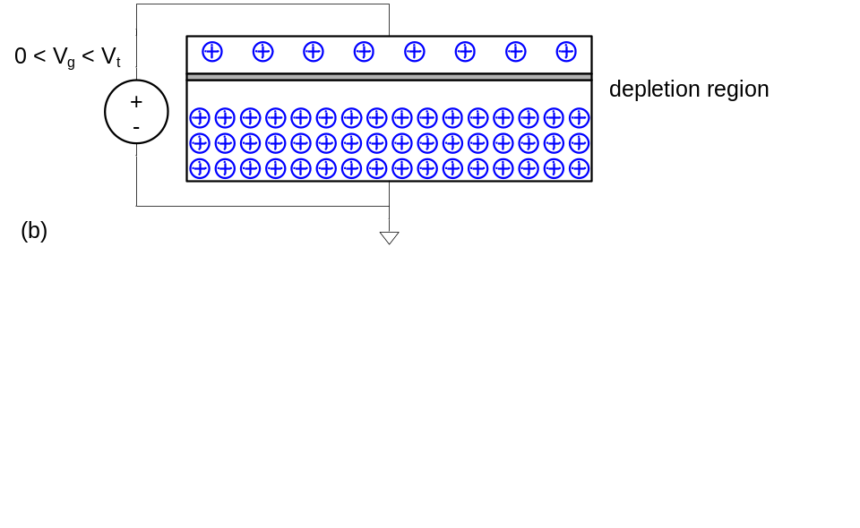
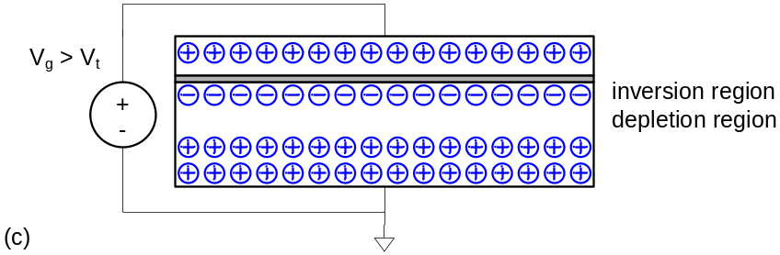
MOS Capacitor
Gate and body form MOS capacitor
Operating modes
  Accumulation
  Depletion
  Inversion
3: CMOS Transistor Theory

Slide 5
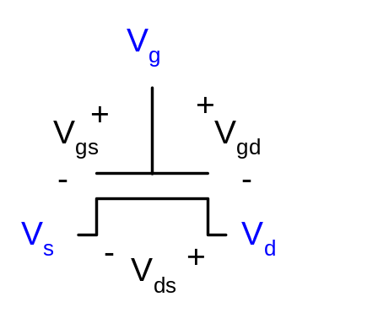
Terminal Voltages
Mode of operation depends on V_{g}, V_{d}, V_{s}
  V_{gs} = V_{g} – V_{s}
  V_{gd} = V_{g} – V_{d}
  V_{ds} = V_{d} – V_{s} = V_{gs} - V_{gd}
Source and drain are symmetric diffusion terminals
  By convention, source is terminal at lower voltage
  Hence V_{ds} ≥ 0
nMOS body is grounded. First assume source is 0 too.
Three regions of operation
  Cutoff
  Linear
  Saturation
3: CMOS Transistor Theory

Slide 6
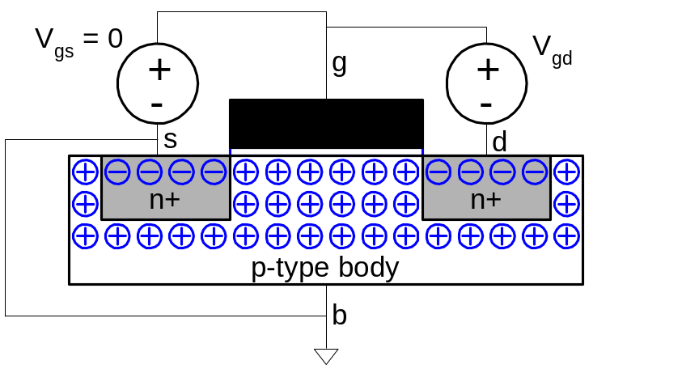
nMOS Cutoff
No channel
I_{ds} ≈ 0
3: CMOS Transistor Theory

Slide 7
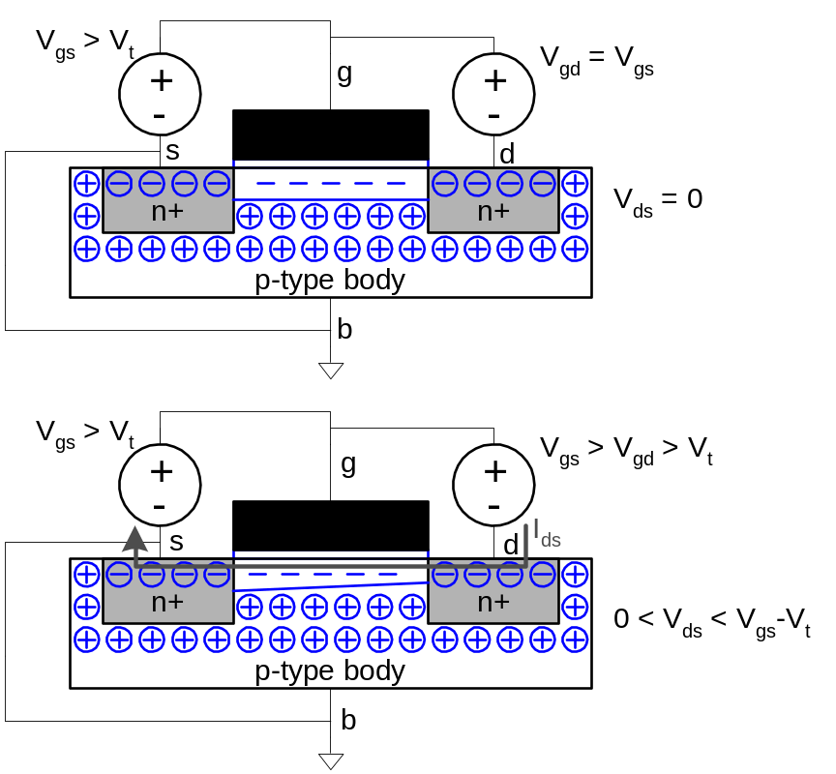
nMOS Linear
Channel forms
Current flows from d to s
  e⁻ from s to d
I_{ds} increases with V_{ds}
Similar to linear resistor
3: CMOS Transistor Theory

Slide 8
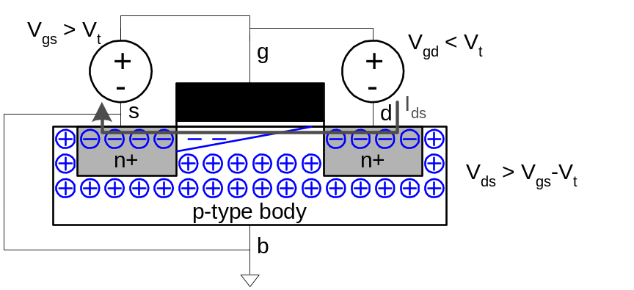
nMOS Saturation
Channel pinches off
I_{ds} independent of V_{ds}
We say current saturates
Similar to current source
3: CMOS Transistor Theory

Slide 9
I-V Characteristics
In Linear region, I_{ds} depends on
  How much charge is in the channel?
  How fast is the charge moving?
3: CMOS Transistor Theory

Slide 10
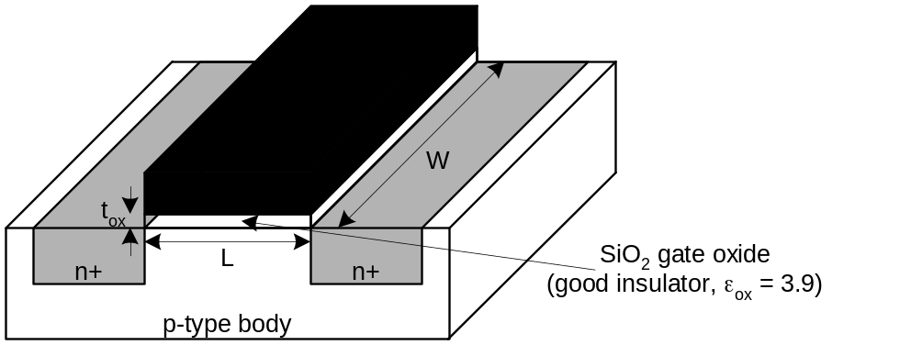
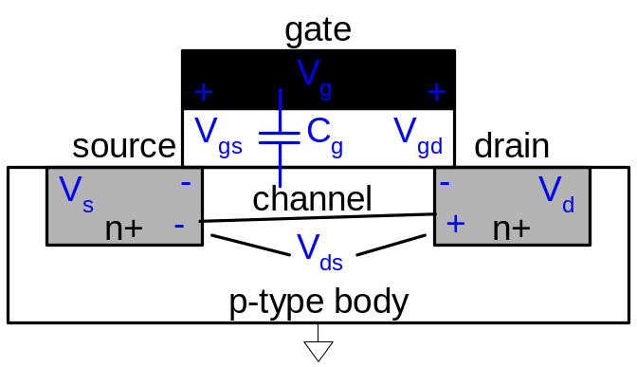
Channel Charge
MOS structure looks like parallel plate capacitor while operating in inversions
  Gate – oxide – channel
Q_{channel} = CV
C = C_{g} = ε_{ox}WL/t_{ox} = C_{ox}WL
V = V_{gc} – V_{t} = (V_{gs} – V_{ds}/2) – V_{t}
C_{ox} = ε_{ox} / t_{ox}
3: CMOS Transistor Theory

Slide 11
Carrier velocity
Charge is carried by e-
Electrons are propelled by the lateral electric field between source and drain
  E = V_{ds}/L
Carrier velocity v proportional to lateral E-field
  v = μE μ called mobility
Time for carrier to cross channel:
  t = L / v
3: CMOS Transistor Theory

Slide 12
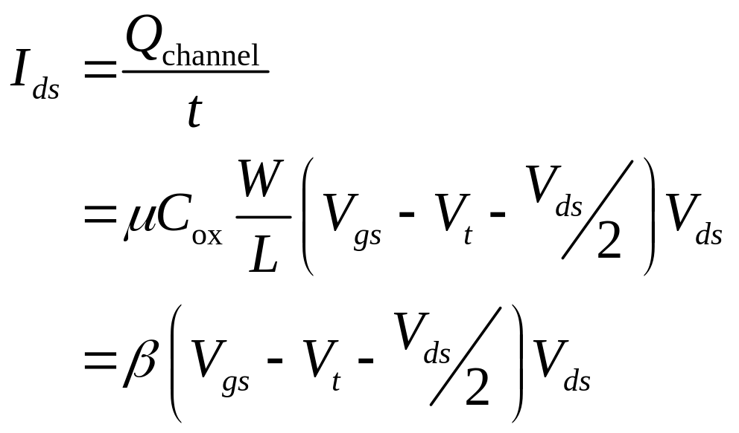
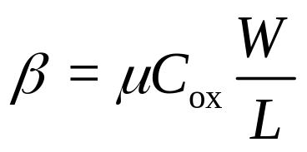
nMOS Linear I-V
Now we know
  How much charge Q_{channel} is in the channel
  How much time t each carrier takes to cross
3: CMOS Transistor Theory

Slide 13
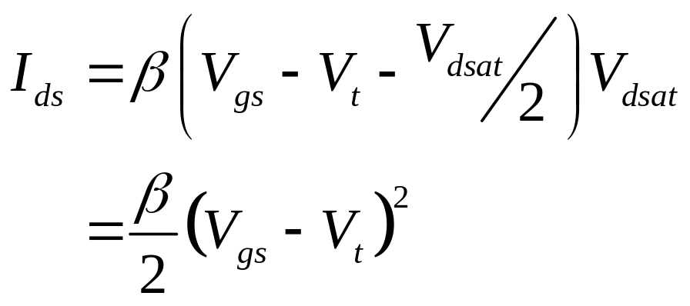
nMOS Saturation I-V
If V_{gd} < V_{t}, channel pinches off near drain
  When V_{ds} > V_{dsat} = V_{gs} – V_{t}
Now drain voltage no longer increases current
3: CMOS Transistor Theory

Slide 14
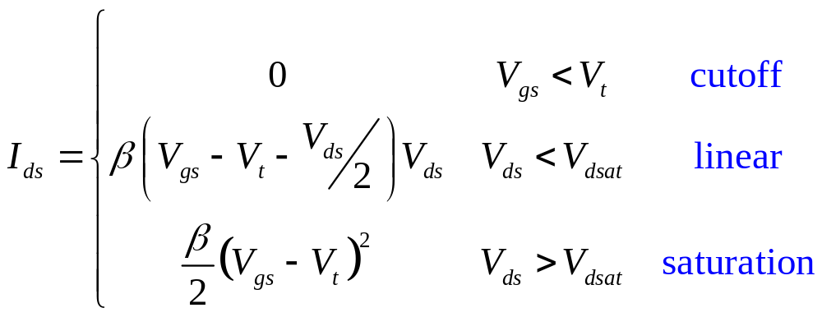
nMOS I-V Summary
Shockley 1st order transistor models
3: CMOS Transistor Theory

Slide 15
Ideal Transistor I-V
Shockley long-channel transistor models
4: Nonideal Transistor Theory

Slide 16
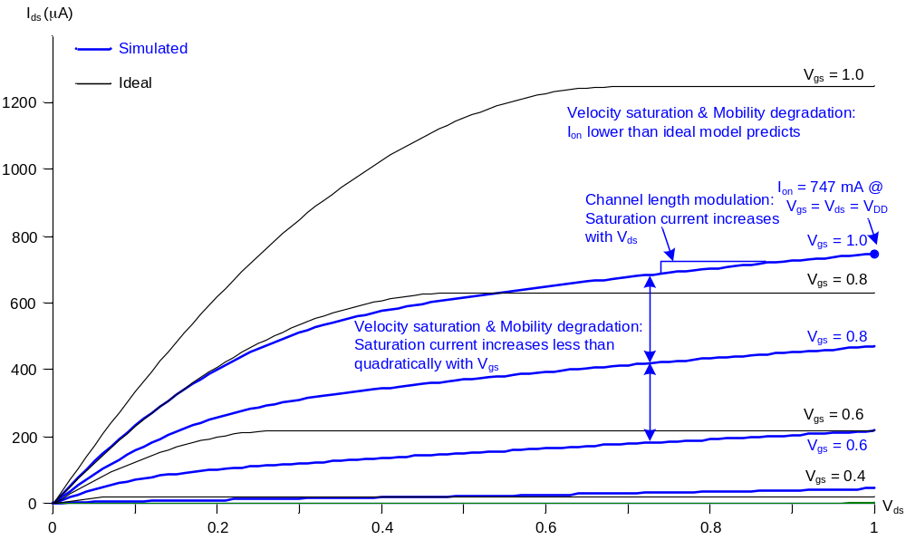
Ideal vs. Simulated nMOS I-V Plot
65 nm IBM process, V_{DD} = 1.0 V
4: Nonideal Transistor Theory

Slide 17
Electric Fields Effects
Vertical electric field: E_{vert} = V_{gs} / t_{ox}
  Attracts carriers into channel
  Long channel: Q_{channel} ∝ E_{vert}
Lateral electric field: E_{lat} = V_{ds} / L
  Accelerates carriers from drain to source
  Long channel: v = μE_{lat}
4: Nonideal Transistor Theory

Slide 18
Coffee Cart Analogy
Tired student runs from VLSI lab to coffee cart
Freshmen are pouring out of the physics lecture hall
V_{ds} is how long you have been up
  Your velocity = fatigue × mobility
V_{gs} is a wind blowing you against the glass (SiO₂) wall
At high V_{gs}, you are buffeted against the wall
  Mobility degradation
At high V_{ds}, you scatter off freshmen, fall down, get up
  Velocity saturation
    Don’t confuse this with the saturation region
4: Nonideal Transistor Theory

Slide 19
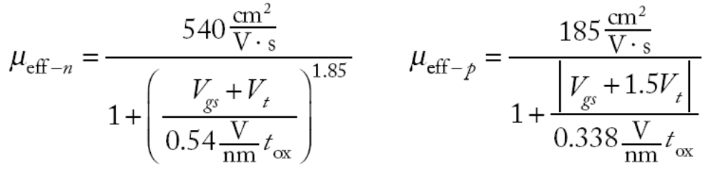
Mobility Degradation
High E_{vert} effectively reduces mobility
  Collisions with oxide interface
4: Nonideal Transistor Theory

Slide 20
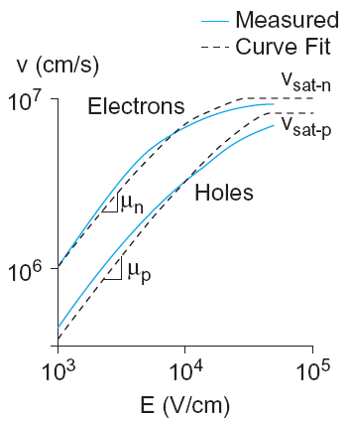
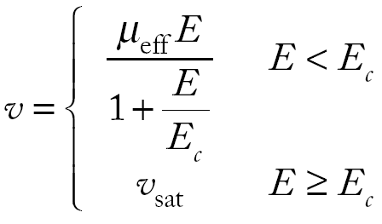
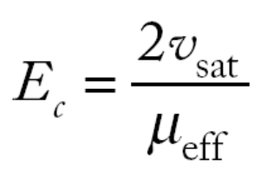
Velocity Saturation
At high E_{lat}, carrier velocity rolls off
  Carriers scatter off atoms in silicon lattice
  Velocity reaches v_{sat}
    Electrons: 10⁷ cm/s
    Holes: 8 x 10⁶ cm/s
  Better model
4: Nonideal Transistor Theory

Slide 21
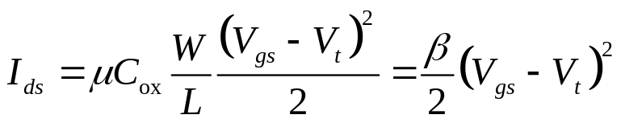
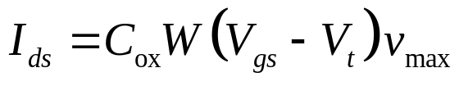
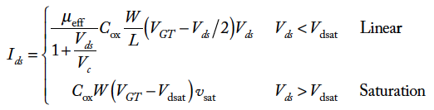
Vel Sat I-V Effects
Ideal transistor ON current increases with V_{DD}²
Velocity-saturated ON current increases with V_{DD}
In linear region:
4: Nonideal Transistor Theory

Slide 22
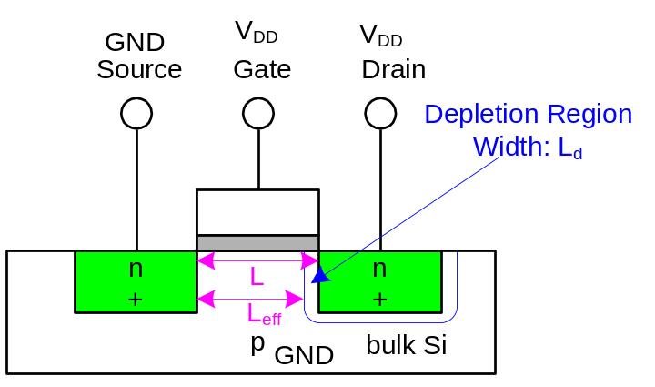
Channel Length Modulation
Reverse-biased p-n junctions form a depletion region
  Region between n and p with no carriers
  Width of depletion L_{d} region grows with reverse bias
  L_{eff} = L – L_{d}
Shorter L_{eff} gives more current
  I_{ds} increases with V_{ds}
  Even in saturation
4: Nonideal Transistor Theory

Slide 23
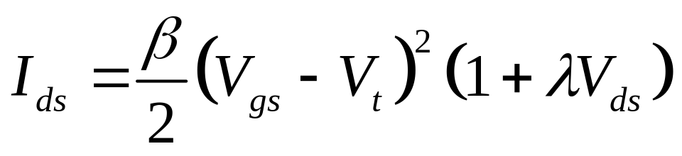
Chan Length Mod I-V
λ = channel length modulation coefficient
  not feature size
  Empirically fit to I-V characteristics
4: Nonideal Transistor Theory

Slide 24

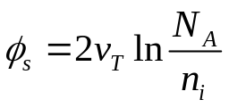
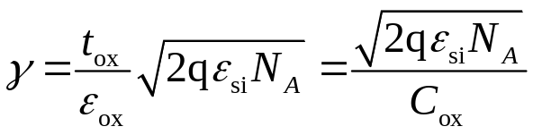
Body Effect
Body is a fourth transistor terminal
V_{sb} affects the charge required to invert the channel
  Increasing V_{s} or decreasing V_{b} increases V_{t}
φ_{s} = surface potential at threshold
  Depends on doping level N_{A}
  And intrinsic carrier concentration n_{i}
γ = body effect coefficient
4: Nonideal Transistor Theory

Slide 25
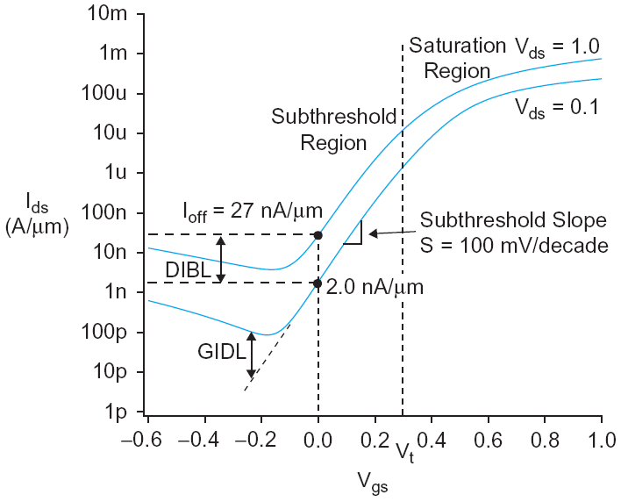
Leakage
What about current in cutoff?
Simulated results
What differs?
  Current doesn’t
  go to 0 in cutoff
4: Nonideal Transistor Theory

Slide 26
Leakage Sources
Subthreshold conduction
  Transistors can’t abruptly turn ON or OFF
  Dominant source in contemporary transistors
Gate leakage
  Tunneling through ultrathin gate dielectric
Junction leakage
  Reverse-biased PN junction diode current
4: Nonideal Transistor Theory

Slide 27
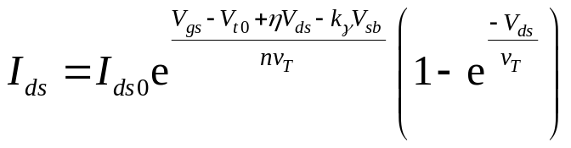
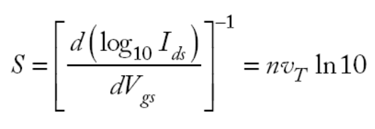
Subthreshold Leakage
Subthreshold leakage exponential with V_{gs}
n is process dependent
  typically 1.3-1.7
Rewrite relative to I_{off} on log scale
S ≈ 100 mV/decade @ room temperature
4: Nonideal Transistor Theory

Slide 28
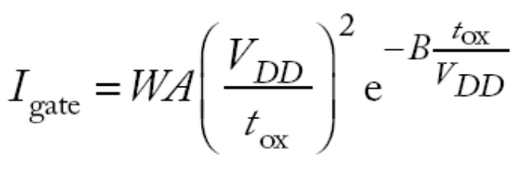
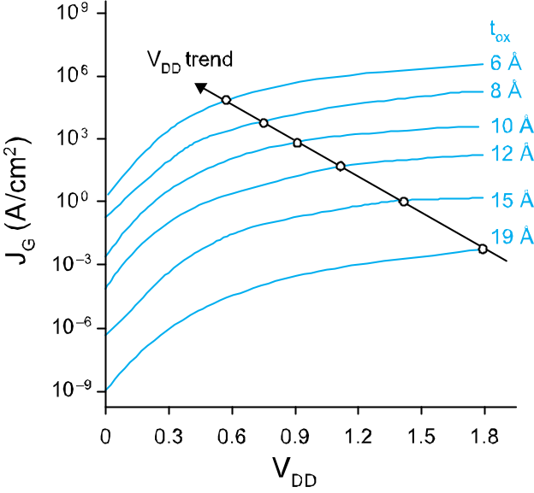
Gate Leakage
Carriers tunnel thorough very thin gate oxides
Exponentially sensitive to t_{ox} and V_{DD}
  A and B are tech constants
  Greater for electrons
    So nMOS gates leak more
Negligible for older processes (t_{ox} > 20 Å)
Critically important at 65 nm and below (t_{ox} ≈ 10.5 Å)
_{From [Song01]}
4: Nonideal Transistor Theory

Slide 29
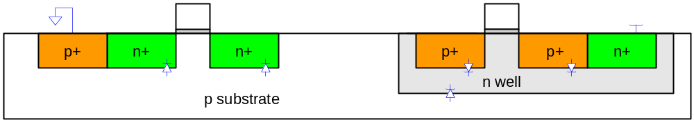
Junction Leakage
Reverse-biased p-n junctions have some leakage
4: Nonideal Transistor Theory

