Slide 1

Memory
Mahdi Fazeli

Slide 2
Outlines
Memroy Type
Memory Access
Reading and Writing
Memory Acess Ports
Data Comunication
Volatile vs Non-Volatime Memories

Slide 3
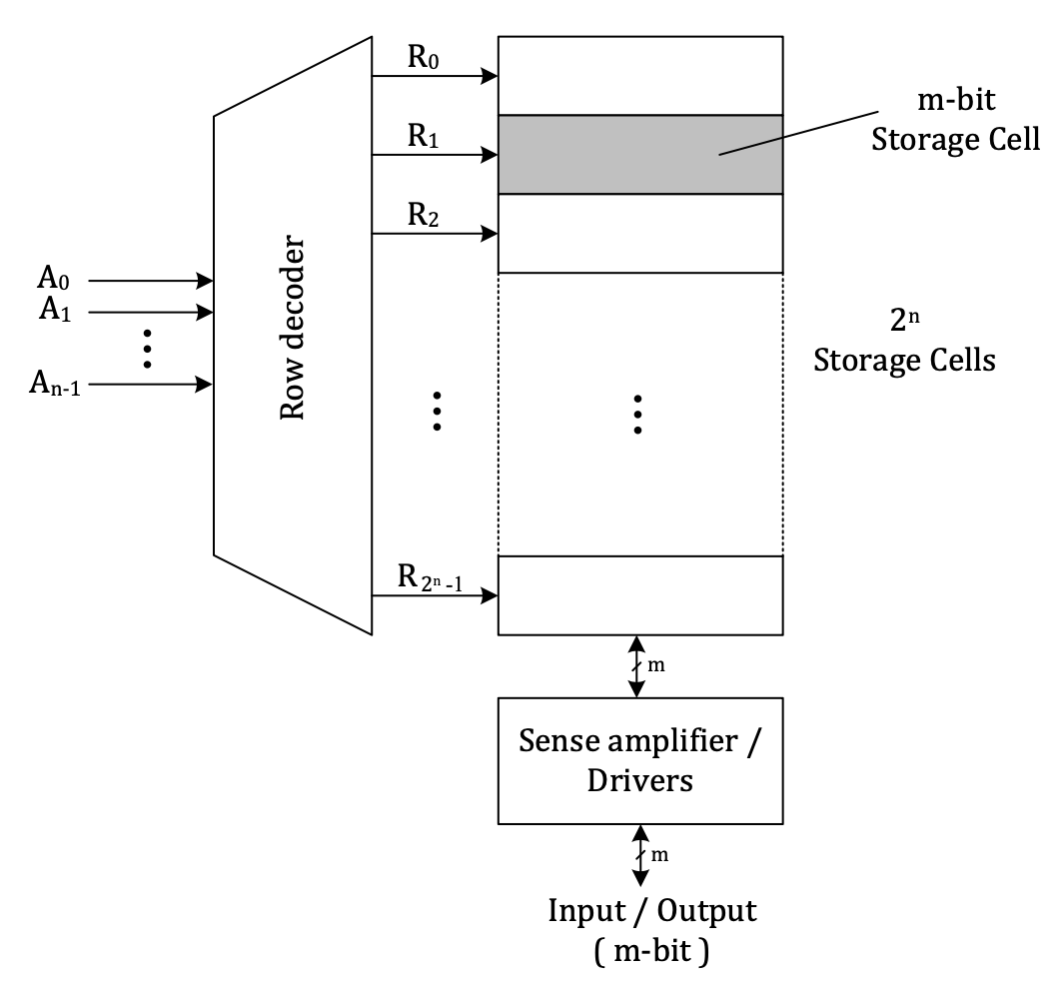
Memory Typical Structure

Slide 4
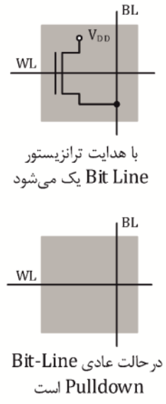
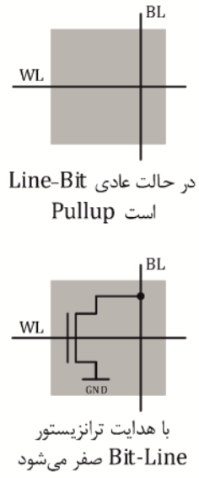
Read Only Memory (ROM)
Masked Rom
User Programmable ROM (PROM)

Slide 5
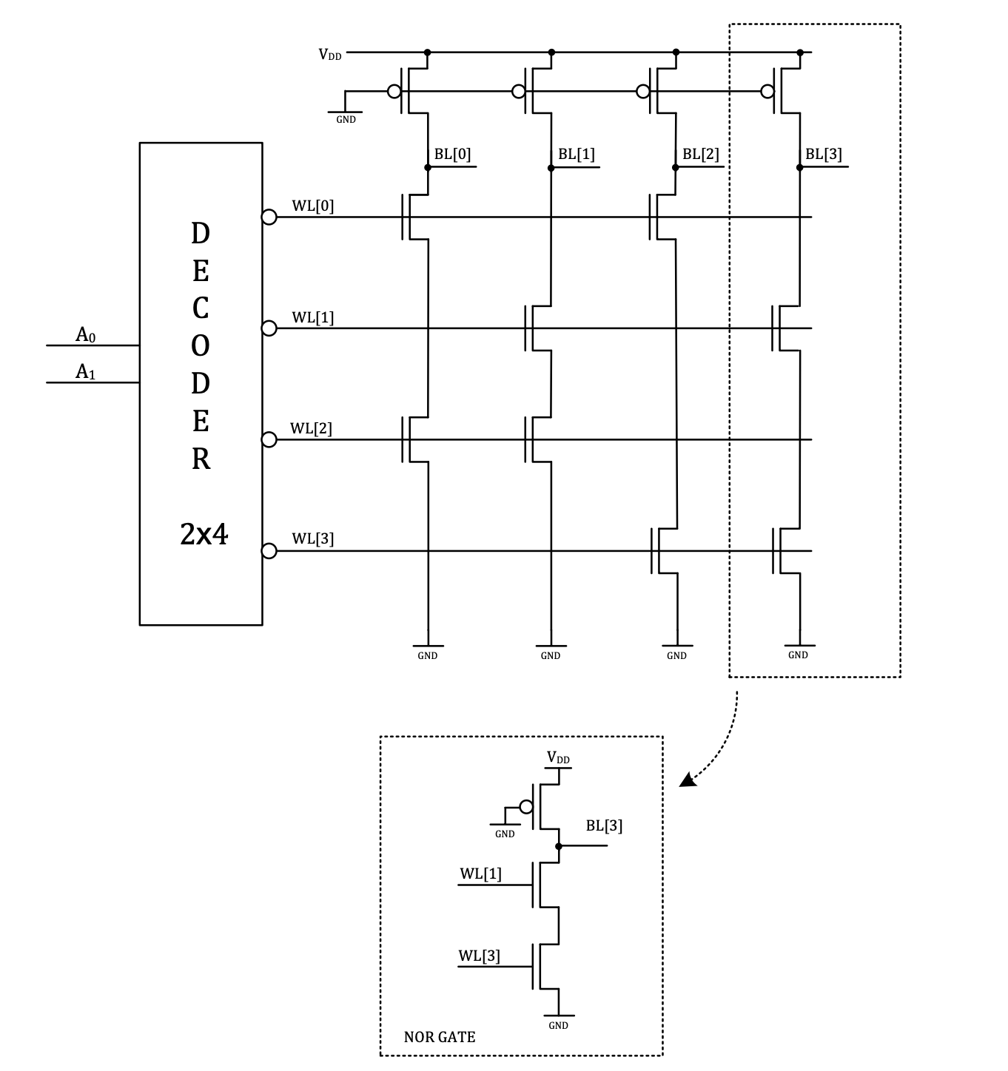
NAND-ROM

Slide 6
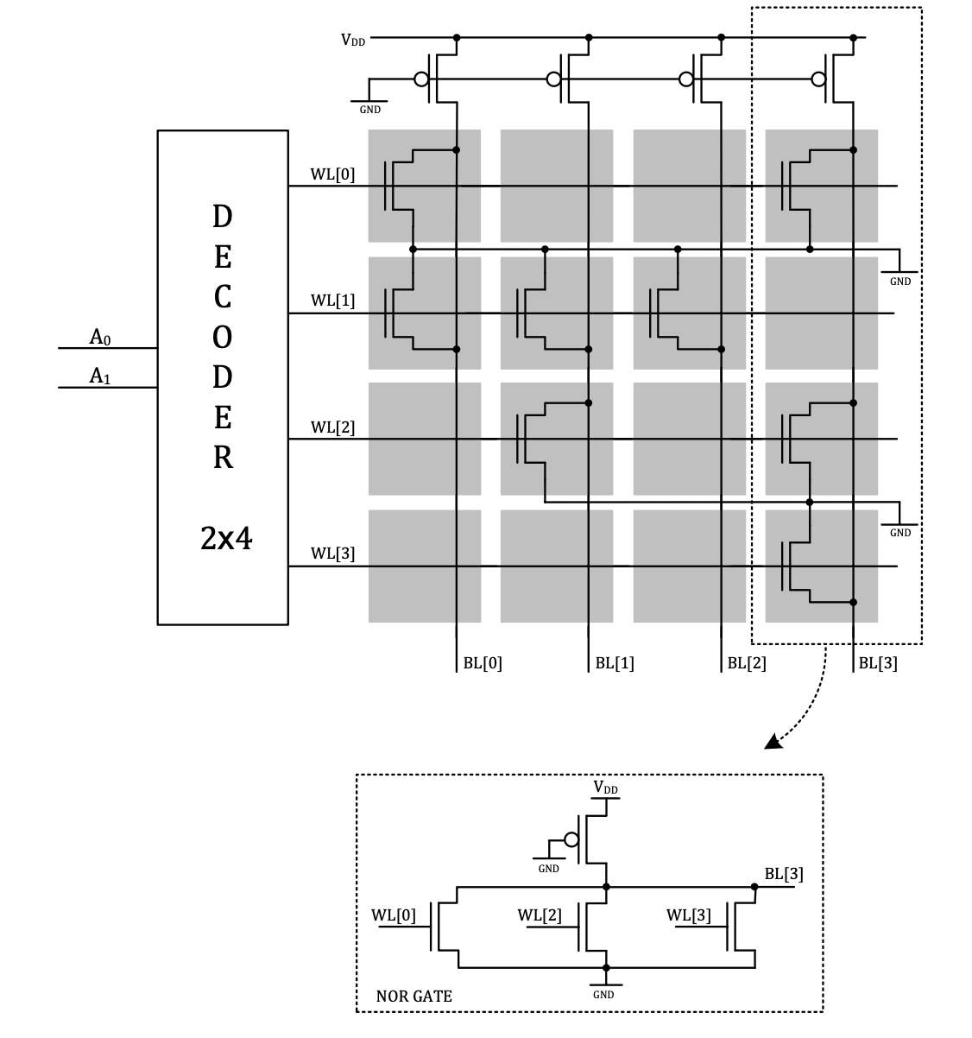
NOR-ROM

Slide 7
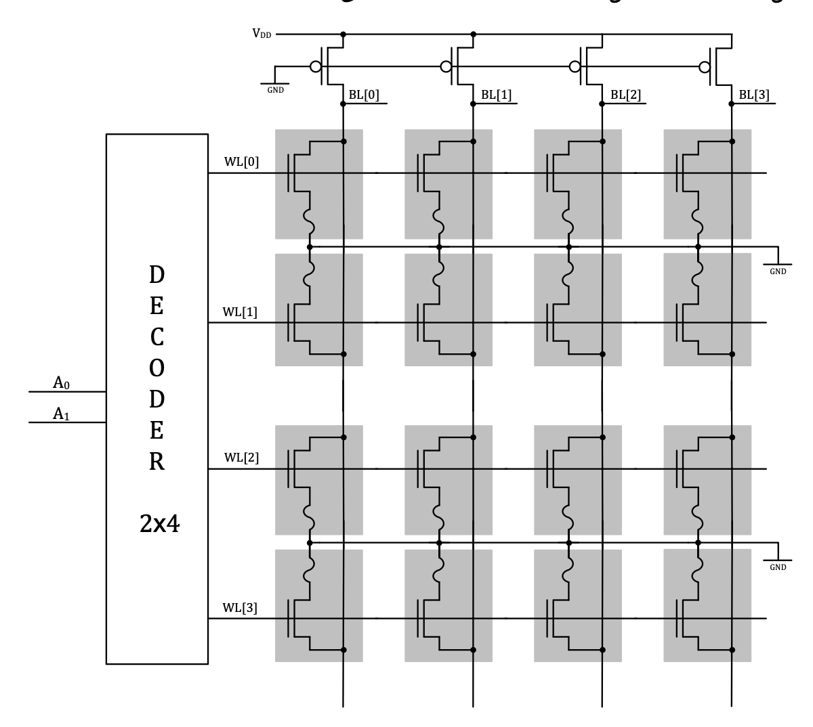
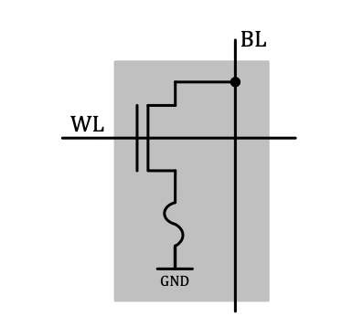
Programmable ROM

Slide 8
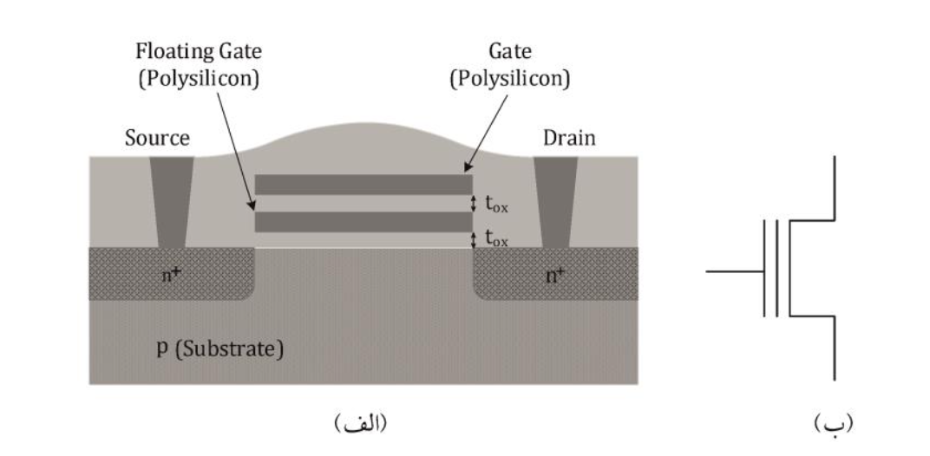
Non-Volatile Read Write Memory

Slide 9
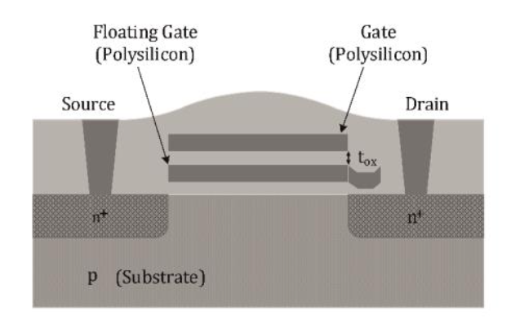
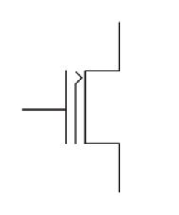
Floating Gate Tunneling Oxide (FLOTOX)

Slide 10
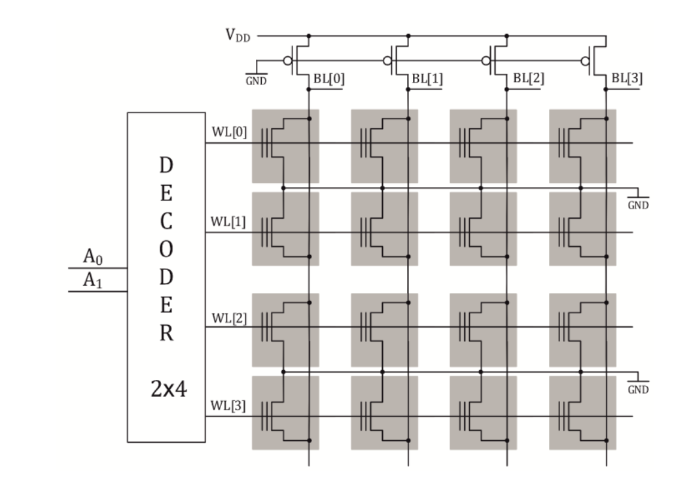
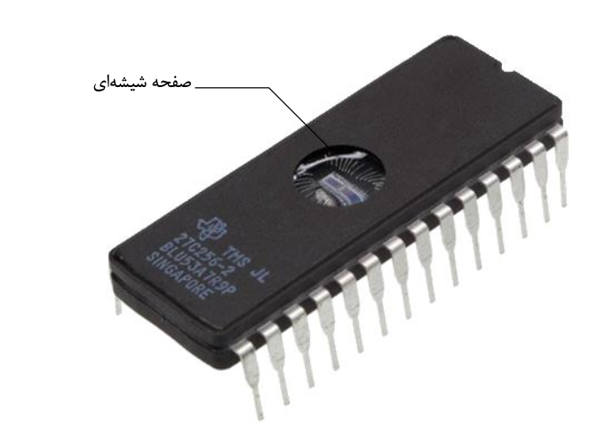
Erasable and Programmble ROM (EPROM)

Slide 11
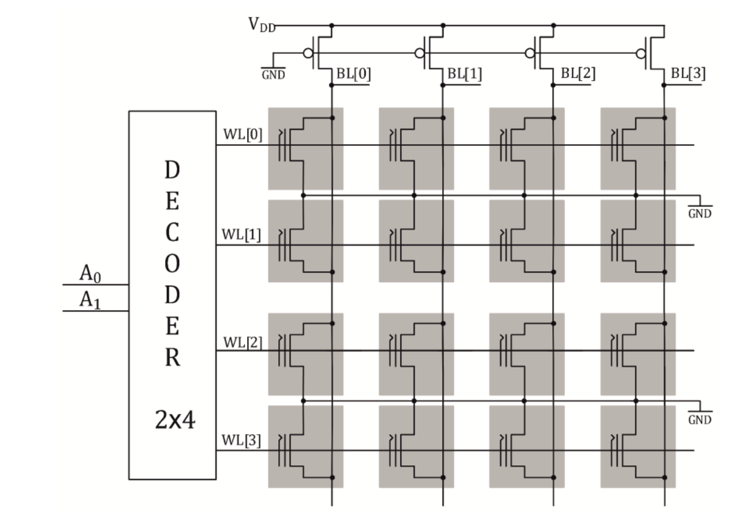
Ellectrically Erasable and Programmble ROM (E²PROM)

Slide 12
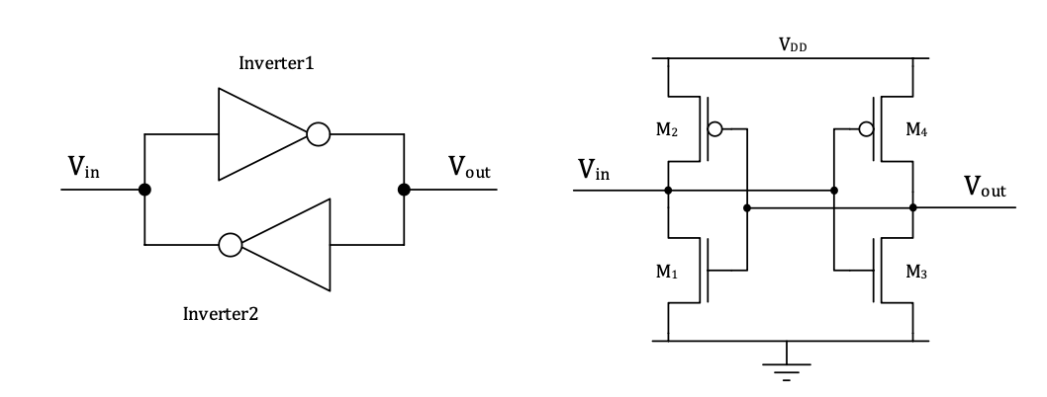
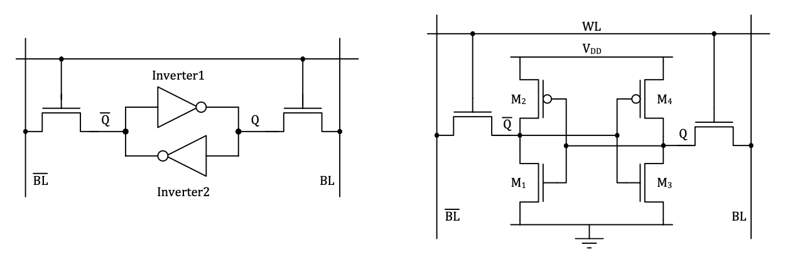
SRAM Cell

Slide 13
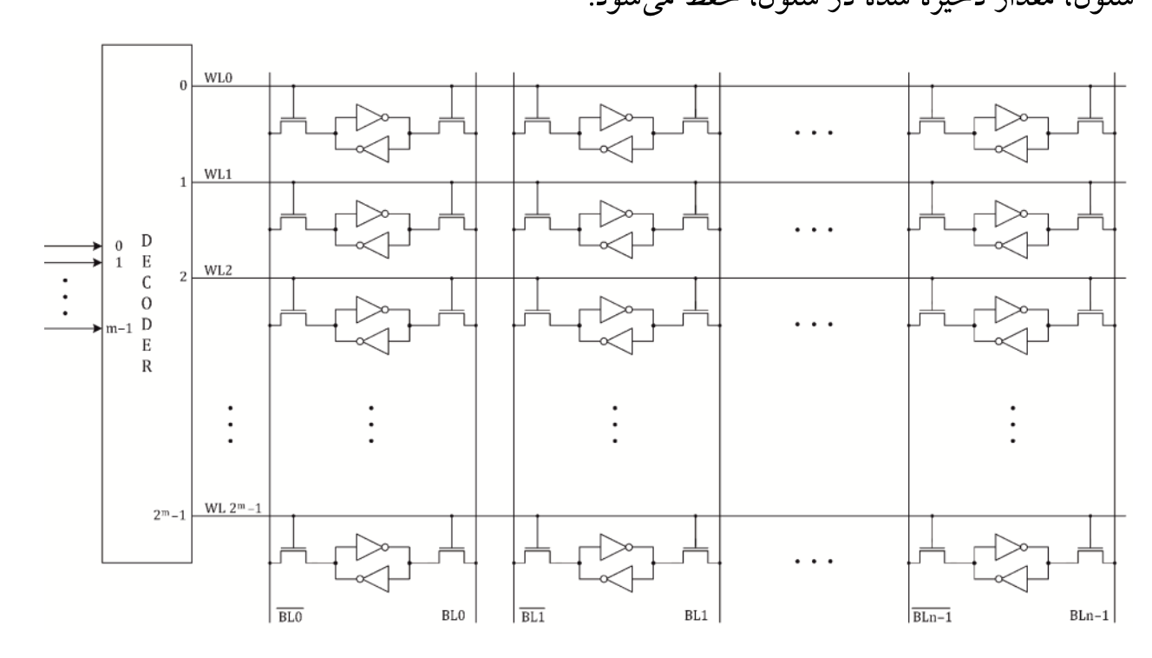
SRAM Cell

Slide 14
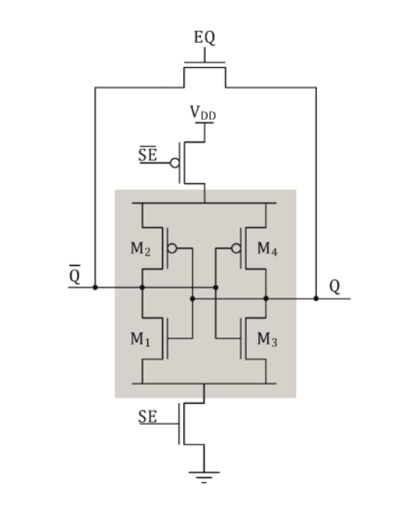
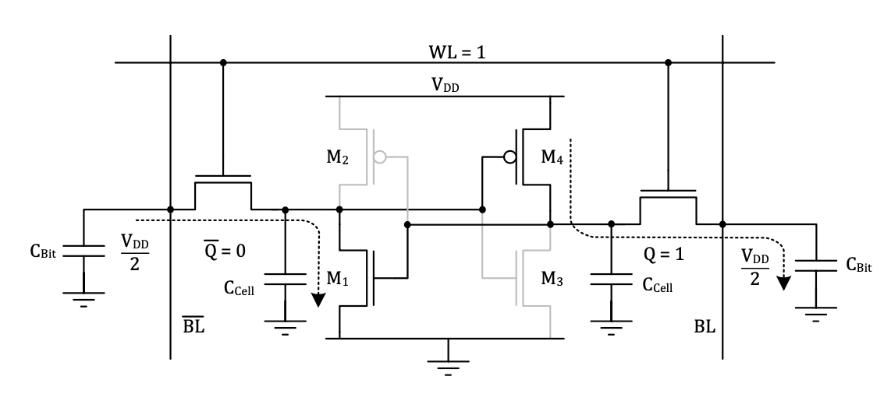
Read/Write in an SRAM Cell

Slide 15
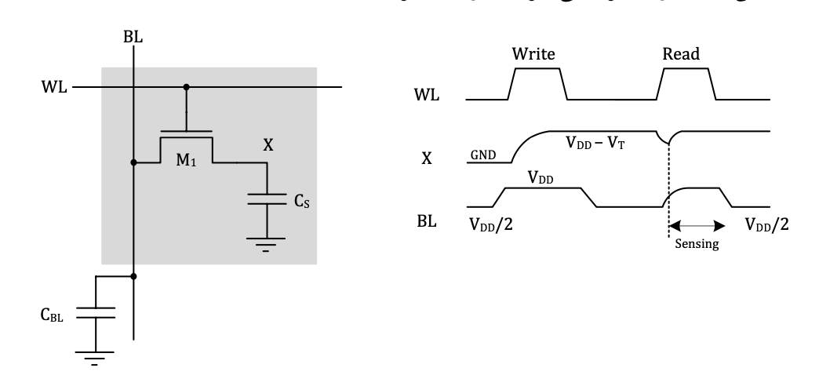
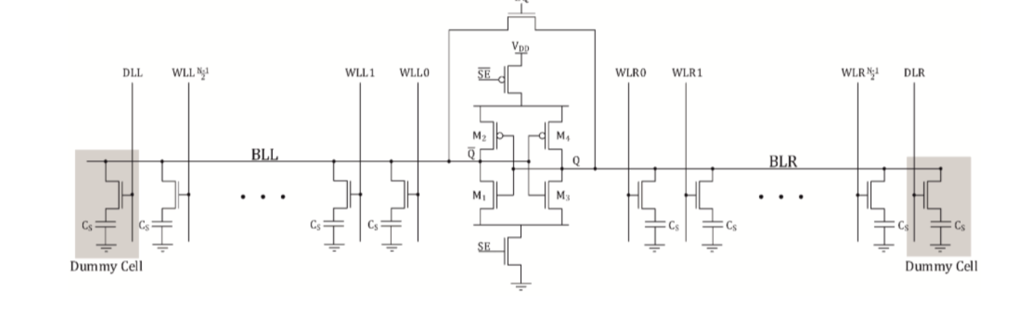
Dynamic RAM

