Slide 1
Power Consumption in CMOS Circuits

Slide 2
Outline
Power and Energy
Dynamic Power
Static Power
7: Power

Slide 3

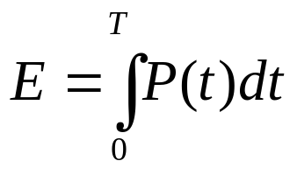
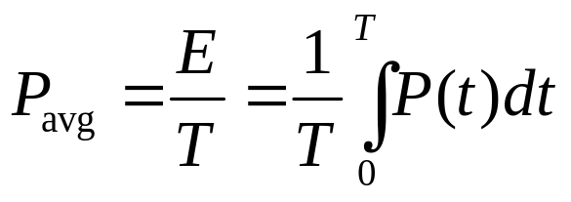
Power and Energy
Power is drawn from a voltage source attached to the V_{DD} pin(s) of a chip.
Instantaneous Power:
Energy:
Average Power:
7: Power

Slide 4
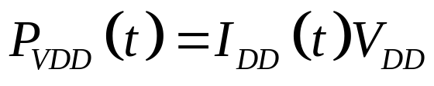
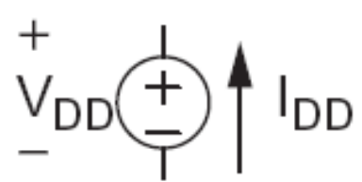
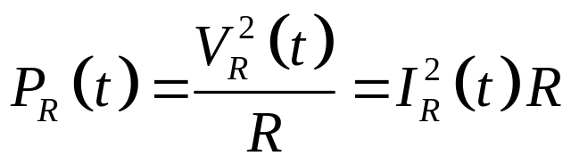
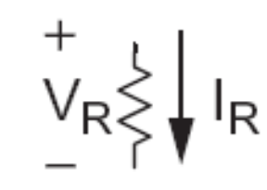
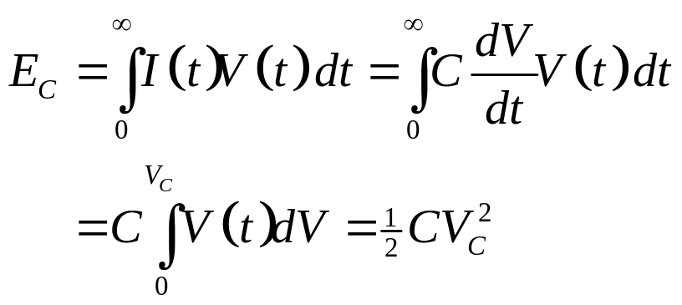

Power in Circuit Elements
7: Power

Slide 5
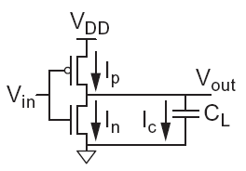

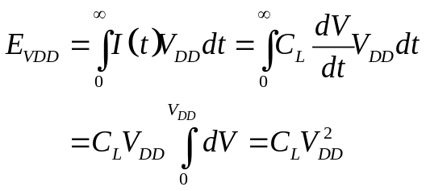
Charging a Capacitor
When the gate output rises
  Energy stored in capacitor is
  But energy drawn from the supply is
  Half the energy from V_{DD} is dissipated in the pMOS transistor as heat, other half stored in capacitor
When the gate output falls
  Energy in capacitor is dumped to GND
  Dissipated as heat in the nMOS transistor
7: Power

Slide 6
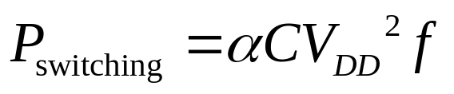
Activity Factor
Suppose the system clock frequency = f
Let f_{sw} = αf, where α = activity factor
  If the signal is a clock, α = 1
  If the signal switches once per cycle, α = ½
Dynamic power:
7: Power

Slide 7
Short Circuit Current
When transistors switch, both nMOS and pMOS networks may be momentarily ON at once
Leads to a blip of “short circuit” current.
< 10% of dynamic power if rise/fall times are comparable for input and output
We will generally ignore this component
7: Power

Slide 8
Power Dissipation Sources
P_{total} = P_{dynamic} + P_{static}
Dynamic power: P_{dynamic} = P_{switching} + P_{shortcircuit}
  Switching load capacitances
  Short-circuit current
Static power: P_{static} = (I_{sub} + I_{gate} + I_{junct} + I_{contention})V_{DD}
  Subthreshold leakage
  Gate leakage
  Junction leakage
  Contention current
7: Power

Slide 9
Dynamic Power Reduction
Try to minimize:
  Activity factor
  Capacitance
  Supply voltage
  Frequency
7: Power

Slide 10
Activity Factor Estimation
Let P_{i} = Prob(node i = 1)
  P_{i} = 1-P_{i}
α_{i} = P_{i} * P_{i}
Completely random data has P = 0.5 and α = 0.25
Data is often not completely random
  e.g. upper bits of 64-bit words representing bank account balances are usually 0
Data propagating through ANDs and ORs has lower activity factor
  Depends on design, but typically α ≈ 0.1
7: Power

Slide 11
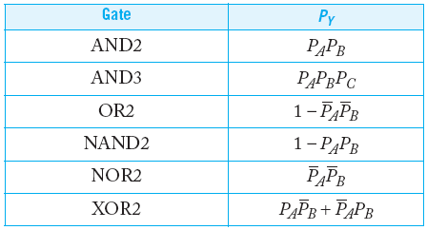
Switching Probability
7: Power

Slide 12
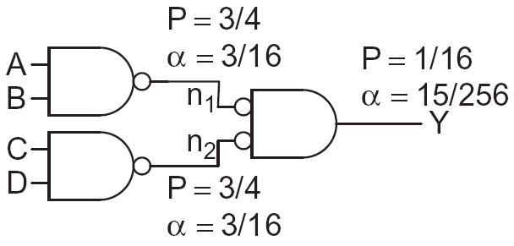
Example
A 4-input AND is built out of two levels of gates
Estimate the activity factor at each node if the inputs have P = 0.5
7: Power

Slide 13
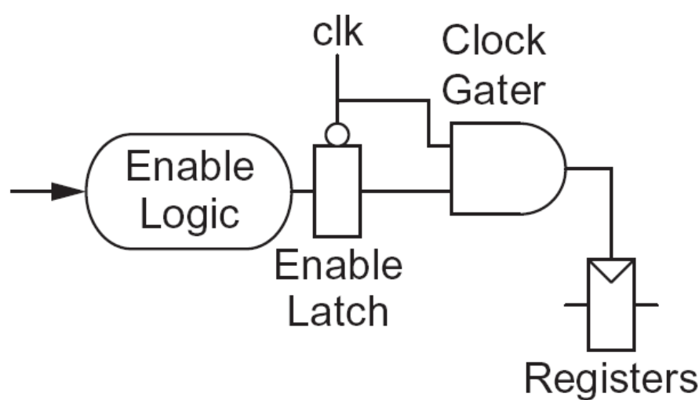
Clock Gating
The best way to reduce the activity is to turn off the clock to registers in unused blocks
  Saves clock activity (α = 1)
  Eliminates all switching activity in the block
  Requires determining if block will be used
7: Power

Slide 14
Capacitance
Gate capacitance
  Fewer stages of logic
  Small gate sizes
Wire capacitance
  Good floorplanning to keep communicating blocks close to each other
7: Power

Slide 15
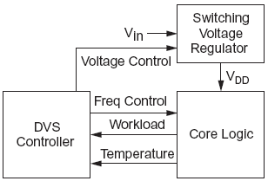
Voltage / Frequency
Run each block at the lowest possible voltage and frequency that meets performance requirements
Voltage Domains
  Provide separate supplies to different blocks
  Level converters required when crossing
  from low to high V_{DD} domains
Dynamic Voltage Scaling
  Adjust V_{DD} and f according to
  workload
7: Power

