Slide 1
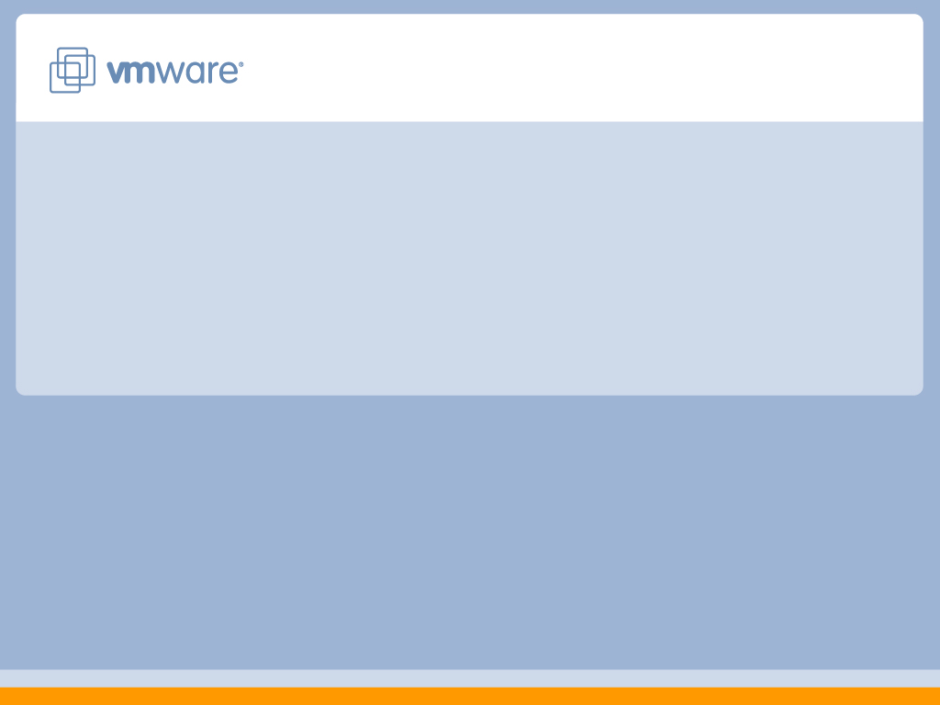
VMware

Slide 2
Agenda
VMware Company Overview
Virtualization Technology
VMware Infrastructure 3
Simplify Operations
Increase Service Levels
Deploy Pervasively
Key Usage Areas
VMware Infrastructure 3 Summary
Virtual Appliances
VMworld Updates
2

Slide 3
VMware
Company Overview

Slide 4
VMware Mission Statement
Virtualize industry standard server and desktop computing
Application
Application
OS
OS
Virtualization
Hardware Hardware
Hardware

Slide 5
VMware: Powerful Momentum Continues in 2007
Founded in 1998
VMware Virtual Infrastructure Emerged as De Facto Standard
100+% revenue growth
Customer Adoption Accelerating
42.000+ Infrastructure customers
6.000.000+ Workstation Users
VMware Revenue
Total Employees: ~ 3.000
2002
2003
2004
2005
2006
VMware IPO: August 2007 (NYSE:VMW)

Slide 6
VMware
Virtualization Technology

Slide 7
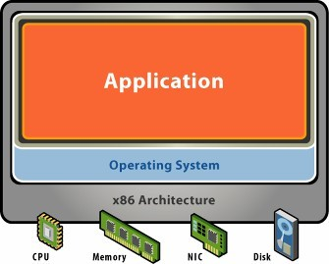
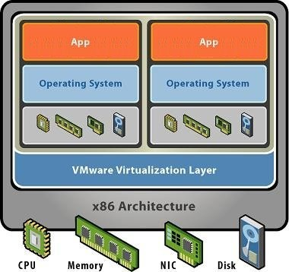
Server Virtualization Transforms x86 Systems
Without virtualization:
With VMware virtualization:
Single OS image per machine
Software and hardware tightly coupled
Running multiple applications on same machine often creates conflict
Underutilized, inflexible, costly infrastructure
Break dependencies between OS and hardware
Manage OS and application as single unit by encapsulating them into VMs
Strong fault and security isolation
VMs are hardware-independent: they can be provisioned anywhere

Slide 8
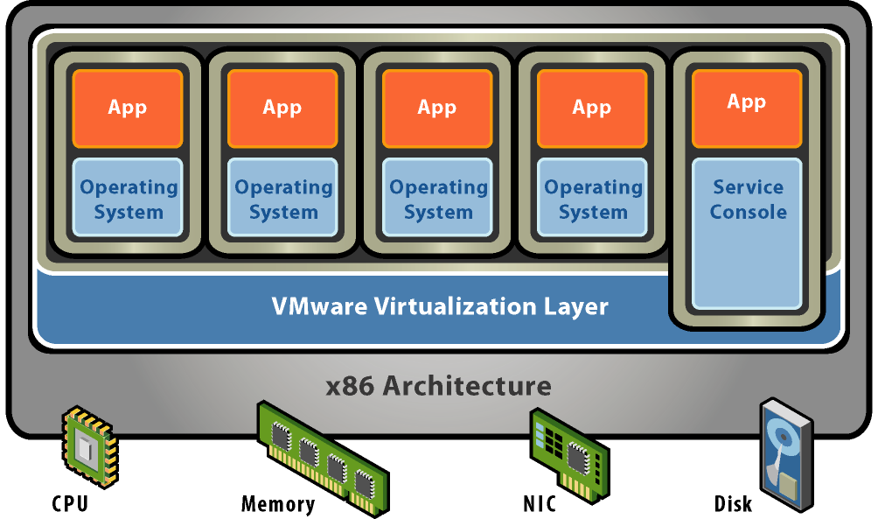


Trend : Virtualization Friendly Hardware
Massive Compute Supply Mandates Virtualization
High Core Count
Large Memory
High Speed Converged I/O Fabric
Future H/W Minimizes Virtualization Overhead
3rd Gen H/W Assist
Virtualization-aware Ecosystem

Slide 9




Comparing VMware platform architectures
VM VM
VMware Server
VM VM
VMkernel
Windows/Linux
x86 hardware
x86 hardware
Hosted (VMware Server)
Maximum hardware compatibility
Excellent product up to 10 VM’s
Native (VMware Infrastructure)
Maximum performance
Single purpose Virtualization layer

Slide 10
VMware Infrastructure 3

Slide 11
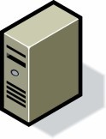
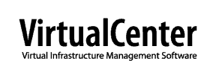
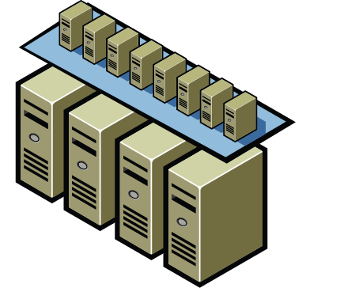
Today’s Virtualization
3rd Generation Virtualisation
Aggregates industry-standard (x86) servers into a single unified identity
Uses logical Resource Pools to manage consumption
Provides Service Level Agreements to manage groups of Virtual Machines
Delivers failure protection for ALL Virtual Machines
Allows central backup protection for ALL Virtual Machines
Runs all types of workloads

Slide 12
VMware Infrastructure 3: Customer impact
Simplify Operations
Increase Service Levels
Deploy Pervasively

Slide 13
Simplify Operations

Slide 14

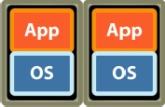
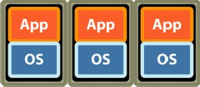
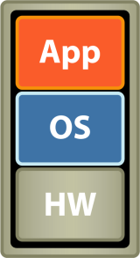
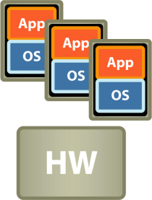










Transforming hardware and capacity management
PHYSICAL
VIRTUALIZED
POOLED
R P 1
R P 2
HW
HW
HW
HW
HW
HW
HW
HW
HW
HW
HW
HW
HW
HW
HW
HW
HW
HW
INDUSTRY FIRSTS:
Logical Resource Pooling (RP) Distributed Resource Scheduler (DRS)

Slide 15
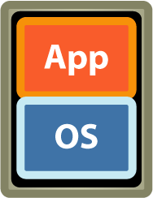




Align and scale capacity to business needs
Development
Production
BI
CRM
Virtual Desktops
E
n
g
ine
eri
n
g
S^{M}HªA^{rk}R^{e}E^{tin}D^{g} HARDWARE INFRASTRUCTURE
Aggregate capacity:
16 x (3GHz, 16GB) = 48GHz, 256GB

Slide 16
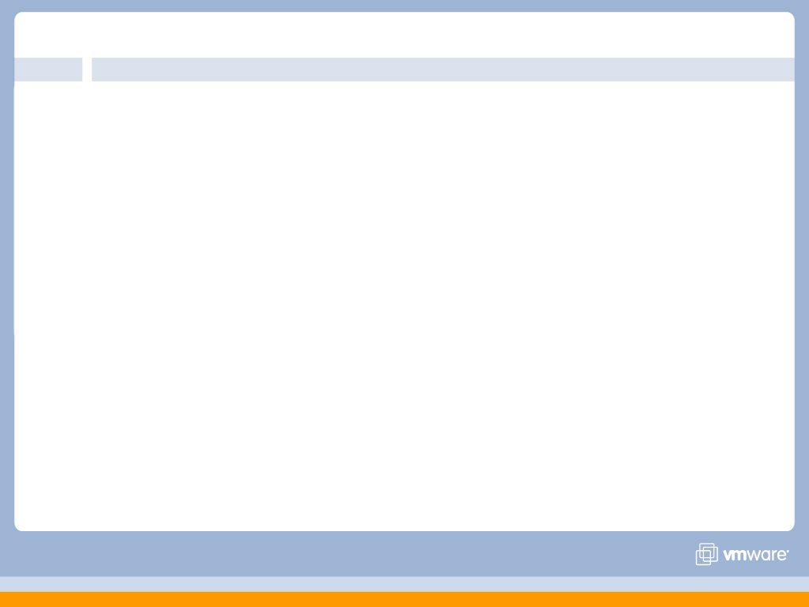
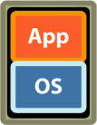
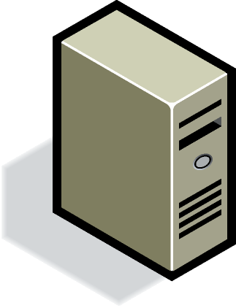
Non-disruptive capacity on demand

Slide 17
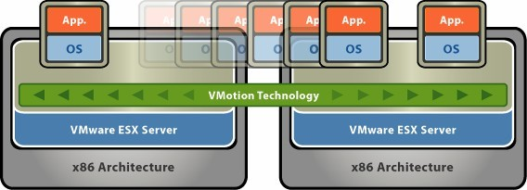

VMotion
VMotion technology lets you move running, stateful virtual machines from one physical system to another while maintaining continuous service availability

Slide 18
Increase Service Levels

Slide 19
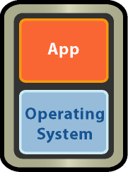
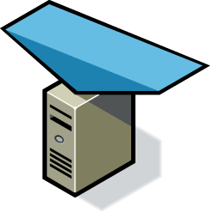
Automate resource assurance for critical applications
VMware DRS
Dynamic Balancing Continuous Optimization

Slide 20
Automatic availability for all applications
VMware HA
X

Slide 21
Transforming availability service levels
Application availability
CONTINUOUS
CLUSTERED
AUTOMATED RESTART
with VMware Infrastructure
UNPROTECTED
0%
10%
100%
Application coverage

Slide 22



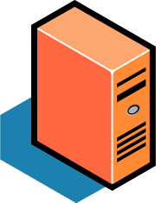

Backup anytime
BACKUP
BACKUP
BACKUP
BACKUP
BACKUP
VMWARE CONSOLIDATED BACKUP
Decouple backup from production VMs 20-40% better resource utilization
Pre-integrated with 3rd party backup products

Slide 23
Transforming data protection service levels
ONLINE, OFF-HOST CONTINUOUS
ONLINE, OFF-HOST IMAGE
ONLINE IMAGE
Backup options
with VMware Infrastructure
STANDARD NETWORK BACKUP
UNPROTECTED
0%
10%
100%
Application coverage

Slide 24
Deploy Pervasively

Slide 25
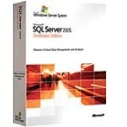




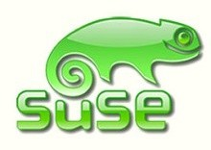



Freedom of Choice: Any OS and workload
Larger, faster enterprise-class virtual machines 30 + operating systems
200 + hardware configurations
WORKLOADS OPERATING SYSTEMS
64-bit 16GB
4-way V-SMP
25

Slide 26
Key Usage Areas

Slide 27
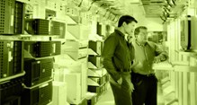
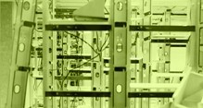
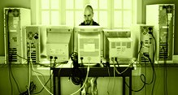

Meeting the Needs of Business
Infrastructure Optimization
Deploy virtual machines that run safely and move transparently across shared hardware.
Business Continuity
Software Lifecycle Automation
Virtual Clients and Desktops
Keep systems up and running through simple, reliable data protection and pervasive failover protection.
Reduce planned and unplanned downtime
Reduce cost and complexity of high availability
Simplify disaster recovery
Leverage assets and speed software development by automating the setup, sharing and storage of multi-machine configurations.
Secure unmanaged PCs while retaining end-user autonomy by layering
a security policy in
software around desktop virtual machines.
For enterprises and end users
Improve security and mobility
>
Consolidate servers
Reduce data center operating costs: real estate, power, cooling
Includes the industry’s most widely deployed Virtualization Infrastructure suite
>
Rapidly provision machines
Improve software quality
>

Slide 28

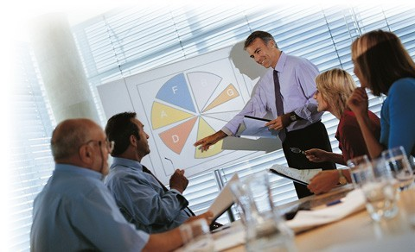
Solving the Problem
VMware Infrastructure provides a managed approach to regain control over server sprawl
VMware customers have consolidated ~1 mln servers to date
Benefits:
Reduce hardware costs up to 30-50% Reduce operations costs up to 70-80% Reduce complexity
Deploy new services efficiently

Slide 29
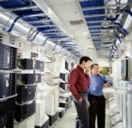

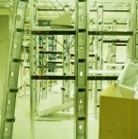

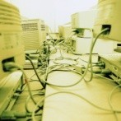

VMware Infrastructure – Key Solutions / Use Cases
Server Consolidation and Containment – Eliminate server sprawl by deploying systems into virtual machines
Infrastructure Provisioning – Reduce the time for provisioning new infrastructure to minutes with sophisticated automation capabilities.
Business Continuity – Reduce the cost and complexity of business continuity by encapsulating entire systems files that can be replicated and restored onto any target server
Test and Development – Rapidly provision and re-provision test and development servers; store libraries of pre-configured test machines
Enterprise Desktop – Secure unmanaged PCs. Alternatively, provide standardized enterprise desktop environments hosted on servers.
Legacy Application Re-hosting – Migrate legacy operating systems and software applications to virtual machines running on new hardware for better reliability

Slide 30
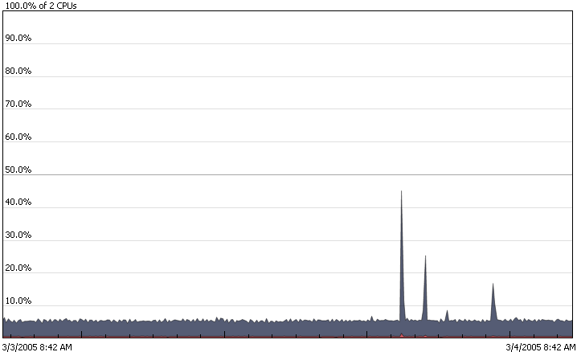
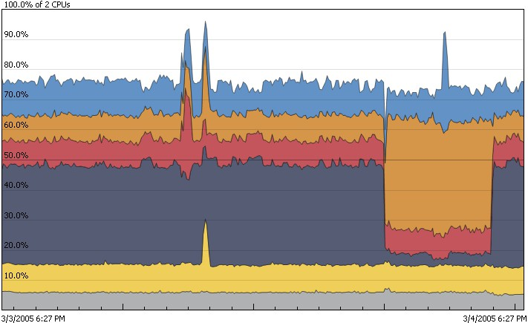
Virtualization Increases Hardware Utilization
Before VMware After VMware
Average consolidation ratio: 5-8 VMs per CPU

Slide 31
VMware Infrastructure – Key Solutions / Use Cases
Server Consolidation and Containment – Eliminate server sprawl by deploying systems into virtual machines
Infrastructure Provisioning – Reduce the time for provisioning new infrastructure to minutes with sophisticated automation capabilities.
Business Continuity – Reduce the cost and complexity of business continuity by encapsulating entire systems files that can be replicated and restored onto any target server
Test and Development – Rapidly provision and re-provision test and development servers; store libraries of pre-configured test machines
Enterprise Desktop – Secure unmanaged PCs. Alternatively, provide standardized enterprise desktop environments hosted on servers.
Legacy Application Re-hosting – Migrate legacy operating systems and software applications to virtual machines running on new hardware for better reliability

Slide 32
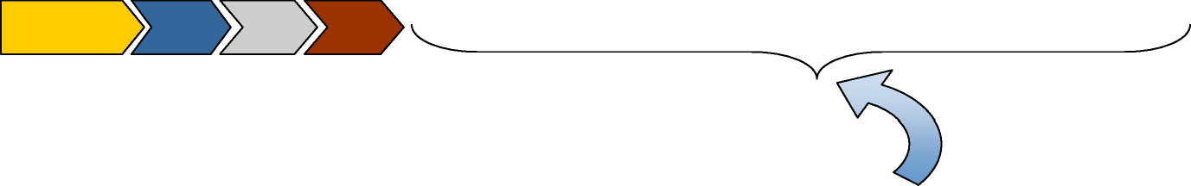
Instant Provisioning
Without VMware Virtualization
Determine | Locate or | Rack and |  | Install/
server | purchase | cable | Install/ | config | Boot
spec | system(s) | system | config OS | application | system
Determine Choose Choose Boot
VM
Server spec
host template system
Time for other productive tasks
With VMware Virtualization
Increases Efficiency and Responsiveness

Slide 33
VMware Infrastructure – Key Solutions / Use Cases
Server Consolidation and Containment – Eliminate server sprawl by deploying systems into virtual machines
Infrastructure Provisioning – Reduce the time for provisioning new infrastructure to minutes with sophisticated automation capabilities.
Business Continuity – Reduce the cost and complexity of business continuity by encapsulating entire systems files that can be replicated and restored onto any target server
Test and Development – Rapidly provision and re-provision test and development servers; store libraries of pre-configured test machines
Enterprise Desktop – Secure unmanaged PCs. Alternatively, provide standardized enterprise desktop environments hosted on servers.
Legacy Application Re-hosting – Migrate legacy operating systems and software applications to virtual machines running on new hardware for better reliability

Slide 34

⯈63% of VMware customers use VMware for Business Continuity or Disaster Recovery.
Business Continuity
⯈Why?
Higher Availability Faster Recovery Lower Hardware Costs

Slide 35
VMware Infrastructure – Key Solutions / Use Cases
Server Consolidation and Containment – Eliminate server sprawl by deploying systems into virtual machines
Infrastructure Provisioning – Reduce the time for provisioning new infrastructure to minutes with sophisticated automation capabilities.
Business Continuity – Reduce the cost and complexity of business continuity by encapsulating entire systems files that can be replicated and restored onto any target server
Test and Development – Rapidly provision and re-provision test and development servers; store libraries of pre-configured test machines
Enterprise Desktop – Secure unmanaged PCs. Alternatively, provide standardized enterprise desktop environments hosted on servers.
Legacy Application Re-hosting – Migrate legacy operating systems and software applications to virtual machines running on new hardware for better reliability

Slide 36
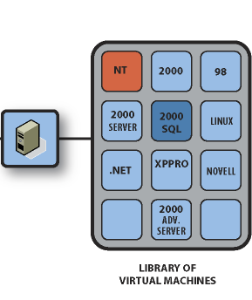
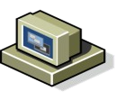





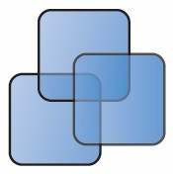

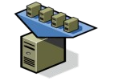


Managing Complexity of Environments
Libraries of Virtual Machines Simulate Complex Environments
Collaborative Test and Development
QA
Rapid Provisioning
Management Console
Image Repository
Development
Production

Slide 37
VMware Infrastructure – Key Solutions / Use Cases
Server Consolidation and Containment – Eliminate server sprawl by deploying systems into virtual machines
Infrastructure Provisioning – Reduce the time for provisioning new infrastructure to minutes with sophisticated automation capabilities.
Business Continuity – Reduce the cost and complexity of business continuity by encapsulating entire systems files that can be replicated and restored onto any target server
Test and Development – Rapidly provision and re-provision test and development servers; store libraries of pre-configured test machines
Enterprise Desktop – Secure unmanaged PCs. Alternatively, provide standardized enterprise desktop environments hosted on servers.
Legacy Application Re-hosting – Migrate legacy operating systems and software applications to virtual machines running on new hardware for better reliability

Slide 38
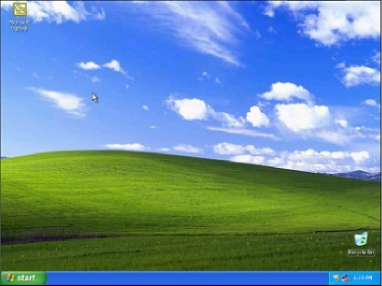
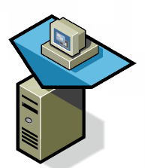
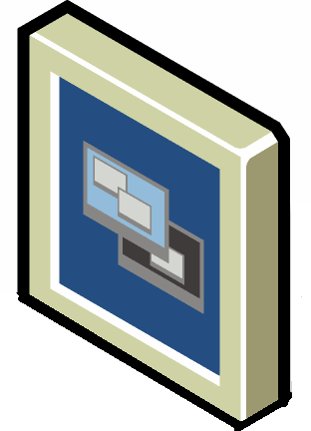
What is VDI?
Thin Client or PC
Virtual Infrastructure 3 Server
VDI leverages Virtual Infrastructure 3 and a remote control protocol such as RDP to provide users access to a standardized remote desktop.

Slide 39
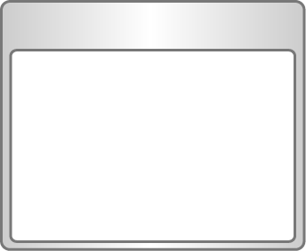





Desktop Needs
Outsourcing
Need to secure data and resources within the corporate data center and provide secure access to outsourcing / offshore developers or transaction workers
Need for Secure, Controlled Access by Outsourcing Entities
Alt. Workspace
Need to be able to support a virtual work environment where users have alternative access to complete desktop resources while
working remotely
Need for Alternative Workspace Access
Disasters
Need to quickly recover, re-provision and reestablish user access to
complete desktop environments to ensure business continuity
Need for Instant Desktop Recovery & Provisioning
Compliance
Need to contain desktop proliferation and build a standardized, centrally managed desktop environment that adheres to internal and external compliance guidelines
Need for Desktop Consolidation & Standardization

Slide 40
Best of both worlds
Benefits of Server-based Computing
Centralized Management
Data Security
Lower Costs
Remote Access
Scalability
User Management
Desktop Lifecycle Management
Benefits of Virtualization
•
•
Remote access to full desktops
(Always on, Always connected )
Hardware independence
+
•
Full application compatibility
•
Complete user isolation
•
Instant provisioning
•
Dynamic resource management
•
Disaster recovery
•
Desktop standardization
=
Virtual Desktop Infrastructure

Slide 41
VMware Infrastructure – Key Solutions / Use Cases
Server Consolidation and Containment – Eliminate server sprawl by deploying systems into virtual machines
Infrastructure Provisioning – Reduce the time for provisioning new infrastructure to minutes with sophisticated automation capabilities.
Business Continuity – Reduce the cost and complexity of business continuity by encapsulating entire systems files that can be replicated and restored onto any target server
Test and Development – Rapidly provision and re-provision test and development servers; store libraries of pre-configured test machines
Enterprise Desktop – Secure unmanaged PCs. Alternatively, provide standardized enterprise desktop environments hosted on servers.
Legacy Application Re-hosting – Migrate legacy operating systems and software applications to virtual machines running on new hardware for better reliability

Slide 42
VMware Infrastructure 3
Summary

Slide 43
Dramatic and real cost savings
Summary
VI3: Infrastructure Virtualization Suite
Simplified operations Increased Service levels
Extended range of supported platforms
43

Slide 44
Virtual Appliances

Slide 45

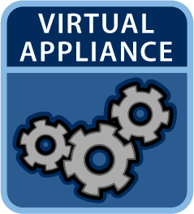

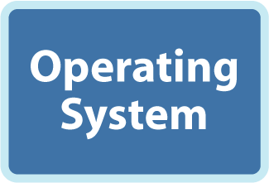


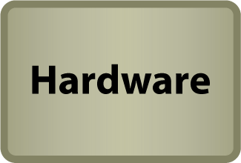




Virtual Appliances changing the role of the OS
Pre-installed, pre-configured packages of application + OS
Easy to provision enterprise software
Deploy on any hardware
Less management: OS is small, more secure
Over 300 available: OS, security, RDBS, infrastructure, collaboration, etc.

Slide 46


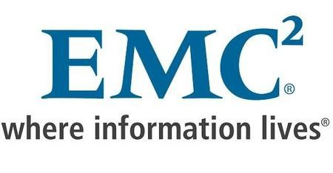



Virtual Appliances
Weblogic Server Virtual Edition
Currently Available
Crystal Decisions Virtual Appliance
Shipping Q1 2008 (Demo at VMworld)
Avamar Virtual Edition
Shipping November 2007
Virtual SAN Appliance
Shipping November 2007
Proventia Network Mail Security System Virtual Appliance
Currently Available
Secure Internet Gateway VMtrial Evaluation Currently Available

Slide 47
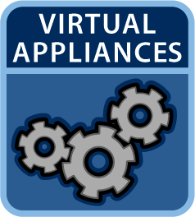
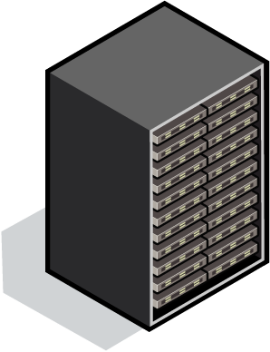

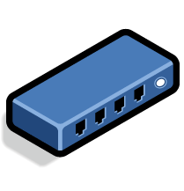

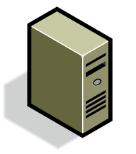
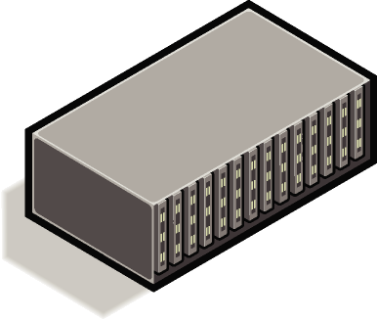

Taking Out the Complexity, Adding Flexibility

Slide 48
VMworld
Updates

Slide 49
Agenda
VMware ESX Server 3i
Storage VMotion Continuous Availability Virtual Desktop Manager 2.0 Site Recovery Manager Other announcements

Slide 50
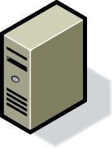
What is ESX Server 3i?
Virtual Machines
ESX Server 3i Physical Server
Next generation architecture in an ultra small form factor
Improved security, reliability and simplified management with a small, virtualization-centric package that minimizes attack surface area
Supports all the VI3 Products and Features
Hypervisor integrated in server systems
Hardware is certified and ready-to-run
Intuitive start up experience that dramatically reduces deployment time
Standards-based management of the underlying hardware

Slide 51

Traditional ESX Server
98%
2%
Agent
…
Agent
RPM
RHEL3-based Service Console
Helpers
VMM
VMM
VMM
VMkernel
Storage
Networking
Resource Management
HAL and Device Drivers
Memory Footprint: Disk Footprint: Percent of Patches
~272MB
2 GB
50%
Memory Footprint: Disk Footprint:
<24 MB
48 MB

Slide 52
ESX Server 3i: Thin Virtualization!
98%
2%
Agent
…
Agent RPM
RHEL3-based Service Console
Helpers
VMM
VMM
VMM
VMkernel
Storage
Networking
Resource Management
HAL and Device Drivers
Memory Footprint: Disk Footprint: Percent of Patches
~272MB
2 GB
50%
Memory Footprint: Disk Footprint:
<24 MB
48 MB

Slide 53
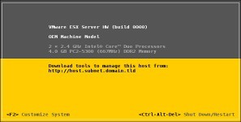



Start Running VMs in Minutes
3i
❶
Power on server and boot into hypervisor
Configure Admin Password
(optional) Modify network configuration
Connect VI Client to IP Address
Or manage with VirtualCenter
❷
❸
❹

Slide 54
Evolution of VI Management
ESX Server 3i continues trend of migrating management functionality from the Service Console to remote management tools
CIM
(Hardware mgmt)
Remote Mgmt
Remote CLI
(scripting)
API/SDK
API/SDK
VirtualCenter
VirtualCenter
VirtualCenter
MUI
VI Client
VI Client
Local Mgmt
Service Console
Service Console
Service Console
ESX 1
ESX 2
ESX 3
ESX 3i

Slide 55
Architectural Benefits
Unmatched security and reliability
OS independence means minimal interfaces and a small attack profile
Locked down, menu-driven interface prevents users from running arbitrary code
Simplified management
No special operating system knowledge required (e.g. Linux) No user accounts or passwords to create and maintain
No OS security hardening, antivirus, or backup effort required Integrated, standards-based CIM providers for hardware management
Fully featured and high performing
ESX Server 3i supports all the functionality of VMware Infrastructure 3

Slide 56
Agenda
VMware ESX Server 3i
Storage VMotion Continuous Availability Virtual Desktop Manager 2.0 Site Recovery Manager Other announcements

Slide 57
Storage VMotion
Storage VMotion
Storage maintenance and upgrades
ESX Server upgrades that change disk format
ILM solutions
Performance troubleshooting
Linked Clones
Lower disk usage
Test and dev workflows
Backup and restore Forensics
Data mining and off-host processing
Thin Provisioning
Lower disk utilization Storage over-provisioning
Pay as you grow storage model

Slide 58
Agenda
VMware ESX Server 3i
Storage VMotion Continuous Availability Virtual Desktop Manager 2.0 Site Recovery Manager Other announcements

Slide 59

Server: Continuous Availability
⯈Two VMs are kept in lock-step across physically separate machines
⯈In case of hardware failure,
Lock Step
Watch Continuous A^{se}v^{co}a^{n}il^{d}a^{V}b^{M}il^{c}itºy^{nti}i^{n}n^{ue}A^{s}c^{ex}ti^{e}o^{cu}n^{tin}b^{g}y
without interruption
viewing the Key⯈no^{Be}te^{ne}S^{fit}p^{s:}eech of day 3 at
_{VMwo}Z_{r}e_{l}r_{d}o d:owntime and zero data loss
http://www.vmwo
wrld.com/ws ebcast
Protects any OS & application
ithout modification
Easier to setup & manage than traditional clustering
More cost effective than dedicated, fault-tolerant hardware

Slide 60
Agenda
VMware ESX Server 3i
Storage VMotion Continuous Availability Virtual Desktop Manager 2.0 Site Recovery Manager Other announcements

Slide 61

Introduction to VMware VDM 2
VMware VDM 2 is the Connection Broker for VMware VDI Background:
Based on Propero technologies acquired by VMware in April 2007; Replaces VDM 1.1 PSO offering;
VMware boxed product, fully supported, production ready;
Overview:
Connects users to virtual desktops; Manages authentication and entitlements;
Integrated with VirtualCenter to manage VI3 platform; Robust and scalable for the Enterprise, yet…
Easy to deploy and administer in smaller environments; Fully-featured, enterprise-class connection broker.
Benefits:
Grow the VMware VDI solution to increase customer penetration;
Simplify VMware VDI for customers: easier to understand, deploy, purchase and support; VMware have a single boxed offering that provides entire VMware VDI solution.

Slide 62







Components of VMware VDM 2
VDM Client
Native Windows client;
Browser access for Linux & MAC;
Thin-client support.
VDM Agent
Run in hosted XP and Vista VM; Session management.
VDM Connection Server
Service running on Windows 2003;
Connects clients to hosted virtual desktops;
Integrated with Active Directory and VirtualCenter.
VDM Security Server
Can install standalone VDM Security Server in DMZ (optional)

Slide 63
Agenda
VMware ESX Server 3i
Storage VMotion Continuous Availability Virtual Desktop Manager 2.0 Site Recovery Manager Other announcements

Slide 64
Site Recovery Manager
Site Recovery Manager lowers the cost and difficulty of meeting DR business objectives
DR protection becomes a property of VMware virtual machines Customers can pre-program their disaster response
Accomplish this through automating DR workflows:
Setup Failover
Failback Test
By adding workflow to the core platform capabilities, we further reduce RTO, cost, and risk

Slide 65

Site Recovery Manager Effect On Customer DR Plans
Increasing Cost
Active/Active Continuous availability based on load balanced
x-site applications
DR
Array-Based _{Plan #2}
Replication Rapid data recovery
Host-Based Replication Faster data
Clustering
Redundancy Rapid failover ^{recovery at} Backup & Reduction in within a site ^{recovery site} Recovery SPF’s
Data Vaulting
DR Plan #1
Worse RPO, RTO
Better RPO, RTO

Slide 66


















Production Data Center
Disaster Recovery Site
APP
APP APP
APP APP APP
OS
OS OS OS OS OS
Production
DR
Production
LAN

Slide 67
Agenda
VMware ESX Server 3i
Storage VMotion Continuous Availability Virtual Desktop Manager 2.0 Site Recovery Manager Other announcements
67

Slide 68

Other announcements
VMware Tools are now Open Source
VMware Tools can be shipped inside Virtual Appliances
Open Source Community can modify the VMware Tools to support any Operating System (Debian, FreeBSD, etc.)
VMware Virtual Machine Streaming
Allows for direct execution of a Virtual Appliance from the VA Marketplace
Saves download-time
Can be used in various areas (e.g. VDI)
These features are representative of feature areas under development. Feature commitments must not be included in contracts, pur⁶c⁸hase orders, or sales agreements of any kind. Technical feasibility and market demand will affect final delivery.

Slide 69
Questions???
Dirk De Meirsman Reseller Manager Belgium & Luxembourg dirk@vmware.com

Slide 70
VMware Infrastructure 3 Editions
 | Starter | Standard | Enterprise
ESX Server 3 | x ⯈ NAS or local storage (license restricted) ⯈ Limited to servers with up to 4 physical CPU (license restricted) up to 8GB physical memory (EULA restricted) | x | x
VirtualCenter Agent | x | x | x
VMFS |  | x | x
Virtual SMP |  | x | x
VMotion |  |  | x
HA |  |  | x
DRS |  |  | x
Consolidated Backup |  |  | x
Price per 2 processors | $1,000 | $3,750 | $5,750
SnS Gold / Platinum | $675 / $805 | 21% / 25% | 21% / 25%
Per 2 processors

Slide 71
VMware Infrastructure 3 A-La-Carte Offerings
Name | Price
VMware VirtualCenter Management Server | $5,000
VMware VMotion | $1,400
VMware HA | $2,000
VMware DRS | $2,000
VMware Consolidated Backup | $500
Per Server
Per 2 processors

