Slide 1
Top-Down Network Design
Chapter Two
Analyzing Technical Goals and Tradeoffs
Copyright 2010 Cisco Press & Priscilla Oppenheimer

Slide 2
Technical Goals
Scalability
Availability
Performance
Security
Manageability
Usability
Adaptability
Affordability
Notes:
Scalability: How much growth a network design must support.
Availability: The amount of time a network is available to users, often expressed as a percent uptime, or as a mean time between failure (MTBF) and mean time to repair (MTTR). Availability goals can also document any monetary cost associated with network downtime.
Security: Goals for protecting the organization's ability to conduct business without interference from intruders inappropriately accessing or damaging equipment, data, or operations. Specific security risks should be documented.
Manageability: Goals for fault, configuration, accounting, performance, and security (FCAPS) management
Usability: Goals regarding the ease with which network users can access the network and its services, including goals for simplifying user tasks related to network addressing, naming, and resource discovery.
Adaptability: The ease with which a network design and implementation can adapt to network faults, changing traffic patterns, additional business or technical requirements, new business practices, and other changes.
Affordability: The importance of containing the costs associated with purchasing and operating network equipment and services.

Slide 3
Scalability
Scalability refers to the ability to grow
Some technologies are more scalable
  Flat network designs, for example, don’t scale well
Try to learn
  Number of sites to be added
  What will be needed at each of these sites
  How many users will be added
  How many more servers will be added

Slide 4
Availability
Availability can be expressed as a percent uptime per year, month, week, day, or hour, compared to the total time in that period
  For example:
    24/7 operation
    Network is up for 165 hours in the 168-hour week
    Availability is 98.21%
Different applications may require different levels
Some enterprises may want 99.999% or “Five Nines” availability

Slide 5
Availability
Downtime in Minutes
Per Hour
Per Day
Per Week
Per Year
99.999%
.0006
.01
.10
5
99.98%
.012
.29
2
105
99.95%
.03
.72
5
263
99.90%
.06
1.44
10
526
99.70%
.18
4.32
30
1577
Notes:
99.70% availability sounds pretty good, but it could mean that the network is down for 0.18 minutes every hour. This is 11 seconds. If those 11 seconds were spread out over the hour, nobody would notice possibly. But if there were some bug, for example, that caused the network to fail for 11 seconds every hour on the hour, people would notice. Users these days are very impatient.
Notice that 99.70% availability also could mean one catastrophic problem caused the network to be down for 1577 minutes all at once. That’s 26 hours. If it were on a Saturday and the network was never down for the rest of the year, that might actually be OK. So, you have to consider time frames with percent availability numbers.
Consider the holy grail: 99.999% availability. That’s 5 minutes downtime per year! Be sure to explain to the customer that scheduled maintenance and upgrades don’t count! Either that or plan for a network with triple redundancy (that could be extremely expensive to implement and operate).

Slide 6


99.999% Availability May Require Triple Redundancy
ISP 1
ISP 2
ISP 3
Enterprise
Can the customer afford this?
Notes:
In the event of failure of the primary router, the secondary becomes the primary and still has a backup. Fix the previous primary and have it become the tertiary.
This helps with maintenance too. Pull out the tertiary and upgrade it. The primary still has a backup. After extensive testing, put the tertiary back in as the primary. Pull out the original primary and upgrade it. Put it back as the secondary. Finally pull out the original secondary and upgrade it.
Of course, the picture brings up all sorts of other questions because it uses an ISP example.
Does the customer have provider independent addressing?
Does the customer have an autonomous system number?
Are the ISPs really independent? Is there true circuit diversity?
Are the speeds the same on the three links to the ISPs so that performance degradation is minimized during upgrades or failures?
Can load balancing be used when all three routers are operational?
What are the routing protocols inside the enterprise network? Can traffic really get to all three routers, regardless of failures inside the enterprise network? Can the routing protocols adjust to changes?
Will traffic flow out the “closest” router? Will traffic come in from the Internet via the “closest” entry?
Instructor note: The slide is not meant to be a design recommendation! It’s just a slide to get a discussion going on the ramifications of 99.999% availability.

Slide 7
Availability
Availability can also be expressed as a mean time between failure (MTBF) and mean time to repair (MTTR)
Availability = MTBF/(MTBF + MTTR)
  For example:
    The network should not fail more than once every 4,000 hours (166 days) and it should be fixed within one hour
    4,000/4,001 = 99.98% availability

Slide 8
Network Performance
Common performance factors include
  Bandwidth
  Throughput
  Bandwidth utilization
  Offered load
  Accuracy
  Efficiency
  Delay (latency) and delay variation
  Response time

Slide 9
Bandwidth Vs. Throughput
Bandwidth and throughput are not the same thing
Bandwidth is the data carrying capacity of a circuit
    Usually specified in bits per second
Throughput is the quantity of error free data transmitted per unit of time
    Measured in bps, Bps, or packets per second (pps)

Slide 10
Bandwidth, Throughput, Load
100 % of Capacity
Throughput
Actual
Ideal
100 % of Capacity
Offered Load

Slide 11
Other Factors that Affect Throughput
The size of packets
Inter-frame gaps between packets
Packets-per-second ratings of devices that forward packets
Client speed (CPU, memory, and HD access speeds)
Server speed (CPU, memory, and HD access speeds)
Network design
Protocols
Distance
Errors
Time of day, etc., etc., etc.

Slide 12
Throughput Vs. Goodput
You need to decide what you mean by throughput
Are you referring to bytes per second, regardless of whether the bytes are user data bytes or packet header bytes
  Or are you concerned with application-layer throughput of user bytes, sometimes called “goodput”
    In that case, you have to consider that bandwidth is being “wasted” by the headers in every packet

Slide 13
Performance (continued)
Efficiency
  How much overhead is required to deliver an amount of data?
  How large can packets be?
    Larger better for efficiency (and goodput)
    But too large means too much data is lost if a packet is damaged
    How many packets can be sent in one bunch without an acknowledgment?

Slide 14
Efficiency
Small Frames (Less Efficient)
Large Frames (More Efficient)

Slide 15

Delay from the User’s Point of View
Response Time
  A function of the application and the equipment the application is running on, not just the network
  Most users expect to see something on the screen in 100 to 200 milliseconds

Slide 16
Delay from the Engineer’s Point of View
Propagation delay
  A signal travels in a cable at about 2/3 the speed of light in a vacuum
Transmission delay (also known as serialization delay)
  Time to put digital data onto a transmission line
    For example, it takes about 5 ms to output a 1,024 byte packet on a 1.544 Mbps T1 line
Packet-switching delay
Queuing delay

Slide 17
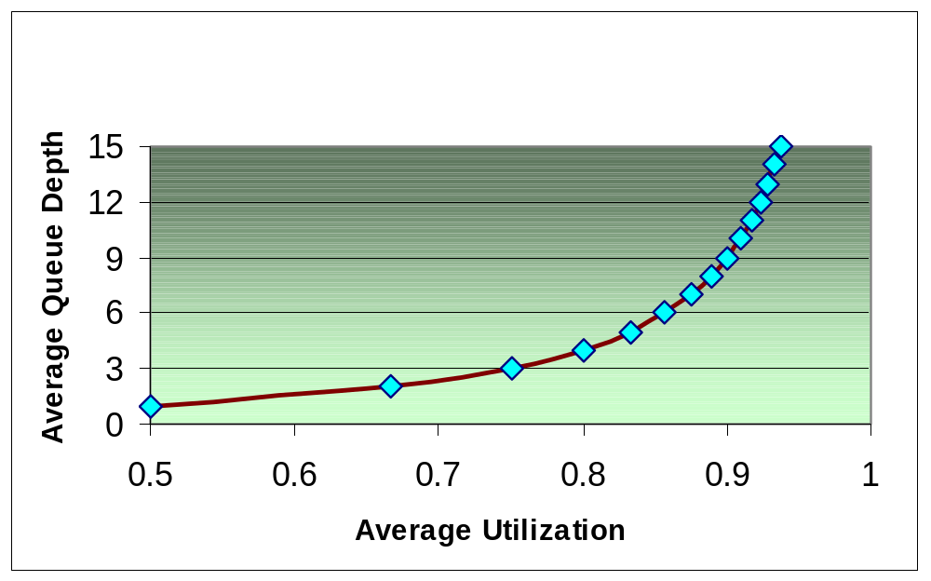
Queuing Delay and Bandwidth Utilization
Number of packets in a queue increases exponentially as utilization increases

Slide 18
Example
A packet switch has 5 users, each offering packets at a rate of 10 packets per second
The average length of the packets is 1,024 bits
The packet switch needs to transmit this data over a 56-Kbps WAN circuit
  Load = 5 x 10 x 1,024 = 51,200 bps
  Utilization = 51,200/56,000 = 91.4%
  Average number of packets in queue =
    (0.914)/(1-0.914) = 10.63 packets

Slide 19

Delay Variation
The amount of time average delay varies
  Also known as jitter
Voice, video, and audio are intolerant of delay variation
So forget everything we said about maximizing packet sizes
  There are always tradeoffs
  Efficiency for high-volume applications versus low and non-varying delay for multimedia

Slide 20
Security
Focus on requirements first
Detailed security planning later (Chapter 8)
Identify network assets
  Including their value and the expected cost associated with losing them due to a security problem
Analyze security risks

Slide 21
Network Assets
Hardware
Software
Applications
Data
Intellectual property
Trade secrets
Company’s reputation

Slide 22
Security Risks
Hacked network devices
  Data can be intercepted, analyzed, altered, or deleted
  User passwords can be compromised
  Device configurations can be changed
Reconnaissance attacks
Denial-of-service attacks

Slide 23
Manageability
Fault management
Configuration management
Accounting management
Performance management
Security management

Slide 24
Usability
Usability: the ease of use with which network users can access the network and services
Networks should make users’ jobs easier
Some design decisions will have a negative affect on usability:
  Strict security, for example

Slide 25
Adaptability
Avoid incorporating any design elements that would make it hard to implement new technologies in the future
Change can come in the form of new protocols, new business practices, new fiscal goals, new legislation
A flexible design can adapt to changing traffic patterns and Quality of Service (QoS) requirements

Slide 26
Affordability
A network should carry the maximum amount of traffic possible for a given financial cost
Affordability is especially important in campus network designs
WANs are expected to cost more, but costs can be reduced with the proper use of technology
  Quiet routing protocols, for example

Slide 27
Network Applications
Technical Requirements
Name of Application
Cost of Downtime
Acceptable MTBF
Acceptable MTTR
Throughput Goal
Delay Must be Less Than:
Delay Variation Must be Less Than:

Slide 28
Making Tradeoffs
Scalability 20
Availability 30
Network performance 15
Security 5
Manageability 5
Usability 5
Adaptability 5
Affordability 15
Total (must add up to 100) 100

Slide 29
Summary
Continue to use a systematic, top-down approach
Don’t select products until you understand goals for scalability, availability, performance, security, manageability, usability, adaptability, and affordability
Tradeoffs are almost always necessary

Slide 30
Review Questions
What are some typical technical goals for organizations today?
How do bandwidth and throughput differ?
How can one improve network efficiency?
What tradeoffs may be necessary in order to improve network efficiency?

