Slide 1
Top-Down Network Design
Chapter Five
Designing a Network Topology
Copyright 2010 Cisco Press & Priscilla Oppenheimer

Slide 2

Topology
A branch of mathematics concerned with those properties of geometric configurations that are unaltered by elastic deformations such as stretching or twisting
A term used in the computer networking field to describe the structure of a network
Notes:
Did you know that according to topologists, a coffee cup and donut are the same shape? If they were made of clay, for example, consider how easy it would be to mold the one to look like the other, while retaining the most significant characteristics (such as the roundedness and the hole).
Just like with coffee and donuts made of clay, in the networking field, during the logical design phase, we are more concerned with the overall architecture, shape, size, and interconnectedness of a network, than with the physical details.
For more information regarding topology, coffee, and donuts, see:
http://en.wikipedia.org/wiki/Topology

Slide 3
Network Topology Design Themes
Hierarchy
Redundancy
Modularity
Well-defined entries and exits
Protected perimeters

Slide 4
Why Use a Hierarchical Model?
Reduces workload on network devices
  Avoids devices having to communicate with too many other devices (reduces “CPU adjacencies”)
Constrains broadcast domains
Enhances simplicity and understanding
Facilitates changes
Facilitates scaling to a larger size

Slide 5


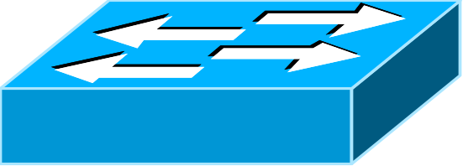


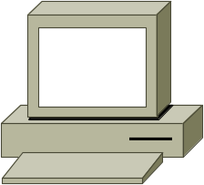
Hierarchical Network Design
Enterprise WAN
Backbone
Core Layer
Campus A
Campus B
Campus C
Distribution Layer
Campus C Backbone
Access Layer
Building C-1
Building C-2

Slide 6
Cisco’s Hierarchical Design Model
A core layer of high-end routers and switches that are optimized for availability and speed
A distribution layer of routers and switches that implement policies and segment traffic
An access layer that connects users via hubs, switches, and other devices

Slide 7
Flat Versus Hierarchy
Headquarters in Medford
Headquarters in Medford
Grants Pass Branch Office
Klamath Falls Branch Office
Ashland Branch Office
Grants Pass Branch Office
Klamath Falls Branch Office
Ashland Branch Office
White City Branch Office
Flat Loop Topology
Hierarchical Redundant Topology

Slide 8

Mesh
Designs
Partial-Mesh Topology
Full-Mesh Topology

Slide 9
A Partial-Mesh Hierarchical Design
Headquarters (Core Layer)
Regional Offices (Distribution Layer)
Branch Offices (Access Layer)

Slide 10
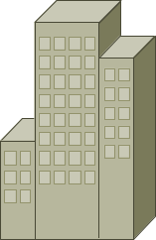
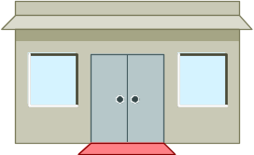
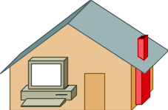
A Hub-and-Spoke Hierarchical Topology
Corporate Headquarters
Branch Office
Home Office
Branch Office

Slide 11
Avoid Chains and Backdoors
Core Layer
Distribution Layer
Access Layer
Backdoor
Chain

Slide 12
How Do You Know When You Have a Good Design?
When you already know how to add a new building, floor, WAN link, remote site, e-commerce service, and so on
When new additions cause only local change, to the directly-connected devices
When your network can double or triple in size without major design changes
When troubleshooting is easy because there are no complex protocol interactions to wrap your brain around
Notes:
Said by Dr. Peter Welcher, consultant and author of many networking articles in magazines, etc.

Slide 13
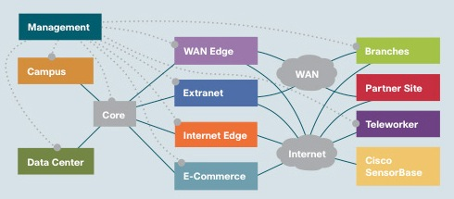
Cisco’s SAFE Security Reference Architecture

Slide 14
Campus Topology Design
Use a hierarchical, modular approach
Minimize the size of bandwidth domains
Minimize the size of broadcast domains
Provide redundancy
  Mirrored servers
  Multiple ways for workstations to reach a router for off-net communications

Slide 15
A Simple Campus Redundant Design
Host A
LAN X
Switch 1
Switch 2
LAN Y
Host B

Slide 16
Bridges and Switches use Spanning-Tree Protocol (STP) to Avoid Loops
Host A
LAN X
X
Switch 1
Switch 2
LAN Y
Host B

Slide 17
Bridges (Switches) Running STP
Participate with other bridges in the election of a single bridge as the Root Bridge.
Calculate the distance of the shortest path to the Root Bridge and choose a port (known as the Root Port) that provides the shortest path to the Root Bridge.
For each LAN segment, elect a Designated Bridge and a Designated Port on that bridge. The Designated Port is a port on the LAN segment that is closest to the Root Bridge. (All ports on the Root Bridge are Designated Ports.)
Select bridge ports to be included in the spanning tree. The ports selected are the Root Ports and Designated Ports. These ports forward traffic. Other ports block traffic.
Notes:
If all ports have equal distance to the Root Bridge, then the Designated Port is chosen by lowest sender Bridge ID. If the IDs are the same, then the port is chosen by lowest Port ID.
In general, STP checks for the best information by using these four criteria in the following order:
Lowest Root Bridge ID
Lowest path cost to the Root Bridge
Lowest sender Bridge ID
Lowest Port ID
See Top-Down Network Design for more details.

Slide 18
Elect a Root
Lowest Bridge ID
Wins!
Bridge A ID = 80.00.00.00.0C.AA.AA.AA
Root
Bridge A
Port 1
Port 2
LAN Segment 1
100-Mbps Ethernet
Cost = 19
LAN Segment 2
100-Mbps Ethernet
Cost = 19
Port 1
Port 1
Bridge B
Bridge C
Port 2
Port 2
Bridge B ID = 80.00.00.00.0C.BB.BB.BB
Bridge C ID = 80.00.00.00.0C.CC.CC.CC
LAN Segment 3
100-Mbps Ethernet
Cost = 19

Slide 19
Determine Root Ports
Bridge A ID = 80.00.00.00.0C.AA.AA.AA
Root
Bridge A
Lowest Cost
Wins!
Port 1
Port 2
LAN Segment 1
100-Mbps Ethernet
Cost = 19
LAN Segment 2
100-Mbps Ethernet
Cost = 19
Root Port
Root Port
Port 1
Port 1
Bridge B
Bridge C
Port 2
Port 2
Bridge B ID = 80.00.00.00.0C.BB.BB.BB
Bridge C ID = 80.00.00.00.0C.CC.CC.CC
LAN Segment 3
100-Mbps Ethernet
Cost = 19

Slide 20
Determine Designated Ports
Bridge A ID = 80.00.00.00.0C.AA.AA.AA
Root
Bridge A
Designated Port
Designated Port
Port 1
Port 2
LAN Segment 1
100-Mbps Ethernet
Cost = 19
LAN Segment 2
100-Mbps Ethernet
Cost = 19
Root Port
Root Port
Port 1
Port 1
Bridge B
Bridge C
Port 2
Port 2
Bridge B ID = 80.00.00.00.0C.BB.BB.BB
Bridge C ID = 80.00.00.00.0C.CC.CC.CC
Designated Port
LAN Segment 3
100-Mbps Ethernet
Cost = 19
Lowest Bridge ID
Wins!

Slide 21
Prune Topology into a Tree!
Bridge A ID = 80.00.00.00.0C.AA.AA.AA
Root
Bridge A
Designated Port
Designated Port
Port 1
Port 2
LAN Segment 1
100-Mbps Ethernet
Cost = 19
LAN Segment 2
100-Mbps Ethernet
Cost = 19
Root Port
Root Port
Port 1
Port 1
Bridge B
Bridge C
Port 2
Port 2
X
Bridge B ID = 80.00.00.00.0C.BB.BB.BB
Bridge C ID = 80.00.00.00.0C.CC.CC.CC
Designated Port
LAN Segment 3
100-Mbps Ethernet
Cost = 19
Blocked Port

Slide 22
React to Changes
Bridge A ID = 80.00.00.00.0C.AA.AA.AA
Root
Bridge A
Designated Port
Designated Port
Port 1
Port 2
LAN Segment 1
LAN Segment 2
Root Port
Root Port
Port 1
Port 1
Bridge B
Bridge C
Port 2
Port 2
Bridge B ID = 80.00.00.00.0C.BB.BB.BB
Bridge C ID = 80.00.00.00.0C.CC.CC.CC
Designated Port Becomes Disabled
LAN Segment 3
Blocked Port Transitions to Forwarding State

Slide 23
Scaling the Spanning Tree Protocol
Keep the switched network small
  It shouldn’t span more than seven switches
Use BPDU skew detection on Cisco switches
Use IEEE 802.1w
  Provides rapid reconfiguration of the spanning tree
  Also known as RSTP

Slide 24
Virtual LANs (VLANs)
An emulation of a standard LAN that allows data transfer to take place without the traditional physical restraints placed on a network
A set of devices that belong to an administrative group
Designers use VLANs to constrain broadcast traffic

Slide 25
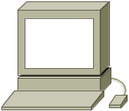
VLANs versus Real LANs
Switch A
Switch B
Station A1
Station A2
Station A3
Station B1
Station B2
Station B3
Network A
Network B
Notes:
To understand VLANs, it helps to think about real (non-virtual) LANs first. Imagine two switches that are not connected to each other in any way. Switch A connects stations in Network A and Switch B connects stations in Network B,
When Station A1 sends a broadcast, Station A2 and Station A3 receive the broadcast, but none of the stations in Network B receive the broadcast, because the two switches are not connected. This same configuration can be implemented through configuration options in a single switch, with the result looking like the next slide.

Slide 26
A Switch with VLANs
VLAN A
Station A1
Station A2
Station A3
Station B1
Station B2
Station B3
VLAN B
Notes:
Through the configuration of the switch there are now two virtual LANs implemented in a single switch, instead of two separate physical LANs. This is the beauty of VLANs. The broadcast, multicast, and unknown-destination traffic originating with any member of VLAN A is forwarded to all other members of VLAN A, and not to a member of VLAN B. VLAN A has the same properties as a physically separate LAN bounded by routers. The protocol behavior in this slide is exactly the same as the protocol behavior in the previous slide.

Slide 27
VLANs Span Switches
VLAN A
VLAN A
Station A1
Station A2
Station A3
Station A4
Station A5
Station A6
Switch A
Switch B
Station B1
Station B2
Station B3
Station B4
Station B5
Station B6
VLAN B
VLAN B
Notes:
VLANs can span multiple switches. In this slide, both switches contain stations that are members of VLAN A and VLAN B. This design introduces a new problem, the solution to which is specified in the IEEE 802.1Q standard and the Cisco proprietary Inter-Switch Link (ISL) protocol. The problem has to do with the forwarding of broadcast, multicast, or unknown-destination frames from a member of a VLAN on one switch to the members of the same VLAN on the other switch.
In this slide, all frames going from Switch A to Switch B take the same interconnection path. The 802.1Q standard and Cisco's ISL protocol define a method for Switch B to recognize whether an incoming frame belongs to VLAN A or to VLAN B. As a frame leaves Switch A, a special header is added to the frame, called the VLAN tag. The VLAN tag contains a VLAN identifier (ID) that specifies to which VLAN the frame belongs.
Because both switches have been configured to recognize VLAN A and VLAN B, they can exchange frames across the interconnection link, and the recipient switch can determine the VLAN into which those frames should be sent by examining the VLAN tag. The link between the two switches is sometimes called a trunk link or simply a trunk.
Trunk links allow the network designer to stitch together VLANs that span multiple switches. A major design consideration is determining the scope of each VLAN and how many switches it should span. Most designers try to keep the scope small. Each VLAN is a broadcast domain. In general, a single broadcast domain should be limited to a few hundred workstations (or other devices, such as IP phones).

Slide 28
WLANs and VLANs
A wireless LAN (WLAN) is often implemented as a VLAN
Facilitates roaming
Users remain in the same VLAN and IP subnet as they roam, so there’s no need to change addressing information
Also makes it easier to set up filters (access control lists) to protect the wired network from wireless users

Slide 29
Workstation-to-Router Communication
Proxy ARP (not a good idea)
Listen for route advertisements (not a great idea either)
ICMP router solicitations (not widely used)
Default gateway provided by DHCP (better idea but no redundancy)
  Use Hot Standby Router Protocol (HSRP) for redundancy

Slide 30

HSRP
Active Router
Enterprise Internetwork
Virtual Router
Workstation
Standby Router

Slide 31
Multihoming the Internet Connection
ISP 1
ISP 1
Enterprise
Paris
Enterprise
NY
Option A
Option C
ISP 1
ISP 2
ISP 1
ISP 2
Enterprise
Paris
Enterprise
NY
Option B
Option D

Slide 32
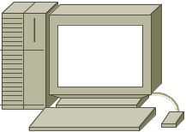
Security Topologies
DMZ
Enterprise
Network
Internet
Web, File, DNS, Mail Servers

Slide 33

Security Topologies
Internet
Firewall
DMZ
Enterprise Network
Web, File, DNS, Mail Servers

Slide 34
Summary
Use a systematic, top-down approach
Plan the logical design before the physical design
Topology design should feature hierarchy, redundancy, modularity, and security

Slide 35
Review Questions
Why are hierarchy and modularity important for network designs?
What are the three layers of Cisco’s hierarchical network design?
What are the major components of Cisco’s enterprise composite network model?
What are the advantages and disadvantages of the various options for multihoming an Internet connection?

