Slide 1

Introduction: Predicting width constrictions during hot rolling
Thomas Bogaerts, ArcelorMittal Belgium

Slide 2
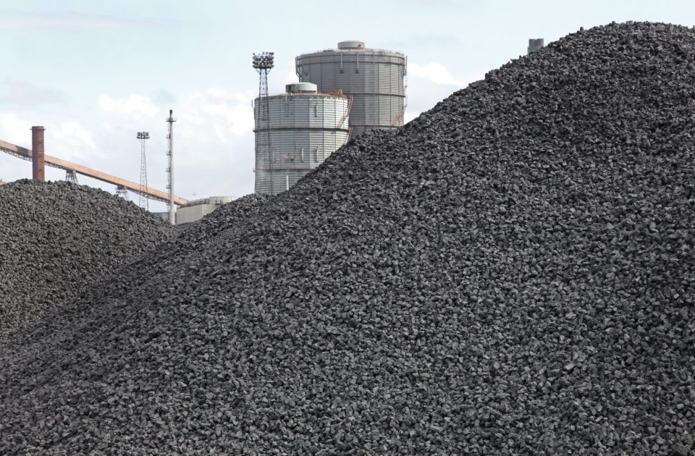
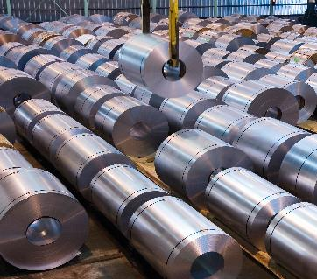
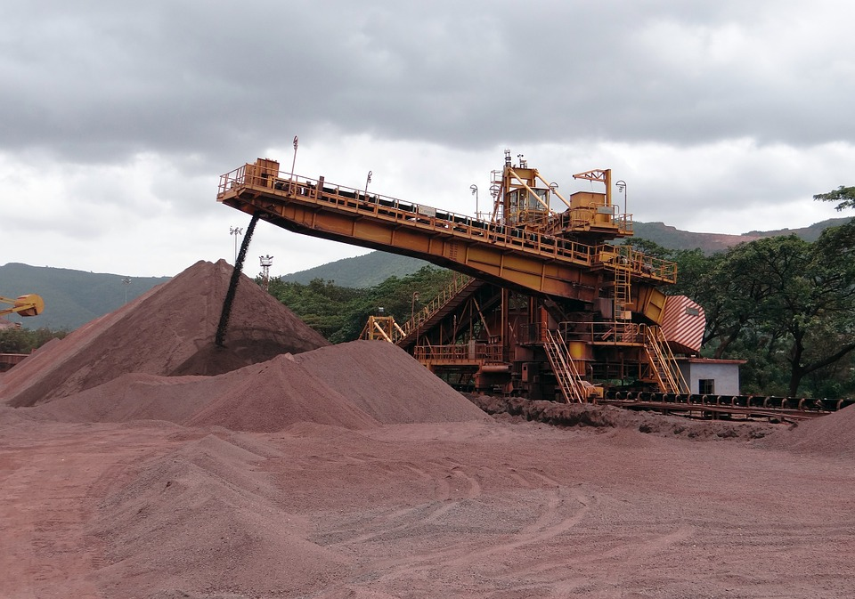
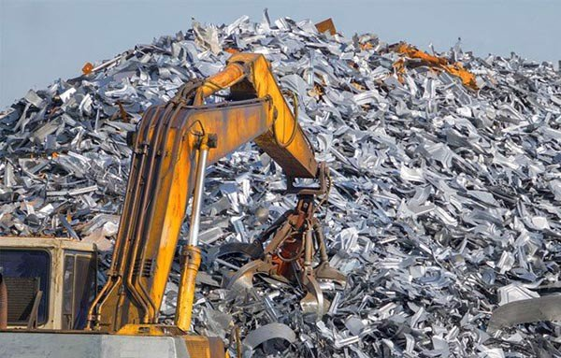

Steel production at ArcelorMittal Belgium

Slide 3
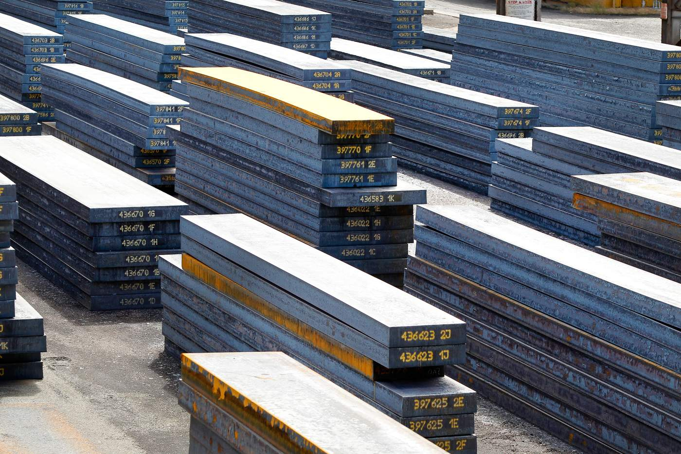
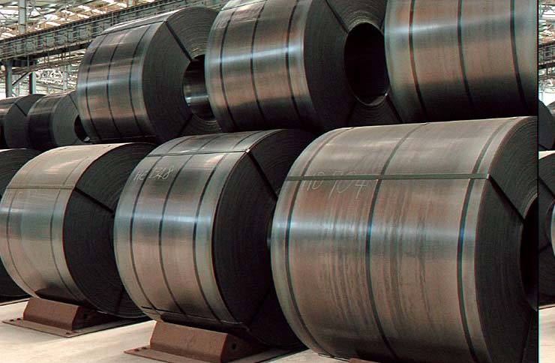
The hot strip mill
Chemical composition already determined
Large dimensional changes (both width and thickness)
At high temperature

Slide 4
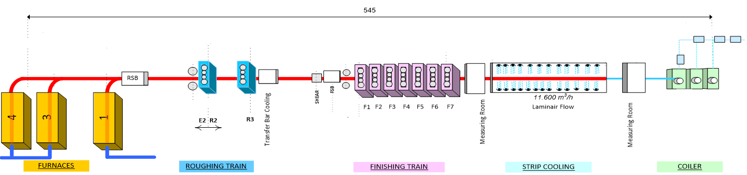
The hot strip mill
Furnaces
Walking beam
Reheating to ±1200°C
Finishing mill
Final thickness reduction up to 1.5mm
About 10 µm accuracy
Roughing mill
First thickness reduction: from 220 to 36mm
Width reduction up to 200mm
About 2 mm accuracy
Cooling and coiling

Slide 5

Width control
Width actuators in roughing mill
Target width after finishing mill
No feedback control possible

Slide 6
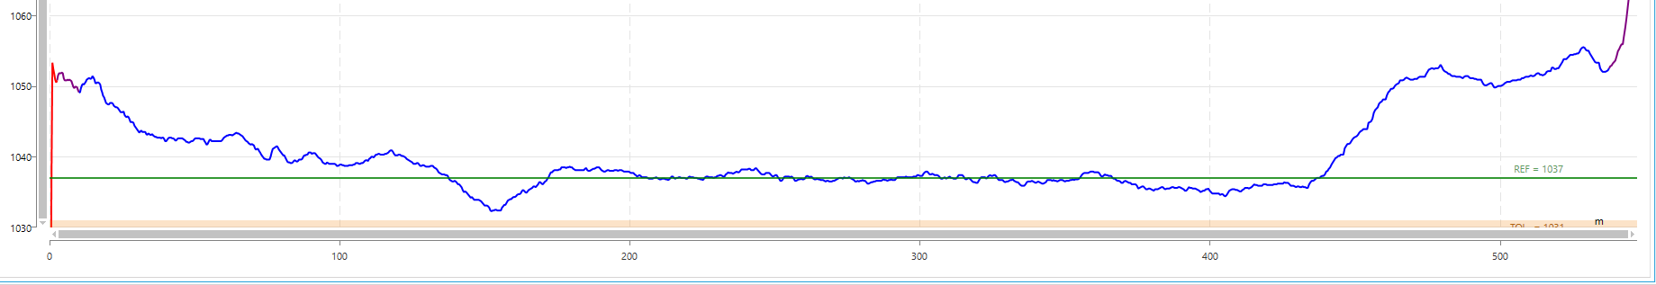
Specific problem: width constrictions during downcoiling
When the strip is picked up by the downcoiler, it is still in the finishing mill
This means tension is put on the strip, potentially lowering its cross section
Possibility of width constriction

Slide 7
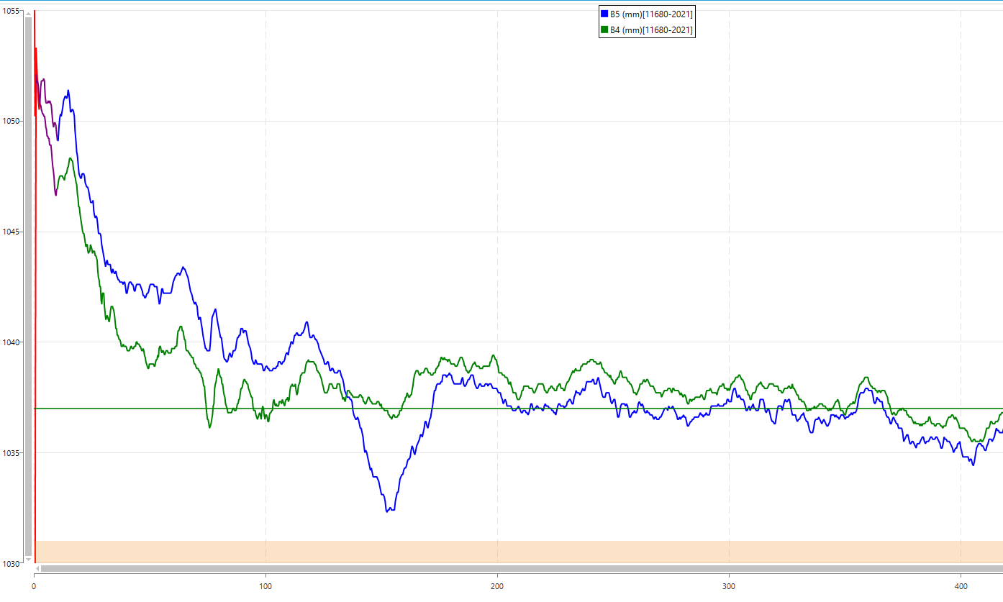
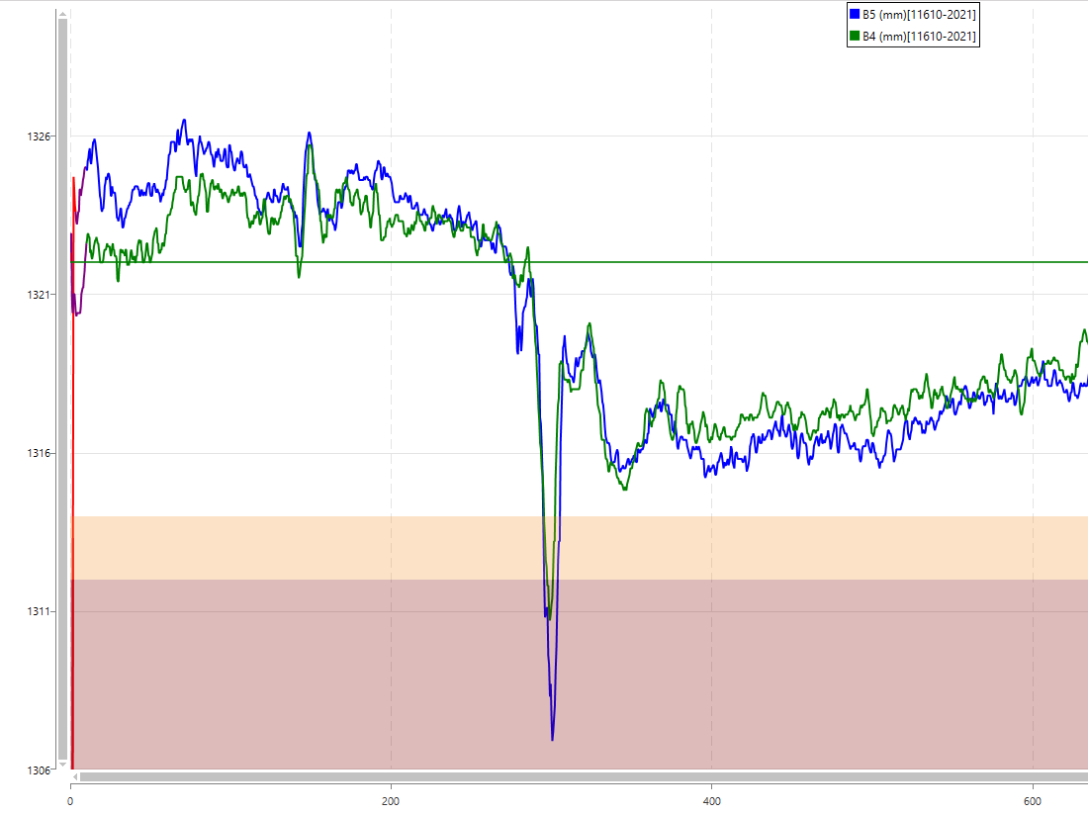
Recognizing the constriction
At about 140 -170m from the head
Two width measurements: B4 and B5
B4 before pickup downcoiler, constriction not visible
B5 after pickup downcoiler, constriction visible

Slide 8
Project question
In order to anticipate on the width constriction, the risk of occurrence should be predictable.
Only data which is known a priori should be used
Prediction can be binary (risk or no risk), but may also be a scale

Slide 9
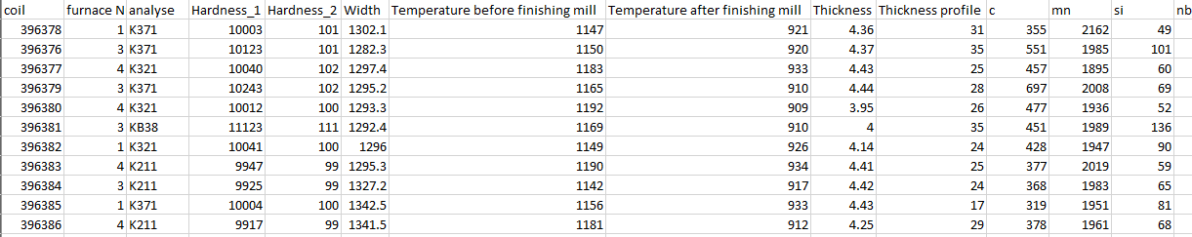
Available data: known a priori
Coil: unique identification: no input
Furnace number: used reheating furnace: preferably not used as input, but interesting if the model can be improved with it
Analyse: identifier of material type, categorical, first 3 digits = main group, last digit = subgroup
Hardness: two quantifications of hardness: dimensionless numbers
Width: average width in mm
Temperature before and after finishing mill: in °C
Thickness: thickness after finishing mill, in mm
Thickness profile: information on the shape of the cross section of the strip after finishing. preferably not used as input, but interesting if the model can be improved with it
c, mn, si,…. : chemical composition in parts per million

Slide 10
Measured data (no input)
One file per measurement (B4/B5) and per coil
Form: coilnumber; measurement; ’lengthpoints:’; <Lengthcoördinates>;’Values’; <Width measurements>
Only first 200m
Some cleaning required (zeros at start,…)
Coilnumber to connect this to input data

Slide 11
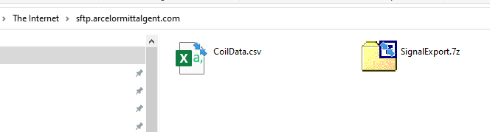
Data location
ftp.arcelormittalgent.com
Paste link in file explorer
Password required:
Username: FTP-uEytAnoB Password: zMu0fMcNeYFeOkGu

Slide 12
Questions?

