Slide 1
Hierarchical Segmentation and Identification of Thoracic Vertebra Using Learning-based Edge Detection and Coarse-to Fine Deformable Model
Jun Ma*, Le Lu, Yiqiang Zhan, Sean Zhou,
Marcos Salganicoff, Arun Krishnan
Siemens Medical Solutions, USA
Johns Hopkins University, USA
* The work was performed when Jun Ma was an intern at SMS with Le Lu.

Slide 2
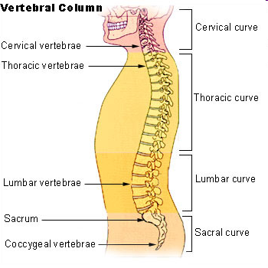
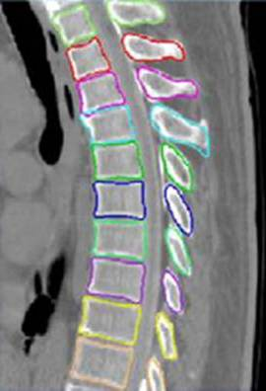
Introduction
Motivations:
Decrease false positive of lung CAD
- Provide intelligent CAD report
- Other orthopedic, neurological and oncological use cases
Notes:
Human vertebral column serves many important functions.
They allowing humans to stand upright and maintain their balance, and also protect the central neural system.
Here is a diagram of human vertebral column. It consists of 24 vertebrae, and was divided into three categories: cervical vertebra, thoracic vertebrae and lumber vertebra. In this project, we focus on the thoracic vertebrae. However, our method can also be applied to cervical vertebra and lumbar vertebra.
Our initial motivation for this work is for our lung CAD system. The segmented and identified vertebrae will help to decrease FP rate and provide intelligent report.
For many medical applications, like oncology or neurosurgery, segmentation and identification of vertebra is very important
There are 12 thoracic vertebra, and they are called T1,T2,T3,…up to T12.
The right diagram is the shape of a thoracic vertebrae in three views.

Slide 3
Related Work
Automated spinal column extraction and partitioning (Yao et. al.)
Automated vertebra detection and segmentation from the whole spine MR images (Peng et.al.)
Localized priors for the precise segmentation of individual vertebras from CT volume data (Shen et.al.)
Automatic lumbar vertebral identification using surface-based registration (Herring et. al.)
Automated model-based vertebra detection, identification, and segmentation in CT images (Klinder et. al.)
Notes:
Yao. Hybrid method: watershed + directed graph search + model fitting + intensity profile analysis
Peng. Model-based disc localization, intensity profile analysis

Slide 4
Methods Overview
Vertebrae Segmentation
  Learning-based edge detector
  Hierarchical deformation scheme
Vertebrae Identification
  Mean Shapes
  Single vertebra identification
  Vertebrae string identification
Notes:
Alright, here is the organization of my talk. First, I will present the automatic segmentation algorithm; then, vertebra identification will be covered. At last, to show the generality of this algorithm, I will show some segmentation results of other bones.
Our system consists of segmentation and identification.
The segmentation method is based on a parametric deformable model.
Based on the segmentation results, we build mean shapes for vertebrae. These mean shapes are applied for single vertebrae or vertebrae string identification.
The major challenge of our method: complex structures around vertebrae body
Traditional deformable model use canny edge detectors not useful
Data-driven method
Unavoidable noisy response

Slide 5
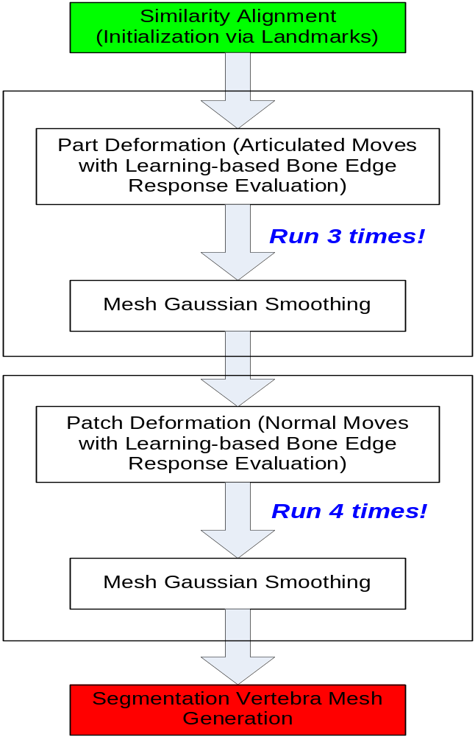
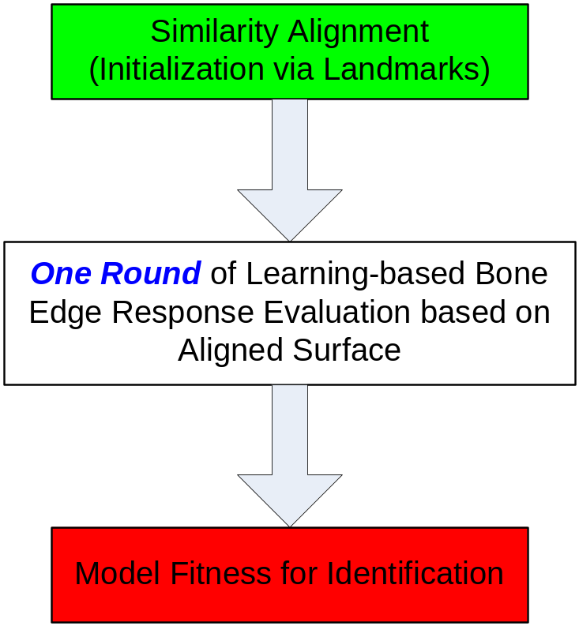
System Flowchart

Slide 6
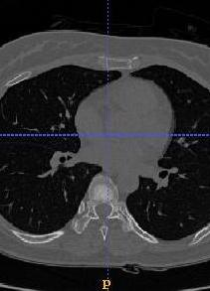
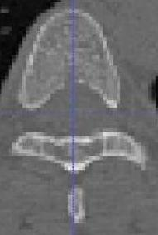
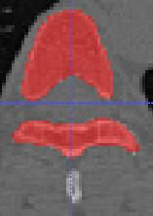
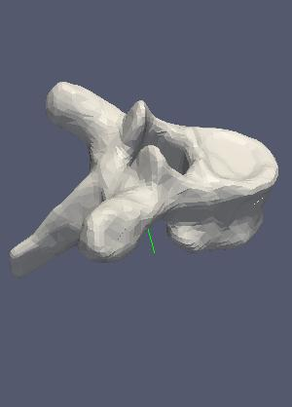
Surface template generation (training purpose)
Original 3D CT image
Pre-processing
Manual segmentation
Surface generation
Notes:
Our method is data-driven. So we must generate this surface template from real data. So, we manually segmented several vertebra from different CT volumes and generate the triangulated surface mesh.
This way, not only we have the template surface, but also the ground truth for edge detection learning.
First image, using marching cube algorithm to generate surface.
All the others, deform the initial surface to binary images.

Slide 7




Edge detectors: gradient steerable features
Sampling parcel:
For a point x, take 5 neighboring sampling points along the normal line.
Features: intensity + derivatives with different Gaussian kernel sizes
Each point x has 5 * 3 = 15 features.
surface
x
Sampling parcel:
Feature vector:
depends on the norm of triangle surface
Notes:
OK. With these ground truth, let’s move onto the edge detection.
Our edge detection algrothm is a learning-based method. So we need to design the features, train it and test it.
We design steerable features this way:
Suppose the black curve indicates a surface mesh, n is the normal direction. x is the point in the normal direction. We take 5 sampling points in the normal direction, with interval of one voxel. The orange dots are the sampling points. For each of the 5 sampling points, compute 3 features, the intensities and projection of gradient onto the normal direction.
Gradient is computed using difference of Gaussian, and delta 1 , delta2 means different scales for the gaussian kernel.

Slide 8
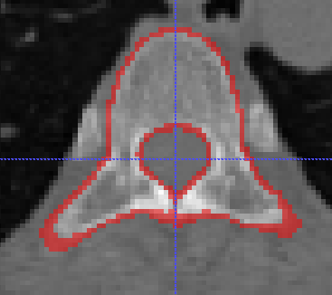
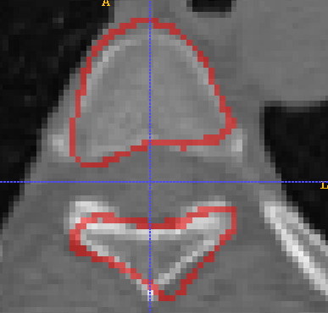
Edge detectors: training of edge detectors
Training samples:
  Positive: boundary parcels
  Negative: interior and exterior parcels
Add random disturbance to the ground truth surface, only points on the border and has norm within certain range will be used as positive samples
(0.9~1.1 for scale, -10°~ 10° for rotation)
Train LDA classifiers using combined non-disturbed and disturbed feature vectors. Output is a probability value.
-
-
-
-
-
-
-
-
+
+
+
+
+
-
+
-
-
-
+
-
-
+
-
+
-
+
-
+
-
+
-
-
-
-
-
+
-
-
+
-
+
-
+
Notes:
For the training of the edge detection,we take voxels on the boundary as positive training samples and voxels away from boundary are negative samples.

Slide 9
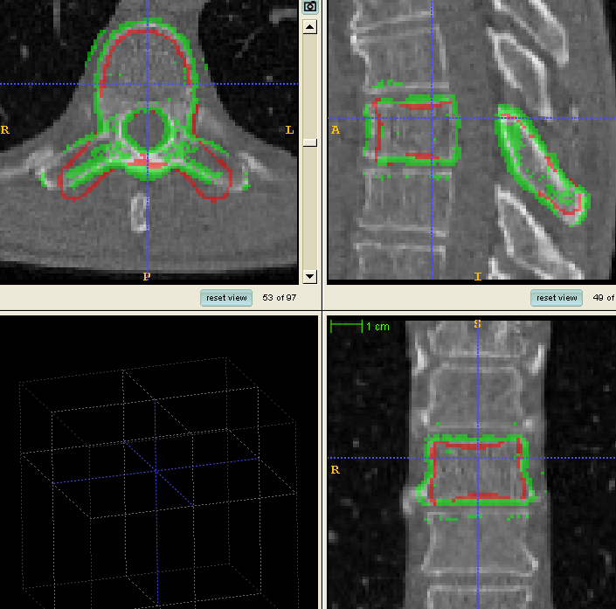
Edge response map
Generate response map by learned edge detectors
  optimally combine image features to detect object-specific edge
  more discriminative and robust
  Indicates edge likelihood (probability map)
  - Informative but noisy
Hierarchical deformation strategy
  - Sub-region deformation
  - Patch deformation
  - Individual vertex deformation
Notes:
Apply this edge detector to the volume, and we use LDA for classification, we get this response map. The red is the template surface, the green dots are detected edge points with probabilty of higher than 0.8.
Overall, we see that the response map captures most edge points. However, it’s still noisy. Some edges points are missing, and some are faluse alarms.

Slide 10
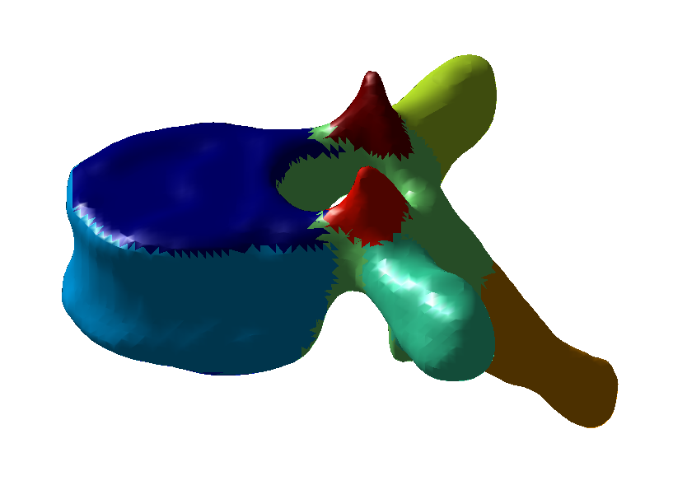
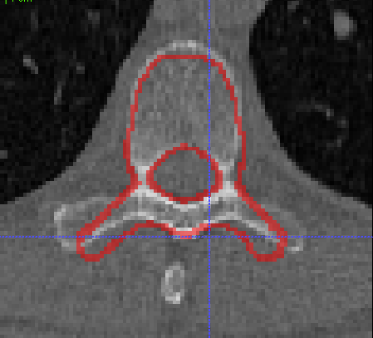
Sub-region deformation
Sub-region deformation
Divide the surface to 12 subregions
Vertices in the same subregion deform together as a team
Rigid transformation with the strongest “edge ” likelihood is the target position.
Maximum response
Calculate response at this position
Notes:
After we have these subregions, how do we know where should a subregions go?
We just apply …
Like this example, we roatate this part to different position, at each position, calcuate the total response map of edge detections. And we determine that the position with the strongest edge response is the target position.

Slide 11
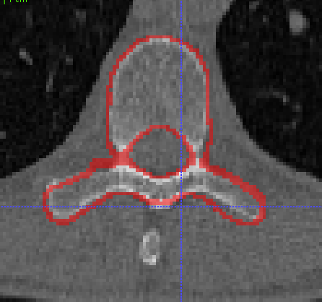
Patch deformation
Patch deformation
Move a patch to a number of positions along its normal direction, and calculate the responses at these positions. Position with strongest response is the target position.
Individual vertices deformation
Move each vertex to a position with highest edge likelihood
Calculate response at this position
Maximum response
Notes:
After the major subregions are deformed to the target postion, we surface template roughly overlap with the vertebra in the CT volume. However, in local areas, we still need finer deformation. This is we called patch deforamtion. The surface is devided into two hundred patches, the each patch has a hundred vertices. Vertices of the same patch move together in search of the edge points.
Like in this areas, the surface still have some disttance to the true boundary. So, we just

Slide 12
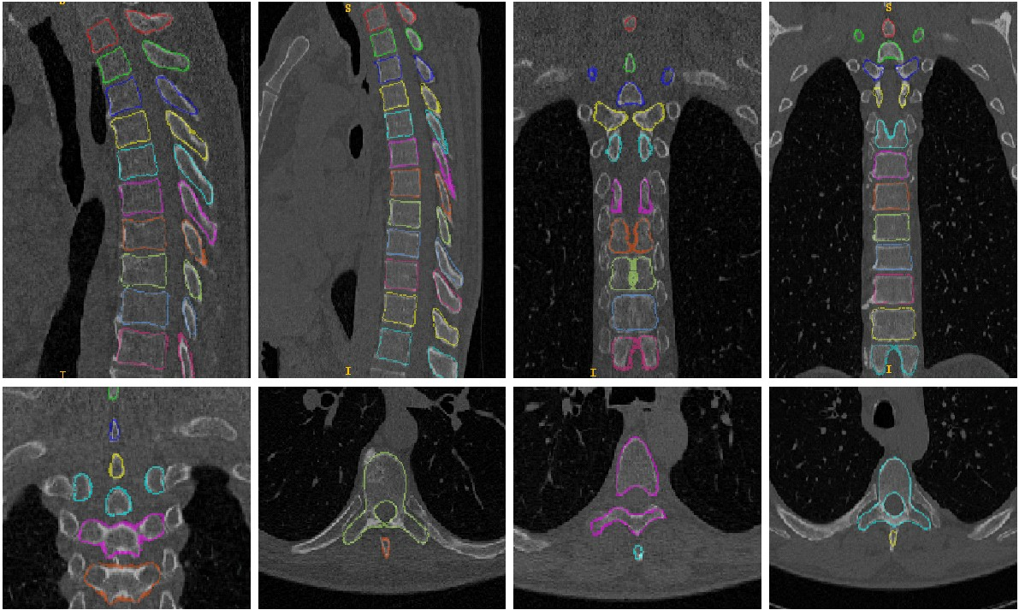
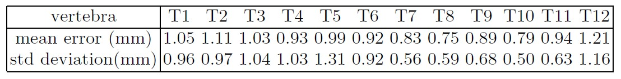
Results
Average Error: 1.12 mm

Slide 13
Methods Overview
Vertebrae segmentation
  Learning-based edge detector
  Hierarchical deformation scheme
Vertebra Identification
  Mean Shapes
  Single vertebrae identification
  Vertebrae string identification
Notes:
Alright, here is the organization of my talk. First, I will present the automatic segmentation algorithm; then, vertebra identification will be covered. At last, to show the generality of this algorithm, I will show some segmentation results of other bones.

Slide 14
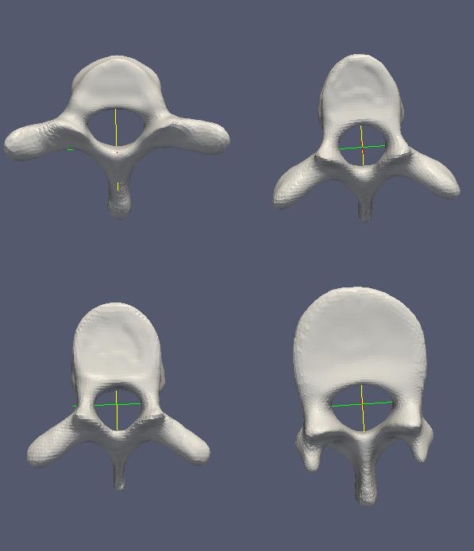
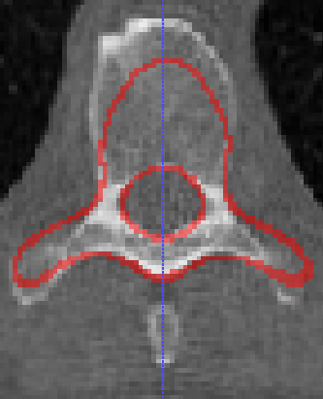
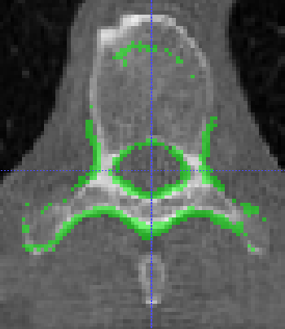
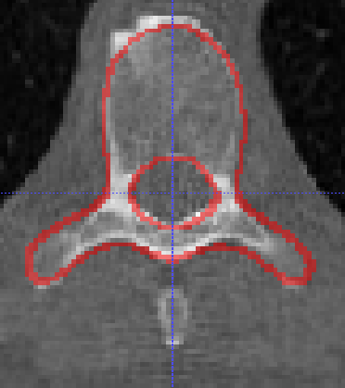
Identification: framework
Compute mean shapes
Mean shape to new image
Compute response
Which has maximum response
T1
T4
T8
T12
Notes:
For each vertebra, we have segmented 10 – 17 examples.
Because all the surface mesh has the same number of vetices and faces, the corresponse between each other are automatically contained.
Thus, we can compute a mean shape for each thoracic vertebra. And these mean shapes are used for identficationo of vertebra.
The framework of identifciation is as follows.
When we get a new image of a vertebrae, we fit the 12 mean shapes one after one, and compute the response for each vertebra. The meanshape with the maximum reponse is dertermined as the correct label.

Slide 15
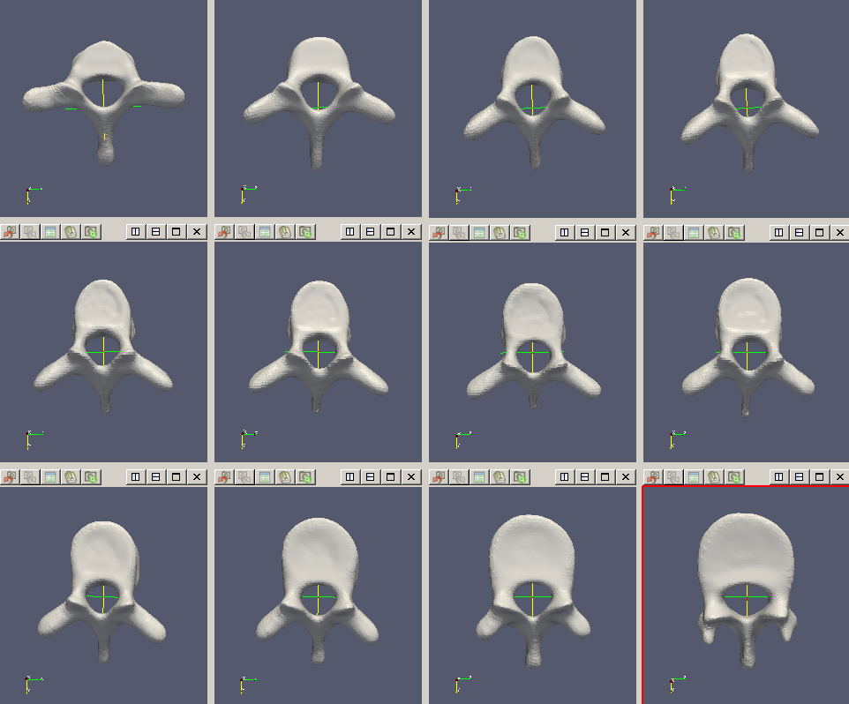
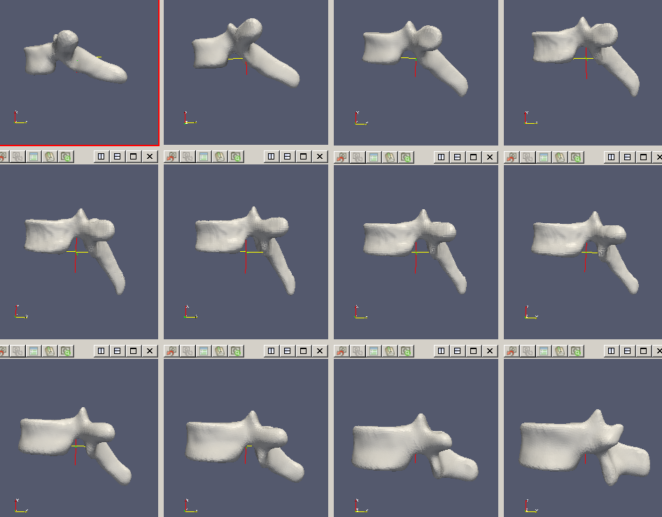
Mean shapes
The segmentation method is applied on 40 CT volumes
Surface meshes of thoracic vertebrae are obtained
Vertex correspondence across meshes are directly available
Mean vertebrae shapes are computed (four-fold cross validation)
T1
T2
T3
T4
T1
T2
T3
T4
T5
T6
T7
T8
T5
T6
T7
T8
T9
T10
T11
T12
T9
T10
T11
T12

Slide 16
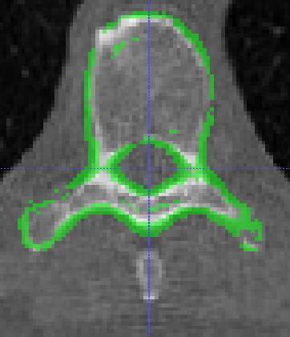
Identification: single bone
T1
…
T4
…
T8
…
T12
Fit 12 mean shapes to the same bone one after one
…
…
…
Note that we have random perturbation in the training
Calculate the response for each mean shape
…
…
…
Notes:
For example,

Slide 17
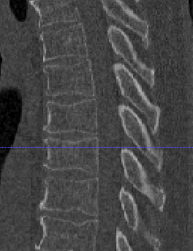

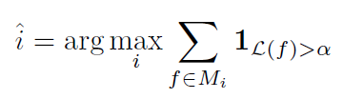
Identification: Two objectives & string test
Compute the overall likelihood of boundary given fitted surface
Count the number of faces with high probability to be boundary point
Extension: fit a string of mean shapes to the image, and calculate the total responses. Find the maximum response.

Slide 18
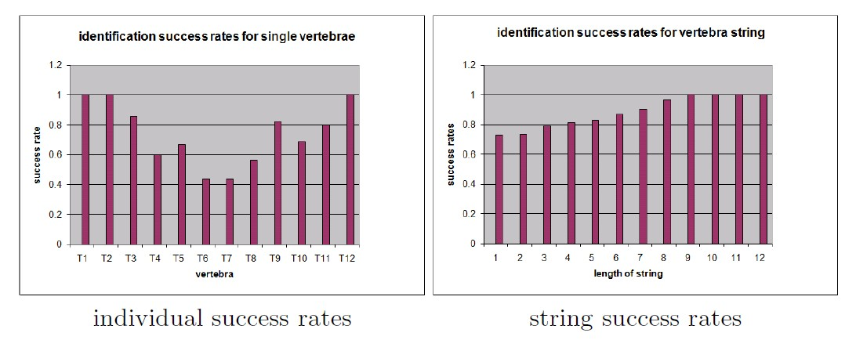
Results

Slide 19
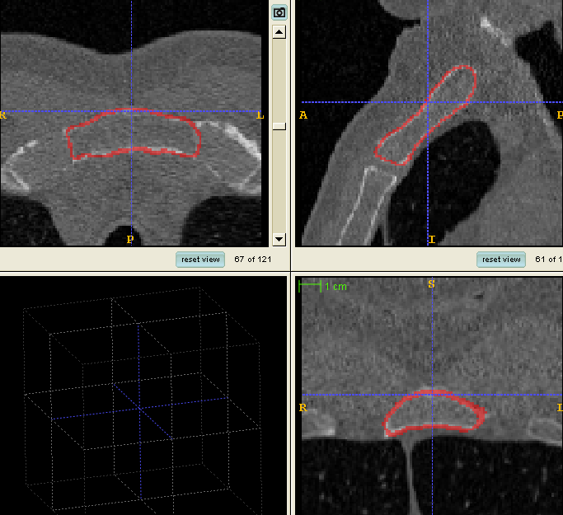
Conclusions
We propose a thoracic vertebrae segmentation algorithm:
- learning-based edge detectors using efficient features
- hierarchical coarse-to-fine deformation strategy
Vertebrae mean shapes generated by this method are used to effectively identify different thoracic vertebrae.
This segmentation method can be extended to other orthopedic structures as well, e.g. manubrium.

Slide 20
Thank you!
Notes:
For many medical applications, like oncology or neurosurgery, segmentation and identification of vertebra is very important. So, in this project, our task is to automatically segment the vertebra and identify a vertebrae is T1 T2, or T12.

Slide 21
Introduction
Segmentation and identification of vertebra
Human vertebral column
Tobias Klinder, Jörn Ostermann, Matthias Ehm, Astrid Franz, Reinhard Kneser and Cristian Lorenz. Automated model-based
vertebra detection, identification, and segmentation in CT images. IEEE Trans. Medical Image Analysis, 2009.
Notes:
For many medical applications, like oncology or neurosurgery, segmentation and identification of vertebra is very important. So, in this project, our task is to automatically segment the vertebra and identify a vertebrae is T1 T2, or T12.

Slide 22

Deformation of subregions
Shoot this part to the target position using Gaussian smoothing.
Maximum response

Slide 23
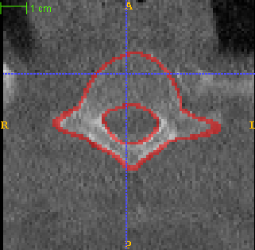
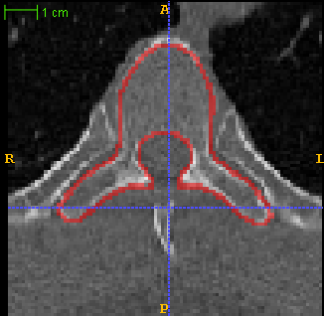
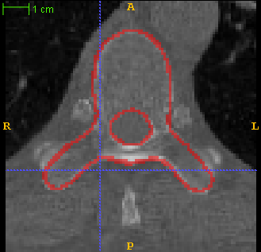
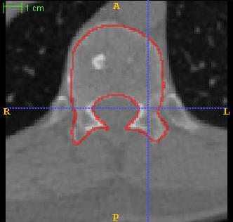
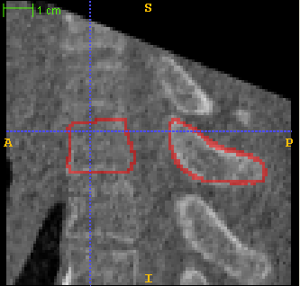
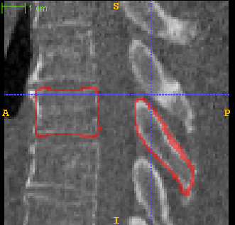
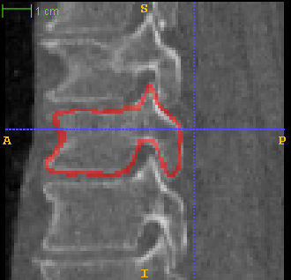
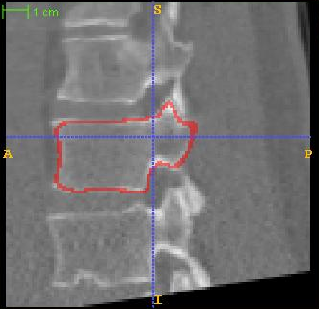
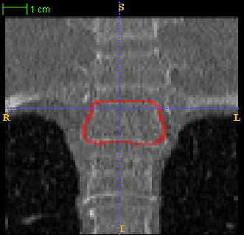
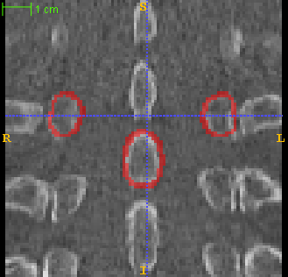
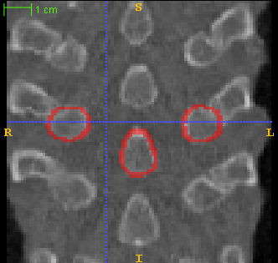
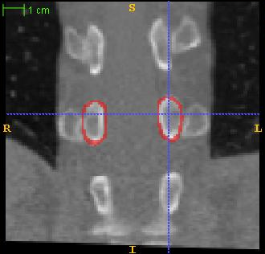
Segmentation result
Notes:
Here is four examples of vertebrae segmentation. Each column is the same volume but in 3 view. One can see that the segmentation result is pretty satisfacotry.
Our algorthim is also fast. In matlab, it take about 15 minutes to segment a vertebra. In this case, we uuse the surface mesh of 10 thousand vertices. However, in real application, we don’t need so many vertices. If we use 1/5 of the vertices, it only take 3 minutes in Matlab.
If we tranfer all the code to C++, it only need several seconds.

