Slide 1


A Nonparametric Treatment for Location/Segmentation Based Visual Tracking
CVPR 2007, Minneapolis, MN
Le Lu Integrated Data Systems Dept.
Siemens Corporate Research, Inc.
Greg Hager Computer Science Dept.
Johns Hopkins University

Slide 2
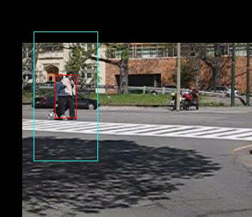
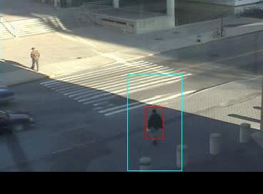
Examples (I)
Data from [Avidan 2005], [Avidan 2007]

Slide 3
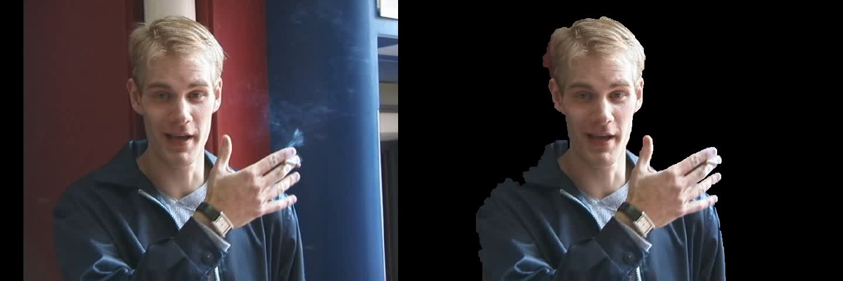
Examples (II)
Data from [Chuang et al. 2002]

Slide 4
Roadmap
Representation: Tracking as a binary classification/matching problem through bags of patches (both model and observation)
Algorithm: Online robust appearance model updating in a nonparametric manner
Extensions for segmentation based tracking
Results
Conclusion & discussion

Slide 5
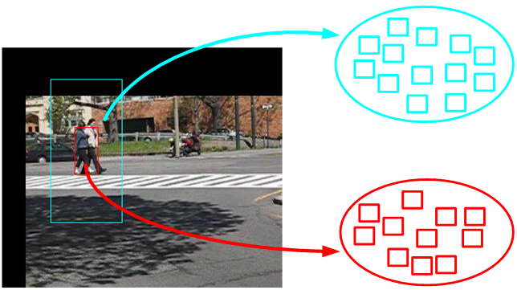
Representation
Frame (t)
Nonparametric bags of patches appearance model
  Image patches are represented as HOG+Color [Avidan 2005]

Slide 6
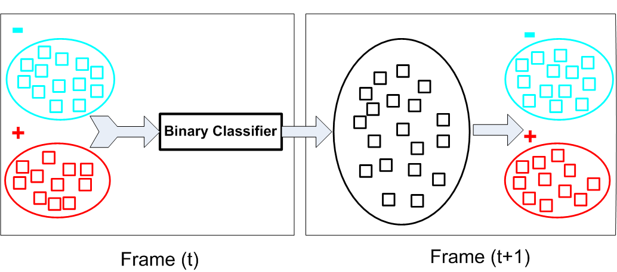
Representation
Binary (Foreground/Background) classification of distributions of image patches:
  KNN distance matching
  PCA/LDA/NDA + KDE matching
  SVM matching

Slide 7
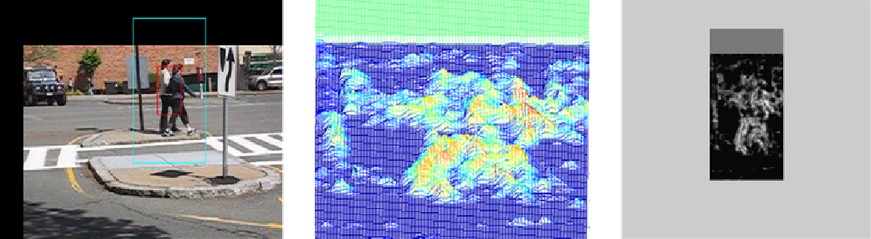
Representation
Frame (t+1)
From the normalized positive-class (ie. Foreground/object) Confidence Map, use Mean-Shift algorithm [Comaniciu et al. 2003] to locate the new object position as the highest sum of confidences within the located foreground rectangle (red).

Slide 8
Algorithm
Maintain appearance model over time via nonparametric bidirectional consistency check and resampling:
  test new image patches against bags of patches appearance models (M^{B}|M^{F})
  test appearance models against new observations of bags of patches (O or O^{B}|O^{F})
Simple computations:
  a sample-to-distribution distance metric using KNN distance
  mean, variance/std over distributions of distances

Slide 9
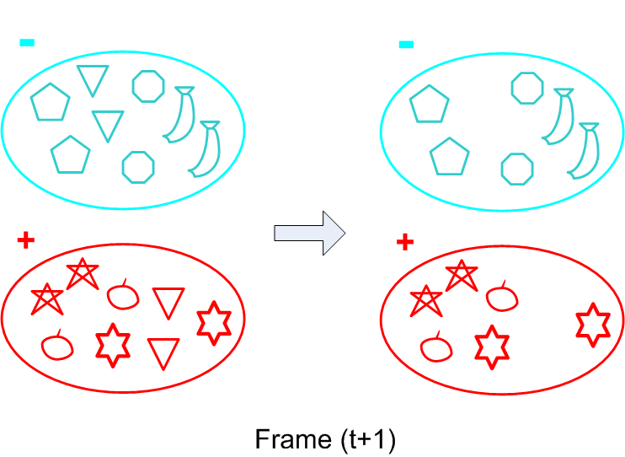



Algorithm
(1) Pre-filtering: reject ambiguous image patches at (t+1) where
,
  comparing , against each other

Slide 10
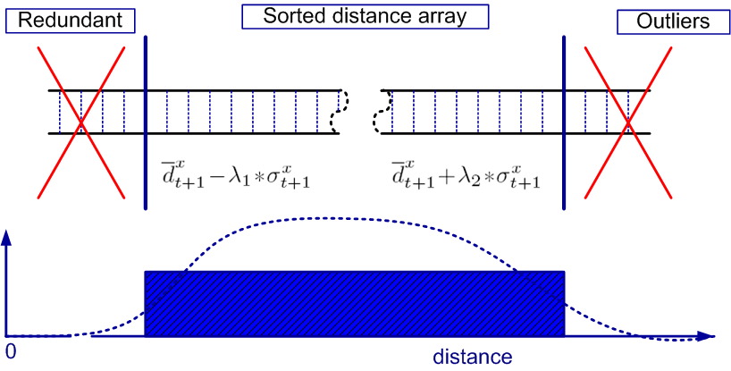






Algorithm
(2) Model Rigidity: reject redundant, outlier image patches while keeping
where
ie. comparing against ; against
Thus we have from

Slide 11







Algorithm
(3) Integrating from last step, we have intermediate appearance models
(4) Probability of Survival:
  For an image patch in above foreground appearance model
  we compute its distance
  convert it as a “probability of survival”
  for resampling to keep the fixed size appearance model
  Similar process to obtain from against

Slide 12

Extension for segmentation tracking
Use “superpixels” to sample image spatially adaptively.
Remove pre-filtering
Run a partitioning algorithm in , and resample with respective to partitions.
Apply a weak shape model in the form of KDE
Use “superpixels” as basic elements for {F|B} labeling by aggregating patch distances inside image segment.

Slide 13
Extension for segmentation tracking
The differences are that
  location tracking is considered as a discriminative task;
  while segmentation tracking is targeted to keep a more complete profile of {F|B} appearance over time.
  HOG+Color for location tracking;
  PCA+KDE for segmentation tracking
    For different feature representations/matching criteria evaluation, see [Lu & Hager, 2006]

Slide 14
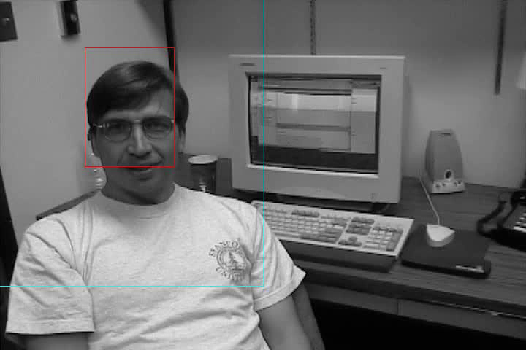
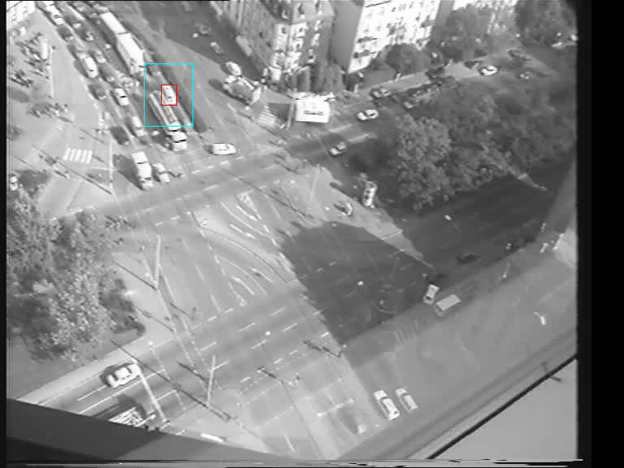
Results
Data from [Jepson, Fleet, El-Maraghi 2003], [Avidan 2005]

Slide 15

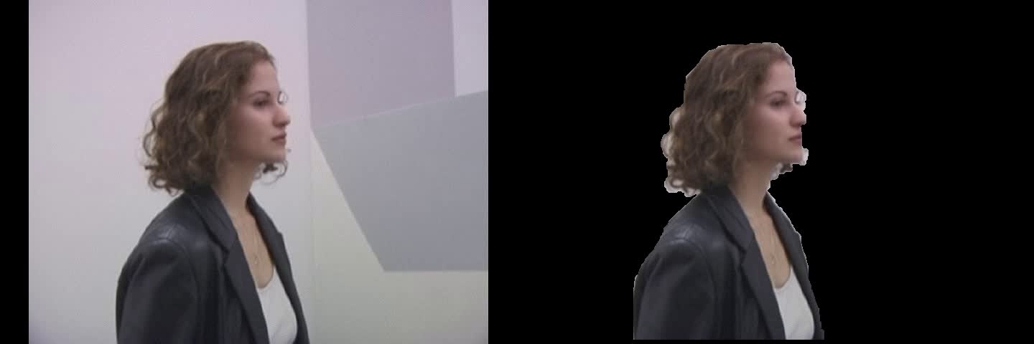
Results
Data from [Chuang et al. 2002]

Slide 16
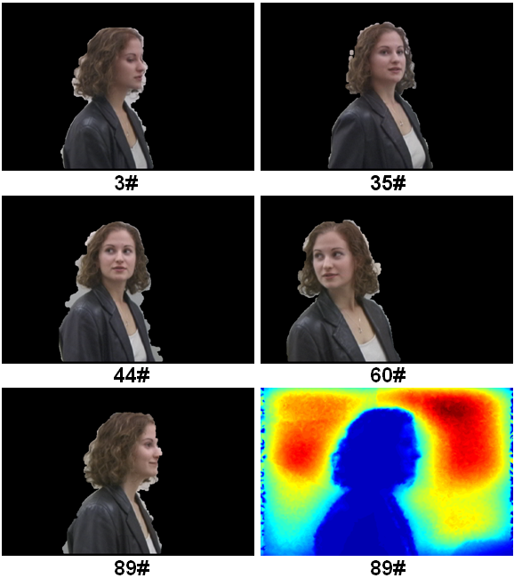
Results

Slide 17
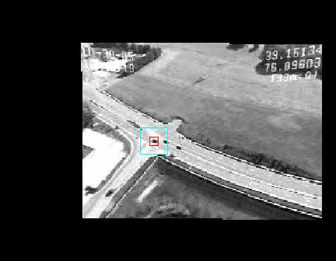
Discussion (other information)

Slide 18
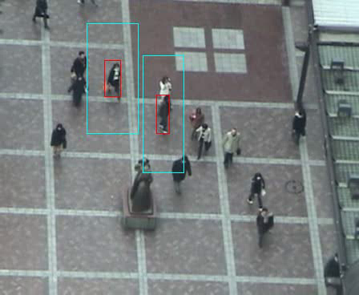
Discussion (multi-target)

Slide 19
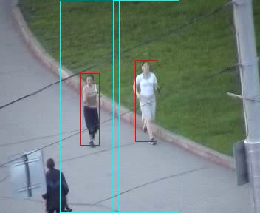
Discussion (full occlusion)

Slide 20
Discussion (differences with Ensemble Tracking [Avidan 2005, 2007] )
Appearance model encoded in sampled and resampled image patches directly; appearance model encoded in weak classifiers
  Flexibility on Long-term interaction modeling
  Flexibility on choosing over different classification methods besides boosting
Feature (dense/sparse) based approach which is robust to partial occlusion without explicit occlusion handling
Discriminative approach for location tracking, exemplar based approach for segmentation tracking; discriminative approach for ensemble tracking

Slide 21
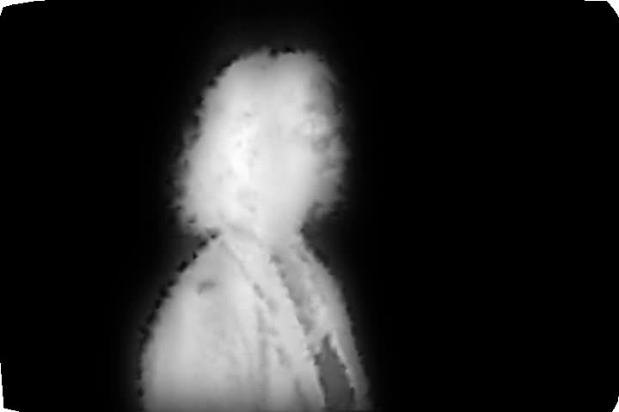
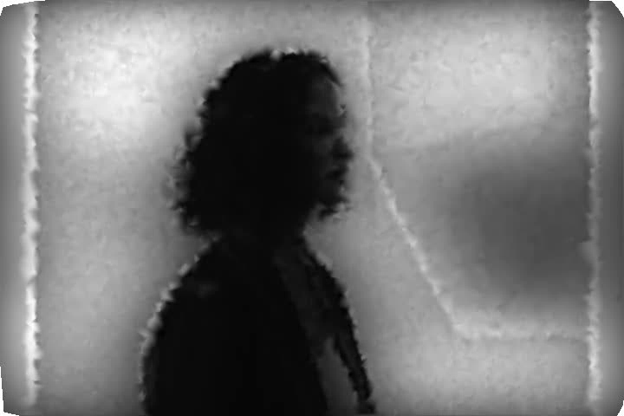
Discussion (Response maps from Appearance only)

Slide 22
Acknowledgement
Dr. Shai Avidan (Merl) for valuable discussion and providing data for testing
Prof. Y.-Y Chuang (NUT) for providing data
Dr. Faith Porikli (Merl) for providing data
Anonymous reviewers for useful feedbacks

