Slide 1
Popquiz:
What is the primary cause of cancer mortality in females worldwide?

Slide 2
Bonus round:
What methods are usually used for screening?

Slide 3
A large model for non-invasive and personalized management of breast cancer from multiparametric MRI
Summerized and presented by:
Luis Schmid

Slide 4
Table of contents
Breastcancer? MRI? Tf is that, im not a doctor?
Model architecture
Results
Possible applications

Slide 5
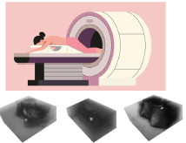
Breast cancer
Primary cause of cancer mortality in females worldwide
Early detection improves odds of survival
Tissue density contributes to risk for breast cancer -> screening recommended
Screening possible with f.e. mammography or MRI imaging
Multiparametric MRI data has the highest sensitivity for breast cancer detection
Problem: Detection requires Radiologists analysing lots of data
Solution? Use AI for regular screening

Slide 6
Current Systems
Imaging features generate Biomarkers
Based on single modality DCE-MRI (Dynamic Contrast-Enhanced)
- high sensitivity, moderate specificity
Usually, more data is available
Other sequences may improve specificity and accuracy
Difficulty is heterogeneity of data and high dimensionality

Slide 7
Proposed System: MOME Mixture-off-modality-experts
Input Data is embedded into features
Each MRI sequence with its own tokenizer
A DCE-MRI with shape 384x256x128x6 to 24x16x8x768
Flattened and concatenated to other tokens
Input into adapted BEiT3 (VLF model 276 Mio parameter)
Fix pretrained weights and inject simple trainable modules
Finish with linear classification layer

Slide 8
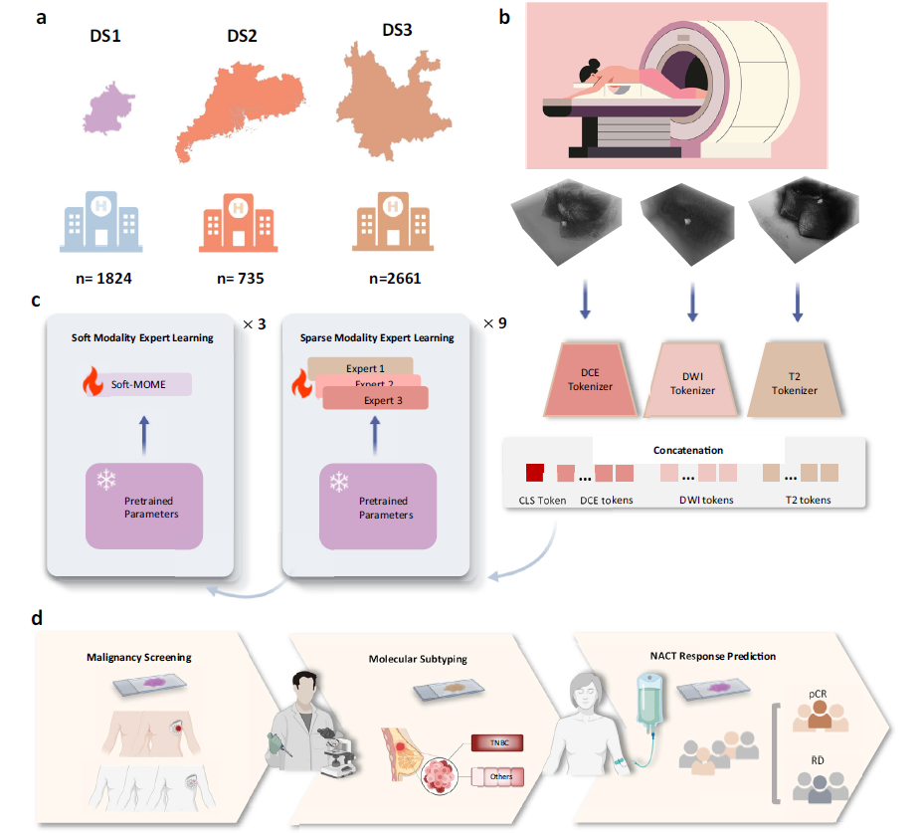
SparseMOME/SoftMOME
9 Transformer blocks with sparse MOME
feed forward structure, 2 layers of linear projections, then layer norm
Sparse MOME can be removed for missing modality
3 Transfomer blocks with soft MOME
Includes SMoE Soft Mixture of Experts
Learns and integrated multimodal information

Slide 9
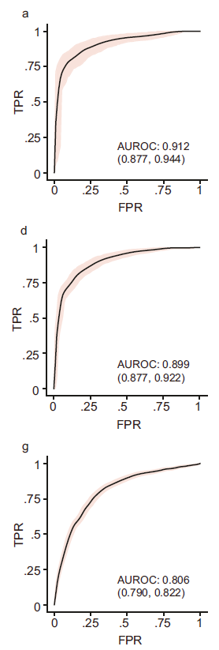
Results
AUROC 0.896 AUCPR 0.901
Outperforms comparable methods, especially unimodal
Able to generalize to datasets of different hospitals
Comparable to radiologists
Able to infer with missing modalities

Slide 10
Why do the results matter?
Possibility of more routine screening
Reduction of unnecessary biopsies
Application to other multimodal tasks

Slide 11

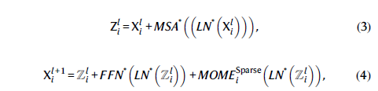



Math, for those who are interrested
Features after tokenizers
Multihead Self Attention
Input into l+1 th transformer block
Feed Forward Net
Gaussian Error Linear Unit
Layer Norm
Linear Projection
Soft Mixture of experts

