Slide 1

INSTITUT TEKNOLOGI DEL
SEMINAR HASIL
IOT WEATHER MONITORING SYSTEM
KELOMPOK 10

Slide 2
INSTITUT TEKNOLOGI DEL
SEMINAR HASIL
Supervisor :
Gerry Italiano Wowiling, S.Tr.Kom., M.T.
Examiners :
Istas Manalu, S.Si., M.Sc
Pandapotan Siagian, ST,M.Eng
Team:
13323012 Jeyshen Siallagan
13323018 Bastian Sitanggang
13323050 Lely N.F. Butarbutar
02

Slide 3
INSTITUT TEKNOLOGI DEL
SEMINAR HASIL
Background
Climate change increases the frequency of extreme weather, which affects agriculture, transportation, and the local economy.
Weather data access in rural areas, such as Toba Regency, is still limited, resulting in decision-making that relies heavily on experience rather than data.
IoT with multi-parameter sensors (DHT22, BH1750, rain gauge, anemometer) enables real-time weather monitoring with high accuracy.
LoRa supports long-range communication with low power consumption, making it suitable for remote areas.
Self-sustained power using solar panels and batteries allows the system to operate without the national electricity grid.
Data is stored in MySQL and displayed on a web-based dashboard, supporting the concept of Weather Data as a Service (WDaaS), where real-time and historical data can be publicly accessed.
03

Slide 4
INSTITUT TEKNOLOGI DEL
SEMINAR HASIL
How to design and build an IoT-based weather data monitoring system capable of reading and transmitting real-time data on temperature, humidity, light intensity, rainfall, and wind speed?
01.
RESEARCH QUESTION
How to implement a weather data storage and management system so that historical data can be stored securely and accessed and downloaded as needed by users?
02.
03.
How to develop a web-based dashboard capable of displaying real-time weather data while providing access to historical data in the form of easy-to-understand visualizations and reports?
04

Slide 5
INSTITUT TEKNOLOGI DEL
SEMINAR HASIL
OBJECTIVES
01.
02.
03.
Building an IoT-based weather monitoring system capable of collecting real-time data on temperature, humidity, light intensity, rainfall, and wind speed, as well as mapping location points.
Developing a web-based dashboard that stores, displays, and provides access to both real-time and historical weather data for use by the public and relevant agencies.
Implementing a renewable energy system using solar panels and batteries to enable devices to operate independently in remote areas without relying on the conventional electricity grid.
05

Slide 6
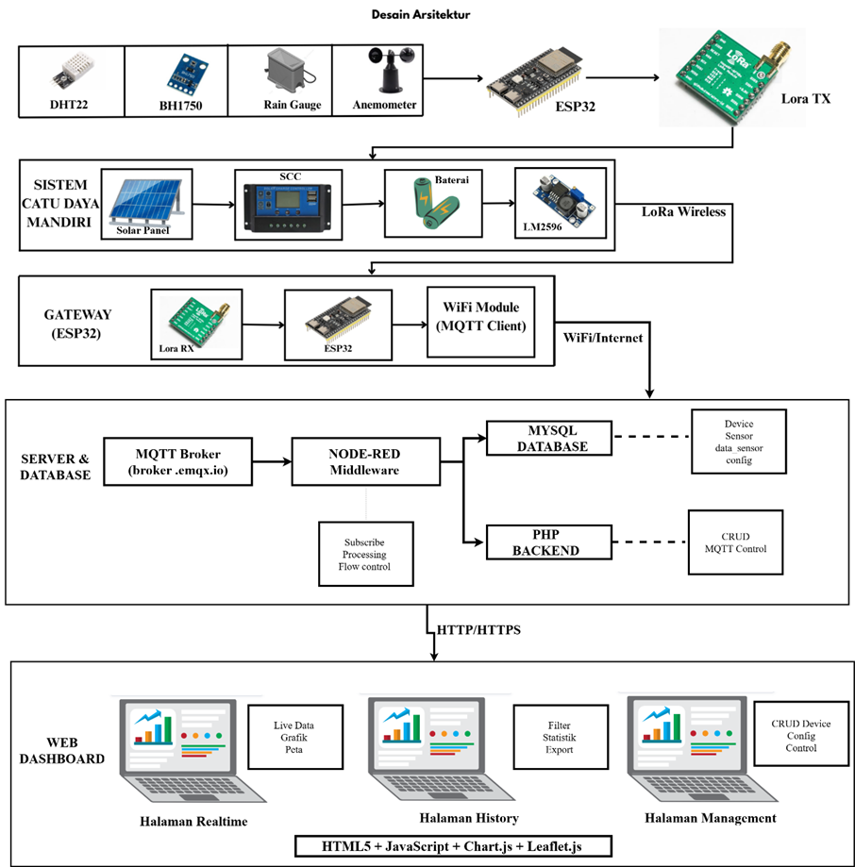
INSTITUT TEKNOLOGI DEL
SEMINAR HASIL
Architectural design
06

Slide 7
INSTITUT TEKNOLOGI DEL
SEMINAR HASIL
Testing Scenarios
07

Slide 8
INSTITUT TEKNOLOGI DEL
SEMINAR HASIL
Sensor Testing
DHT22 (temperature & humidity), BH1750 (light intensity), anemometer (wind speed), rain gauge (rainfall).
Data Transmission Testing
LoRa communication from node to gateway, then distribution via MQTT to the server.
Dashboard Testing
Real-time monitoring, historical data, device management (CRUD & sensor control).
03

Slide 9
INSTITUT TEKNOLOGI DEL
SEMINAR HASIL
Sensor & Transmission Test Results
07

Slide 10
INSTITUT TEKNOLOGI DEL
SEMINAR HASIL
Sensor readings: temperature, humidity, light, rainfall, wind speed
Sensor deviation within tolerance limits
Data sent via LoRa → MQTT → MySQL
Data packets stable, no loss
03

Slide 11
INSTITUT TEKNOLOGI DEL
SEMINAR HASIL
Dashboard Test Results
07

Slide 12
INSTITUT TEKNOLOGI DEL
SEMINAR HASIL
Dashboard Test Results
The dashboard displays real-time data with automatic updates.
Historical data can be filtered by device and date.
Device management features work well: add, edit, and delete.
The dashboard supports graph visualization and location maps.
03

Slide 13
INSTITUT TEKNOLOGI DEL
SEMINAR HASIL
Energy System Test Results
07

Slide 14
INSTITUT TEKNOLOGI DEL
SEMINAR HASIL
The sensor node is powered by a battery and solar panels.
The system is designed to be self-sufficient without PLN electricity.
Battery life testing is an estimate/theoretical and has not been tested in real life.
03

Slide 15
INSTITUT TEKNOLOGI DEL
SEMINAR HASIL
1. The system is capable of reading real-time weather data from the DHT22 (temperature & humidity), BH1750 (light intensity), anemometer (wind speed), and rain gauge (rainfall) sensors, then displays the data on a web dashboard.
Data from the sensor nodes is successfully sent via LoRa and forwarded by the gateway to the MQTT broker, where it is effectively stored in a MySQL database.
A battery-based power supply system supported by solar panels is designed to support autonomous node operation, although actual battery life testing has not yet been conducted.
The web dashboard allows for visualization of historical data, real-time monitoring, and device management with add, edit, and delete functions.
Conclusion
08

Slide 16
INSTITUT TEKNOLOGI DEL
SEMINAR HASIL
DEMO
07

Slide 17
INSTITUT TEKNOLOGI DEL
SEMINAR HASIL
Q & A
07

Slide 18
INSTITUT TEKNOLOGI DEL
SEMINAR HASIL
THANK YOU
18

